Slide 1

Insurance Cost Prediction
- Rushikesh Shinde

Slide 2

Table of content
Introduction
Objective
Data Description
EDA(Exploratory Data Analysis)
Data Visualization
Model Building
Conclusion
Suggestion

Slide 3

Introduction
Insurance cost prediction is a regression problem where we will be predicting the insurance charges for customer based on past data.
Dataset originally belongs to US which is available on Kaggle.
This will help insurance company to predict insurance charges of customer with minimum efforts and less cost.
It will also save a lot of time as now employee don’t have to look in past data or don’t need experience at all to do prediction.

Slide 4
Objective
To predict insurance cost based on input data.
To make the process fast.
To minimise the error of company.

Slide 5
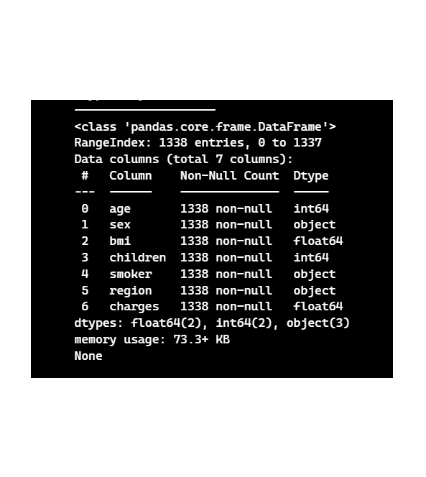
Data Description
Data consists of 1338 records and 7 columns including target column.
Data consists of following datatypes:
Object
Integer
Float

Slide 6
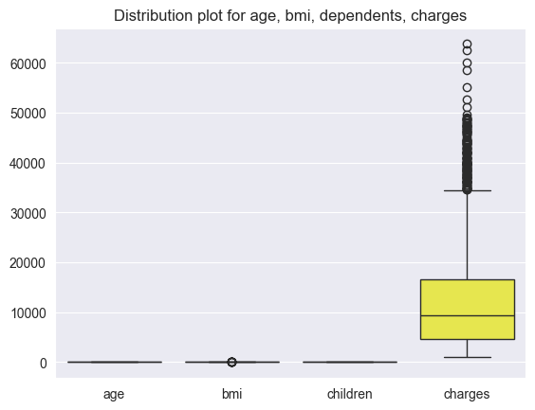
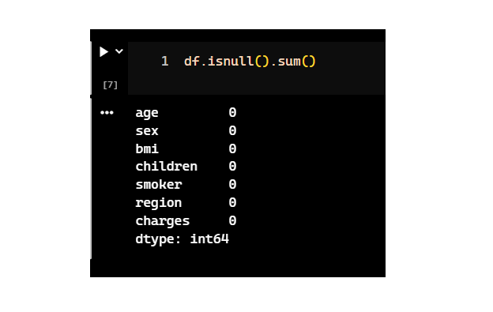
EDA (Expletory Data Analysis)
Here we are checked for missing values, we don’t have missing values in our data.
Here we checked for outliers, there are outliers in our target column so handled with log transformation.

Slide 7
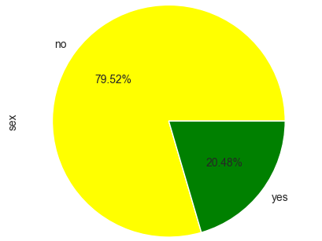
Data Visualization
In our data almost 80% of the beneficiaries are non-smoker’s and 20% smoker’s.

Slide 8
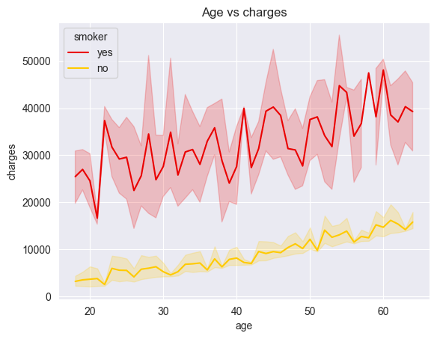
Data Visualization
As we can see in the graph the on average the smoker beneficiaries are charged very high as compared to non-smoker, irrespective of their age.

Slide 9
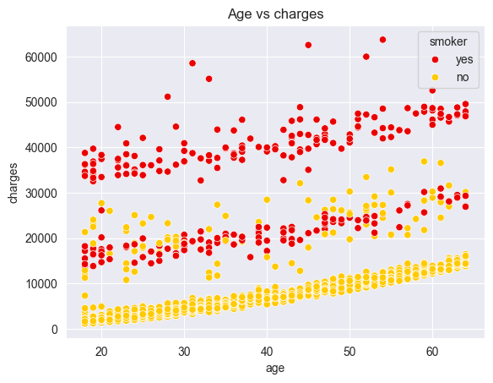
Data Visualization
In the scatter plot we can see that for most of the smoker beneficiaries the charges start where the maximum charges of non-smoker beneficiaries end.

Slide 10
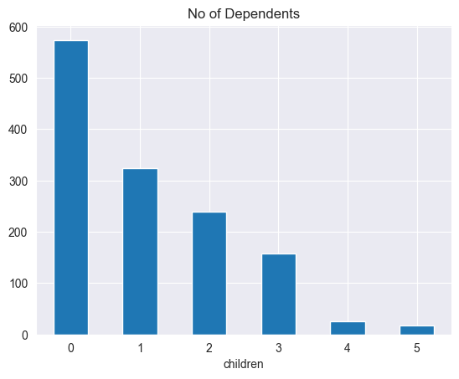
Data Visualization
In this count plot of dependents, we can see that most of the beneficiaries are not having dependents.

Slide 11
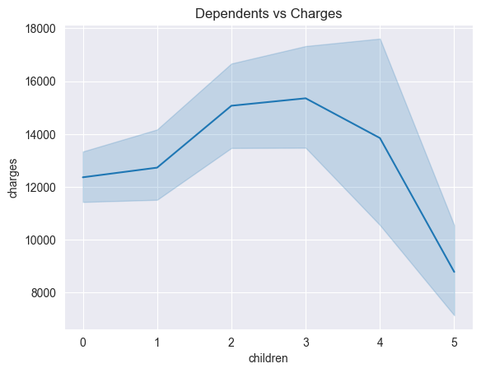
Data Visualization
In this dependents vs charges line plot we can see that the charges increase as the no of dependents increase but for some reason the charges for beneficiaries with 5 dependents is lower than the beneficiaries of no dependents.

Slide 12
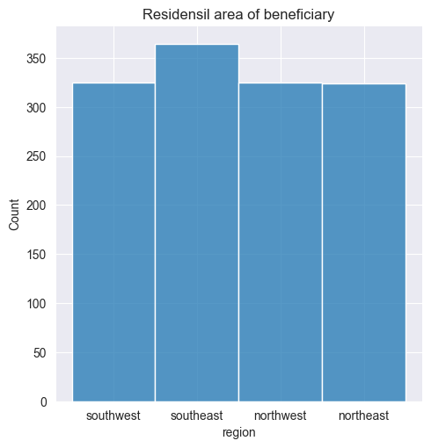
Data Visualization
In our data the southeast region is slightly more populated with beneficiaries.

Slide 13
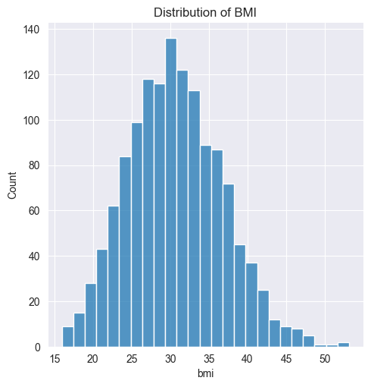
Data Visualization
The BMI is these region seam's to be normally distributed but the mean is 30 which not in the ideal range of 18.5 to 24.9 which means insurance company id likely to find people above ideal BMI range.

Slide 14
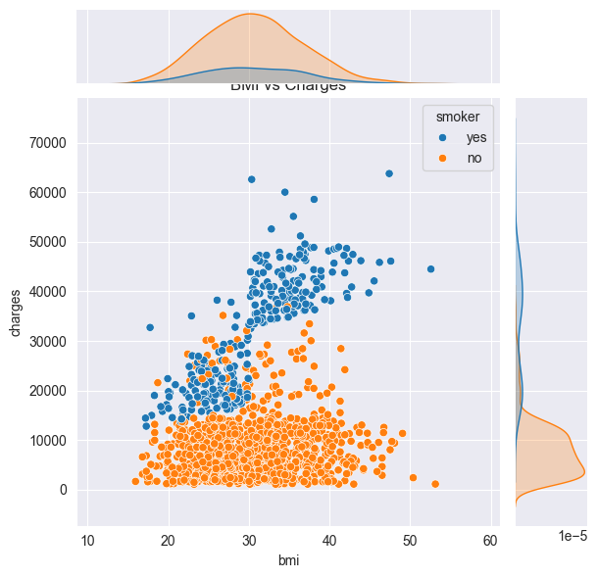
Data Visualization
From the joint plot we can see that if BMI is above ideal range and beneficiaries is not smoker then charges might increase, but if be beneficiary is smoker and BMI is above ideal range then charges will certainly to increase.

Slide 15
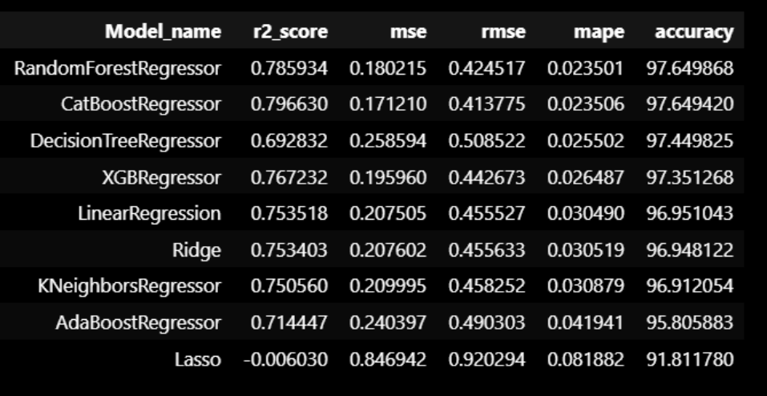
Model Building
The results shown are form the test data, all the models were trained and tested on 80/20 ratio respectively, where the best model comes out to be RandomForestRegressor with 97.65% accuracy.

Slide 16
Conclusion
Charges for smoker beneficiary are very high as compared to the non-smoker.
Charges might increase if the BMI is above ideal range of 18.5 - 24.9 and the beneficiary is nonsmoker, for beneficiary who smoke and has BMI above the ideal range the charges are certain to increase.
Maximum no of beneficiaries don't have dependents, charges tend to increase with increase in dependents, but for some reason the charges for dependents with beneficiaries with more then 4 is very less this maybe due to these beneficiaries would be buying insurance of low-cost or of low coverage.
In southeast region beneficiaries are slightly more populated than other regions.
Best preforming model is RandomForestRegressor with 97.65% accuracy.

Slide 17
Suggestion
Company should decrease the cost of insurance or should introduce new plans for smoking so that more people who smoke will be attracted to insurance.
1
Also new plans for beneficiaries with dependents more then 4, as it seems these people are paying charges less then people with no dependents like they are opting for some low coverage plan.
2

Slide 18

Thank You

