Slide 1
Multispectral Image Identification using Clustering Algorithms
Tejas Sahasranaman
Rushikesh Gawali
Joel Menezes
Unmey Mahaddalkar

Slide 2
Literature Survey
Multispectral image have found wide applications in the field Biometrics and forensic sciences and other fields
Effective use of multiple features of remotely sensed data and the selection of a suitable classification method are especially significant for improving classification accuracy
Conventionally , Classification techniques like naïve bayes and svm have been employed with great effectiveness to classify object images
This project presents an experimental approach to check the effectiveness of various clustering algorithms to achieve the same task

Slide 3
Dataset: Multispectral Images
A multispectral image is one that captures image data within specific wavelength ranges across the electromagnetic spectrum.
The wavelengths may be separated by filters or by the use of instruments that are sensitive to particular wavelengths, including light from frequencies beyond the visible light range, i.e. infrared and ultra-violet.
Spectral imaging can allow extraction of additional information the human eye fails to capture with its receptors for red, green and blue.

Slide 4
Dataset: Multispectral Images
Spectral bands:
Blue (450-515..520 nm)
Green (515..520-590..600 nm)
Red (600..630-680..690 nm)
Near Infrared (750-900 nm)
Mid Infrared (1550-1750 nm)
Far Infrared (2080-2350 nm)
Thermal Infrared (10400-12500 nm)
Radar

Slide 5
Dataset: Multispectral Images
This sample data contains a series of multispectral images of handwritten numbers between 0 and 9, from six different peoples, using two different pens.
Each csv file contains pixels for 10 grayscale images (350 * 350).
Each image row has 10 channels to represent the multispectral image.
X, Y represent the location of the pixel, and channel0 - channel9 represent channels.

Slide 6
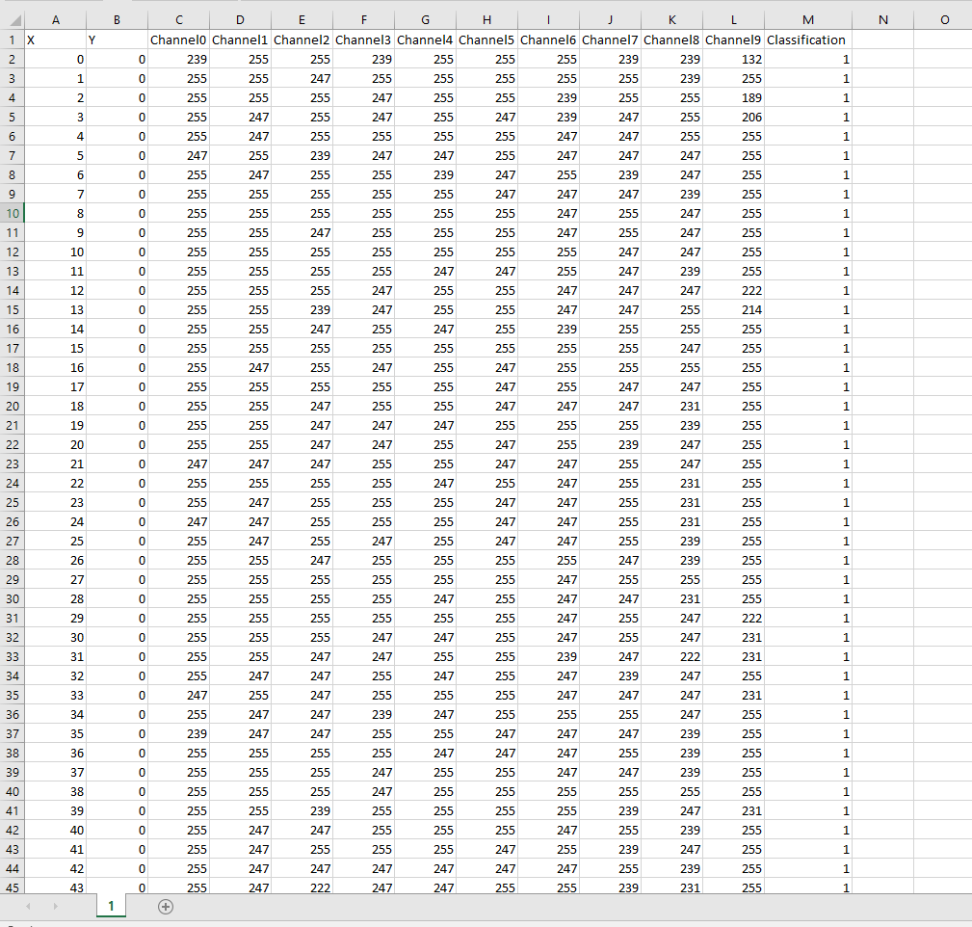
Dataset: Multispectral Images

Slide 7
Data Cleaning
Rows with empty column values were discarded.
The X and Y location parameters range from 0 to 349
The attributes channel0 - channel 9 range from 0 to 255.
No further normalization is required as all values have a fixed range and therefore one feature does not have a major influence over other column features on the similarity calculation and clustering process.

Slide 8
Data Preprocessing
All csv files were combined into a single csv file containing all rows of all multispectral images with their ground truth label appended as the additional column.
The label column is converted into a numeric categorical variable which maps an integer to the ground truth label (for example , blue0 to 1 , blue1 to 2 .. black9 to 20 )
A proportionate sample in the scale of 10,000 to 1 million was taken to suit our implementations of different clustering algorithms according to the amount of data they could process.
The performance and coverage of each of those algorithms are compared and contrasted in a later section.

Slide 9
K-means Clustering
Each cluster is associated with a centroid (center point)
Each point is assigned to the cluster with the closest centroid.
Number of clusters, K, must be specified.
The basic algorithm is very simple.:
Randomly compute k centroids
Assign points to these centroids to form clusters
Recompute the centroids
Repeat 2-3 till data doesn’t converge.

Slide 10
K-Means Complexity
Complexity is O( n * K * I * d )
n = number of points,
K = number of clusters,
I = number of iterations,
d = number of attributes

Slide 11
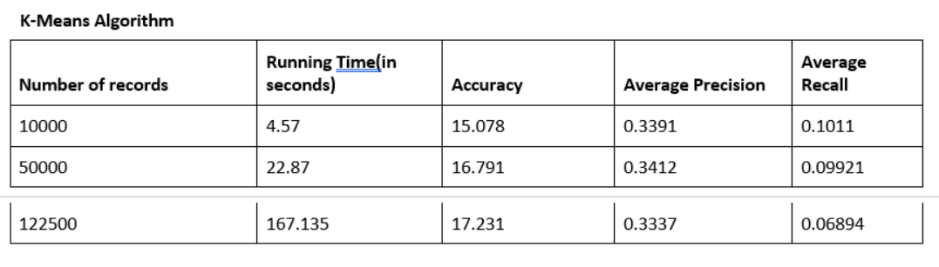
K-means Clustering

Slide 12
K-Mediods Clustering
Initialize: select k of the n data points as the medoids
Associate each data point to the closest medoid
While the cost of the configuration decreases :For each medoid m, for each non-medoid data point o: Swap m and o, recompute the cost (sum of distances of points to their medoid)
If the total cost of the configuration increased in the previous step, undo the swap
Repeat until number of iterations is exhausted or tolerance level is reached

Slide 13
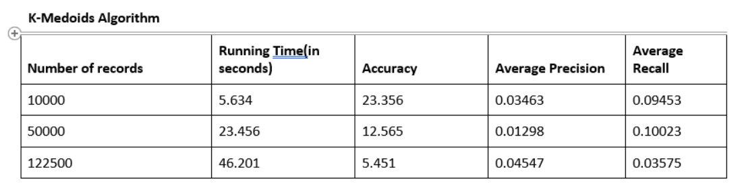
K-Mediods Clustering

Slide 14
DBSCAN
Find the ε (eps) neighbors of every point, and identify the core points with more than minPts neighbors.
Find the connected components of core points on the neighbor graph, ignoring all non-core points.
Assign each non-core point to a nearby cluster if the cluster is an ε (eps) neighbor, otherwise assign it to noise.
A naive implementation of this requires storing the neighborhoods in step 1, thus requiring substantial memory. The original DBSCAN algorithm does not require this by performing these steps for one point at a time

Slide 15
DBSCAN
DBSCAN visits each point of the database, possibly multiple times (e.g., as candidates to different clusters).
DBSCAN executes exactly one such query for each point, and if an indexing structure is used that executes a neighborhood query in O(log n), an overall average runtime complexity of O(n log n) is obtained.
Without the use of an accelerating index structure, or on degenerated data (e.g. all points within a distance less than ε), the worst case run time complexity remains O(n²).
The distance matrix of size (n²-n)/2 can be materialized to avoid distance recomputations, but this needs O(n²) memory, whereas a non-matrix based implementation of DBSCAN only needs O(n) memory.

Slide 16
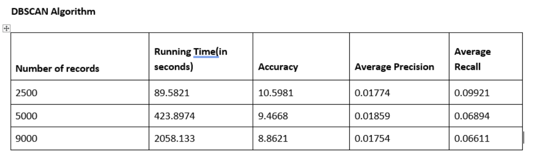
DBSCAN

Slide 17
SNN Clustering
Compute the similarity matrix
Sparsify the matrix by keeping only kk most similar neighbors for each data point
Construct the SSN graph (use the Jarvis-Patrick algo)
Find SSN density of each point pp:
in the KNN list of pp count qq s.t. sim(p,q)⩾ϵsim(p,q)⩾ϵ
Find the core points
all points with SSN density greater than min_ptsmin_pts are the core ones
Form clusters from the core points
all non-core points not within ϵϵ from the core ones are discarded as noise
Align non-noise non-core points to clusters

Slide 18
SNN Clustering
Time Complexity: O(n^2)
Space Complexity: O(n^2)

Slide 19
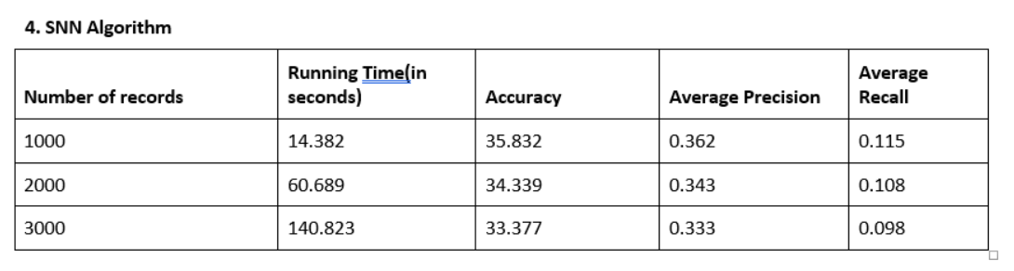
SNN Clustering

Slide 20
Performance Comparison

Slide 21
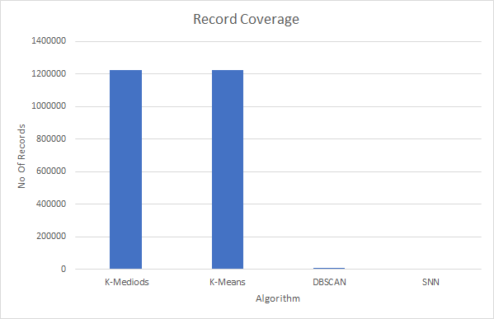
Performance Comparison

Slide 22
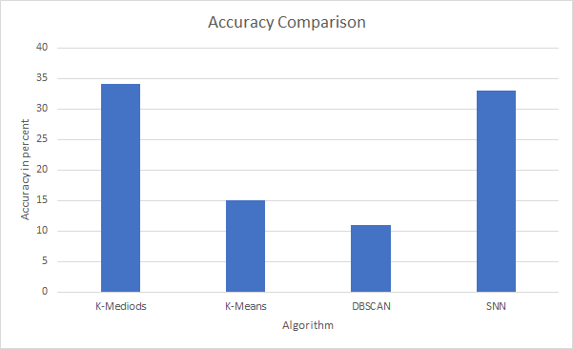
Performance Comparison

Slide 23
Limitations
During our implementation we found out that the algorithms or our implementation of these wasn’t very accurate. We would have liked higher accuracy.
Since we were implementing these algorithms on our local machines, the space limitations hurt us tremendously, especially for algorithms like SNN and DBSCAN which require O(n2) space where n is the number of records in the dataset.
Also because of the limited processing capability of our machines, the execution time for algorithms was quite high.

Slide 24
Future Improvement
We can work on improving the accuracy of our implementation of these algorithms.
We can also improve upon the time and space requirements.
We can implement other clustering approaches like CURE and BIRCH to tackle the data size and improve accuracy.

