Slide 1



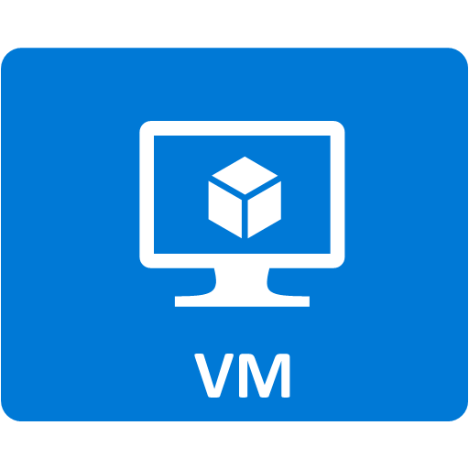



Landing area
COMET JOB
Azure File
Caspian
Cluster
Morgan Stanley Network
Azure data lake storage (ADLS)

