Slide 1
Budworm Forest Model - Analysis of the slow Forest variables
Aditya Joglekar 201401086
Rajdeep Pinge 201401103
Rushikesh Nalla 201401106
Omkar Damle 201401114

Slide 2
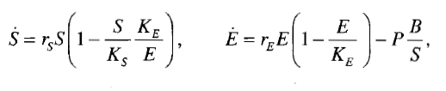
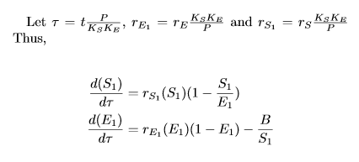
Equations for Forest Variables (E and S)
S : Average size of trees in the forest (which is an indicator of their age)
E : The level of energy reserves (this includes the condition of the foliage and health of the trees)
Biological Significance
Non-dimensionalized form :

Slide 3
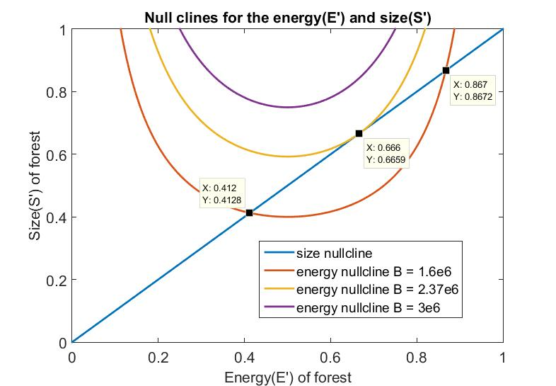


Null Clines
Equations:

Slide 4




Analytical calculation of the critical B value
One can calculate the critical B value using two methods-
Equating the derivatives and the function values of the null clines.
Using the condition for existence of real roots of a cubic equation.

Slide 5
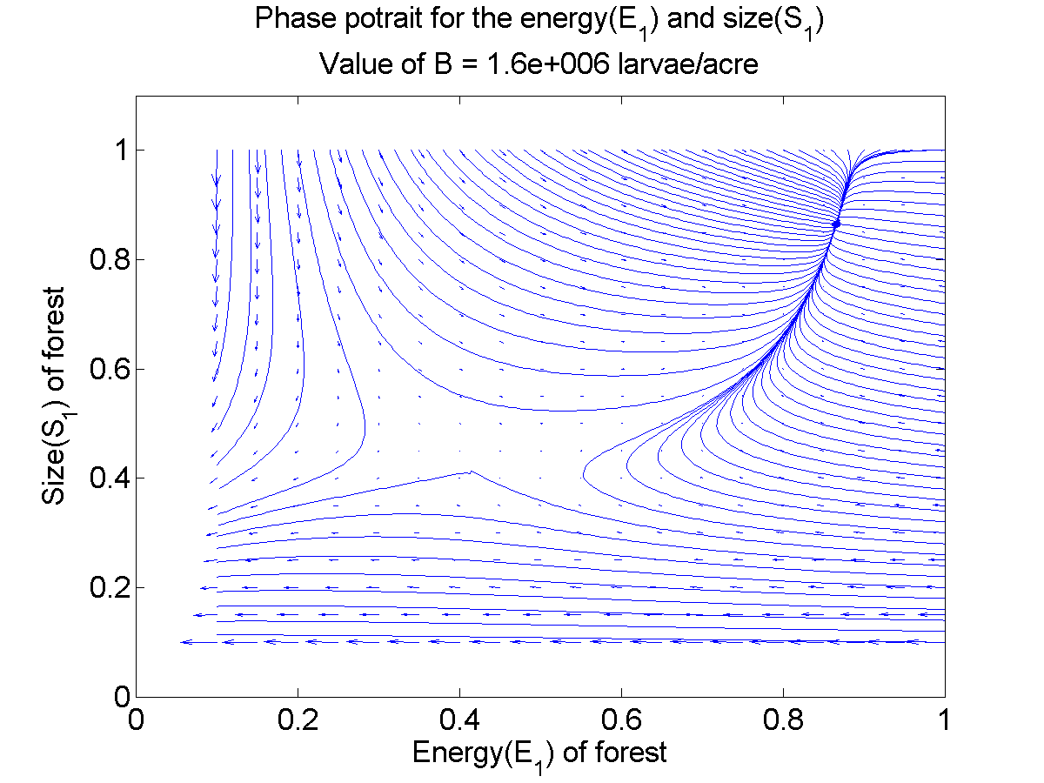
Phase Portrait 1
B = 1.6 x 10⁶
2 Fixed Points
Saddle Node (0.412, 0.412)
Stable Node (0.867, 0.867)

Slide 6
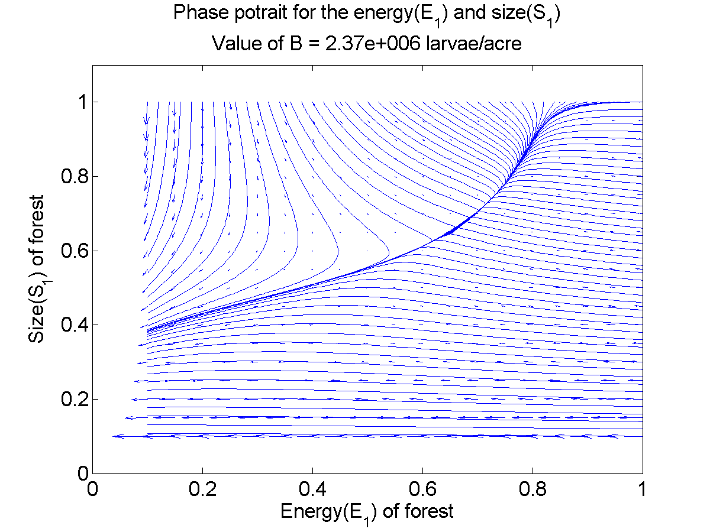
Phase Portrait 2
B = 2.37 x 10⁶
1 Fixed Point
Hybrid Fixed Point (0.67, 0.67)

Slide 7
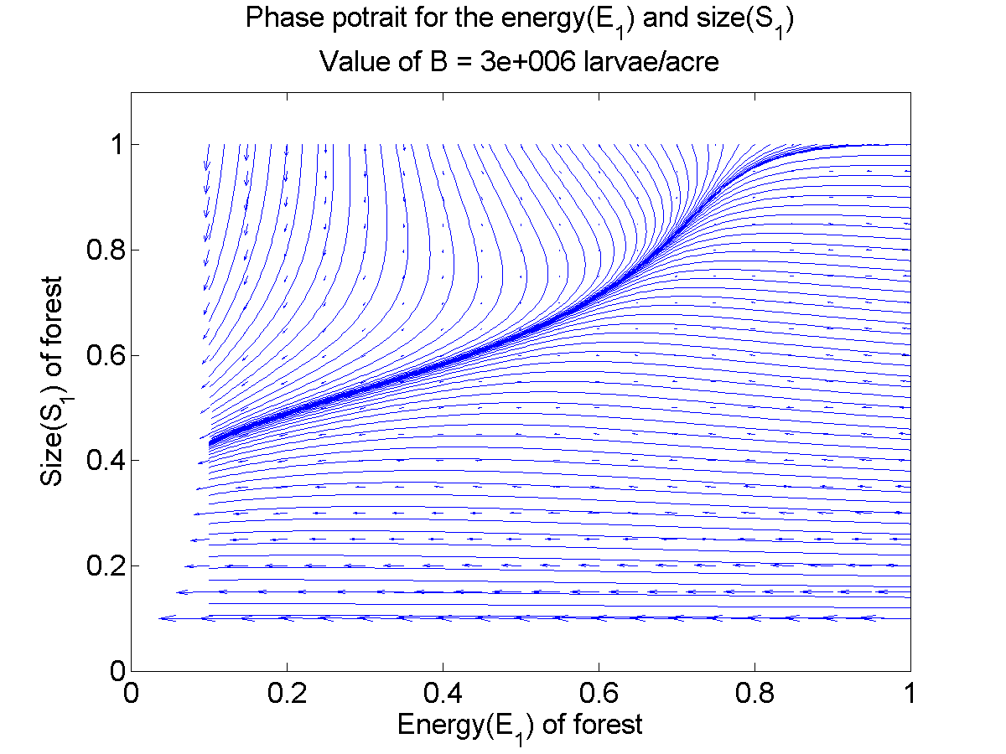
Phase Portrait 3
B = 3 x 10⁶
No Fixed Point

Slide 8
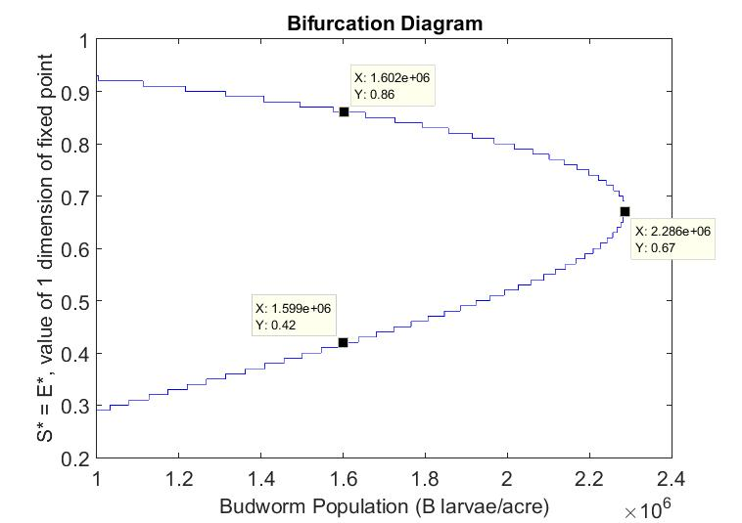
Bifurcation Diagram
In 2D
Significance
Saddle Node Bifurcation

Slide 9
Results, Key Observations:
The system shows a saddle-node bifurcation. If Budworm population(B) is below the critical value two fixed points exist. The forest survives(the variables stabilize to the fixed point) if and only if both Size(S) and Energy(E) are large enough.
If Budworm population goes above the critical value, no matter what the variables are, the forest is doomed! We have to keep B below critical value to save the forest.
The parameters decide how much a forest can withstand. A weak forest can be snuffed out even by a small number of Budworms in the refuge while a relatively strong forest can even survive a severe outbreak!

