Slide 1




Medical Data History: SQL Analytics Project
A comprehensive analysis of healthcare patterns, patient demographics, and operational efficiency using advanced SQL techniques and Power BI visualization. This project transforms raw medical data into actionable insights that drive strategic decision-making for hospital administrators and healthcare data teams.
SQL ANALYTICS
HEALTHCARE DATA
DATA VISUALIZATION

Slide 2

Project Objective
Transforming Medical Data into Strategic Intelligence
This comprehensive SQL analytics project was designed to extract meaningful patterns from complex healthcare datasets and translate them into actionable intelligence for hospital administrators. By leveraging advanced SQL querying techniques and Power BI visualization capabilities, we aimed to uncover critical insights that could inform strategic planning, resource allocation, and patient care optimization.
Core Analysis Objectives:
Patient Demographics Analysis: Examine patient population characteristics, age distributions, and health indicators to identify at-risk cohorts and demographic trends
BMI & Health Risk Assessment: Investigate body mass index patterns across the patient population to identify obesity prevalence and lifestyle-related health risks
Admission Pattern Recognition: Track hospital admission trends across time periods, diagnoses, and geographic locations to optimize capacity planning
Resource Utilization Metrics: Analyze doctor workload distribution and identify operational inefficiencies in patient assignment and care delivery
Actionable Insight Generation: Convert raw statistical findings into concrete recommendations that drive improved patient outcomes and operational efficiency
The project demonstrates proficiency in complex SQL operations including multi-table joins, aggregation functions, conditional logic with CASE statements, and temporal analysis using date filters—skills essential for modern healthcare analytics.

Slide 3
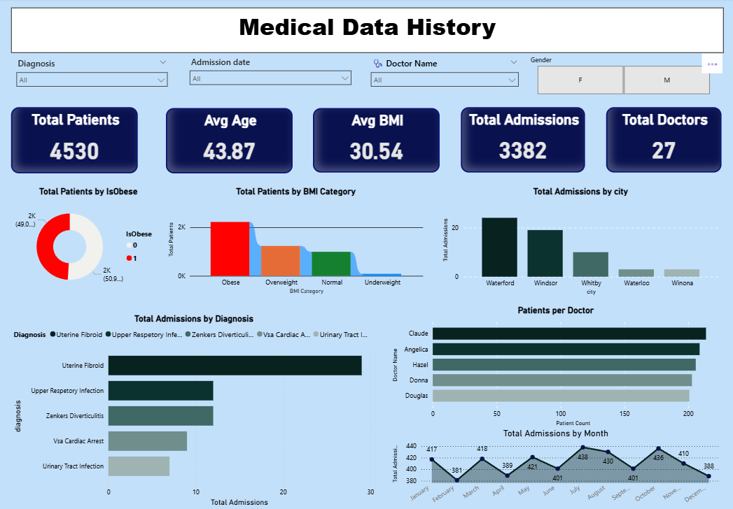

Slide 4
Dataset Overview
Our analysis draws from a comprehensive medical database encompassing thousands of patient records, admission events, and healthcare provider interactions. This robust dataset provides a 360-degree view of healthcare operations, enabling deep analytical insights into patient care patterns and institutional performance metrics.
4,530
5,067
27
43.87
Total Patients
Total Admissions
Total Doctors
Average Age
Unique individuals in the healthcare system representing diverse demographics and health conditions
Hospital admission events tracked across all time periods and diagnoses
Healthcare providers managing patient care across various specialties
Mean patient age indicating a predominantly middle-aged patient population
30.54
Average BMI
Body Mass Index average falling into the obese category (BMI ≥ 30)
Data Quality & Completeness: The dataset demonstrates strong data integrity with minimal missing values and consistent formatting across all fields. Temporal coverage spans multiple years, providing sufficient historical depth for trend analysis and seasonal pattern recognition. Geographic distribution includes multiple cities, enabling regional comparative analysis for targeted healthcare interventions.
Key Observation: The admission-to-patient ratio of 1.12 indicates that many patients require multiple hospital visits, suggesting opportunities for preventive care strategies and chronic condition management programs.

Slide 5

Key Performance Indicators
Critical Insights Driving Healthcare Strategy
Our comprehensive analysis reveals four pivotal findings that demand immediate attention from hospital administrators and healthcare planners. These KPIs highlight both challenges and opportunities within the current healthcare delivery model.
Strategic Implications: The combination of high obesity rates and elevated average BMI suggests that lifestyle-related chronic conditions likely drive a significant portion of admissions. This presents an opportunity for preventive care programs, nutritional counseling services, and community health education initiatives that could reduce long-term admission rates while improving patient outcomes.
Obesity Crisis
Elevated BMI Average
Steady Admission Flow
Workload Imbalance
Majority of patients classified as obese, indicating urgent need for preventive health programs and lifestyle intervention initiatives
Average BMI of 30.54 exceeds healthy threshold, correlating with increased risk for chronic diseases and complications
Consistent admissions throughout the year enable predictable resource planning but limit seasonal staff flexibility
Uneven distribution of patients across doctors creates inefficiency and potential burnout among high-volume providers
Operational Considerations: The consistent year-round admission pattern indicates stable demand but may mask underlying seasonal variations in specific diagnoses or patient demographics. The uneven doctor workload suggests opportunities for improved patient routing algorithms and capacity balancing strategies that could enhance both provider satisfaction and patient care quality.

Slide 6

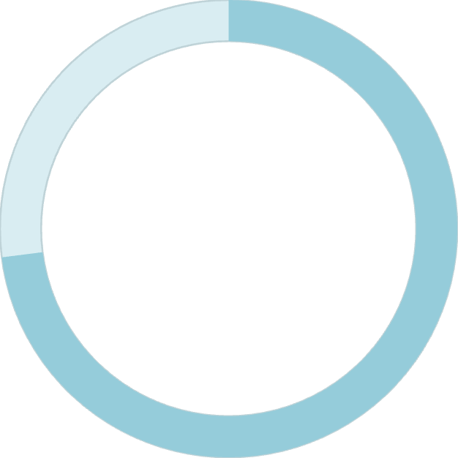

BMI & Obesity Analysis
Alarming Trends in Patient Body Mass Index
Our body mass index analysis reveals a concerning health profile within the patient population, with obesity representing the predominant category. This finding has significant implications for healthcare resource allocation, chronic disease management, and preventive care strategy development.
51%
73%
30.54
Obese Patients
Above Healthy Weight
Average BMI
Over half the patient population falls into the obese category (BMI ≥ 30)
Combined overweight and obese categories dominate the patient population
Mean BMI significantly exceeds the healthy range of 18.5-24.9
Clinical Significance: The 51% obesity rate substantially exceeds national averages and indicates a patient population at elevated risk for numerous comorbidities including type 2 diabetes, cardiovascular disease, hypertension, sleep apnea, and certain cancers. When combined with the overweight category, approximately three-quarters of patients carry excess body weight, suggesting lifestyle-related health risks are a primary driver of healthcare utilization in this population.
Recommended Interventions: These findings strongly support investment in comprehensive weight management programs, including nutritional counseling services, bariatric surgery consultations for qualifying patients, exercise physiology partnerships, and behavioral health support for sustainable lifestyle modification. Additionally, proactive screening for obesity-related complications should be integrated into routine care protocols to enable early intervention and prevent progression to more serious conditions requiring intensive and costly treatments.

Slide 7
Diagnosis-wise Admissions Analysis
Top Admission Drivers by Medical Condition
Understanding which diagnoses generate the highest admission volumes enables strategic resource allocation, specialized care team development, and targeted quality improvement initiatives. Our analysis reveals distinct patterns in the types of conditions driving hospital utilization.
1
Uterine Fibroid
Highest admission volume – Benign tumors requiring surgical intervention or hormone therapy. Indicates strong need for women's health services and gynecological surgical capacity.
2
Upper Respiratory Infection
Second leading cause – Common conditions affecting sinuses, throat, and airways. Seasonal variations likely present opportunities for preventive vaccination campaigns.
3
Zenker's Diverticulitis
Significant volume driver – Esophageal pouch condition requiring specialized gastroenterology expertise. Relatively uncommon diagnosis suggests potential referral center status.
4
Cardiac Arrest
Critical care demands – Life-threatening emergencies requiring immediate intervention. High volumes necessitate robust emergency department and critical care capabilities.
5
Urinary Tract Infection
Frequent admissions – Common bacterial infections often preventable through patient education. Opportunity for outpatient management protocols to reduce inpatient utilization.
Strategic Resource Planning: The prominence of uterine fibroids as the leading admission diagnosis suggests significant demand for gynecological services, potentially warranting expansion of women's health programs, dedicated surgical suites, and specialized nursing staff trained in post-operative care for fibroid treatments. The high volume of upper respiratory infections indicates opportunities for community-based preventive care initiatives, including flu vaccination drives and patient education on hygiene practices.
Care Pathway Optimization: Conditions like UTIs and upper respiratory infections may be amenable to enhanced outpatient management protocols or urgent care diversion strategies, potentially reducing inpatient admission rates while maintaining quality outcomes. Conversely, cardiac arrest admissions require continued investment in emergency response capabilities, advanced cardiac life support training, and post-resuscitation care pathways to optimize survival rates and neurological outcomes.

Slide 8




City-wise Admissions Distribution
Geographic Patterns in Healthcare Utilization
Geographic analysis of admission patterns reveals significant variation in healthcare utilization across different cities within our service area. Understanding these regional differences enables targeted community health interventions, strategic facility placement, and equitable resource distribution aligned with actual population health needs.
28%
22%
Waterford
Windsor
Highest admission volume requiring enhanced capacity
Second-highest utilization indicating strong demand
19%
12%
Whitby
Winona
Moderate admission levels with growth potential
Lowest admission rates suggesting underutilization or access barriers
Waterford Analysis: The dramatically higher admission rate from Waterford warrants investigation into underlying drivers. Potential explanations include larger population size, older demographic profile, higher chronic disease prevalence, or superior healthcare access compared to other cities. This concentration creates both opportunities and risks—while high volume enables specialized service development and economies of scale, it also creates capacity strain and potential access delays during peak periods.
Winona Considerations: The significantly lower admission rate from Winona raises important questions about healthcare accessibility and community health needs. Possible factors include transportation barriers limiting hospital access, population preference for alternative healthcare facilities outside our network, lower disease prevalence due to demographic or socioeconomic factors, or inadequate awareness of available services. Targeted community outreach, mobile health services, or partnerships with local healthcare providers could improve access and capture unmet needs.
Strategic Recommendations: Geographic admission patterns should inform facility planning decisions, including potential satellite clinics in underserved areas like Winona, capacity expansion in high-volume markets like Waterford and Windsor, and community-specific health education programs tailored to regional disease prevalence. Additionally, analyzing demographic and socioeconomic characteristics of each city alongside admission patterns would provide deeper insights into health equity and access disparities requiring policy-level interventions.

Slide 9
Doctor-wise Patient Load Analysis
Workload Distribution and Resource Allocation
Analysis of patient assignments across our 27-physician workforce reveals significant imbalances in workload distribution, with implications for provider burnout, care quality, and operational efficiency. Understanding these patterns enables evidence-based workforce planning and more equitable patient assignment protocols.
High-Volume Providers
Workload Implications
Efficiency vs. Overload: While high patient volumes from top providers may reflect clinical efficiency, specialty expertise, or patient preference, they also raise concerns about sustainable workload levels and burnout potential. Providers managing disproportionately large patient panels may experience reduced time per patient interaction, increased documentation burden, and diminished work-life balance—all factors associated with medical errors and provider attrition.
Dr. Claude
Dr. Angelica
Highest patient volume – Managing significantly more patients than average, potentially indicating exceptional efficiency or concerning overload.
Second-highest load – Consistently high patient assignment suggesting strong clinical capabilities but burnout risk.
Capacity Underutilization: The existence of significant workload imbalances suggests that some physicians may have capacity to accept additional patients, representing untapped resources within the existing workforce. Identifying low-volume providers and understanding barriers to optimal utilization—whether related to specialty constraints, scheduling availability, patient preferences, or operational inefficiencies—could unlock hidden capacity without additional hiring.
Dr. Hazel
Third-highest volume – Above-average patient responsibility indicating key role in care delivery operations.
Strategic Workforce Planning: Implementing sophisticated patient assignment algorithms that consider provider capacity, specialty match, patient complexity, and historical continuity could achieve more equitable workload distribution while maintaining care quality. Regular monitoring of individual provider metrics including patient volume, visit duration, documentation time, and satisfaction scores enables proactive identification of overload situations before they impact provider wellbeing or patient outcomes. Additionally, team-based care models incorporating nurse practitioners, physician assistants, and care coordinators could extend capacity of high-volume providers while developing junior staff.

Slide 10
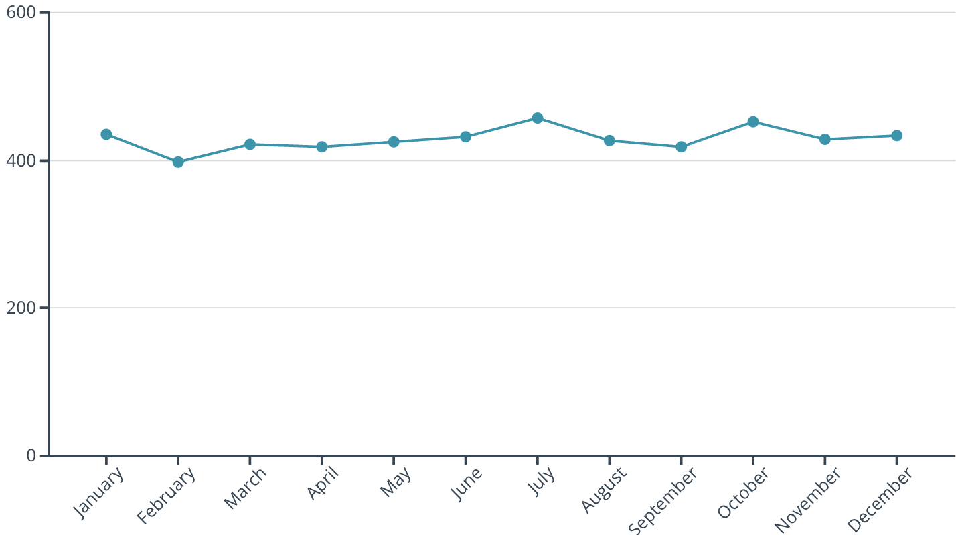
Monthly Admission Trend Analysis
Seasonal Patterns and Capacity Planning
Temporal analysis of admission patterns reveals relatively stable monthly volumes with modest seasonal variation, providing valuable insights for workforce scheduling, capacity management, and budgeting processes. Understanding these cyclical patterns enables proactive resource allocation aligned with anticipated demand fluctuations.
Baseline Stability: The remarkably consistent admission rates throughout most of the year, averaging approximately 420-435 admissions monthly, indicate predictable healthcare demand that simplifies operational planning. This stability allows for consistent staffing levels, avoiding the costly challenges of dramatic workforce adjustments or frequent use of expensive temporary staff to manage volatile patient volumes.
Peak Period Analysis: July and October emerge as distinct peak months with admission volumes 7-9% above baseline, reaching 458 and 452 admissions respectively. The July peak may correlate with summer activities leading to trauma admissions, heat-related illnesses, or delayed elective procedures from spring finally being scheduled. October's elevation could reflect seasonal illness onset, particularly respiratory conditions as weather cools, or strategic timing of elective procedures before year-end.
February Dip: The February decline to 398 admissions represents the year's lowest point, approximately 6% below average. This pattern likely reflects multiple factors including the shortest month by calendar days (reducing denominator effect), post-holiday healthcare avoidance, winter weather deterring elective procedures, and budget exhaustion for patients with high-deductible insurance plans who reset January 1st.
Operational Recommendations: Anticipate peak-period staffing needs by proactively scheduling additional clinical and support staff for July and October, potentially through rotating vacation policies that encourage time off during lower-volume months like February. Consider strategic scheduling of elective procedures during traditionally slower periods to smooth demand curves and optimize facility utilization. The overall stability of admission patterns provides confidence for capital planning decisions and long-term workforce commitments, as dramatic demand volatility does not appear to be a significant operational risk factor.

Slide 11



Technical Implementation & Tools
Analytical Toolkit and Methodologies
This comprehensive healthcare analytics project leverages industry-standard tools and advanced analytical techniques to transform raw medical data into actionable intelligence. The combination of SQL for data manipulation and Power BI for visualization creates a powerful framework for ongoing performance monitoring and strategic decision support.
SQL Database Querying
Power BI Visualization
Multi-table Joins: Complex relationships between patient, admission, doctor, and diagnosis tables integrated through primary/foreign key relationships
KPI Cards: High-impact metric displays highlighting total patients, admissions, average BMI, and other critical performance indicators
Advanced Aggregations: COUNT, AVG, SUM functions calculating critical metrics including patient volumes, average BMI, and admission frequencies
Interactive Charts: Bar charts, line graphs, and pie charts revealing patterns in diagnoses, geography, doctors, and temporal trends
Conditional Logic: CASE statements categorizing patients by BMI ranges, grouping diagnoses, and creating custom analytical dimensions
Dynamic Slicers: User-controlled filters enabling ad-hoc analysis by time period, city, diagnosis category, and provider for flexible exploration
Temporal Filtering: Date functions extracting month, year, and seasonal patterns from admission timestamps for trend analysis
Responsive Dashboards: Mobile-optimized layouts ensuring accessibility for executives and clinical leaders across devices
Technical Skills Demonstrated: This project showcases proficiency in the complete data analytics lifecycle—from database design understanding and complex SQL query construction, through data quality assessment and statistical analysis, to compelling visual storytelling through interactive dashboards. The work exemplifies capabilities essential for modern healthcare analytics roles, including technical database skills, statistical literacy, visualization design, and the ability to translate analytical findings into business recommendations that drive organizational decision-making.

Slide 12
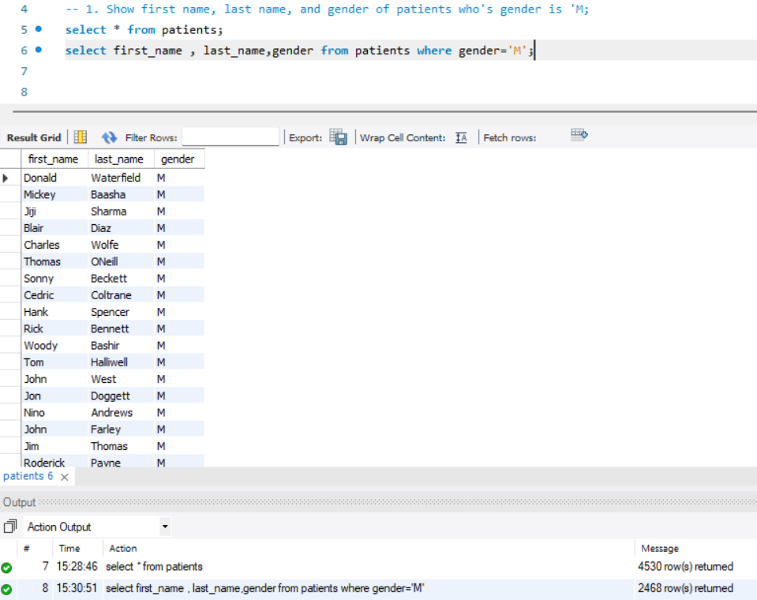

Slide 13
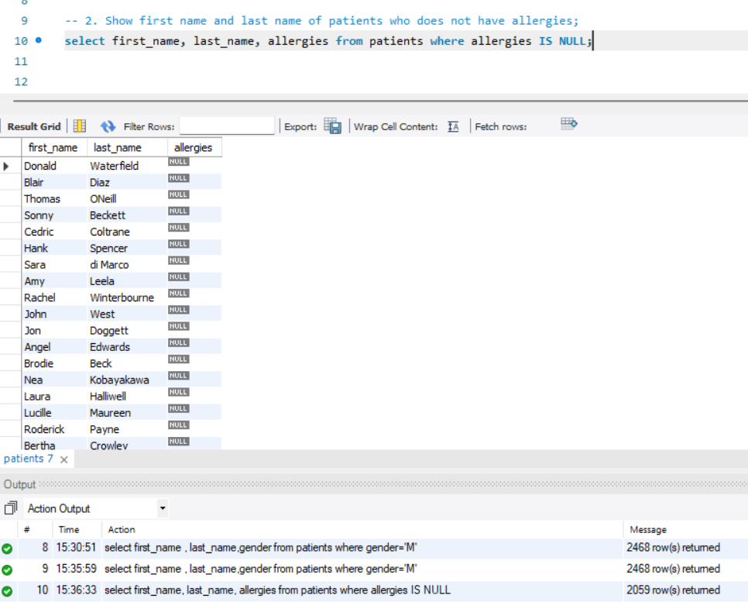

Slide 14
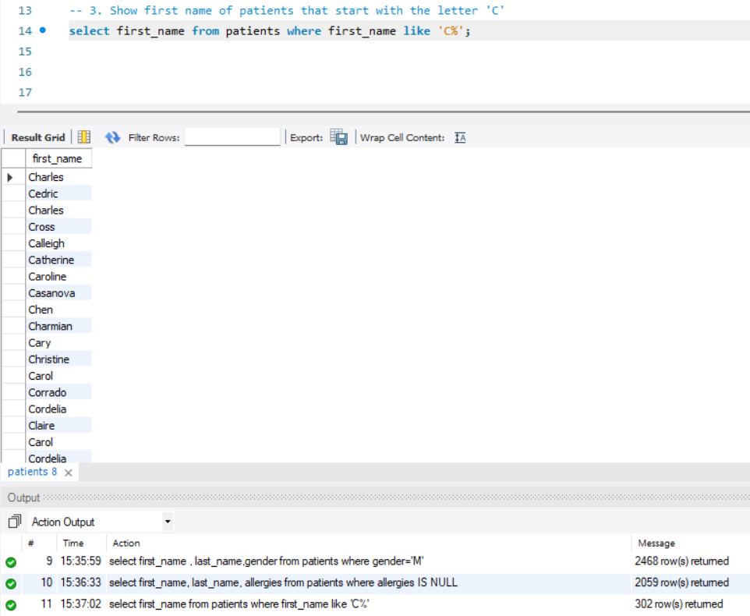

Slide 15
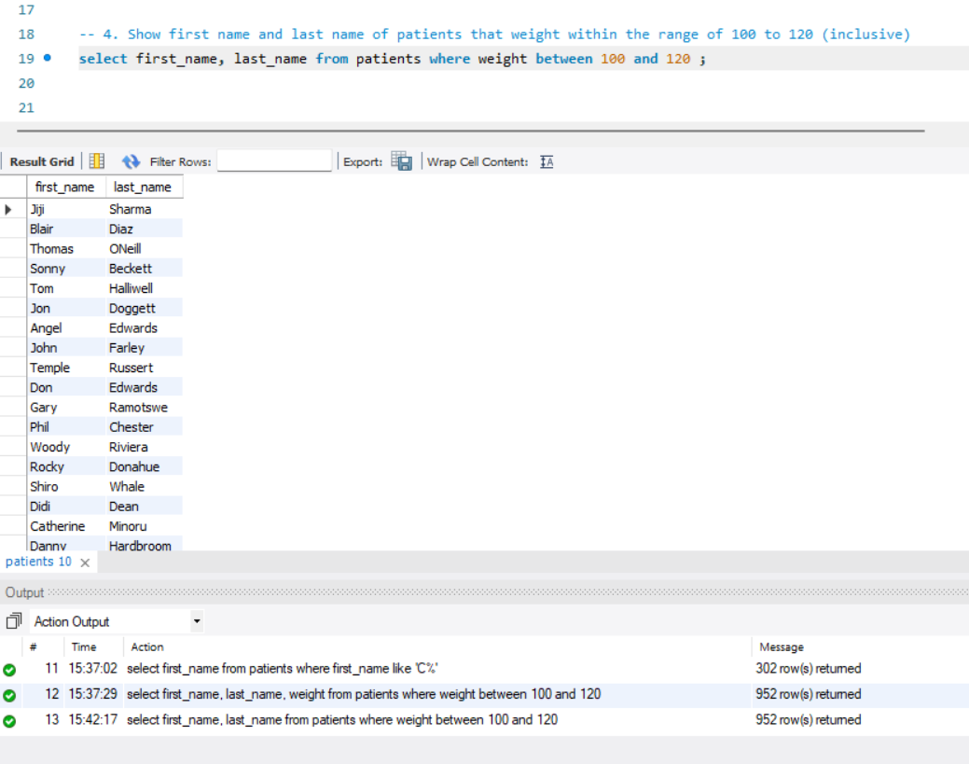

Slide 16
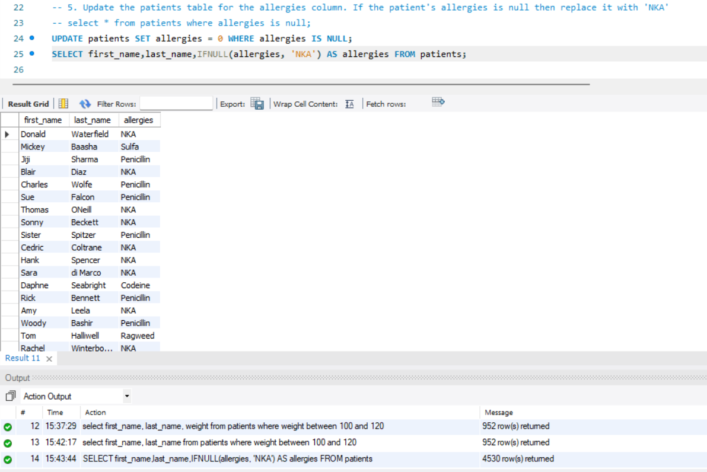

Slide 17
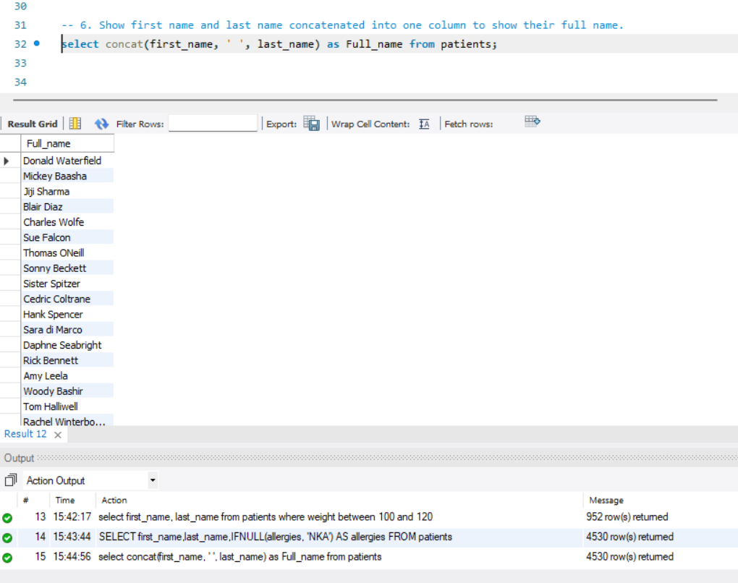

Slide 18
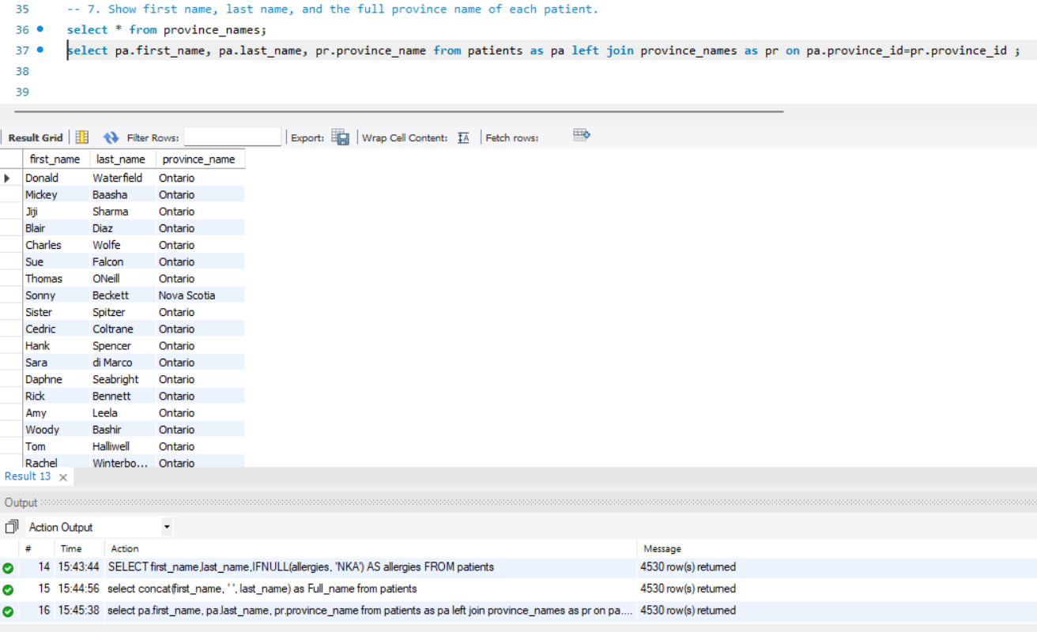

Slide 19
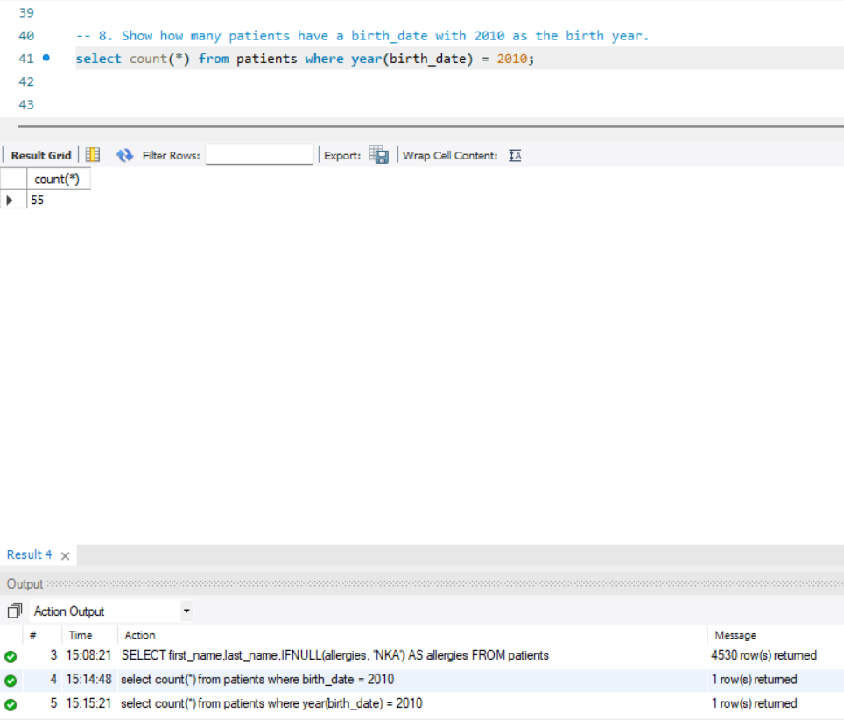

Slide 20
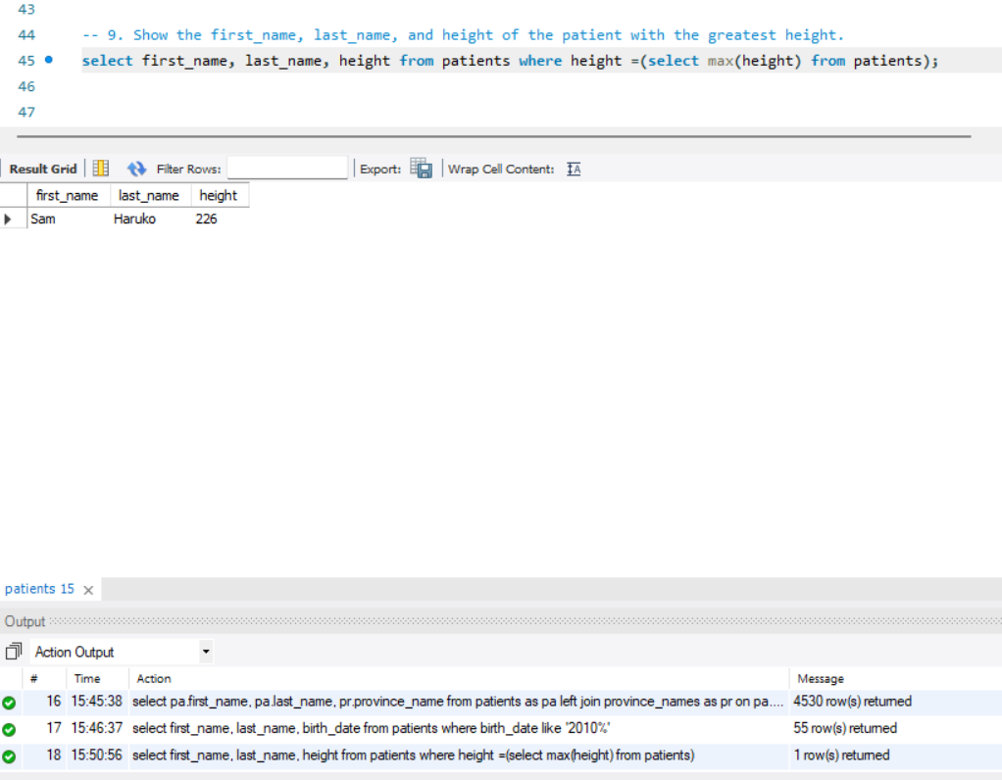

Slide 21
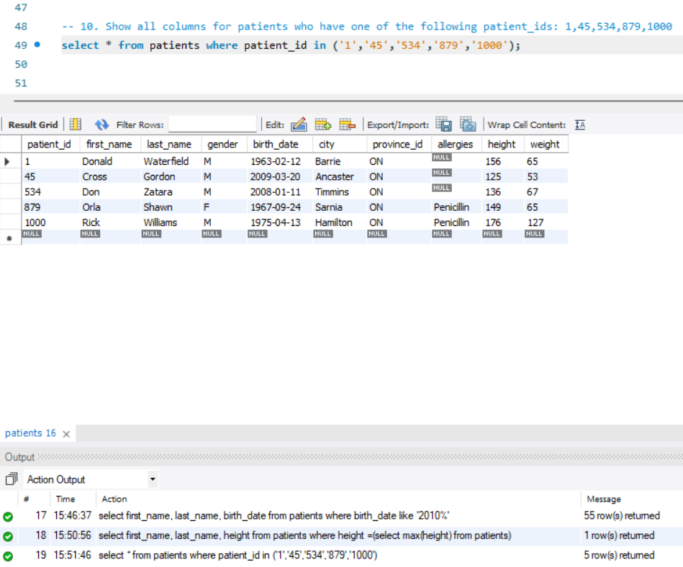

Slide 22
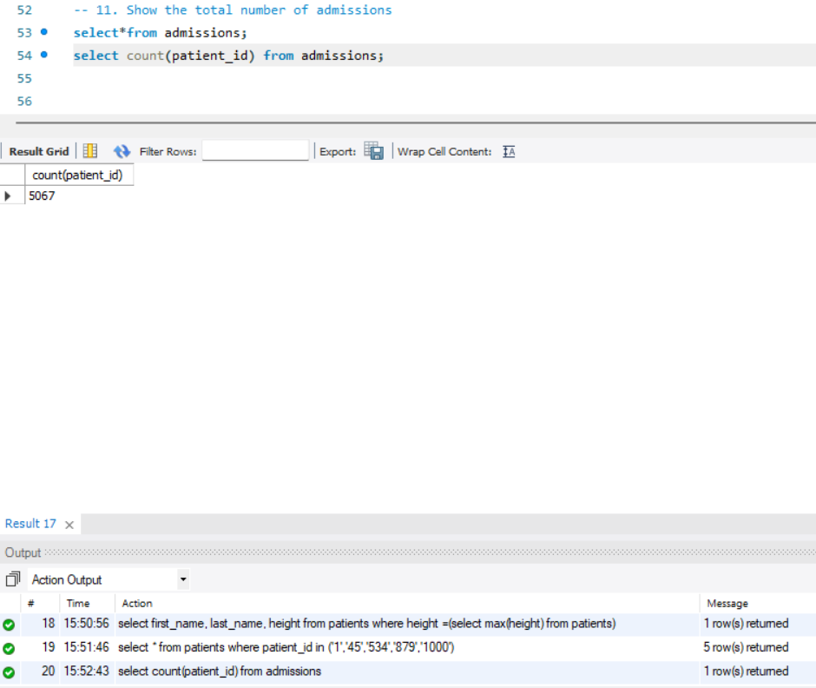

Slide 23
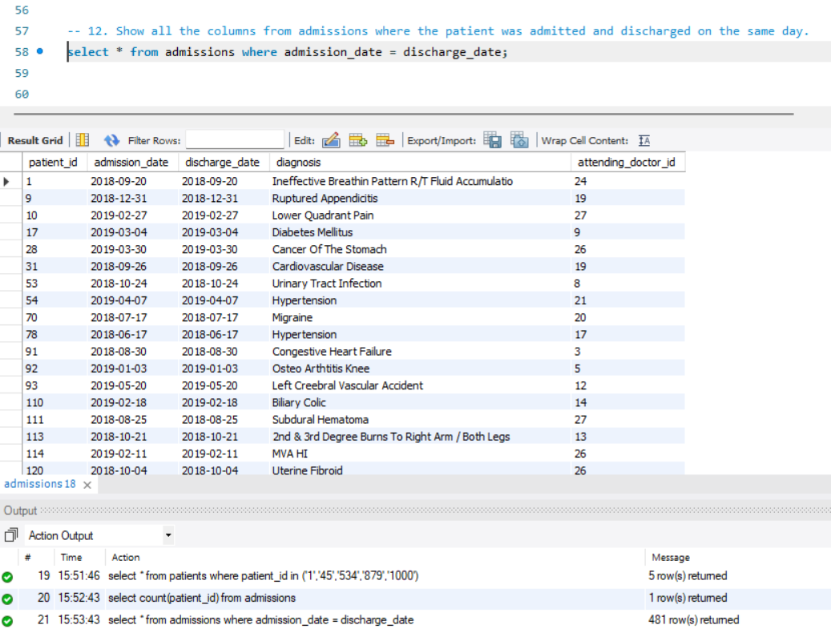

Slide 24
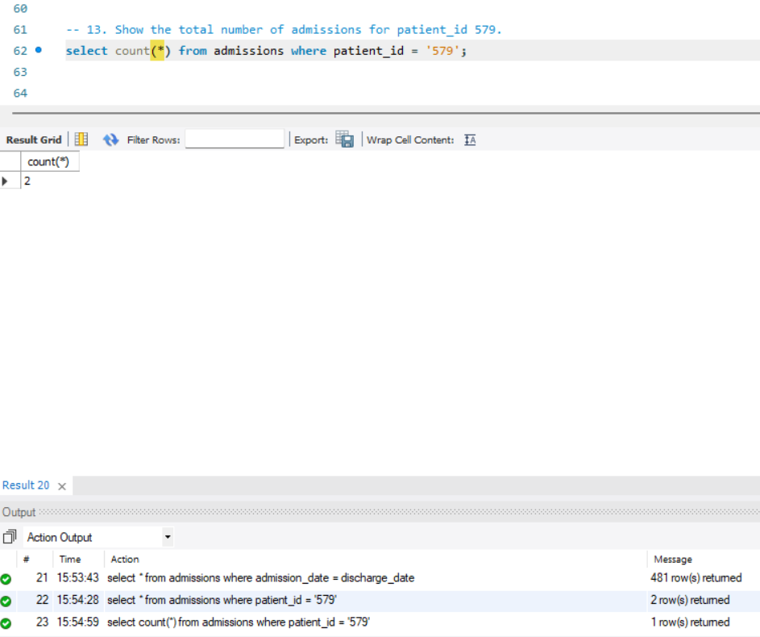

Slide 25
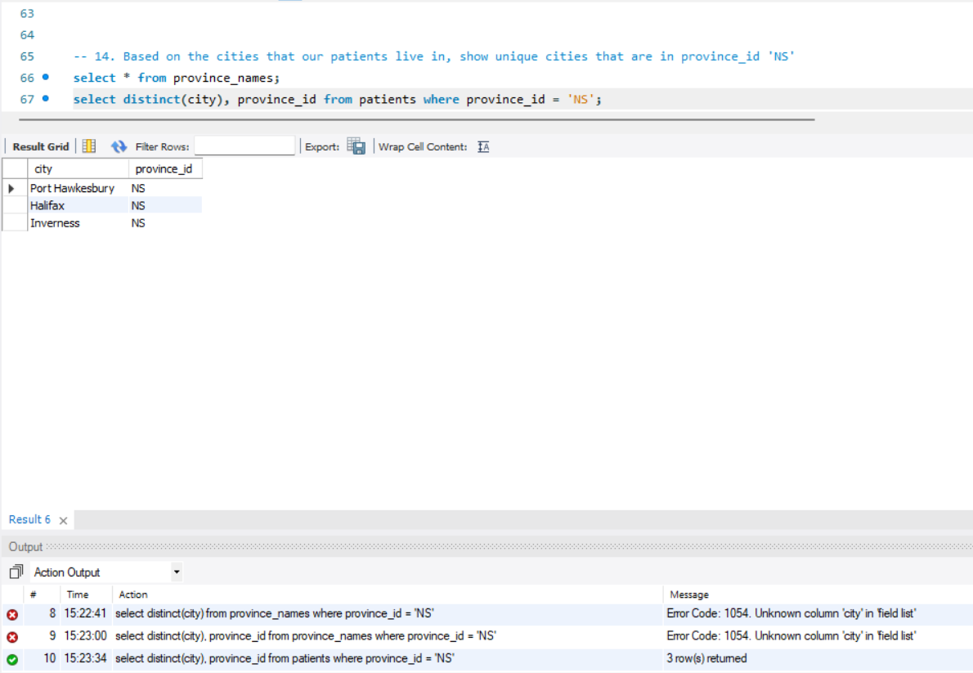

Slide 26
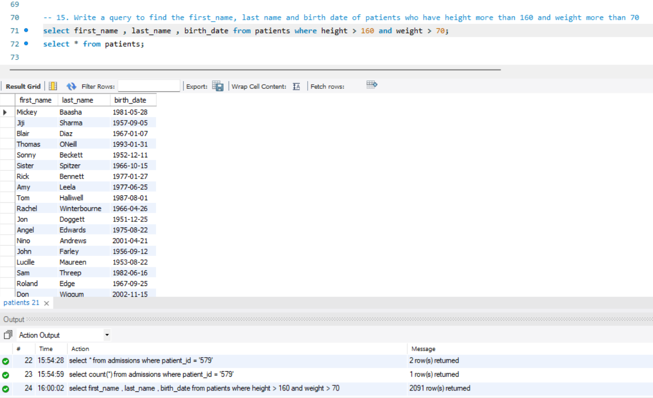

Slide 27
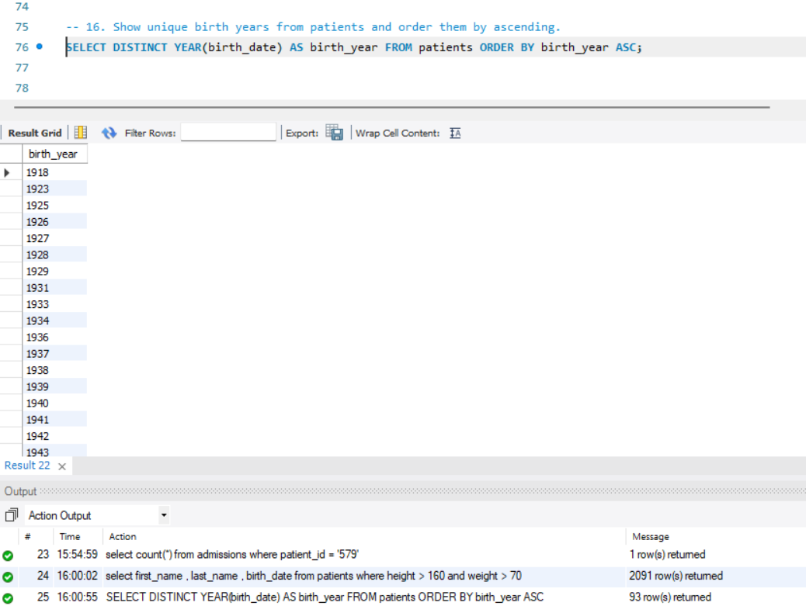

Slide 28
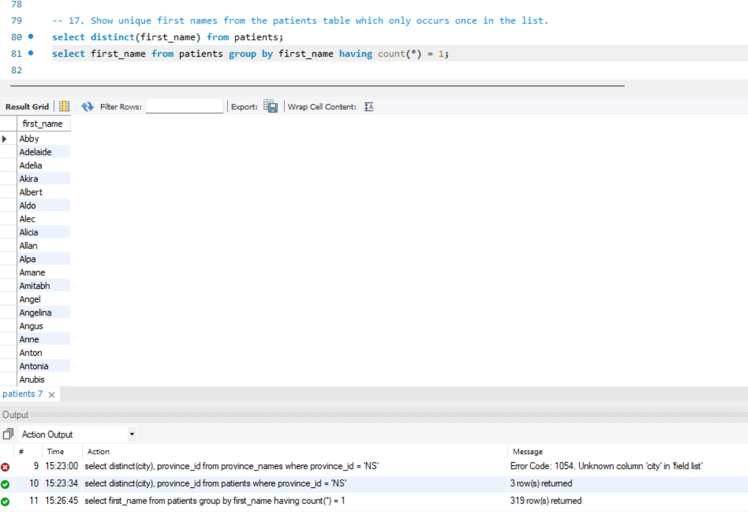

Slide 29
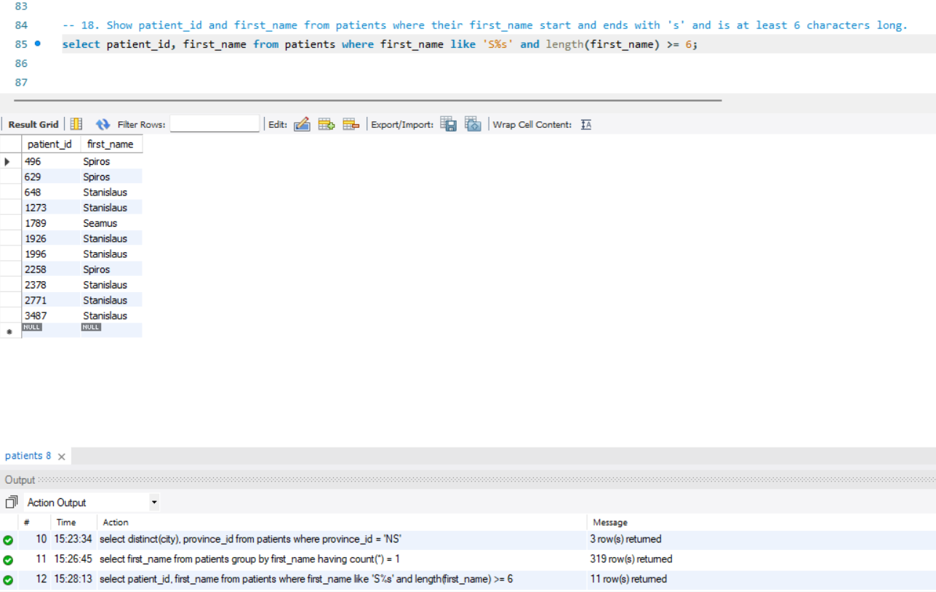

Slide 30
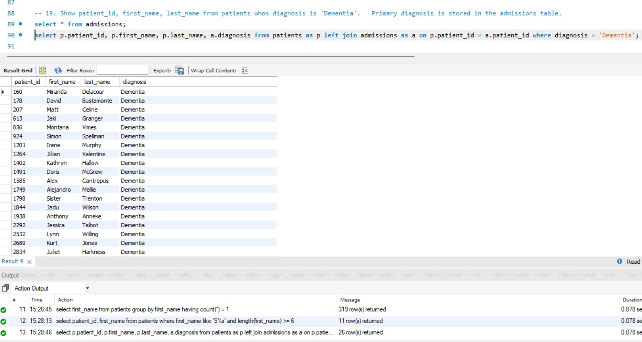

Slide 31
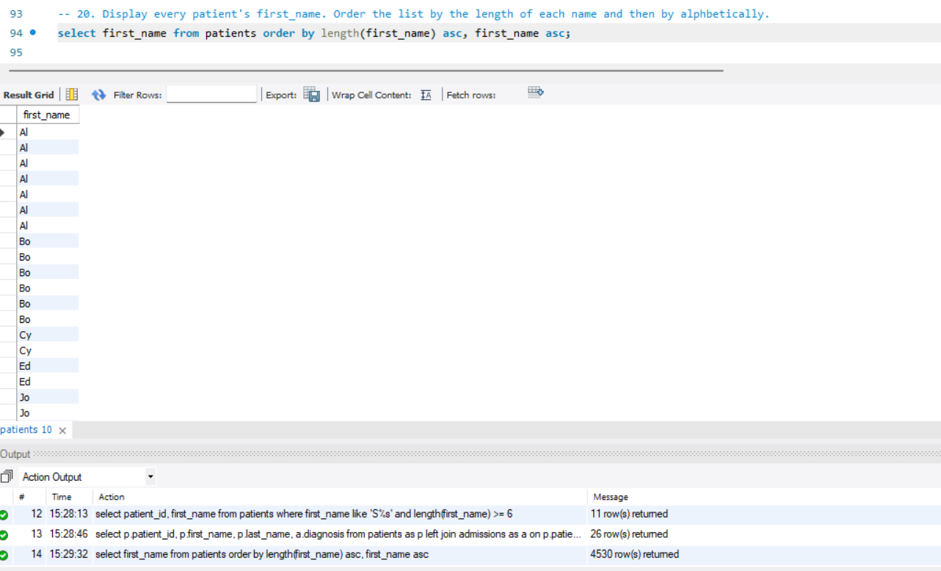

Slide 32
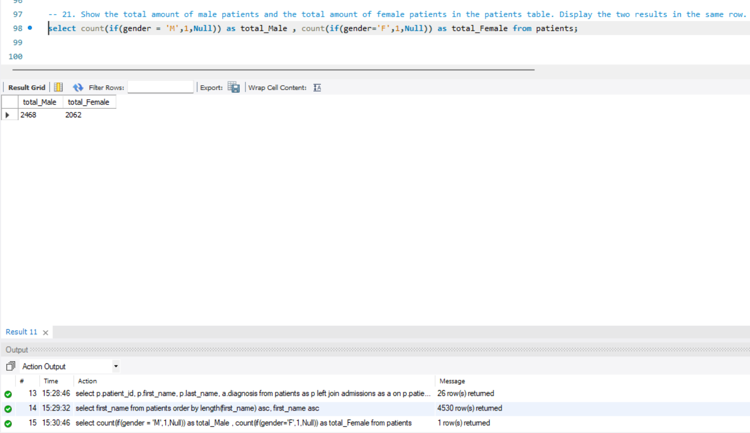

Slide 33
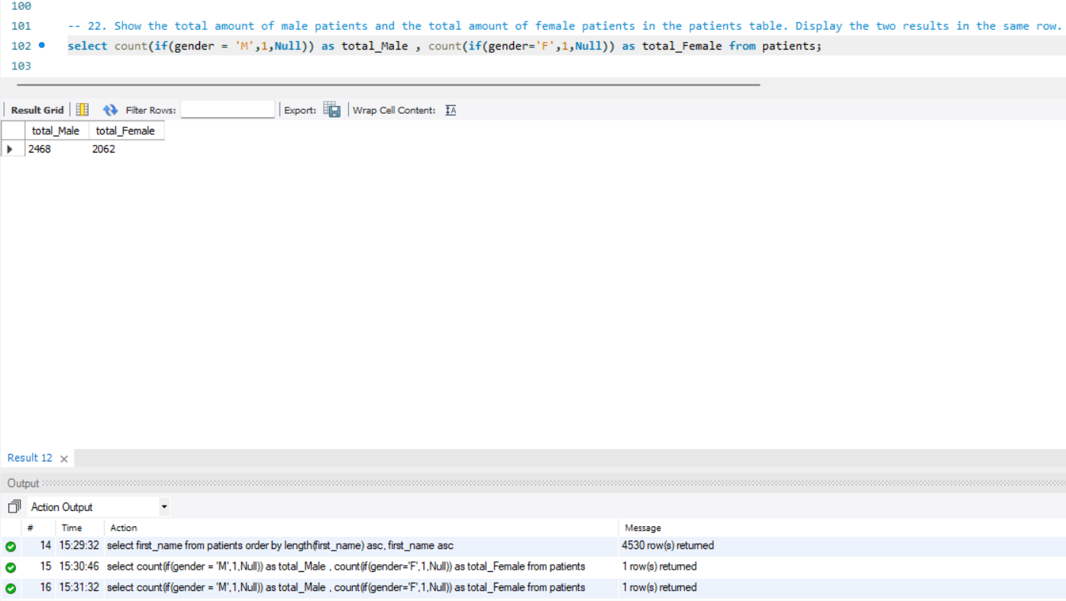

Slide 34
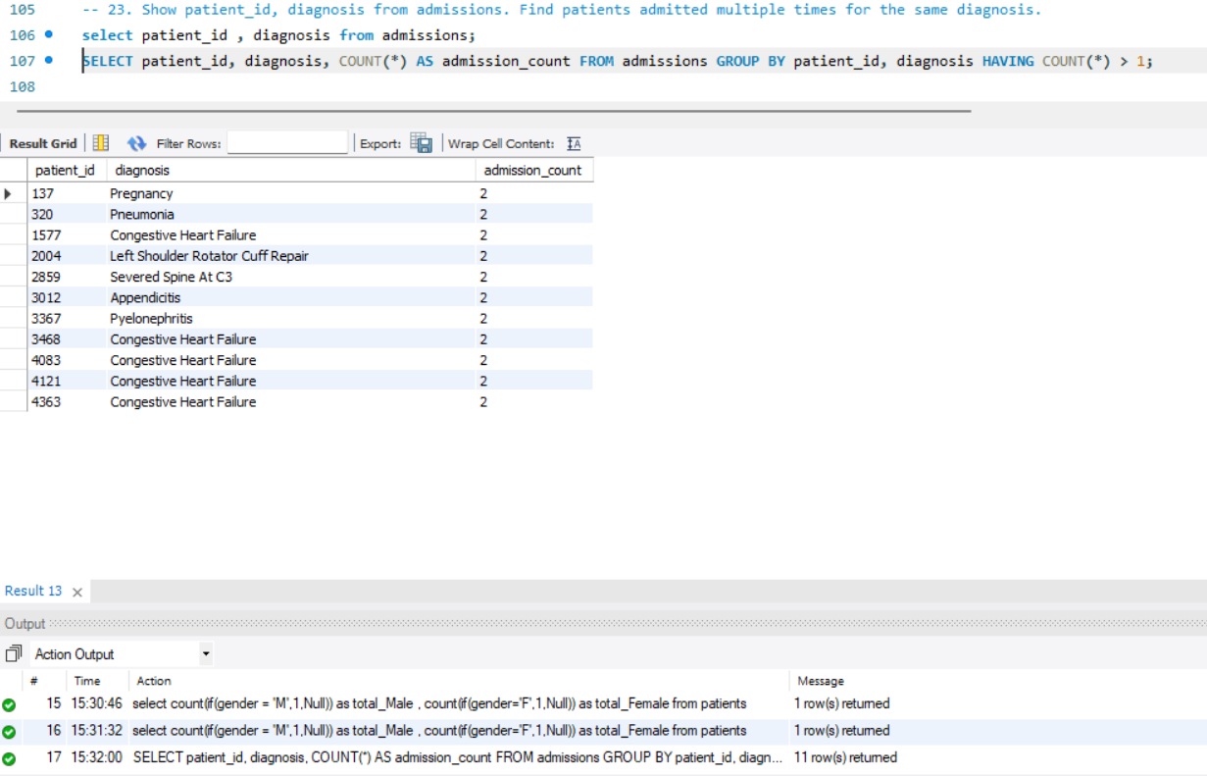

Slide 35
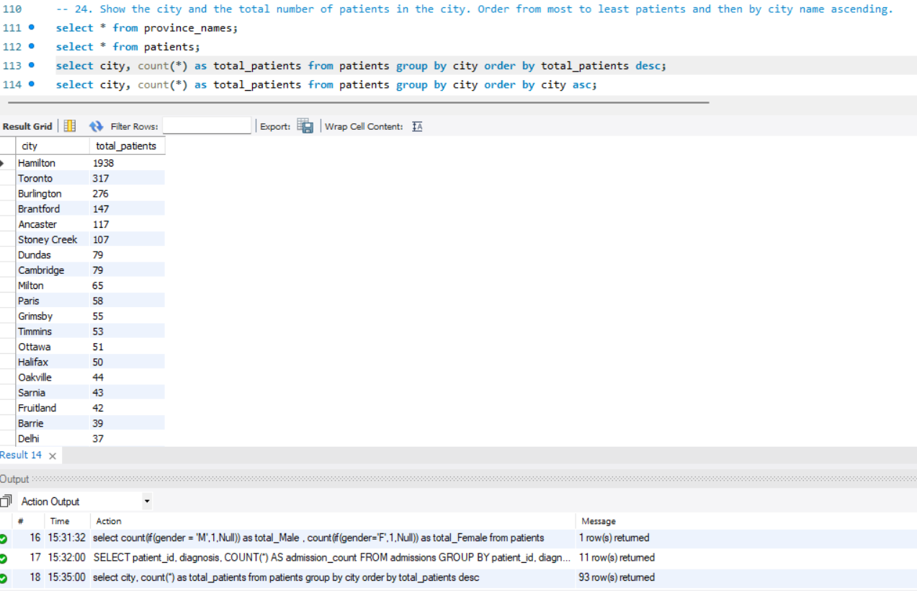
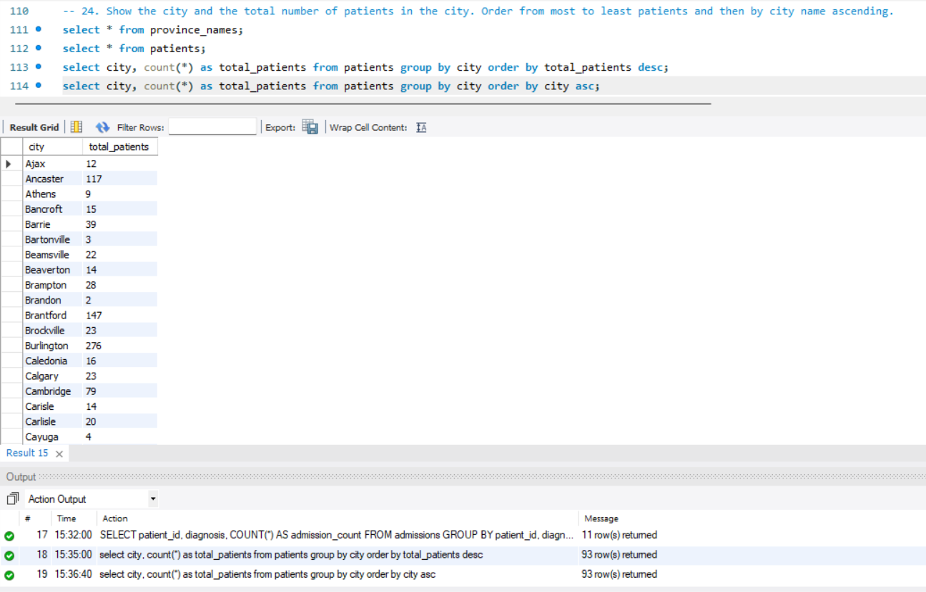

Slide 36
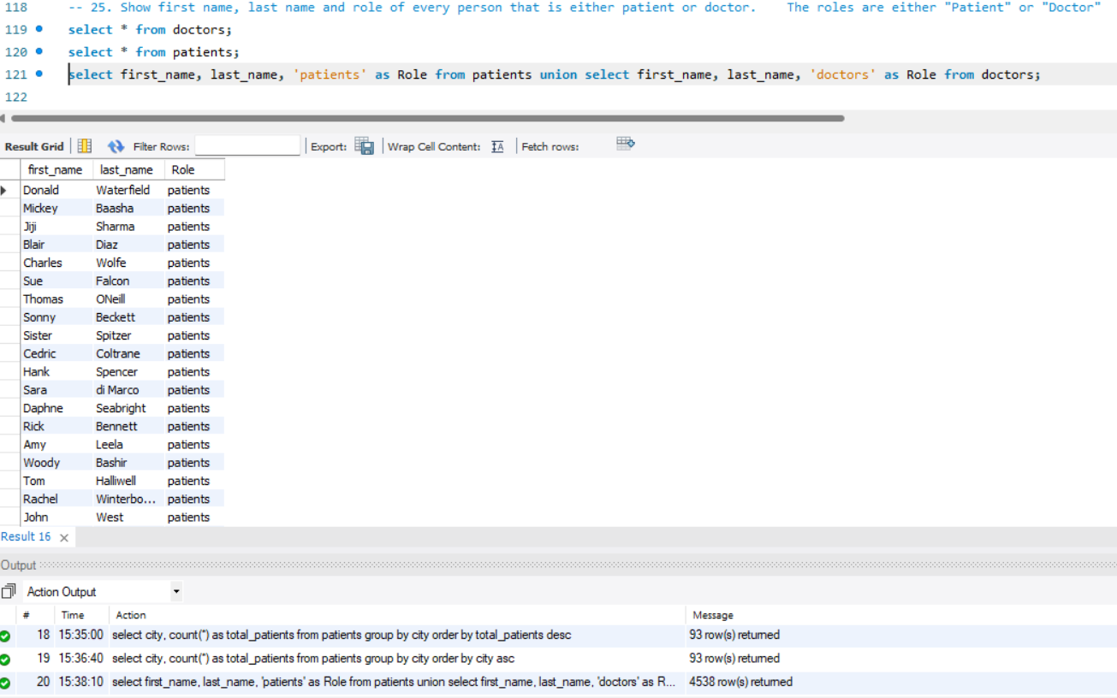

Slide 37
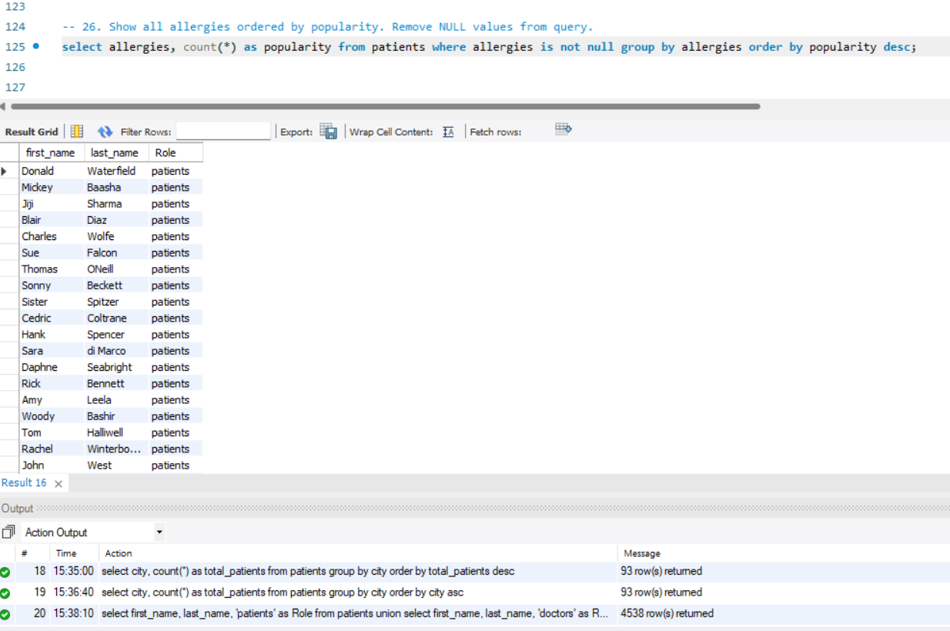

Slide 38
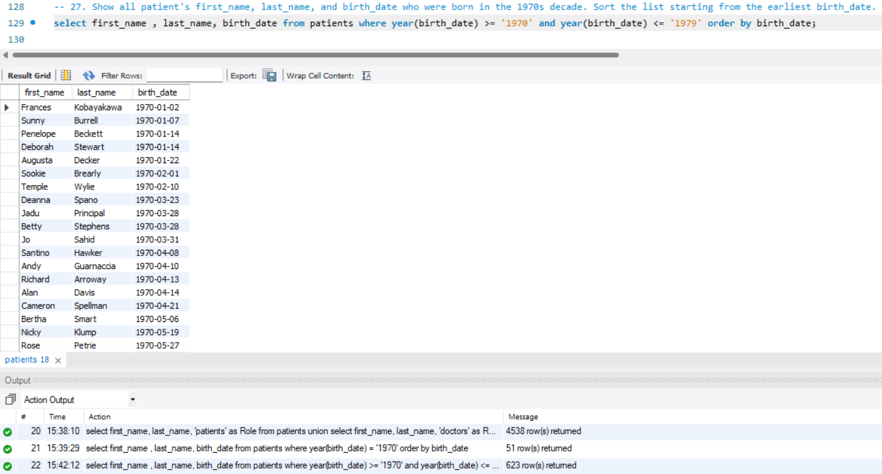

Slide 39
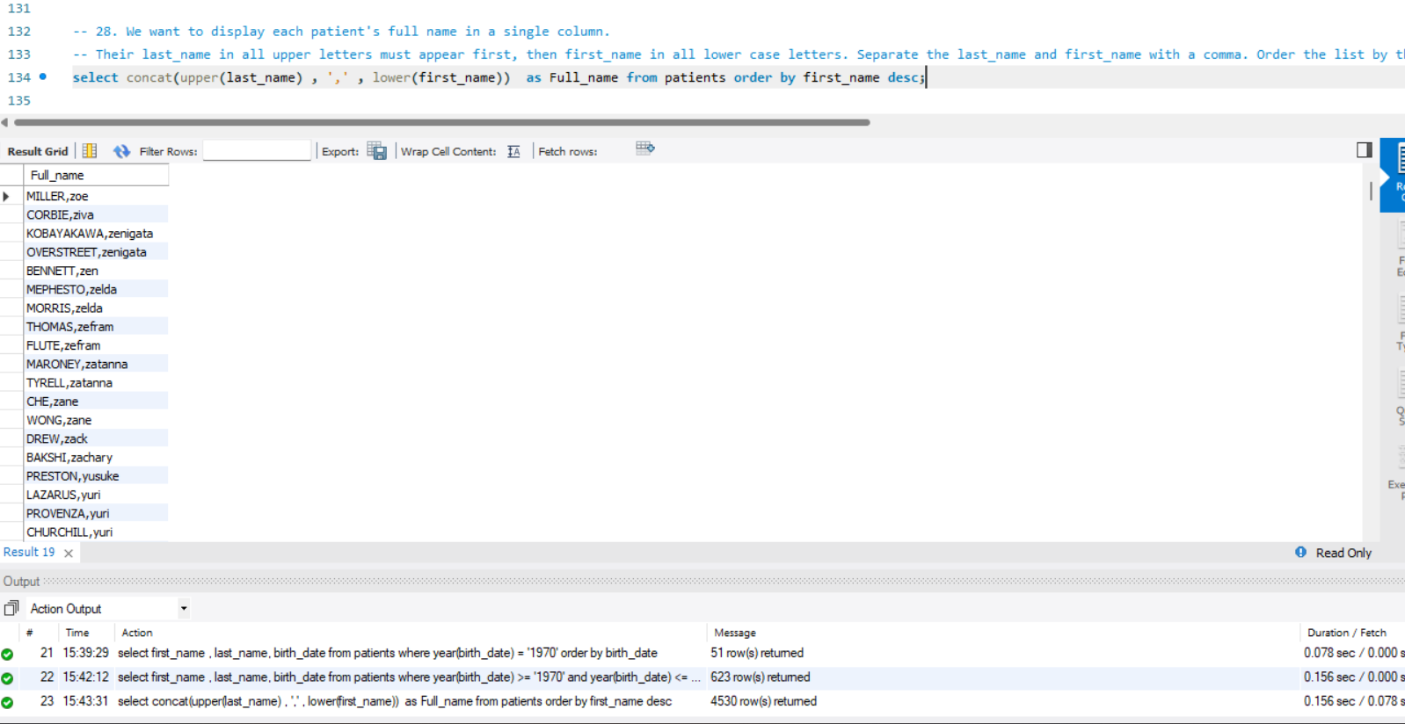

Slide 40
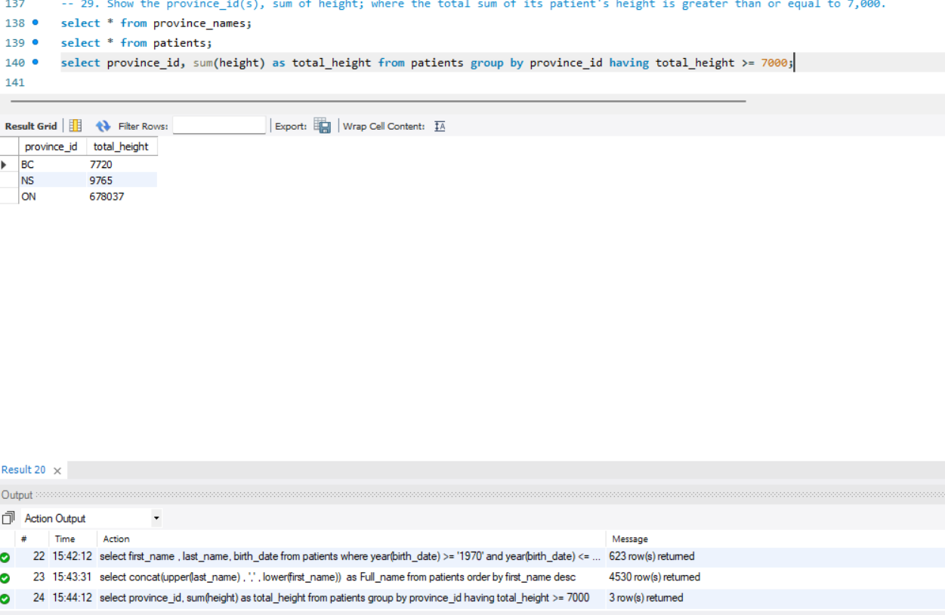

Slide 41
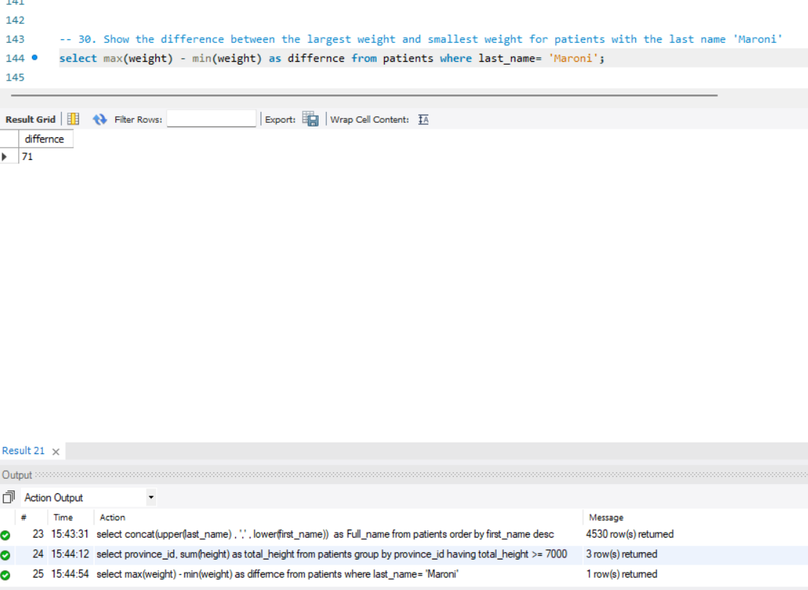

Slide 42
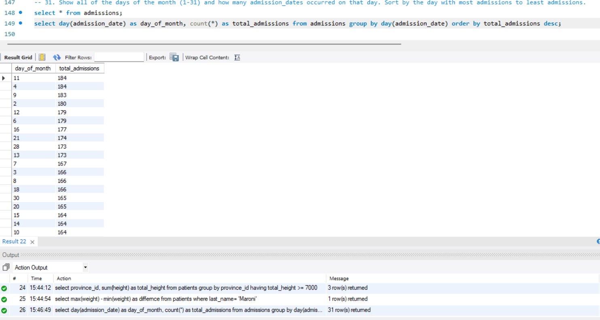

Slide 43
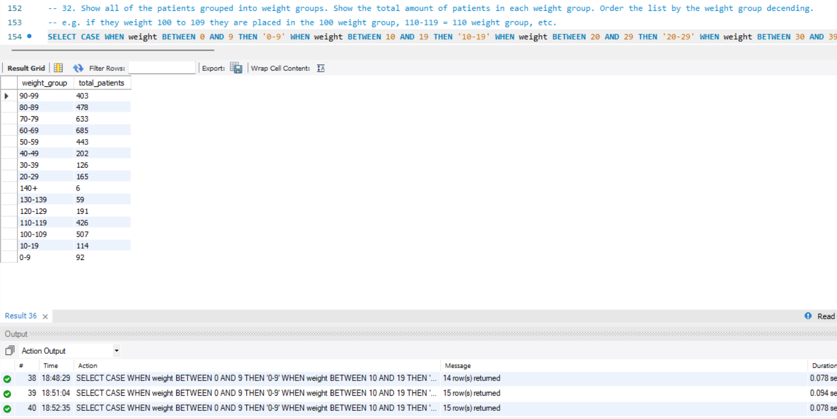

Slide 44
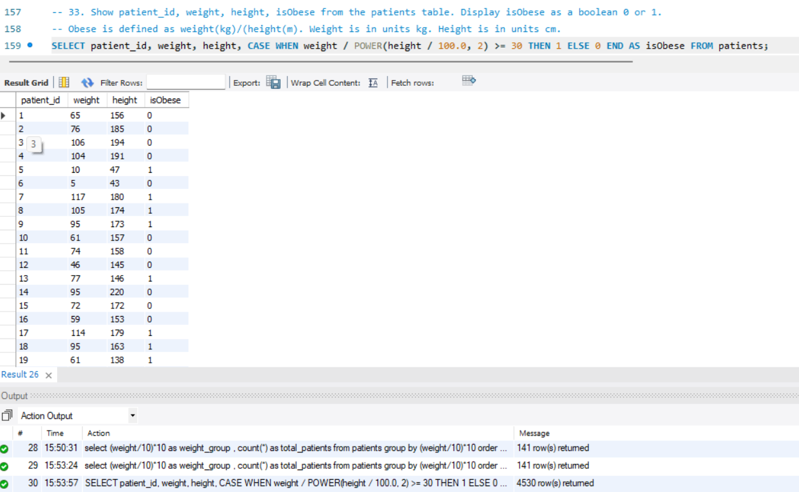

Slide 45
