Slide 1
PIP4004 - INTERNSHIP Review-1 Presentation WEB DEVELOPER - INTERN (BACKEND DEVELOPMENT)
Student Details
Name | Rushi Dave
Roll No | 20211CSE0055
Section | 8COM11
Batch No. | INTERNSHIP
Under the Supervision of,
Prof. Dr. Ruhin Kouser
School of Computer Science and Engineering
Presidency University
Name of the Program: B.Tech
Name of the HoD: Dr. Asif Mohamed H B
Name of the Program Project Guide: Prof.Dr. Ruhin Kouser

Slide 2
Content
About Company or Organization
Working domain or the technology
About your team and reporting Manager
Challenges Faced in Internship
Objectives of the work
Literature Review
Proposed System
Problem Statement
System Requirements
Advantages of Proposed System/Work
Internship Roadmap

Slide 3
About Company or Organization
PSSD Cable Tech Private Limited: Pioneering Excellence in Cable Manufacturing and Internet Services
PSSD Cable Tech Private Limited is a leading name in the cable manufacturing industry, known for its commitment to quality, innovation, and technological excellence. Specializing in the production of high-performance cables, the company caters to a wide range of industries, including telecommunications, power distribution, networking, and home automation. With a state-of-the-art manufacturing facility and stringent quality control measures, PSSD Cable Tech ensures that every product meets international standards, delivering unmatched durability, efficiency, and reliability.

Slide 4
In addition to its core manufacturing business, PSSD Cable Tech Private Limited has ventured into the Internet Service Provider (ISP) sector as a subsidiary business. Leveraging its expertise in fiber optics and networking solutions, the company offers high-speed broadband and enterprise networking services. With a focus on providing seamless internet connectivity, PSSD Cable Tech’s ISP division ensures robust infrastructure, low-latency networks, and reliable customer support, making it a preferred choice for businesses and residential users alike.
Through a combination of top-quality cable manufacturing and cutting-edge internet solutions, PSSD Cable Tech Private Limited continues to establish itself as a trusted brand in the industry. With a vision to expand its reach and enhance digital connectivity, the company remains committed to innovation, customer satisfaction, and technological advancement.

Slide 5
Working domain or the technology
My role primarily involved developing and optimizing server-side applications, database management, and API integration to support the company’s web-based platforms.
The key technologies I worked with included Node.js, Express.js, MySQL, and MongoDB, which were used to build scalable and efficient backend systems. One of the crucial aspects of my work was ensuring seamless data flow between the company’s cable manufacturing operations and its ISP services. This involved creating RESTful APIs for secure data exchange, implementing authentication mechanisms, and optimizing database queries to enhance performance.
The importance of backend development in this domain cannot be overstated. A robust backend system ensures secure transactions, real-time data processing, and smooth user experience, which is vital for both the company's internal operations and customer interactions. Additionally, backend systems play a key role in integrating IoT-based cable monitoring and ISP service management, enabling efficient tracking and automated workflows.

Slide 6
About your team and reporting Manager
During my ongoing internship at PSSD Cable Tech Private Limited as a Web Developer - Intern (Backend Development), I am part of a four-member team consisting of two backend developers, one frontend developer, and one server-side specialist. This team structure ensures efficient division of tasks, enabling seamless collaboration across different aspects of the project.
Our reporting manager is Mr. Asuthosh Shukla, who oversees our progress, assigns tasks, and provides technical guidance. He ensures that we follow best practices in development while adhering to the company’s security and operational standards.
The project we are working on is divided into four stages, each aligned with a structured timeline. This approach helps us systematically develop and implement features while maintaining efficiency and scalability. Due to the company's confidentiality norms, specific project details cannot be disclosed. However, our work involves building secure, scalable, and high-performance backend systems that integrate with PSSD Cable Tech’s existing digital infrastructure.
This experience has been instrumental in enhancing my technical skills, particularly in backend development, database management, and API integrations, while also improving my ability to collaborate effectively within a team and work on industry-level projects.

Slide 7
Challenges Faced in Internship
Setting the server up:- we got issues in running the Mariadb and MYSQL Running together
Converting the DHCP ip to static ip:- the server is maintained in house starting we have ip based op dhcp and we got our public ip while converting the local ip to public ip which allow us to add domain and dns setting and mail server to.
Configuration of Server is still on going till now problem faced are:- Node.js Server and Vult.js Server Not Running Side by side.

Slide 8
Objectives of the work
1.Development of a Client Area Backend Portal
Build a secure and efficient backend system to support a client portal where users can check their subscribed services,
recharge their plans, view available plans, monitor data usage, and check due dates and bills.
Implement billing features for additional purchases such as IP addresses, network boosters, and other value-added
services. Integrate payment gateways and automated reminders for bill payments to enhance customer experience.
Backend Development for PSSD Cable Tech’s Frontend Website
Develop a structured backend for the company's official website, which will showcase PSSD Cable Tech’s cable
manufacturing business separately from its ISP services. Enable seamless navigation, service inquiries, and
order management through dynamic APIs.
Secure and Scalable API Development
Design and implement RESTful APIs for secure communication between the frontend and backend systems.
Optimize API performance to handle real-time data updates efficiently.

Slide 9
Literature Review
Technological Framework
The internship focused on backend development with technologies including Node.js, Express.js, MySQL, and MongoDB. Contemporary literature in computer science consistently highlights these technologies for their ability to build scalable, secure, and high-performance server-side applications. Key areas of emphasis in the literature include:
RESTful API Development: Current research underscores the need for secure and efficient API design, which is critical for enabling seamless communication between client and server systems. This aligns with the internship’s objective of developing robust API integrations to support both cable manufacturing operations and ISP services.
Database Management: Studies in data management stress the importance of optimized database queries and the use of both SQL and NoSQL systems (such as MySQL and MongoDB) to handle diverse data types and workloads effectively.
Backend System Security and Scalability: Academic and industrial reports point to the necessity of secure backend architectures to protect sensitive information and support real-time data processing, both of which are central to the internship role

Slide 10
Team Dynamics and Mentorship
A notable aspect of the internship was its structured team environment. The intern worked as part of a four-member team under the supervision of a reporting manager and experienced coordinators. Literature in experiential learning and software engineering stresses that collaborative work environments enhance problem-solving skills and foster technical growth. Mentorship from experienced professionals is especially critical in guiding interns through complex project stages and in imparting best practices in development and security. This structured approach is supported by research suggesting that well-organized teams contribute significantly to both the learning outcomes and the successful implementation of technology projects.
Challenges and Learning Opportunities
At the early stage of the internship, the absence of significant challenges—attributed to the learning phase—aligns with educational models that advocate a gradual increase in project complexity. The internship roadmap, as outlined in the presentation, provides a phased approach to skill development. Literature on cognitive load and scaffolded learning supports this approach, arguing that initial low-risk environments help build confidence and foundational skills before progressing to more challenging tasks. This methodical increase in responsibility prepares interns to tackle real-world issues effectively as they advance in their careers.

Slide 11
Proposed System / Work
System Architecture:-
The system will be structured into several interconnected components:
Presentation Layer: While the primary focus is on backend development, the system will interface seamlessly with the frontend for both the client portal and the website.
Application Layer: This layer will handle core business logic using Node.js and Express.js to develop secure, RESTful APIs.
Data Layer: MySQL and MongoDB will be used for relational and NoSQL data storage, respectively, ensuring efficient data management and rapid query performance.
Key Components and Functionality:-
Client Area Backend Portal
Website Backend
API Development and Integration

Slide 12
Problem Statement
Problem Statement
PSSD Cable Tech Private Limited is at the intersection of traditional cable manufacturing and modern digital service delivery. Despite its industry-leading position, the company faces significant challenges in integrating and managing its backend systems to support its dual business operations. Specifically, the current infrastructure lacks a unified, secure, and scalable backend that can efficiently handle:
Data Integration: Seamless communication between the cable manufacturing processes and the Internet Service Provider (ISP) services is essential, yet existing systems do not adequately synchronize data across these domains.
User Interaction: The absence of a comprehensive client portal limits users' ability to access and manage subscribed services, monitor usage, and perform secure transactions.
API Management: Robust API development is needed to ensure real-time data processing, secure information exchange, and effective communication between various system components.
System Security and Performance: Ensuring secure transactions, efficient data storage, and high system performance across multiple databases (MySQL and MongoDB) remains a critical challenge.
Addressing these issues is vital for enhancing operational efficiency, improving customer experience, and enabling future technological advancements. Therefore, the proposed project aims to design and implement an integrated backend system that overcomes these challenges by establishing a secure, scalable, and efficient architecture tailored to the evolving needs of PSSD Cable Tech Private Limited.

Slide 13
System Requirements
The backend system must provide a secure, scalable, and high-performance environment to support both a client portal and the company website. The system will be built using Node.js and Express.js to develop RESTful APIs for seamless communication between the presentation layer and the data layer. User management functionalities—including registration, secure login, profile management, and password recovery—will be integrated with robust authentication and authorization mechanisms. The system must support secure payment integration by interfacing with reliable payment gateways to handle transactions, automate billing, and send payment reminders.
On the data management side, the system will employ a dual-database strategy: MySQL for structured relational data and MongoDB for flexible document storage. Both databases will be optimized for high-volume transactions and real-time data processing. To ensure data security, the system will implement encryption protocols, secure API endpoints, and regular security audits. Scalability will be addressed through a modular architecture that can dynamically adjust resources in response to increasing user loads and data volume.
In addition, the system will be designed for high availability and reliability, featuring redundancy, failover mechanisms, and routine backups. Development and maintenance will leverage version control systems like Git, with API testing facilitated by tools such as Postman or Swagger. Overall, the architecture is structured to provide a seamless integration with frontend interfaces while ensuring maintainability, performance, and adherence to industry-standard security practices.

Slide 14
Advantages of Proposed System/Work
Enhanced Security: The system employs robust authentication, authorization, and encryption measures, ensuring secure data transactions and safeguarding sensitive information throughout all interactions. This minimizes the risk of data breaches and unauthorized access.
Scalability: With a modular architecture built on Node.js and Express.js, the system can dynamically scale to accommodate increasing user loads and expanding data requirements. This design facilitates future enhancements without significant overhauls.
High Performance: Optimized RESTful APIs, coupled with efficient database management using MySQL and MongoDB, ensure low-latency responses and real-time data processing. This results in a seamless and responsive user experience, even under high-traffic conditions.
Seamless Integration: The proposed system is designed to integrate diverse functionalities—ranging from a client portal to the company website—into a unified backend. This ensures coherent data flow between different operational domains, such as cable manufacturing and ISP services.
Improved Maintainability: A well-documented, modular codebase managed via version control (e.g., Git) simplifies maintenance and future upgrades. This structured approach supports ongoing system improvements and rapid troubleshooting.
High Availability and Reliability: The system includes redundancy, failover mechanisms, and regular backups, ensuring continuous uptime and reliable performance. This is critical for mission-critical operations and customer satisfaction.
Enhanced Customer Experience: By providing secure, real-time access to service information, billing details, and transaction processing, the system significantly enhances user engagement and trust, resulting in better customer service and operational efficiency.

Slide 15
Internship Road Map
Note: Write in the below table what u will be achieving in each review
Review 0
Will be Explaining about the internship and its stages
Review 1
Will be Showing some Samples and Screenshots of work we did and what we learnt
Review 2
Will Explain about Technologies that we learnt in Depth
Review 3
Conclusion of all Review with some Insights.

Slide 16
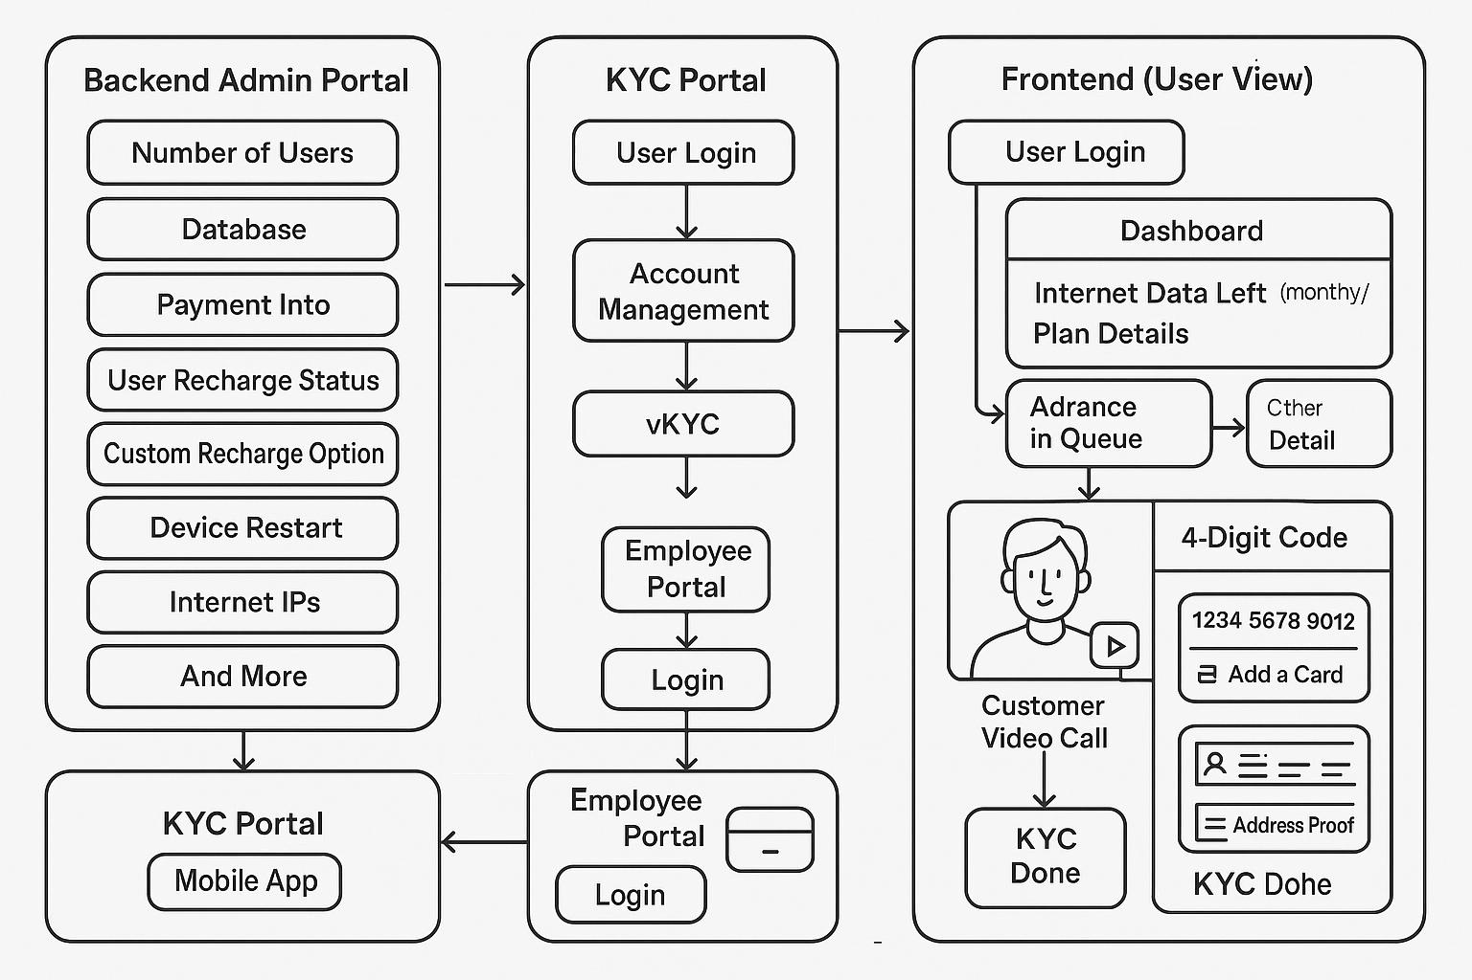
Project Flow-Chart

Slide 17
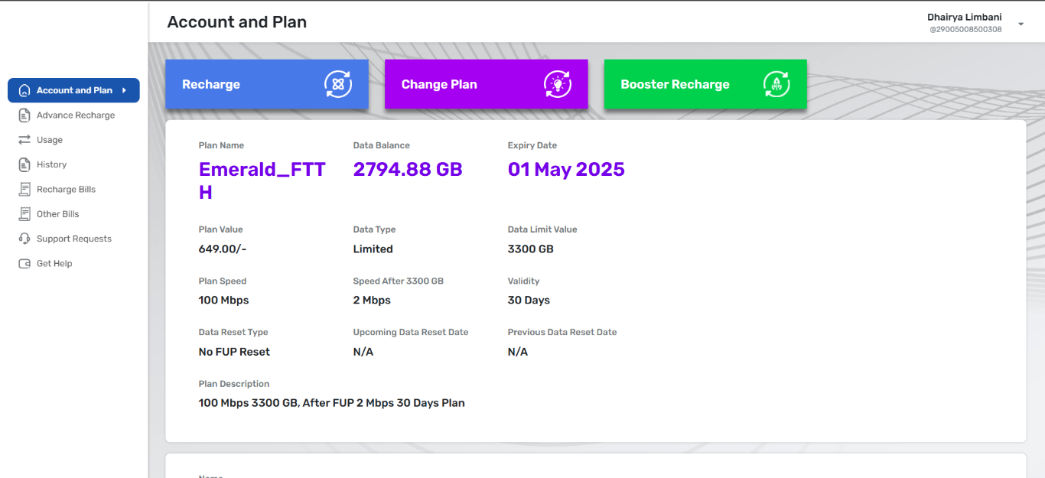

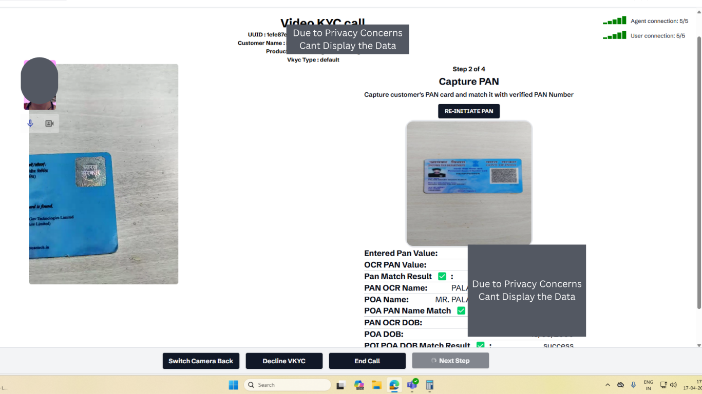
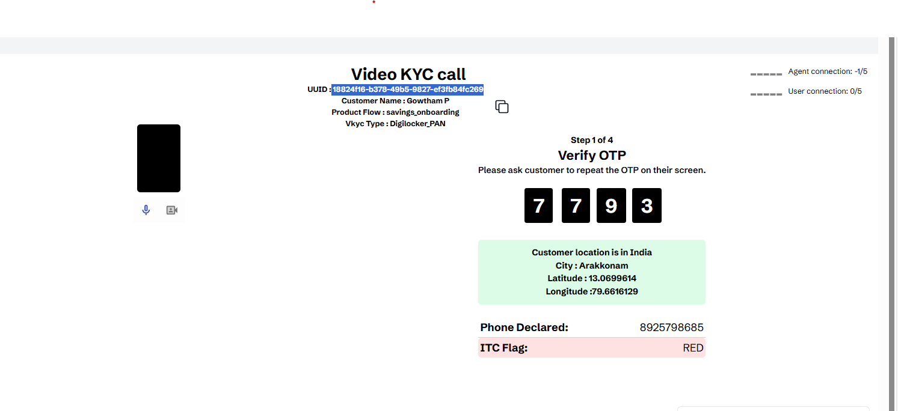
Portal Images

Slide 18
https://github.com/rushidave88/PSSD-CABLE-TECH-.git
Github Link

Slide 19
Q&A

Slide 20
Thank you !!

