Slide 1

UI Design
Of Tourism Page

Slide 2
Group members
Name
Prn Numbers
Rushikesh Giri
Rohnit kabade
Pranav Kamble
Pranav Karadage
20UCS055
20UCS062
20UCS065
20UCS070

Slide 3
Contents
Introduction
Objectives
Requirements
Methodology
Conclusion
Reference

Slide 4
Introduction
India has democratic government. As now all Indian citizens become a part of the growing digital India. They have a digital ID that is Aadhaar card. Voting schemes have evolved from counting hands in early days to systems that include paper, punch card, electronic voting machine. An electronic voting system which is used nowadays provide some characteristic different from the traditional voting technique, and also it provides improved features of voting system over traditional voting system such as accuracy, convenience, flexibility, privacy, verifiability and mobility. But Electronic voting systems suffers from various drawbacks such as time consuming, consumes large volume of paperwork, no direct role for the higher officials, damage of machines due to lack of attention, mass update doesn’t allow users to update and edit many item simultaneously etc. These drawbacks can overcome by Online Voting System. This is a voting system by which any voter can use his/her voting rights from anywhere in the country. Voter can cast their votes from anywhere in the country without visiting to voting booths, in highly secured way. That makes voting a fearless of violence and that increases the percentage of voting

Slide 5
Objectives
Increasing number of voters as individuals will find it easier and more convenient to vote.
Less effort and less labor intensive, as the primary cost and focus primary on creating, managing, and running a secure web voting portal.
The system can be used anytime and from anywhere by the Voters.
No one can cast votes on behalf of others and multiple times.
Saves time and reduces human intervention.
The system is flexible and secured to be used.
Unique Identification of voter through Aadhar number.
Improves voting with friendly Interface.
No fraud vote can be submitted

Slide 6
Requirements
Hardware :
Microsoft Windows Professional /Windows 10:
Processor: 800MHz Intel Pentium III or equivalent Memory: 512 MB
Disk space: 750 MB of free disk space
Software :
Operating System: Windows 11
Language: HTML
Database: myphpadmin
Tool: HTML and CSS, Notepad

Slide 7
Methodology
Login: - Candidate need to login with their Existing Account to start using Secure system.
Sign up :-Candidate needs to signup If they are not existing user.
Vote: - Candidate is needed to click on vote for being in voting process.
Aadhaar number: Candidate needs to write their Aadhaar number.
Vote: - Candidate is needed to click on vote for being in voting process.
Submit: -When they try to enter Aadhaar number, their credentials will be stored in our existing database.
Eligible for voting: -Candidate voted successfully.

Slide 8
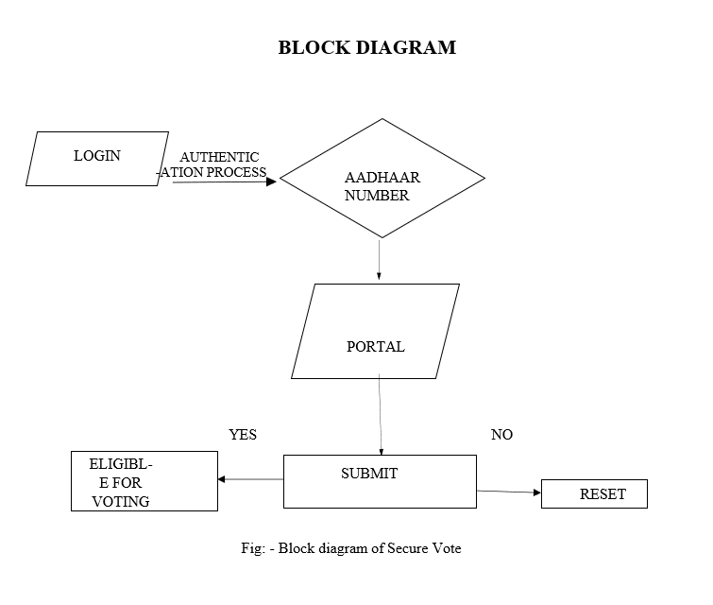
FLOW Diagram

Slide 9
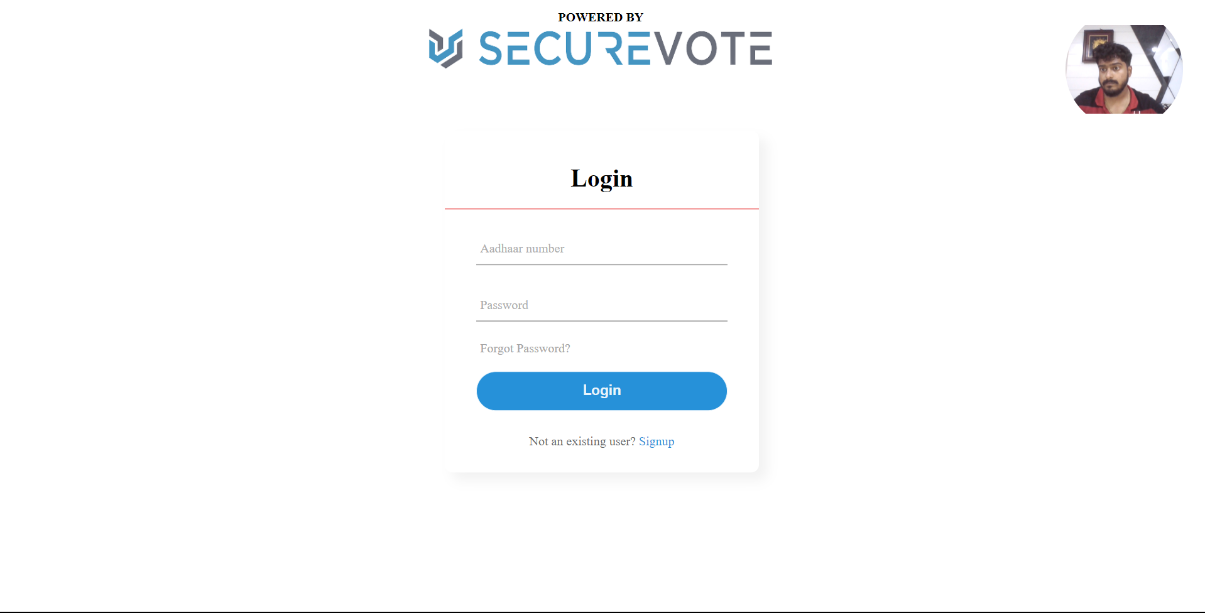
Front End
17.31 cm

Slide 10
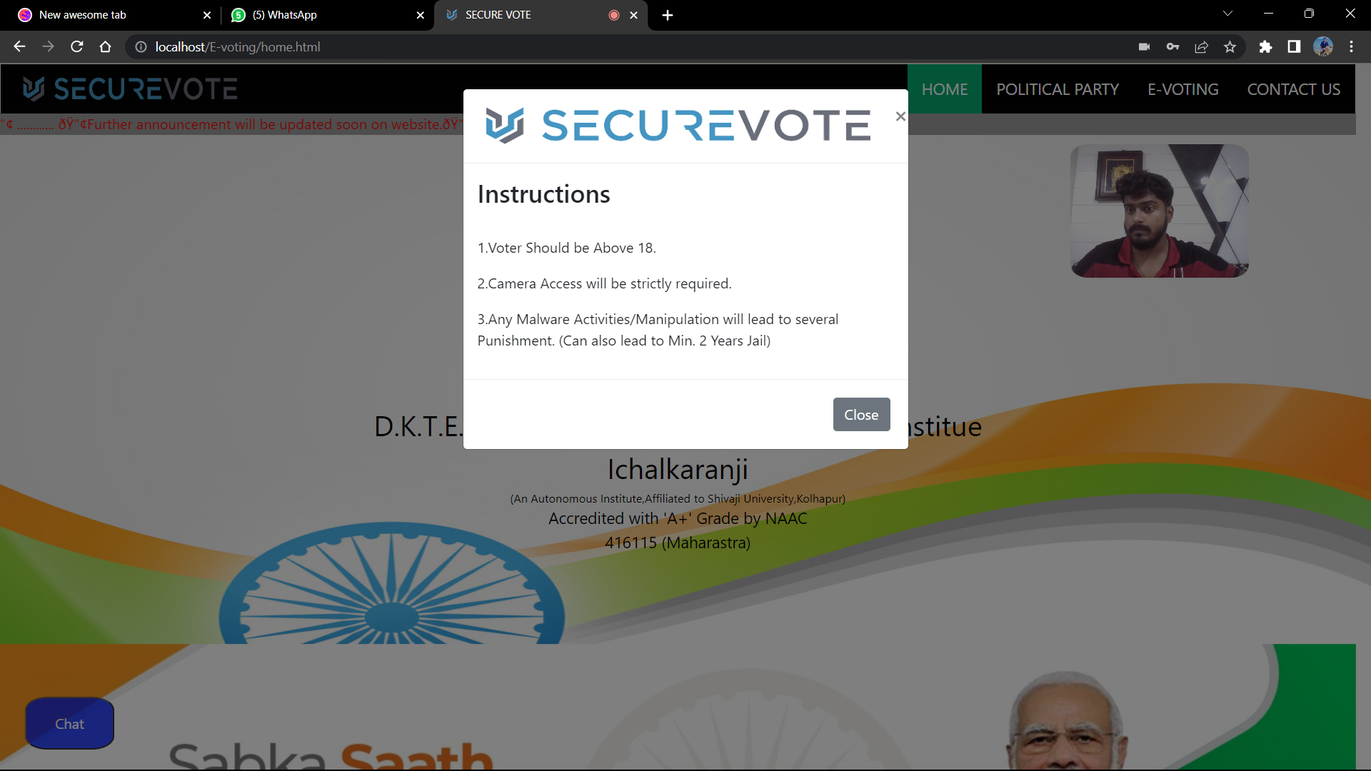
Front End

Slide 11
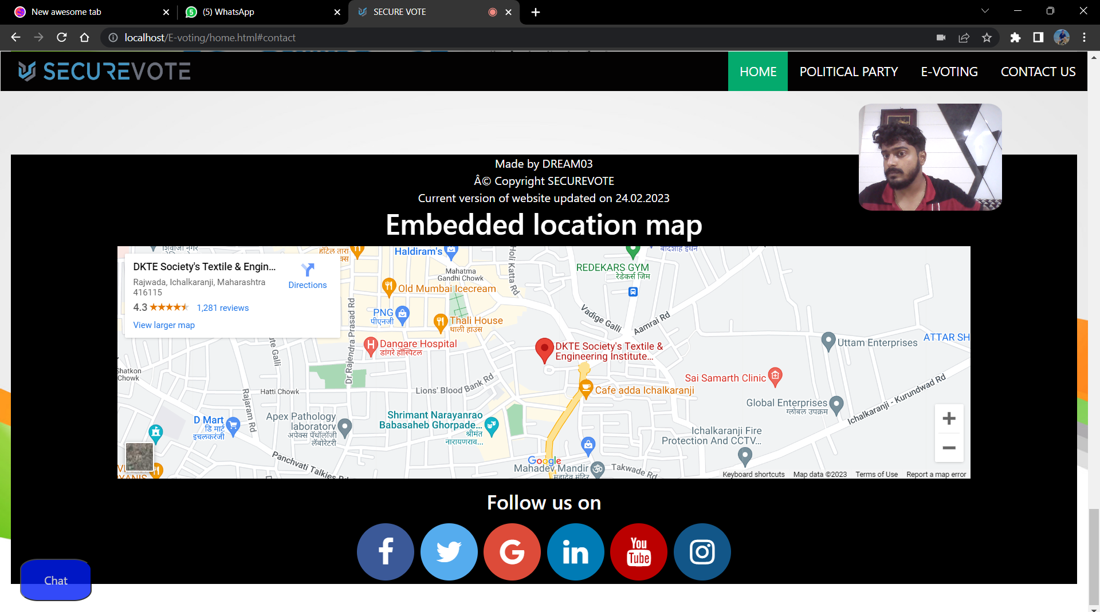
Front End

Slide 12
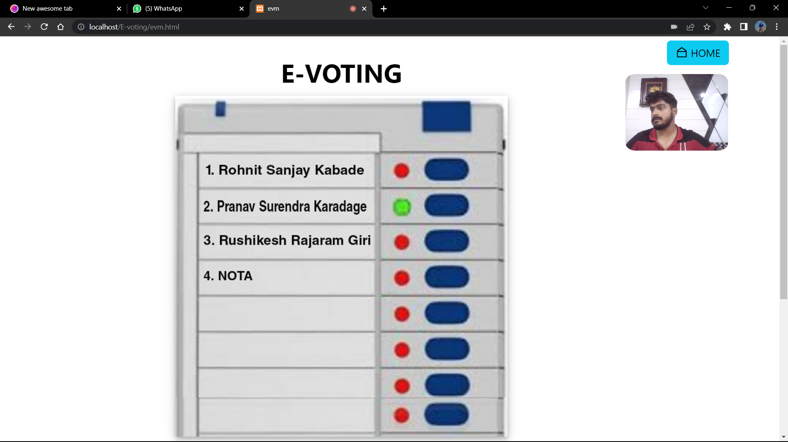
Front End

Slide 13
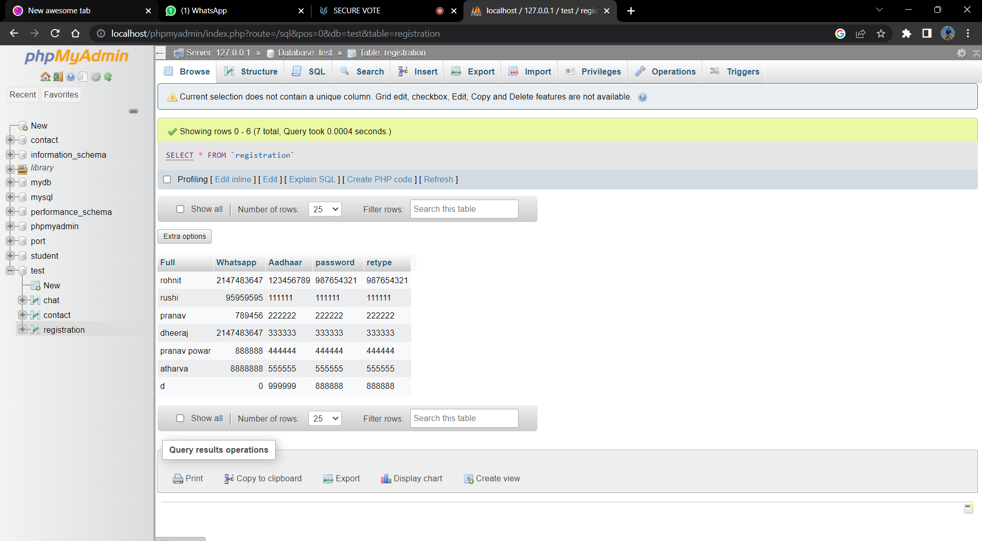
Back End

Slide 14
Conclusion
Online Voting Systems have many advantages over the traditional voting system. Some of these advantages are less cost, faster generation results, easy accessibility, accuracy, and low risk of human and mechanical errors. It is very difficult to develop online voting system which can allow security and privacy on the high level.
Future development focused to design a system which can be easy to use and will provide security and privacy of votes on acceptable level by proper authentication and processing section. It is easy to use and it is less time consuming. It is very easy to debug.

Slide 15
References
1. Design of a secured e-voting Publisher: IEEE https://ieeexplore.ieee.org/document/6521985
2. Geetanjali Rathee, Razi Iqbal(Senior Member, IEEE),Omer Waqar (Member, IEEE), and Ali Kashif Bashir, (Senior Member, IEEE)
https://www.studocu.com/in/document/jk-lakshmipat-university/computer- science-
and-engineering/on-the-design-and-implementation-of-a-blockchain-enabled-e- voting-application-within-io-t-oriented-smart-cities/27264885
This work is licensed under a creative common attribution 4.0 VOLUME 9,2021
34165
3. Government college university Faisalabad Course Information Technology Academic Year 2019/2022.IEEE.
https://www.studocu.com/in/document/government-college-university- faisalabad/information-technology/documentation-e-voting-system/31410607

