Slide 1
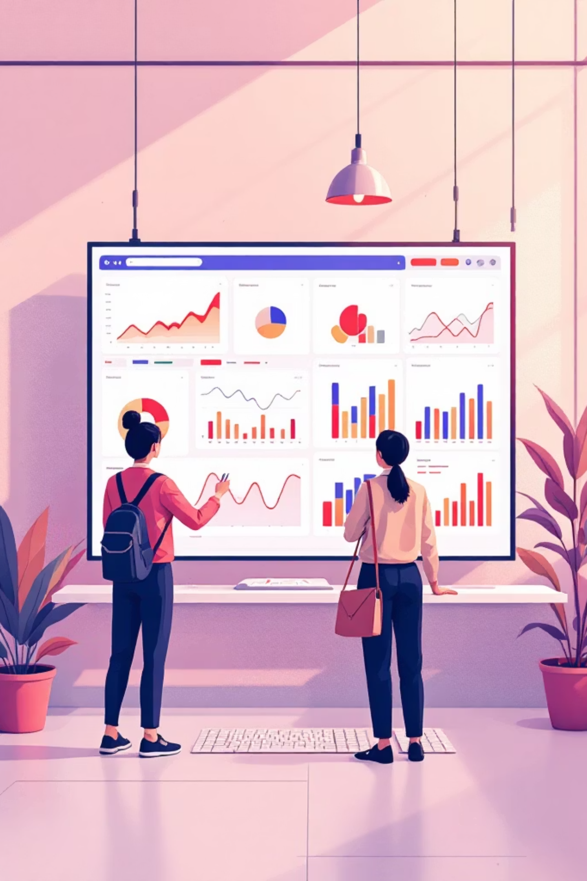
Customer Shopping Behavior Analysis
Uncovering insights from 3,900 purchases to guide strategic business decisions

Slide 2
Dataset Overview
3,900
18
37
Transactions
Features
Missing Values
Purchase records analyzed
Data columns tracked
Review ratings imputed
Customer Data
Purchase Details
Behavior Metrics
Demographics (Age, Gender, Location)
Subscription Status
Previous Purchases
Item, Category, Amount
Season, Size, Color
Shipping Type
Discount Applied
Promo Code Used
Review Rating

Slide 3
Python Data Preparation
01
02
03
Data Loading
Exploration
Cleaning
Imported dataset using pandas
Checked structure and summary statistics
Handled missing values, standardized columns
04
05
Feature Engineering
Database Integration
Created age groups and purchase frequency
Loaded to PostgreSQL for SQL analysis

Slide 4

SQL Analysis: Revenue Insights
Gender Revenue
Age Group Revenue
Male: $157,890
Female: $75,191
Young Adult: $62,143
Middle-aged: $59,197
Adult: $55,978
Senior: $55,763
Male customers generated 2.1x more revenue

Slide 5


Product Performance
Top Rated
Most Discounted
Gloves (3.86 avg)
Hat (50%)
Sandals (3.84 avg)
Sneakers (49.66%)
Boots (3.82 avg)
Coat (49.07%)
Best Sellers
Blouse (171 orders)
Jewelry (171 orders)
Pants (171 orders)

Slide 6

Shipping & Subscription Analysis
Shipping Comparison
Subscription Impact
Standard: $58.46 avg
Express: $60.48 avg
Subscribers: 1,053 customers
Non-subscribers: 2,847 customers
Express shipping customers spend 3.5% more
Non-subscribers generated 2.7x more total revenue

Slide 7

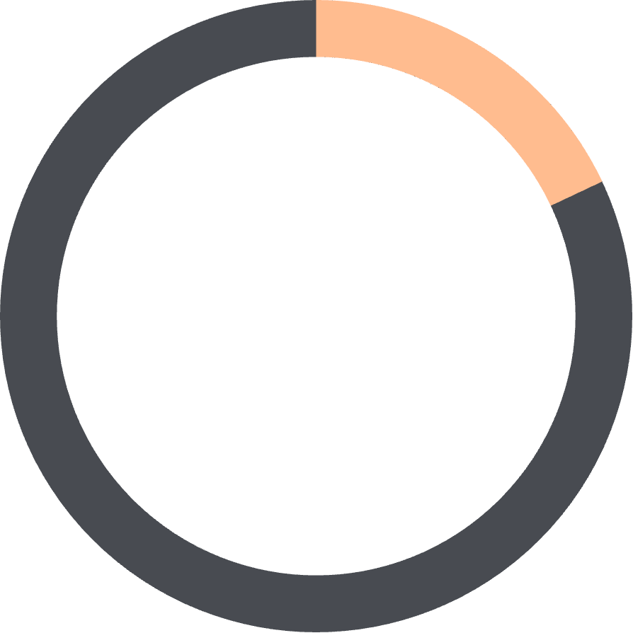

Customer Segmentation
79%
18%
2%
Loyal
Returning
New
3,116 customers
701 customers
83 customers

Slide 8
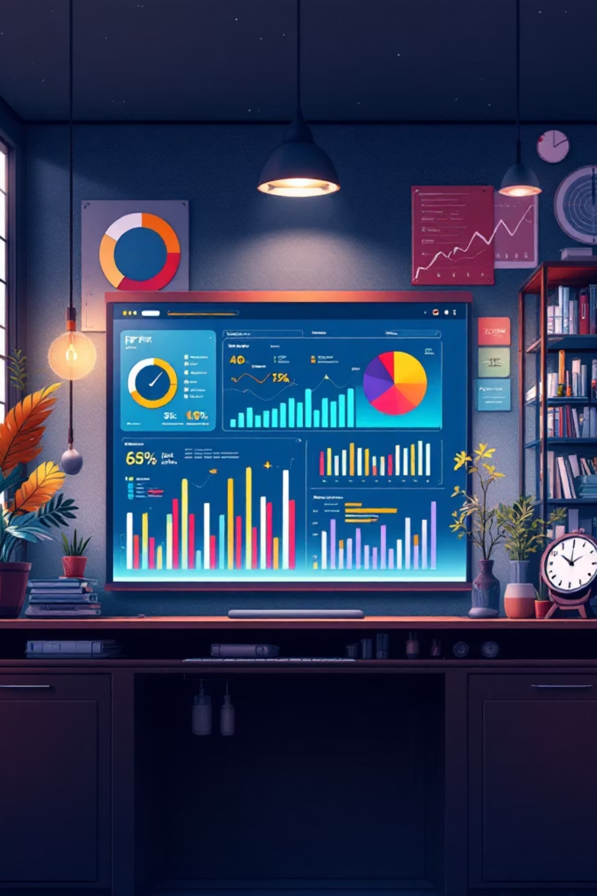
Power BI Dashboard
KPIs Tracked
3,900 customers
$59.76 avg purchase
3.75 avg review rating
Visualizations
Revenue by category
Customer demographics
Subscription status

Slide 9
Key Findings
Male customers drive 2.1x revenue vs. female
Young adults generate highest revenue ($62K)
Express shipping correlates with 3.5% higher spend
839 customers use discounts but spend above average
97% of customers are loyal or returning

Slide 10
Strategic Recommendations
Boost Subscriptions
Customer Loyalty Programs
Review Discount Policy
Promote exclusive benefits for subscribers
Reward repeat buyers to move into "Loyal" segment
Balance sales boosts with margin control
Product Positioning
Targeted Marketing
Highlight top-rated and best-selling products in campaigns
Focus on high-revenue age groups and express-shipping users

