Slide 1
Airbnb's Road to Recovery

Slide 2
Agenda
Objective
Background
Key Findings
Recommendations

Slide 3
Objective
Find the insights to understand customer preference.
Segment and profile the customer base to identify the most valuable customer segments for Airbnb's business.
Improve customer experience and Implement revenue-boosting strategies.

Slide 4
Background
The travel industry was impacted by the COVID outbreak, which had an immediate impact on Airbnb.
The COVID position has improved, and the company needs to remain stable.

Slide 5
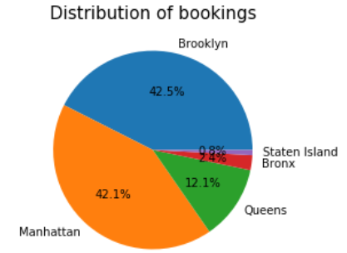
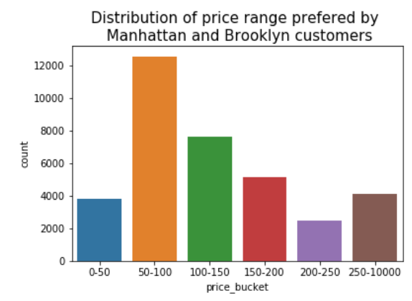
Key findings: Customers in Manhattan and Brooklyn prefer to reserve hosts whose rates range from 50 to 100.
The majority of reservations are made in Manhattan.
85.4% of all bookings are contributed by Manhattan and Brooklyn.
33% of Manhattan and Brooklyn clients prefer to reserve the host with ticket prices between 50 and 100.

Slide 6
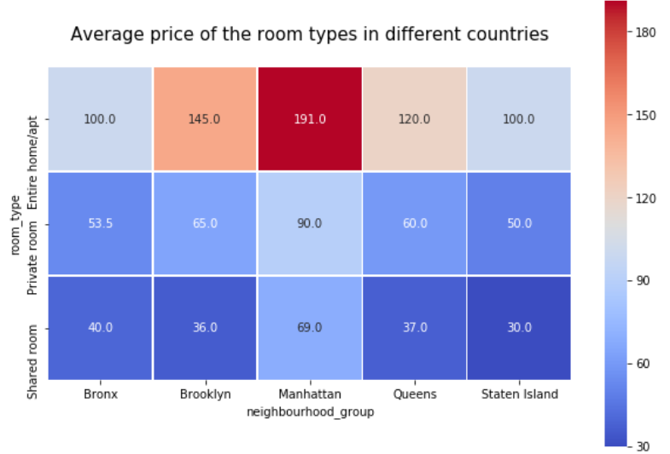
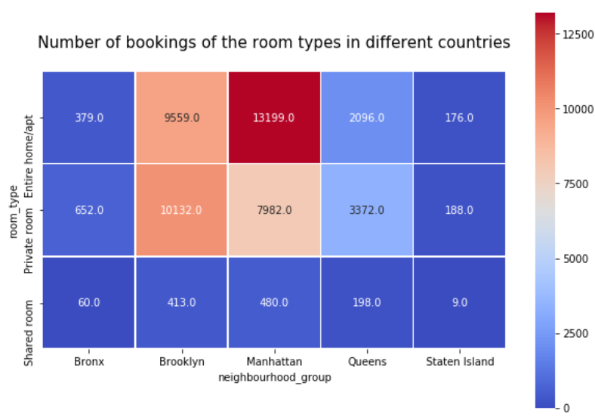
Customers from Manhattan prefers to reserve expensive hosts
The average rate for reservations in Manhattan is greater than in other neighborhood groups, and it is especially high for "Entire home/apt" room types.
Customers from Manhattan prefer to book "entire_home/apt" room types even if they are more expensive there.
Customers in Brooklyn and Queens prefer to reserve private rooms.

Slide 7
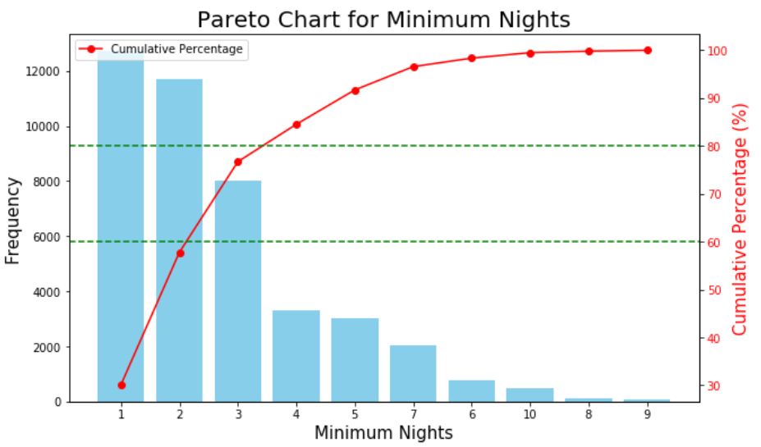
Reducing the host's required minimum nightly stay could boost business profits.
Nearly 60% of clients prefer to reserve the host for up to 2 nights.
Nearly 80% of clients prefer to reserve the host for a minimum of 3 nights.
Few visitors want to remain for longer than six nights.

Slide 8
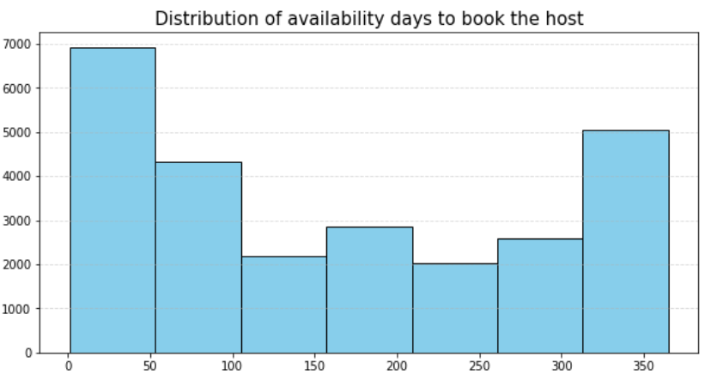
Customers tend to like hosts with up to 50 days of availability.
Customers prefer to reserve hosts who have fewer than 50 days available.

Slide 9
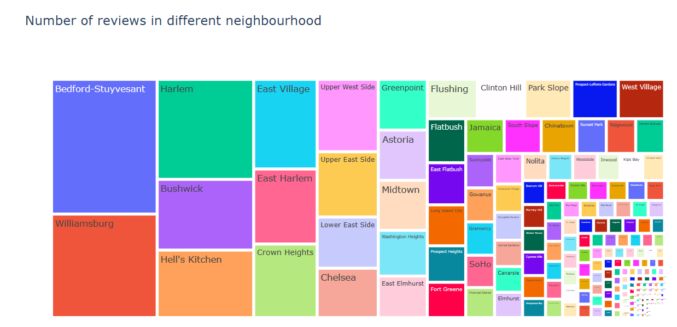
The reviews of Bedford-Stuyvesant, Williamsburg, and Harlem can be examined to better understand client expectations.
The most reviews are for Bedford-Stuyvesant.

Slide 10
Recommendation:
Focusing on growing its company in Manhattan and Brooklyn is a priority for Airbnb.
Some attractive travel packages must be developed in order to increase reservations from Queens.
Reduce the minimum number of stays to no more than three nights.

