Slide 1
Big Mountain Resort Project

Slide 2
Outline
Problem identification
Recommendation
Modeling results and analysis
Summary and conclusion

Slide 3
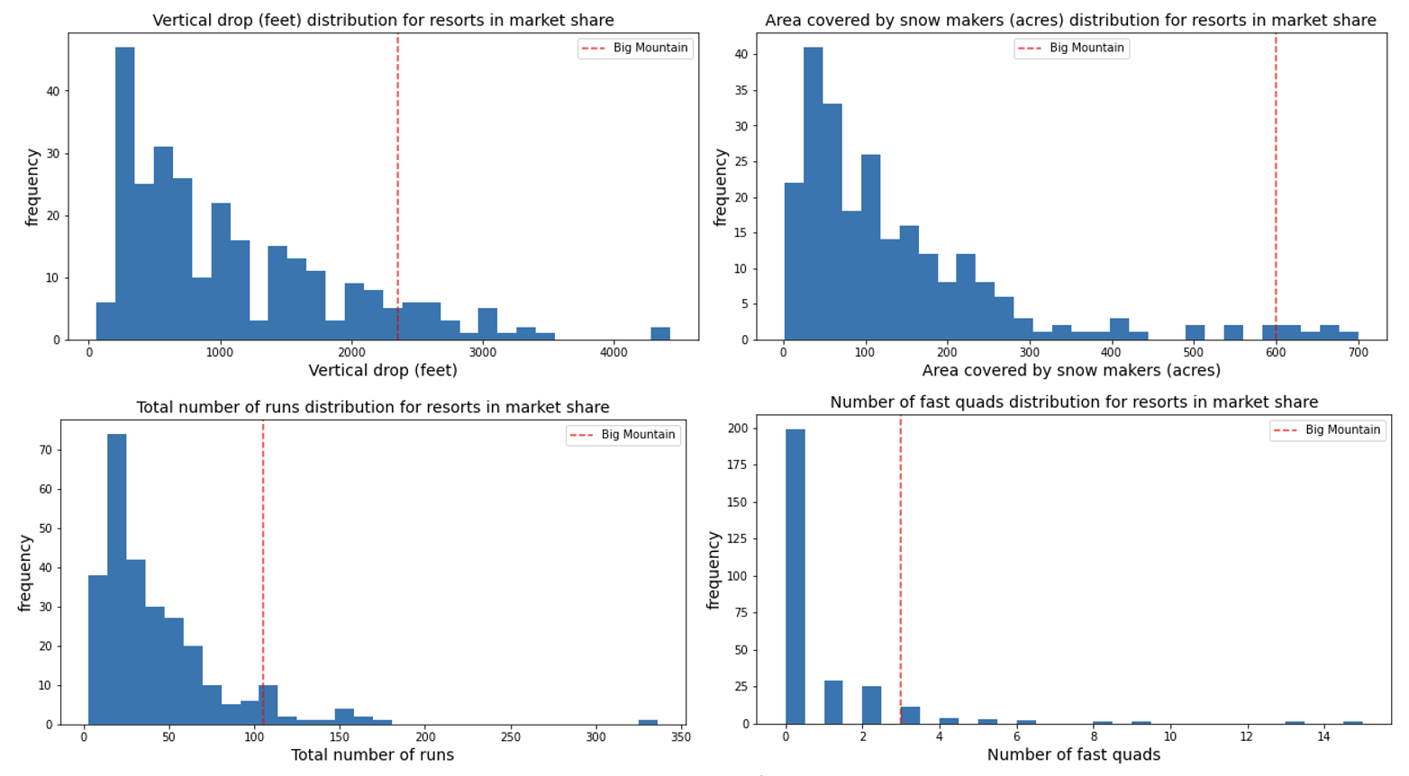
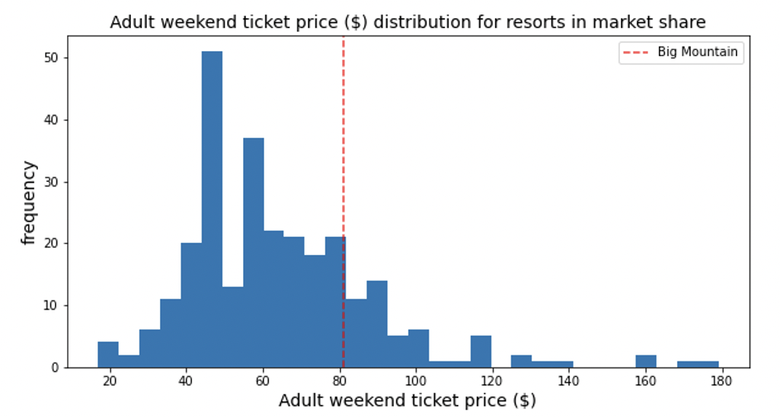
Problem Identification
Investigations to support higher ticket price
Offset additional operating costs from new facilities
Help with making business and investment decisions

Slide 4
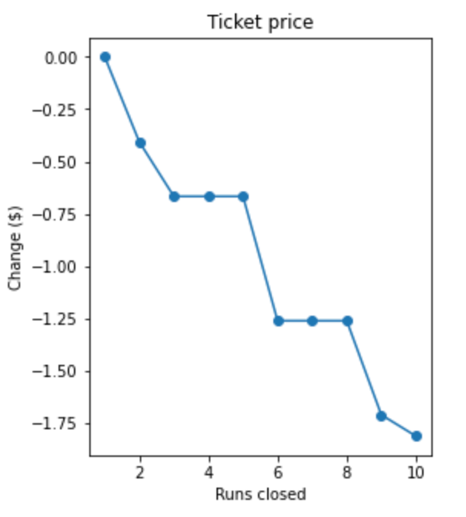
Recommendations
Increase the ticket price from current $81 to $85.34 per day per adult for the next season. This will lead to an increase in annual revenue by 5.4% ($7.6M).
Close one run which is the least popular among the visitors for next season.
Use the model to make investment decisions by running different scenarios. For example, a 150ft increase of vertical drop via a new run and a new chair, could support an increase of $1.99 in ticket price.

Slide 5
Modelling Results and Analysis
Resort Data: 330 Resorts across the US with features consisting of their location, ticket price and facilities such as runs, quads, chairs, snow making, night skiing, etc)
State Data: Population and area
The total dataset contained 277 resorts and 32 features
The target variable for modelling – Adult Weekend ticket price

Slide 6
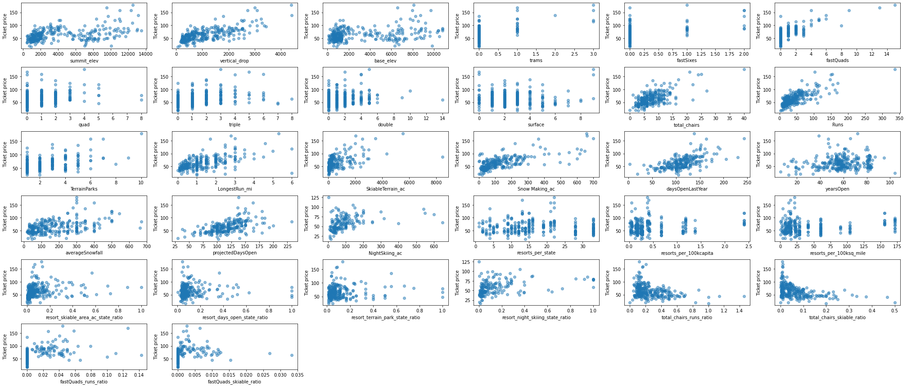
Modelling Results and Analysis
EDA

Slide 7
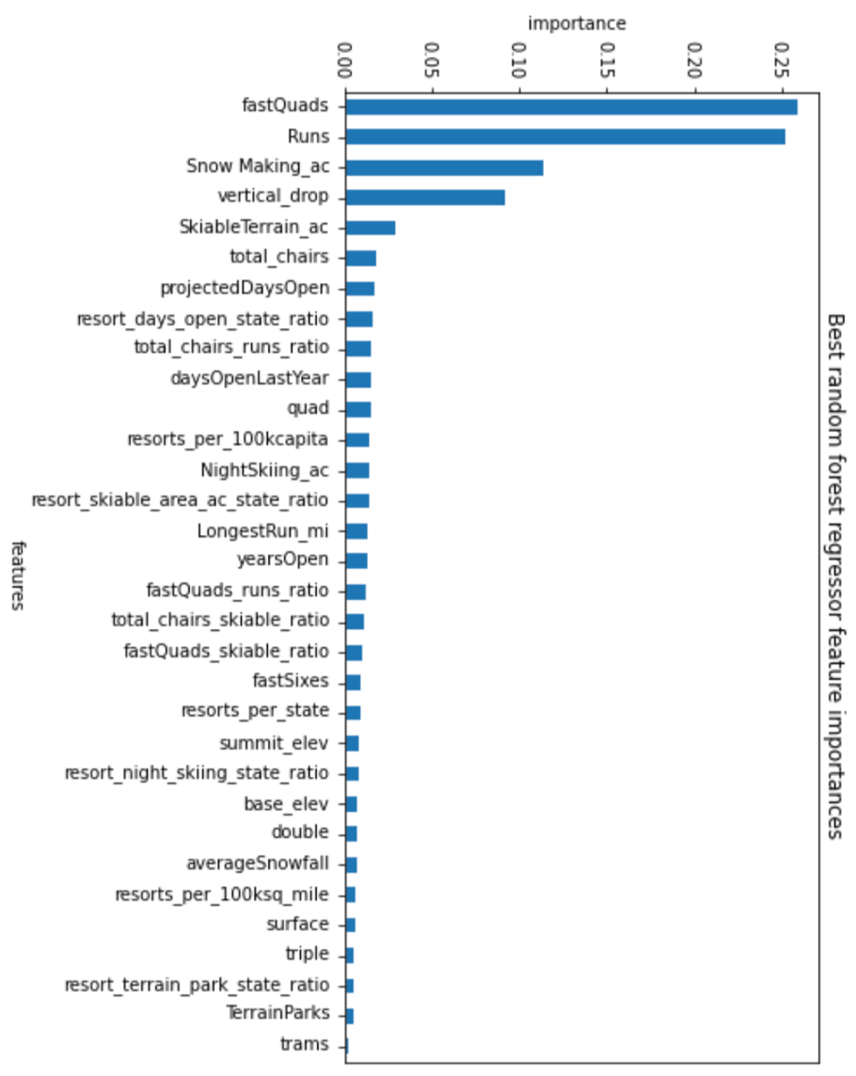
Modelling Results and Analysis
Linear regression and Random Forest regressor (RFR) models
RFR was selected due to lower mean absolute error and standard deviation
RFR mean absolute error - $10.53
RFR predicted ticket price - $95.87
Four important features: fastQuads, Runs, Snow Making_ac and Vertical drop

Slide 8
Summary and conclusion
A model to predict ticket price of skiing resort based on location and facilities.
Model can be used for running different scenario and analysis.
Facilities/features influencing the ticket price most are identified

