Slide 1
Text Mining
Rushikesh Bansode(6)
Manan Shah(41)
Aniket Dongre(17)
Shivanjay Wagh(76)

Slide 2
Introduction
Text mining (also referred to as text analytics) is an artificial intelligence (AI) technology that uses natural language processing (NLP) to transform the free (unstructured) text in documents and databases into normalized, structured data suitable for analysis or to drive machine learning (ML) algorithms.
Text mining is a relatively new area of computer science, and its use has grown as the unstructured data available continues to increase exponentially in both relevance and quantity.

Slide 3
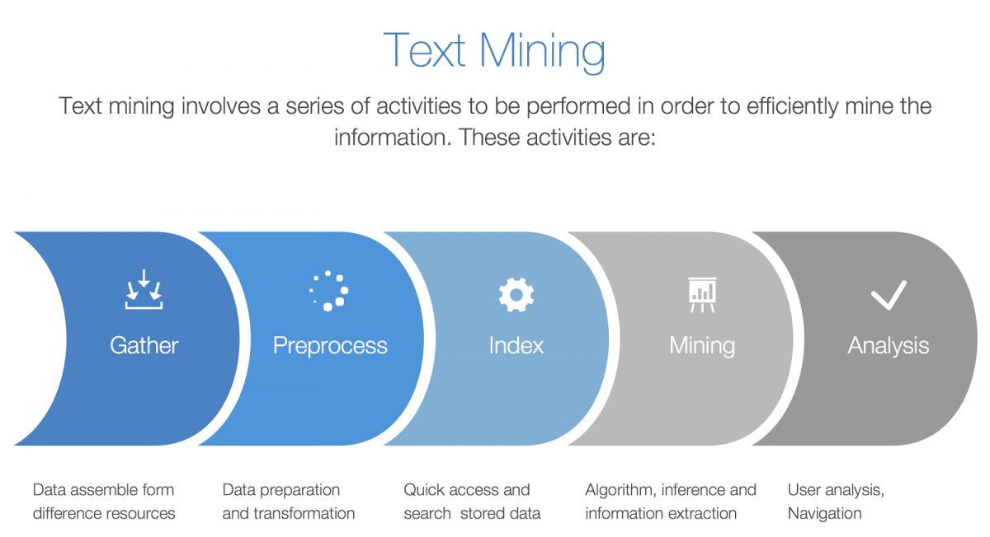

Slide 4
Advantages of Data Mining
1 .Marketing / Retail
2 .Finance / Banking
3 .Manufacturing
4 .Governments

Slide 5
Dis-advantages
1 .Privacy Issues
2 .Security issues
3 .Misuse of information/inaccurate information

Slide 6
Text Mining Techniques
Information Technique :
This is the most famous text mining technique. Information exchange refers to the process of extracting meaningful information from vast chunks of textual data.
Information Retrieval :
Information Retrieval (IR) refers to the process of extracting relevant and associated patterns based on a specific set of words or phrases.

Slide 7
3. Categorization :
This is one of those text mining techniques that is a form of “supervised” learning wherein normal language texts are assigned to a predefined set of topics depending upon their content.
4. Clustering :
Clustering is one of the most crucial text mining techniques. It seeks to identify intrinsic structures in textual information and organize them into relevant subgroups or ‘clusters’ for further analysis.
5. Summarisation :
Text summarisation refers to the process of automatically generating a compressed version of a specific text that holds valuable information for the end-user.

Slide 8
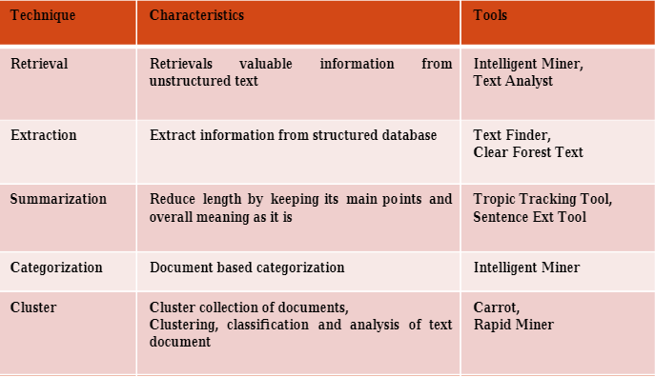

Slide 9
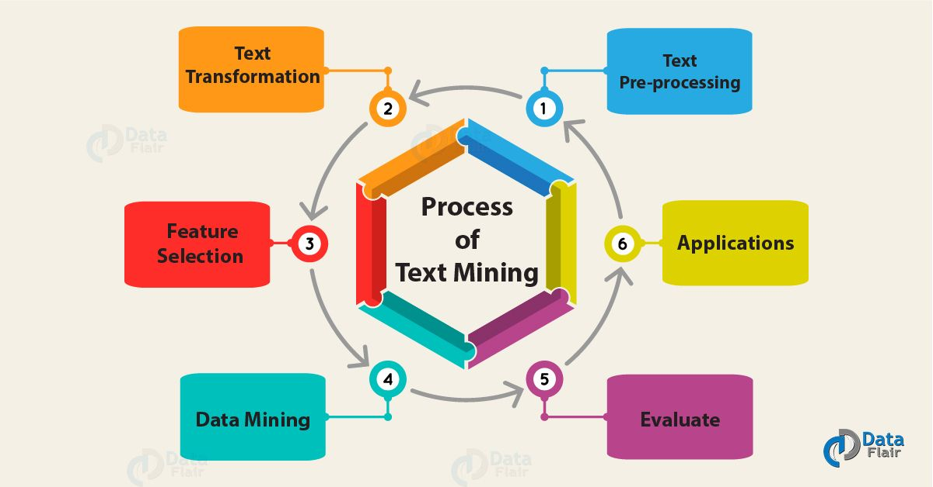
Text Mining Process

Slide 10
a.Text Pre-preprocessing
It involves a series of steps as shown in below:
Text Cleanup:-Text Cleanup means removing any unnecessary or unwanted information. Such as remove ads from web pages, normalize text converted from binary formats.
Tokenization:-Tokenizing is simply achieved by splitting the text into white spaces.
Part of Speech Tagging:-Part-of-Speech (POS) tagging means word class assignment to each token. Its input is given by the tokenized text. Taggers have to cope with unknown words (OOV problem) and ambiguous word-tag mappings.

Slide 11
b.Text Transformation (Attribute Generation)
A text document is represented by the words it contains and their occurrences.
Two main approaches to document representation are:
i. Bag of words
ii. Vector Space
c. Feature Selection (Attribute Selection)
Feature selection also is known as variable selection. It is the process of selecting a subset of important features for use in model creation. Redundant features are the one which provides no extra information. Irrelevant features provide no useful or relevant information in any context.

Slide 12
d. Data Mining
At this point, the Text mining process merges with the traditional process. Classic Data Mining techniques are used in the structured database. Also, it resulted from the previous stages.
e. Evaluate
Evaluate the result, after evaluation, the result discard.

Slide 13
Applications
1. Risk Management
One of the primary causes of failure in the business sector is the lack of proper or insufficient risk analysis.
Since text mining tools and technologies can gather relevant information from across thousands of text data sources and create links between the extracted insights, it allows companies to access the right information at the right moment
This enhances the entire risk management process.

Slide 14
4. Business Intelligence
Apart from providing profound insights into customer behavior and trends, text mining techniques also help companies to analyze the strengths and weaknesses of their rivals, thus, giving them a competitive advantage in the market.
Text mining tools such as Cogito Intelligence Platform and IBM text analytics provide insights on the performance of marketing strategies, latest customer and market trends, and so on.

Slide 15
2. Customer Care Service
Companies are investing in text analytics software to enhance their overall customer experience by accessing the textual data from varied sources such as surveys, customer feedback, and customer calls, etc.
Text analysis aims to reduce the response time of the company and help address the grievances of the customers speedily and efficiently.

Slide 16
3. Fraud Detection
Text analytics backed by text mining techniques provides a tremendous opportunity for domains that gather a majority of data in the text format.
Insurance and finance companies are harnessing this opportunity.
By combining the outcomes of text analyses with relevant structured data these companies are now able to process claims swiftly as well as to detect and prevent frauds.

