Slide 1
DIGITAL SIGNAL PROCESSING | MINI-PROJECT
Interpolation for
Smooth Reconstruction
of Sensor Signals
Submitted by
Rushikesh Gajanan Borade | PRN: 1022512003
Guide: Dr. Hrishikesh Vanjari
Third Year ECE • Division B • Semester I • Academic Year 2026–2027
Department of Electronics and Communication
School of Engineering and Technology
DES Pune University, Pune

Slide 2
01 | PROBLEM FRAMING
Why signal reconstruction matters
The problem
Study inputs
Sensors may store or transmit sparse measurements to reduce power, memory and bandwidth. Downsampling saves data, but can distort the waveform or introduce aliasing.
Synthetic signal: 1 kHz sampling, 5 Hz + 20 Hz + 50 Hz tones, with controlled noise.
Real-data validation: a short audio recording.
PROJECT OBJECTIVES
• Build a downsample–reconstruct pipeline in MATLAB.
• Compare five interpolation methods under the same test conditions.
• Identify practical downsampling factors for a target error.
• Evaluate anti-alias filtering and reconstruction quality.
• Score results with RMSE, MAE and correlation.
DSP MINI-PROJECT • DES PUNE UNIVERSITY
02

Slide 3
02 | METHOD
Methodology: one pipeline, five interpolators
1
Input signal
2
Anti-alias filter
3
Downsample
4
Reconstruct
5
Evaluate
›
›
›
›
Synthetic / audio
Optional low-pass FIR
Keep every M-th sample
Five methods
RMSE • MAE • Corr.
INTERPOLATION METHODS
Zero-order hold
Linear
Cubic spline
Repeats the previous value; staircase artefacts.
Straight-line segments; baseline method.
Smooth piecewise cubic reconstruction.
FFT (sinc)
Polyphase FIR
Spectrum zero-padding; band-limited assumption.
Efficient upsampling + anti-imaging FIR filter.
Metrics: RMSE and MAE should be lower; correlation should be closer to 1.
DSP MINI-PROJECT • DES PUNE UNIVERSITY
03

Slide 4
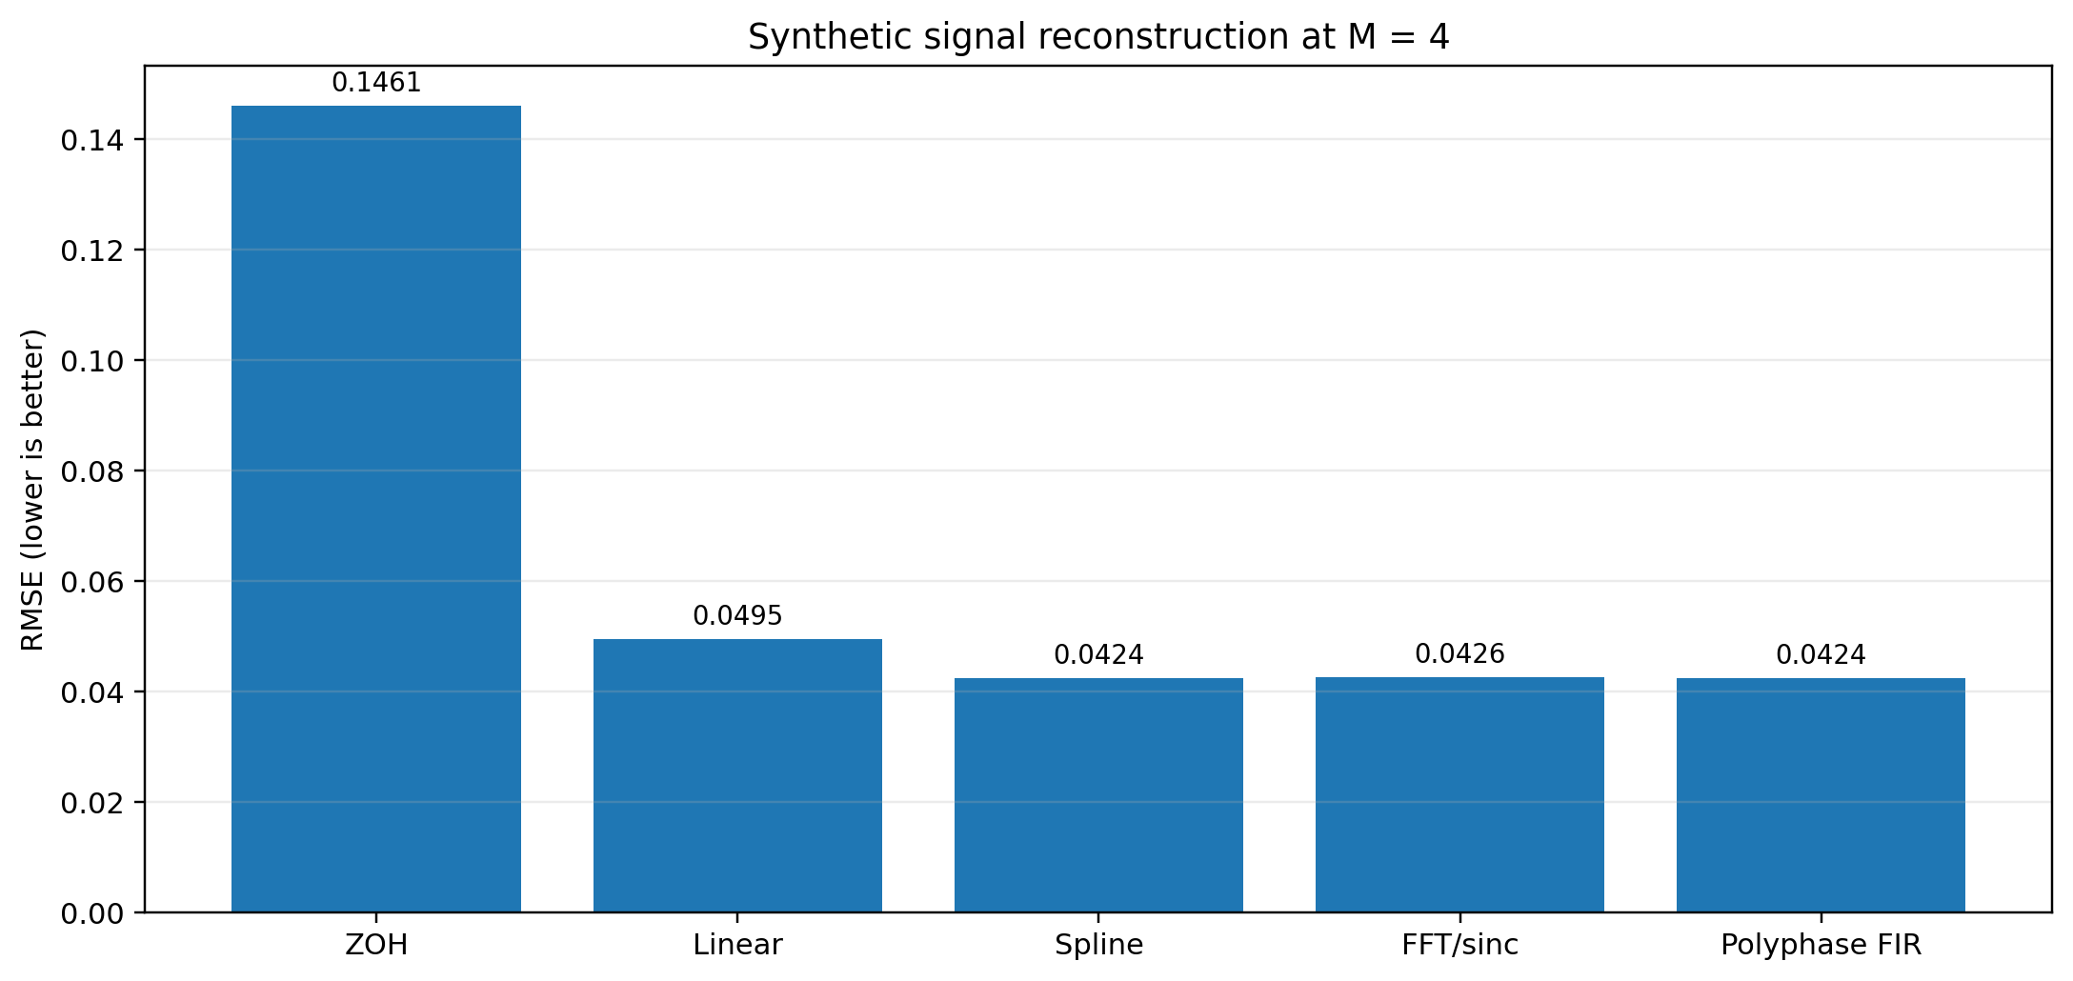
03 | RESULTS • SYNTHETIC SIGNAL
Result 1 — smooth interpolators reduce error
Best at M = 4
Polyphase FIR RMSE = 0.0424
14% lower RMSE
Polyphase FIR vs. linear baseline: 0.0424 vs. 0.0495
Least accurate
Zero-order hold RMSE = 0.1461
Spline, FFT and polyphase FIR are nearly equivalent on this noisy test.
DSP MINI-PROJECT • DES PUNE UNIVERSITY
04

Slide 5
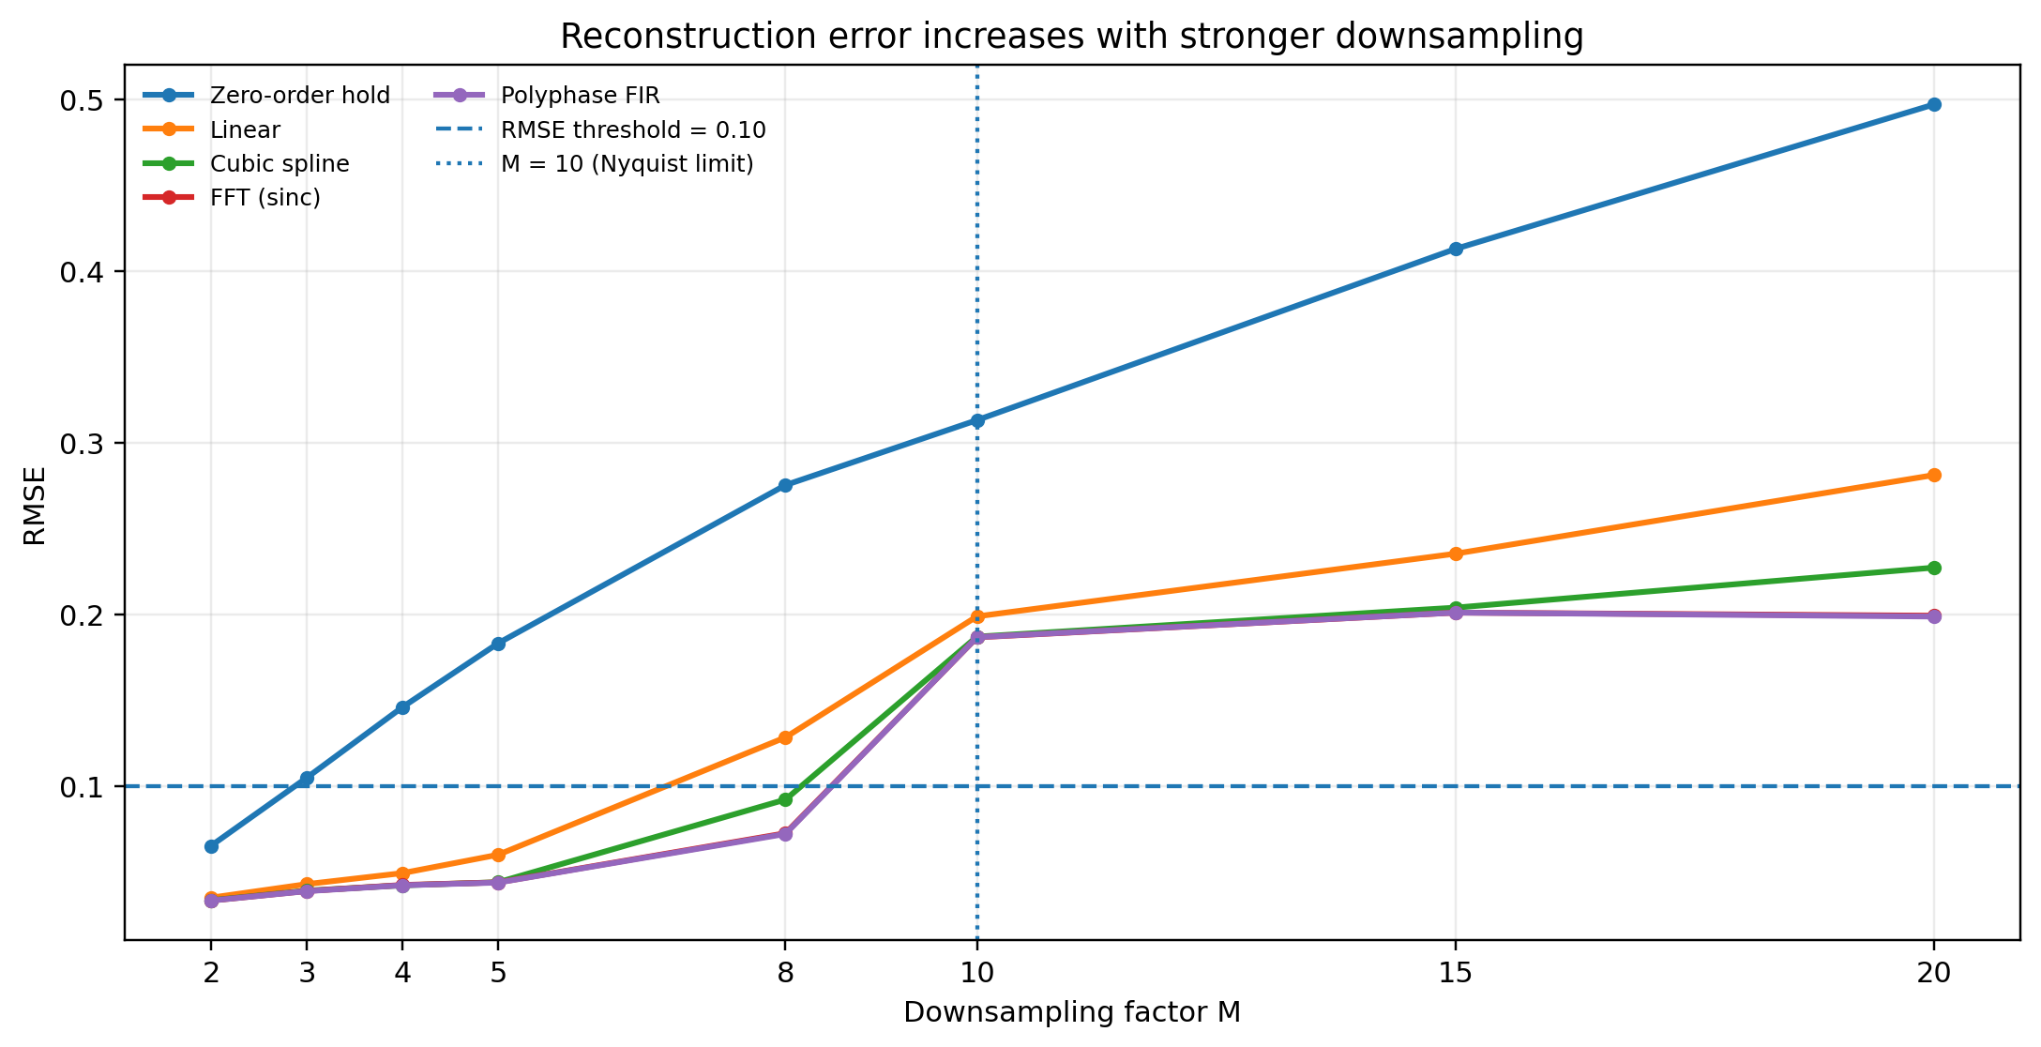
03 | RESULTS • DOWNSAMPLING FACTOR
Result 2 — error rises as data reduction increases
Practical threshold
At RMSE < 0.10, spline, FFT and polyphase FIR reach M = 8.
Nyquist warning
At M = 10, the new Nyquist frequency is 50 Hz—the highest input tone.
Recommendation
Keep fs/M comfortably above 2 × fmax; M = 8 worked for this test.
The suitable factor depends on signal bandwidth and the acceptable reconstruction error.
DSP MINI-PROJECT • DES PUNE UNIVERSITY
05

Slide 6
03 | RESULTS • ANTI-ALIASING
Filtering: useful, but not universally beneficial
RMSE comparison from the report
Method / factor | With filter | No filter
M = 4 • Linear | 0.0496 | 0.0583
M = 4 • Cubic spline | 0.0425 | 0.0573
M = 4 • Polyphase FIR | 0.0425 | 0.0591
M = 8 • Linear | 0.1286 | 0.1113
M = 8 • Cubic spline | 0.0924 | 0.0763
M = 8 • Polyphase FIR | 0.0724 | 0.0646
At M = 4
Filtering reduced error by removing out-of-band noise.
At M = 8
All three listed methods had slightly lower RMSE without the pre-filter in this experiment.
Conclusion: filter design, transition band and edge transients matter; pre-filtering is not automatically better.
DSP MINI-PROJECT • DES PUNE UNIVERSITY
06

Slide 7
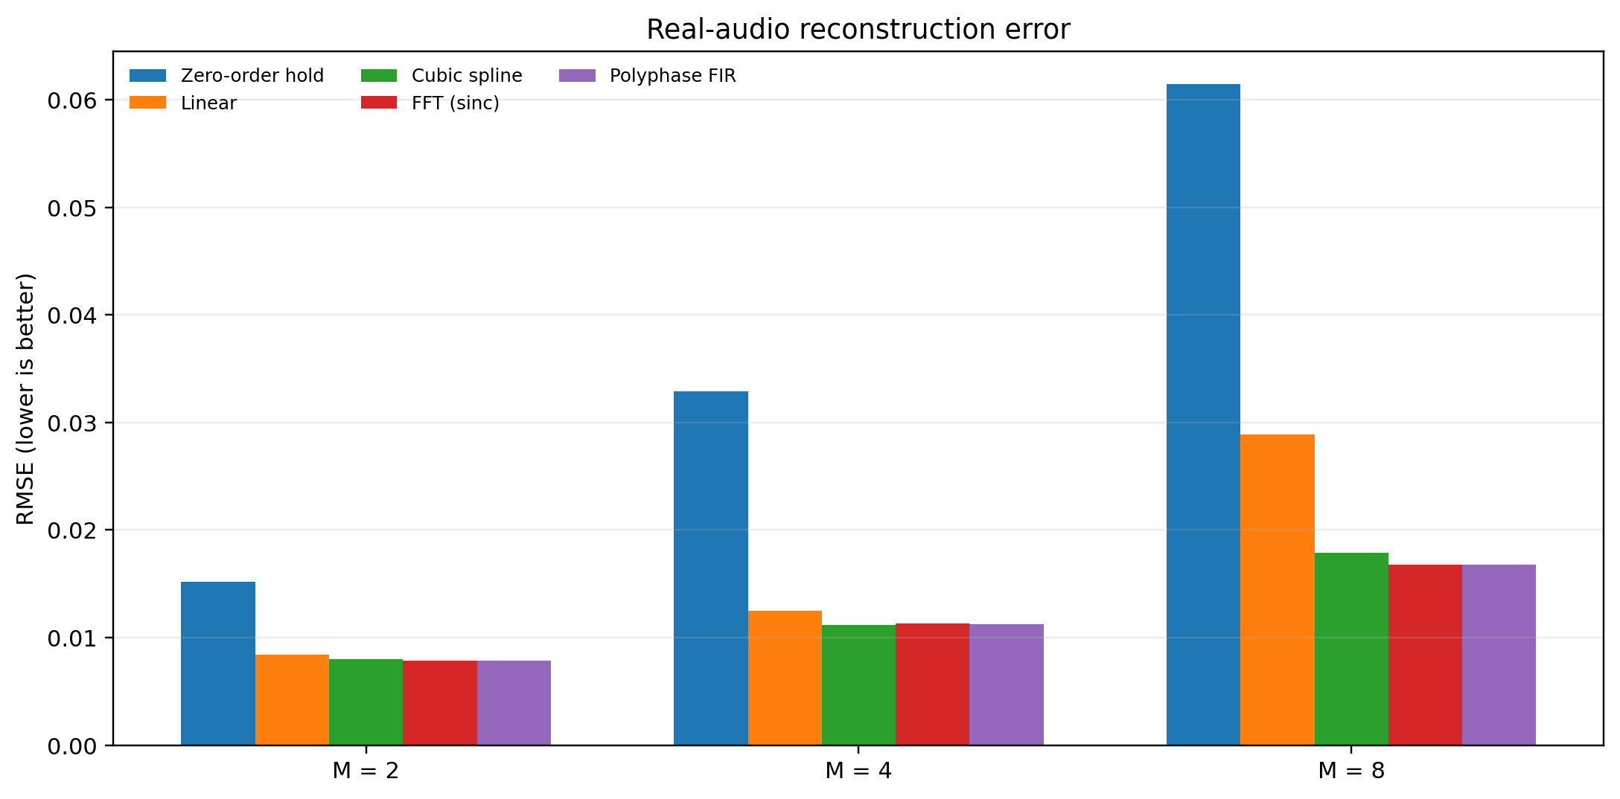
03 | RESULTS • REAL-DATA CHECK
Result 3 — real audio confirms the ranking
At M = 8
Polyphase FIR RMSE = 0.0168
42% lower RMSE
Compared with linear: 0.0168 vs. 0.0289
Shape correlation
0.983 for polyphase FIR vs. 0.967 for linear (M = 8).
Only one audio excerpt of about two seconds was tested; broader real-sensor validation remains future work.
DSP MINI-PROJECT • DES PUNE UNIVERSITY
07

Slide 8
04 | TAKEAWAYS
Conclusion and recommendations
01
Method choice
Spline, FFT and polyphase FIR were most accurate; zero-order hold was least accurate.
02
Baseline comparison
Polyphase FIR lowered RMSE by ~14% on synthetic data at M = 4 and ~42% on real audio at M = 8.
03
Sampling factor
Choose M so the reduced sampling rate stays safely above twice the highest signal frequency.
04
Filtering
Anti-alias filtering helps when out-of-band content exists, but filter design and edge effects matter.
05
Noise limitation
Noise removal creates an error floor that interpolation cannot recover.
Recommended default: polyphase FIR for quality-conscious multirate reconstruction; cubic spline for offline smooth reconstruction.
DSP MINI-PROJECT • DES PUNE UNIVERSITY
08

Slide 9
05 | SOURCES
References and project code
• R. E. Crochiere and L. R. Rabiner, Multirate Digital Signal Processing, Elsevier, 1983. https://doi.org/10.1016/0165-1684(83)90013-0
• R. W. Schafer and L. R. Rabiner, “A digital signal processing approach to interpolation,” Proceedings of the IEEE, vol. 61, no. 6, pp. 692–702, 1973.
• A. V. Oppenheim and R. W. Schafer, Discrete-Time Signal Processing, 3rd ed., Pearson, 2010.
• V. Panayotov et al., “LibriSpeech: an ASR corpus based on public domain audio books,” ICASSP 2015, pp. 5206–5210. https://www.openslr.org/12
• P. Virtanen et al., “SciPy 1.0: fundamental algorithms for scientific computing in Python,” Nature Methods, vol. 17, pp. 261–272, 2020.
• MathWorks, MATLAB Signal Processing Toolbox documentation: decimate, resample, interpft and interp1.
SOURCE CODE | GITHUB
https://github.com/rushikeshborade123/Interpolation-for-Smooth-Reconstruction-of-Sensor-Signals
Note: the report lists a PubMed reference (PMID 40534299) without complete bibliographic details; it has not been expanded here.
DSP MINI-PROJECT • DES PUNE UNIVERSITY
09

