Slide 1
STARTUP PROFIT ANALYSIS
Data Analytics Capstone Project | PRDA-01
Regression Analysis • Profit Prediction • Power BI Dashboard
Prepared by: Rushikesh Fuke

Slide 2
Problem Understanding
Project objective
• Startups need to make careful decisions about how to allocate their budgets.
• This project studies the relationship between R&D Spend, Administration, Marketing Spend, and Profit.
• Regression is used to estimate profit for two spending combinations supplied in the project.
• Power BI visuals are used to compare profit performance and derive recommendations.

Slide 3
Dataset & Source
Dataset extracted using SQL from the database provided by DataMites
50 observations
5 main fields
Source workflow
DataMites Database → SQL Query → CSV Export → Excel Regression → Power BI Dashboard
• R&D Spend
• Administration
• Marketing Spend
• State
• Profit

Slide 4
Methodology
• Extracted the dataset from the provided SQL database.
• Reviewed the data and used Excel for multiple linear regression.
• Examined R Square, coefficients, and p-values to interpret the model.
• Calculated profit predictions for the two required input combinations.
• Built a Power BI dashboard with KPI cards, state comparisons, and a state slicer.

Slide 5
Regression Model Results
Excel multiple linear regression | 50 observations
R Square
Adjusted R²
95.07%
94.75%
Multiple R
Standard Error
0.9751
9,232.33
The model explains about 95.07% of the variation in profit in this dataset.

Slide 6
Regression Coefficients & Interpretation
Variable | Coefficient | P-value | Interpretation
R&D Spend | 0.805715 | 0.0000 | Positive; statistically significant
Administration | -0.026816 | 0.601755 | Not significant at 5%
Marketing Spend | 0.027228 | 0.104717 | Not significant at 5%
R&D Spend is the only spending variable with a statistically significant relationship with profit at the 5% level in this model. This does not prove causation.

Slide 7
Profit Prediction
Predictions for the two input combinations specified in the project
Input | R&D Spend | Administration | Marketing Spend | Predicted Profit
1 | 21,892.92 | 81,910.77 | 164,270.70 | 70,034.27
2 | 23,940.93 | 96,489.63 | 137,001.10 | 70,551.16
These are model estimates, not guaranteed actual profits.

Slide 8
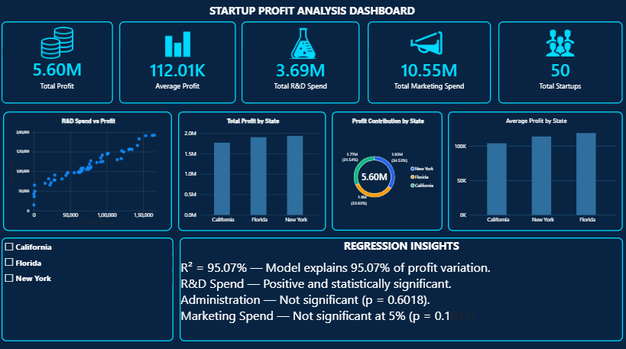
Power BI Dashboard
Dashboard screenshot from the project

Slide 9
Key Insights
• The regression model has R Square of 95.07%, indicating a strong fit for this dataset.
• R&D Spend has a positive, statistically significant relationship with Profit.
• Administration and Marketing Spend are not significant at the 5% level.
• The dashboard enables comparison of total and average profit across the three states.
• Predicted profits for the two supplied inputs are approximately 70,034.27 and 70,551.16.

Slide 10
Recommendations
• Evaluate R&D investments carefully because of the positive significant relationship found in the model.
• Monitor administrative expenses and review operational efficiency.
• Evaluate marketing activities using campaign results and return on investment rather than assuming higher spend always increases profit.
• Compare state-level performance before making location or expansion decisions.
• Use the model as a planning aid and validate predictions against future actual results.

Slide 11
Conclusion
PRDA-01 | Thank you
• Excel regression and Power BI visualization were used to analyze startup profit data.
• The model explains approximately 95.07% of profit variation in the 50-row dataset.
• R&D Spend was the only statistically significant spending factor at the 5% level.
• The dashboard presents the results in a clear, interactive way to support business review.

