Slide 1

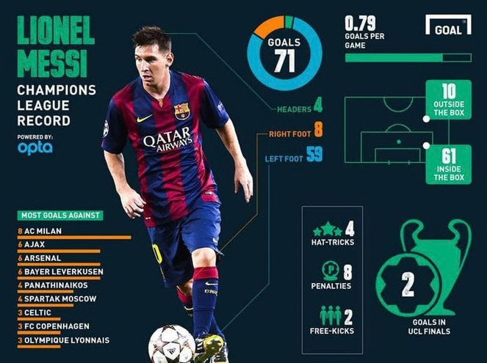
MACHINE LEARNING MINI PROJECT
Regression
Football Player Performance Analysis Using Machine Learning
predict a performance score
Classification
label players High / Low
A Practical Application of Regression, Classification and Clustering
Clustering
discover player groups
1
Notes:
Hello everyone. Our project is Football Player Performance Analysis Using Machine Learning. We use football statistics as real data to practise three ML ideas: regression, classification and clustering.
1

Slide 2
Problem & Motivation
Why football data, and why machine learning
01
A lot of data
02
Hard to analyse by hand
A single match is recorded as thousands of events: passes, shots, tackles.
Comparing hundreds of players across many statistics manually is slow and subjective.
03
ML learns patterns
04
A good learning domain
Models can learn how statistics relate to performance and group similar players.
Real, numeric, tabular data: ideal for practising regression, classification and clustering.
Football in one line: players' actions are recorded as statistics. We simply treat them as ordinary numeric data for ML.
Football Player Performance Analysis Using Machine Learning
2
Notes:
Football produces a huge amount of data, and comparing players by hand is hard. ML can find patterns in that data. Football is only our practice domain: the statistics are just numbers.
2

Slide 3
Project Objectives
Three objectives, three ML tasks
1
SUPERVISED
2
SUPERVISED
3
UNSUPERVISED
Predict performance
Classify High / Low
Discover player groups
Use regression to predict a player performance score from match statistics.
Turn the score into two classes and predict whether a player is High or Low performing.
Group players with similar statistics. No labels are given.
Linear Regression · Random Forest
Logistic Regression · Decision Tree
K-Means
Main goal: learn and demonstrate ML concepts through a practical problem.
Football Player Performance Analysis Using Machine Learning
3
Notes:
Three objectives. One: predict a performance score with regression. Two: classify players as High or Low. Three: find player groups with clustering. The main goal is learning ML concepts, not building a scouting product.
3

Slide 4
Dataset & Features
Raw football data becomes one row per player
Dataset
Public football data, e.g. StatsBomb Open Data or a player-statistics CSV
Player Statistics
One row per player: counts and rates
ML Features
Numeric columns the models learn from
FROM EVENTS TO PLAYER ROWS
PLAYER-LEVEL COLUMNS
Player | Event | Outcome
Player A | Pass | complete
Player A | Shot | goal
Player B | Tackle | won
Player A | Pass | complete
Goals
builds the target
Assists
builds the target
Minutes played
per-90 rates + filter
Shots
feature
Passes
feature
Pass accuracy
feature
count events per player
Player | Goals | Passes | Tackles
Player A | 1 | 2 | 0
Player B | 0 | 0 | 1
Tackles
feature
Interceptions
feature
Tiny illustrative example, not real data
Goals and assists build the target, so they are not used as inputs. This avoids target leakage.
Football Player Performance Analysis Using Machine Learning
4
Notes:
We start from public football data. Raw events are counted per player, which gives one row per player. Shots, passes, pass accuracy, tackles and interceptions are the features. Goals and assists are used to build the target, so we keep them out of the inputs to avoid leakage.
4

Slide 5
ML Workflow
One simple pipeline used for all three tasks
1
2
3
4
5
6
7
Data
Cleaning
Features
Train / Test
ML Models
Evaluation
Insights
Load public football statistics
Handle missing values, remove duplicates, filter low-minute players
Select stats, compute per-90 rates, build the target
Split rows 80% / 20% to test on unseen players
Regression, classification, K-Means. Scale only where needed
MAE · RMSE · R² · Precision · Recall · F1 · Silhouette
Compare models, read feature importance, interpret clusters
Regression
Linear Regression · Random Forest
Classification
Logistic Regression · Decision Tree
Clustering
K-Means
Scaling is needed for Logistic Regression and K-Means. Decision Tree and Random Forest do not need it.
Football Player Performance Analysis Using Machine Learning
5
Notes:
This is our workflow. Data, cleaning, features, train-test split, models, evaluation, insights. The same steps apply to regression, classification and clustering. Scaling is applied only where an algorithm needs it.
5

Slide 6
Regression: Linear Regression vs Random Forest
Which model performs better is decided by test-set metrics (to be evaluated)
Input features
Shots · Passes · Pass accuracy · Tackles · Interceptions
Model
Linear Regression or Random Forest
Predicted Performance Score
project-defined, not an official rating
Linear Regression
Random Forest Regression
  Fits a straight-line relationship
  Coefficients show each feature's effect
  Simple, easy-to-explain baseline
  Many decision trees, predictions averaged
  Can capture non-linear patterns
  Gives feature importance
MAE average size of the error
RMSE like MAE, but large errors count more
R² share of the variation the model explains
Football Player Performance Analysis Using Machine Learning
6
Notes:
For regression we compare two models. Linear Regression fits a straight-line relationship and is easy to explain. Random Forest averages many trees and can capture non-linear patterns. We judge them with MAE, RMSE and R-squared on the test set. Which one wins is still to be evaluated.
6

Slide 7
Classification: Logistic Regression vs Decision Tree
Which model performs better is decided by test-set metrics (to be evaluated)
Performance Score
Above the threshold?
e.g. the median score
High performance = 1
Both models predict this label from the same input features.
Low performance = 0
Logistic Regression
Decision Tree
Confusion Matrix
feature ≤ value ?
Pred. High
Pred. Low
Actual High
TP
FN
Low
High
Actual Low
FP
TN
  Outputs a probability (0 to 1)
  Above 0.5 means High
  Needs scaled inputs
  Splits data with simple rules
  Easy to visualise
  No scaling needed
Precision = TP / (TP + FP)
Recall = TP / (TP + FN)
F1 = balance of both
Compared using Accuracy, Precision, Recall, F1-score and the Confusion Matrix (to be evaluated).
Football Player Performance Analysis Using Machine Learning
7
Notes:
For classification we turn the score into two classes: High is 1 and Low is 0. Logistic Regression gives a probability. A Decision Tree uses simple if-then rules. We compare them with the confusion matrix, precision, recall and F1. Results are to be evaluated.
7

Slide 8
Clustering: K-Means
Unsupervised learning: no labels, the algorithm finds the groups
Player statistics
per-90 numbers, scaled
Clusters
K groups found by K-Means
Different statistical profiles
interpreted afterwards
HOW K-MEANS WORKS
PLAYER GROUPS (ILLUSTRATIVE)
CHOOSING K
1
Choose K and place K centroids
2
Assign each player to the nearest centroid (distance)
K
3
Move each centroid to the mean of its players
Elbow method: pick K where the curve bends.
Silhouette score: closer to 1 means players sit well inside their own cluster.
4
Repeat until nothing changes
Rings mark centroids. Features are scaled first, because K-Means uses distance.
Clusters are discovered by the algorithm and interpreted afterwards. We do not decide the groups in advance.
Football Player Performance Analysis Using Machine Learning
8
Notes:
K-Means is unsupervised. It places K centroids, assigns each player to the nearest one, moves the centroids, and repeats. We pick K with the elbow method and silhouette score. The picture is illustrative. We interpret the clusters after the algorithm finds them.
8

Slide 9
Expected Output / Application
What the final notebook (or a simple Streamlit demo) will show
WHAT THE NOTEBOOK WILL PRODUCE
ILLUSTRATIVE OUTPUT
  Predictions and High / Low labels for each player
  Model comparison tables
  Confusion matrix and feature-importance charts
  Cluster scatter plot and elbow curve
Player A
Predicted Performance
X.XX
Category
High / Low
Model | Metrics (Expected / To be evaluated)
Linear Regression | MAE · RMSE · R²: to be evaluated
Random Forest | MAE · RMSE · R²: to be evaluated
Logistic Regression | Accuracy · Precision · Recall · F1: to be evaluated
Decision Tree | Accuracy · Precision · Recall · F1: to be evaluated
K-Means | Elbow · Silhouette: to be evaluated
Cluster
Cluster 2
Important features
Shots · Passes · Pass accuracy
Illustrative output: actual values will be generated after training.
Football Player Performance Analysis Using Machine Learning
9
Notes:
This is what the finished project will show for a player: a predicted score, a High or Low label, a cluster, and the features that mattered. The card is illustrative only. All numbers are to be evaluated after we train the models.
9

Slide 10
Conclusion & Future Scope
CONCLUSION
FUTURE SCOPE
1
Demonstrates supervised and unsupervised ML on one dataset
XGBoost
SVM
2
Compares simple ML algorithms with appropriate metrics
PCA
Advanced scouting similarity
3
Turns football statistics into predictions, labels and player groups
Larger datasets
Real-time analytics
4
Gives practical understanding of the full ML workflow
Depth over breadth: five algorithms, each properly understood.
Thank you. Questions?
Football Player Performance Analysis Using Machine Learning
10
Notes:
To conclude: we use one football dataset to show regression, classification and clustering, compare simple algorithms with the right metrics, and understand the whole ML workflow. Future work could add XGBoost, SVM, PCA and larger datasets. Thank you.
10

