Slide 1
ALTERA AGILEX 7 + TEXAS INSTRUMENTS AFE7950
Discrete RFIC + FPGA
DRA Architecture
Ku-band uplink & downlink with JESD204C interconnect
9x Agilex 7 | 18x AFE7950 | Separate RX / TX clusters
Alternative to Direct-RF SoC: RF sampling in TI RFIC, beamforming/PHY in Agilex 7

Slide 2
SYSTEM OVERVIEW
Split roles: RFIC converts, FPGA computes
Same 32/40 beam DRA map as the Direct-RF option — different silicon partition
TI AFE7950 RFIC
4 TX + 4 RX (+2 feedback)
12 GSPS DAC / 3 GSPS ADC
Integrated DUC / DDC / NCO / DSA
RF coverage to 12 GHz
JESD204B/C Subclass-1
Space path: AFE7950-SP
Altera Agilex 7
Digital beamforming network
UL channelizer / PHY framer
DVB-RCS2 / DVB-S2X / NTN
High-speed SerDes (JESD)
HPS control & telemetry
Cluster phase / SYSREF sync
Slot model
1x Agilex 7 + 2x AFE7950
8 RF channels per slot
RX: 4 slots (32 beams)
TX: 5 slots (40 beams)
Shared LO / SYSREF tree
Router fabric between sides

Slide 3
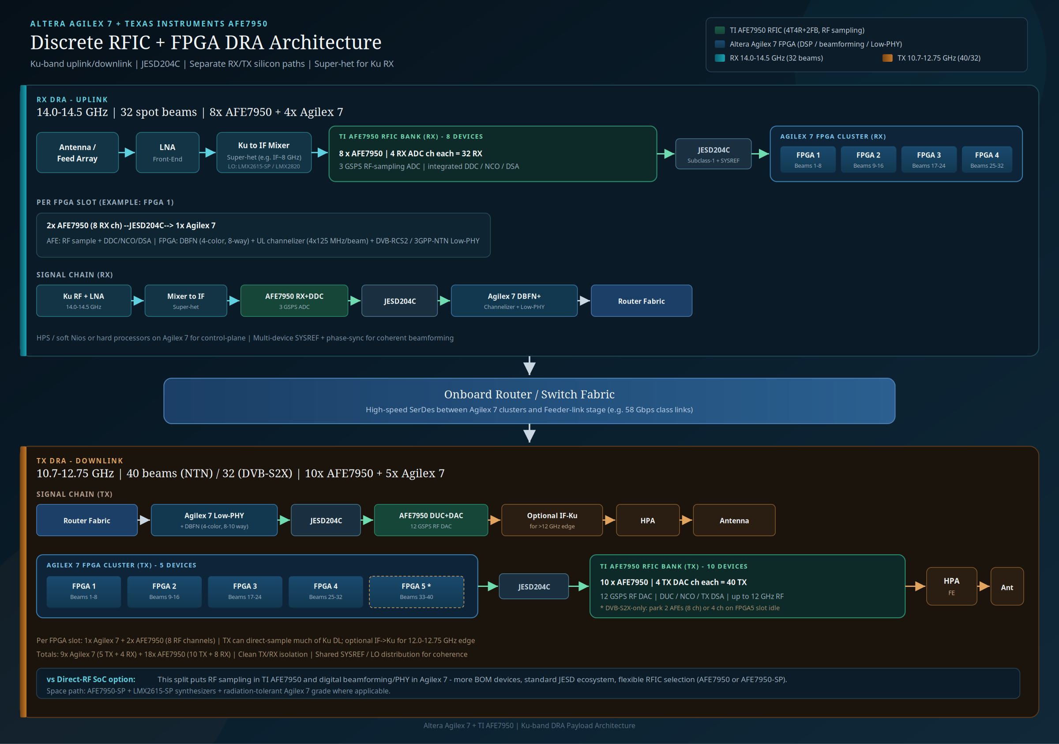

Slide 4
RX UPLINK
14.0–14.5 GHz · 32 beams · Super-het into AFE
Antenna → LNA → Ku→IF mixer → 8× AFE7950 → JESD204C → 4× Agilex 7
FPGA 1
2× AFE · Beams 1–8
FPGA 2
2× AFE · Beams 9–16
FPGA 3
2× AFE · Beams 17–24
FPGA 4
2× AFE · Beams 25–32
Why super-het on RX?
AFE7950 RF input tops out near 12 GHz
Ku uplink (14.0–14.5) mixes to IF (~8 GHz class)
LO from LMX2615-SP / LMX2820
AFE handles ADC + DDC/NCO/DSA
Agilex 7 runs DBFN + channelizer + Low-PHY
FPGA DSP (per slot)
Digital beamforming: 4-color reuse
8-way spatial reuse
UL channelizer: 4 × 125 MHz / beam
Handoff: DVB-RCS2 / 3GPP-NTN Low-PHY
Egress to onboard router fabric

Slide 5
TX DOWNLINK
10.7–12.75 GHz · 40 / 32 beams · RF DAC + optional upconvert
5× Agilex 7 → JESD204C → 10× AFE7950 → HPA → Antenna
FPGA 1
Beams 1–8
FPGA 2
Beams 9–16
FPGA 3
Beams 17–24
FPGA 4
Beams 25–32
FPGA 5 *
Beams 33–40
RF transmit path
AFE7950 12 GSPS DAC covers much of Ku DL
Direct RF TX up to ~12 GHz
Optional IF→Ku for 12.0–12.75 GHz edge
TX DSA + external HPA front-end
* DVB-S2X-only: idle beams 33–40
FPGA DSP (per slot)
DVB-S2X / 3GPP-NTN Low-PHY framer
DBFN: 4-color · 8–10 way spatial
Baseband / IQ to AFE over JESD204C
AFE integrates DUC + RF DAC
2× AFE7950 = 8 DAC channels / slot

Slide 6
INTERCONNECT & SYNC
JESD204C, SYSREF, and fabric
JESD204C
Subclass-1 deterministic latency
AFE7950 ↔ Agilex 7 SerDes
8b/10b or 64b/66b modes
Per-slot multi-lane links
Scales with channel BW
Coherent array
Shared SYSREF distribution
Common LO / sample clock tree
LMX2615-SP or LMX2820
Multi-device phase alignment
Required for DBFN spatial reuse
Router fabric
Bridges RX Low-PHY → TX framer
Feeder-link stage attach
58 Gbps-class SerDes links
Keeps RX/TX clusters isolated
Control plane via FPGA HPS

Slide 7
ARCHITECTURE COMPARISON
Direct-RF SoC vs Agilex 7 + TI RFIC
Aspect | Direct-RF SoC (AGRW) | Agilex 7 + AFE7950
RF conversion | On-chip Direct-RF ADC/DAC | TI AFE7950 RFIC
Digital DSP | Same device as converters | Agilex 7 FPGA
RX @ 14 GHz | 1st Nyquist Direct-RF | Ku→IF super-het + AFE
TX @ Ku DL | Direct-RF DAC | RF DAC (+ opt. upconvert)
Interconnect | On-chip / SerDes fabric | JESD204C + fabric
Device count | 9 RF SoCs | 9 FPGA + 18 RFIC
Flexibility | Integrated density | Multi-vendor / SP grade

Slide 8
BOM SNAPSHOT
Conservative separate TX/RX path
Item | Qty | Notes
Agilex 7 (RX) | 4 | 8 beams each via 2× AFE
Agilex 7 (TX) | 5 | FPGA 5 optional in DVB-S2X
AFE7950 (RX) | 8 | 4 RX ch × 8 = 32
AFE7950 (TX) | 10 | 4 TX ch × 10 = 40
LMX2615-SP / LMX2820 | Cluster | LO + SYSREF distribution
Ku→IF mixers (RX) | 32 paths | Super-het front-end
HPA / LNA FE | Array | Per-beam RF front-end

Slide 9
SUMMARY
Agilex 7 digital fabric
meets TI RF sampling
32-beam Ku UL (super-het) + 40/32-beam Ku DL
JESD204C slot model: 1 FPGA + 2 AFE7950 = 8 channels
Space-ready path via AFE7950-SP + LMX2615-SP

