Slide 1


TECHNICAL PROPOSAL
Cisco 128G Fibre Channel
Agilex™ 7 M-Series AGM039 · Package R47
FC128
8 × 112G
16 × 58G
8 × 58G
AGM039
Fibre Channel
Client side
System side
Secondary
R47 package
Single-chip 8-port 128GFC datapath: FHT client SerDes to 116G PAM4,
FGT system fabric at 58G PAM4 — with Altera Search IP (TCAM / BCAM / MBL) classify ahead of the gearbox.
Altera Confidential · Cisco FC128 Proposal · AGM039 R47
1 / 10

Slide 2
Agenda
Proposal contents
Cisco FC128 on Agilex 7 M039 R47
01
Requirements & fit
Stated I/O plan vs device resources
02
128GFC primer
FC-PI-8 signaling, FEC, optics
03
Architecture
Client → Search IP → gearbox → system
04
Search IP / TCAM
Altera TCAM, BCAM, MBL for classify
05
Package options
R47A / R47B / R47C selection guide
06
Engagement plan
Align → PoC → Pilot → Production
Altera Confidential · Cisco FC128 Proposal · AGM039 R47
2 / 10

Slide 3
Requirements · Device Fit
Stated requirements map to AGM039 R47
Client 112G on FHT · System 58G on FGT
Domain | Channels | Rate | Role | Tile resource
Client (line) | 8 | 112G PAM4 | 8 × 128GFC ports | FHT (to 116G PAM4)
System (primary) | 16 | 58G PAM4 | Cisco ASIC / fabric | FGT (to 58G PAM4)
System (secondary) | 8 | 58G | Protect / debug / expand | FGT or FHT @ 58G
~897.6 Gbps
~928 Gbps
~3% headroom
~464 Gbps
Client aggregate
8 × 112.2G
System primary
16 × 58G
Primary path
FEC / PCS margin
Secondary bank
8 × 58G spare
Altera Confidential · Cisco FC128 Proposal · AGM039 R47
3 / 10

Slide 4
Technology · 128GFC
Fibre Channel 128G (FC-PI-8)
PAM4 at 112.2 Gbps — mandatory FEC — SFP112 optics
Physical layer essentials
Why FHT covers the client
Marketing name: 128GFC
Line rate: 112.2 Gbps PAM4 (56.1 GBd)
Nominal throughput: ~12.4 GB/s per lane
Mandatory RS-FEC on every link
Electrical + optical both PAM4 (CDR in module)
Typical optics: SFP112 SR / LI / LW
Backward compatible ~2 generations (64/32GFC)
Agilex 7 F-Tile FHT rated to 116 Gbps PAM4
128GFC needs 112.2 Gbps — within FHT envelope
FGT at 58G PAM4 matches system chip-to-chip
Hardened RS/KP FEC blocks available in F-Tile
Soft logic implements FC framing & BB_Credit
CMIS path for modern SFP112 module manageability
Altera Confidential · Cisco FC128 Proposal · AGM039 R47
4 / 10

Slide 5
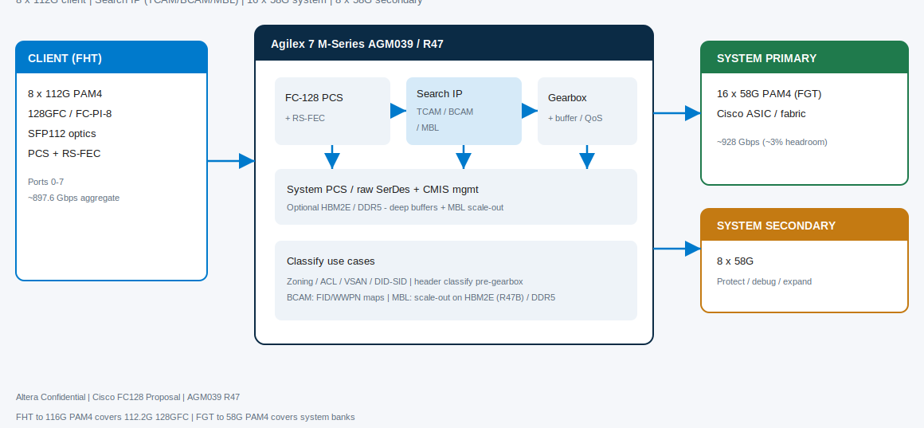
Architecture · Datapath
8×112G client ↔ 16×58G system gearbox
AGM039 soft logic + F-Tile SerDes · Search IP ahead of gearbox
Altera Confidential · Cisco FC128 Proposal · AGM039 R47
5 / 10

Slide 6
Lookup · Altera Search IP
TCAM / BCAM / MBL for FC128 classify
Primary recommendation: Altera Memory Subsystem Lookup Core IPs (up to 8 instances)
TCAM (MS-TCAM)
BCAM
MBL
Ternary, bit-maskable search
AXI-ST line-rate · AXI-Lite mgmt
Key 16–512b · result 8–1024b
Entries ~32–1024 (up to 4096/table)
Up to 4 core tables · 1 search/cycle
On-chip exact match (cuckoo)
Key 16–512b · entries 32–4196
Modify supported
FID / WWPN map tables
Low-latency exact classify
External-memory exact match
Key/result up to ~1280b
Scales with DDR5 / HBM2E
Rule depth beyond on-chip
Pairs with R47B HBM path
FC128 use cases · enablement
Zoning / ACL / VSAN / DID-SID classify · frame/header classify before gearbox · BCAM for FID/WWPN · MBL scale-out on HBM2E (R47B) or DDR5
UG emphasizes Agilex 7 F/I-Series — for AGM039 M-Series, Search/TCAM remains the recommended fabric; family enablement / Soft CAM portability: FAE confirm
Optional partner: Design Gateway tCAM-IP (~1M rules, ~400 MSPS) — secondary to first-party Altera Search IP
Altera Confidential · Cisco FC128 Proposal · AGM039 R47
6 / 10

Slide 7
Device · Package Selection
AGM039 R47 options
Freeze SKU with Cisco BOM — all cover the stated I/O plan
Package | Tiles (typical) | 116G-class | 58G-class | Choose when…
R47A | 3× F + 1× R | 8 | 48 | Need PCIe 5.0 / CXL host attach
R47B | 4× F + HBM2E | 8 | 64 | Need deep on-package buffering
R47C | 4× F | 16 | 64 | Roadmap >8 client ports @ 112G
Baseline channel assignment
Client ports 0–7 → 8× FHT @ 112G PAM4 · System primary → 16× FGT @ 58G PAM4 · Secondary → 8× FGT @ 58G
Recommendation: start with R47A for host connectivity; move to R47B if VOQ / store-and-forward depth requires HBM
Altera Confidential · Cisco FC128 Proposal · AGM039 R47
7 / 10

Slide 8
Value · Why Agilex 7 M
Fit for Cisco FC128
Transceiver density, Search IP, memory options, and local support
Cisco need | Altera answer
112G PAM4 client | F-Tile FHT to 116G PAM4 covers 112.2G 128GFC
Dense 58G fabric | FGT to 58G PAM4 — 48 to 64 channels by R47 SKU
Single-chip 8-port bridge | One AGM039 holds client + both system banks
Zoning / ACL / classify | Altera Search IP — TCAM / BCAM / MBL
Deep queues | DDR5 external and/or HBM2E on R47B
Host / control | R-Tile PCIe 5.0 / CXL on R47A
Program longevity | Altera production roadmap + Cisco India FAE coverage
Altera Confidential · Cisco FC128 Proposal · AGM039 R47
8 / 10

Slide 9
Engagement · Path to Production
Phased plan
Align package, SerDes protocol, and Search IP before silicon bring-up
Phase 0
Phase 1
Phase 2
Phase 3
Phase 4
Align
Architecture
PoC
Pilot
Production
R47 SKU, system protocol,
FEC, Search IP enablement
BW/latency, pin mux,
TCAM/BCAM/MBL sizing
1–2 clients + loopback
+ sample classify path
Full 8×112 + 16×58,
CMIS, Search IP tables
Timing, SEU, PVT,
mfg test vectors
Open items for Cisco
R47A vs B vs C · system SerDes on 16×58G / 8×58G · FEC latency · tri-rate 128/64/32GFC · Search IP M-Series enablement & rule depth · SFP112 mechanical
Altera Confidential · Cisco FC128 Proposal · AGM039 R47
9 / 10

Slide 10
Ask · Next Step
Recommended decision
Approve AGM039 R47 + Altera Search IP as the FC128 baseline
Baseline device: Agilex™ 7 M-Series AGM039, package family R47
I/O plan: 8×112G client (128GFC) + 16×58G system + 8×58G secondary
Lookup fabric: Altera Search IP (TCAM / BCAM / MBL) for zoning, ACL, VSAN, DID-SID
Next step: architecture workshop — freeze SKU, system SerDes, and lookup table sizing
PoC exit: multi-port link-up, FEC clean, BER evidence, sample classify path
Prepared for Cisco Systems · Altera FAE / Account team
Supporting docs: proposal/cisco_fc128/Cisco_FC128_Proposal.md · Executive_Brief.md
Altera Confidential · Cisco FC128 Proposal · AGM039 R47
10 / 10

