Slide 1
ALTERA · SPACE / NTN PAYLOAD
RX / TX Direct Radiating Array
Architecture
Ku-band uplink & downlink · AGRW027/039 device clusters
Direct-RF 64 Gsps · Digital beamforming · 58 Gbps SerDes fabric
Conservative option: physically separate TX / RX silicon paths (9 devices)

Slide 2
SYSTEM OVERVIEW
End-to-end DRA payload signal path
Antenna → RF front-end → device cluster DSP → router fabric → opposite-side cluster
RX DRA — Uplink
14.0–14.5 GHz, 32 spot beams
4× AGRW027/039 (ADC side)
8 ADC channels / device
DVB-RCS2 / 3GPP-NTN Low-PHY handoff
TX DRA — Downlink
10.7–12.75 GHz
40 beams (NTN) / 32 (DVB-S2X)
5× AGRW027/039 (DAC side)
DVB-S2X / 3GPP-NTN Low-PHY framer
Onboard Router / Switch Fabric
58 Gbps SerDes interconnect between device clusters and Feeder-link stage
Bridges uplink Low-PHY handoff to downlink framer / beamforming path
Supports coherent multi-device operation with phase-sync IP across the cluster

Slide 3
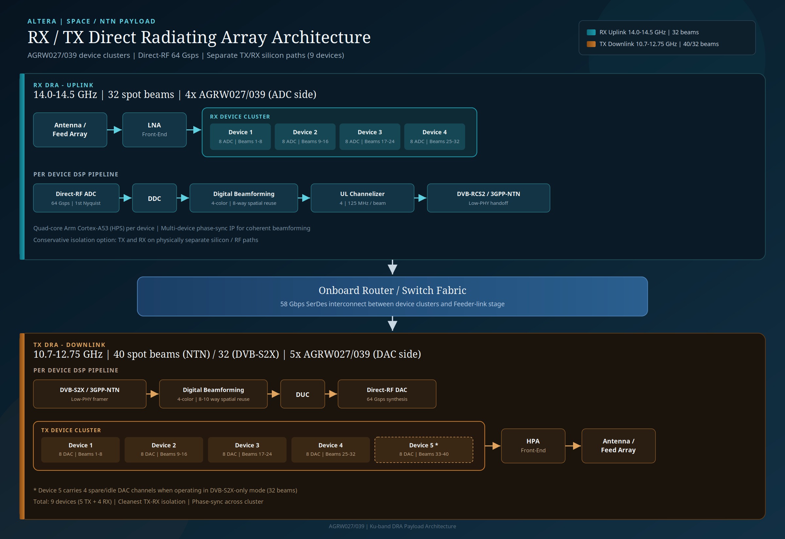

Slide 4
RX DRA — UPLINK
4-device ADC cluster · 32 spot beams
Antenna / Feed Array → LNA Front-End → RX Device Cluster
Device 1
8 ADC ch · Beams 1–8
Device 2
8 ADC ch · Beams 9–16
Device 3
8 ADC ch · Beams 17–24
Device 4
8 ADC ch · Beams 25–32
Per-device DSP pipeline
Direct-RF ADC
64 Gsps · 1st Nyquist
DDC
Digital downconvert
DBFN
4-color · 8-way spatial
UL Channelizer
4 × 125 MHz / beam
Low-PHY
DVB-RCS2 / 3GPP-NTN
Front-end: Antenna/Feed Array → LNA → Device cluster
Handoff into onboard router / switch fabric for feeder and TX path

Slide 5
TX DRA — DOWNLINK
5-device DAC cluster · 40 / 32 spot beams
Device Cluster → HPA Front-End → Antenna / Feed Array
Device 1
8 DAC · Beams 1–8
Device 2
8 DAC · Beams 9–16
Device 3
8 DAC · Beams 17–24
Device 4
8 DAC · Beams 25–32
Device 5 *
8 DAC · Beams 33–40
Per-device DSP pipeline
Low-PHY Framer
DVB-S2X / 3GPP-NTN
DBFN
4-color · 8–10 way
DUC
Digital upconvert
Direct-RF DAC
64 Gsps synthesis
* Device 5 carries 4 spare/idle DAC channels in DVB-S2X-only mode (32 beams)
NTN mode uses full 40-beam map; DVB-S2X-only parks spare channels on Device 5

Slide 6
DIGITAL SIGNAL PROCESSING
Beamforming, reuse, and channelization
Same 4-color reuse concept on both links; spatial reuse scaled to beam count
Uplink DSP (per RX device)
Direct-RF ADC at 64 Gsps (1st Nyquist sampling)
DDC into digital baseband / IF
Digital Beamforming Network
· 4-color frequency reuse
· 8-way spatial reuse
UL channelizer: 4 × 125 MHz per beam
Handoff: DVB-RCS2 or 3GPP-NTN Low-PHY
Downlink DSP (per TX device)
DVB-S2X / 3GPP-NTN Low-PHY framer
Digital Beamforming Network
· 4-color frequency reuse
· 8–10 way spatial reuse
DUC to RF synthesis band
Direct-RF DAC at 64 Gsps
HPA front-end → antenna / feed array

Slide 7
PLATFORM NOTES
Isolation, compute, and synchronization
Conservative silicon split for RF cleanliness and coherent array control
TX / RX Isolation
Physically separate silicon & RF paths
9 devices total: 5 TX + 4 RX
Cleanest TX→RX isolation option
Independent ADC vs DAC clusters
Control Plane
Quad-core Arm Cortex-A53 (HPS)
Per-device control & telemetry
Configures DDC/DUC, DBFN, PHY
Health / status reporting
Phase Sync
Multi-device phase-sync IP
Cluster-wide coherent beamforming
Required for spatial reuse
Aligns ADC/DAC sampling clocks

Slide 8
KEY SPECIFICATIONS
Quick reference table
Domain | RX Uplink | TX Downlink
Band | 14.0–14.5 GHz | 10.7–12.75 GHz
Beams | 32 spot beams | 40 (NTN) / 32 (DVB-S2X)
Devices | 4 × AGRW027/039 | 5 × AGRW027/039
Converters | 8 ADC ch / device | 8 DAC ch / device
Sample rate | 64 Gsps (1st Nyquist) | 64 Gsps synthesis
Beamforming | 4-color · 8-way | 4-color · 8–10 way
Channelization | 4 × 125 MHz / beam | —
Air interface | DVB-RCS2 / 3GPP-NTN | DVB-S2X / 3GPP-NTN
Interconnect | 58 Gbps SerDes fabric | 58 Gbps SerDes fabric

Slide 9
SUMMARY
Nine-device DRA payload with
separated RX and TX paths
32-beam Ku uplink + 40/32-beam Ku downlink
Direct-RF 64 Gsps ADC/DAC · digital beamforming · 58 Gbps fabric
Arm HPS control plane · multi-device phase sync for coherent arrays

