Slide 1
18-DOF Walking Hexapod Robot
Design, Kinematic Analysis and Simulation in ROS 2 and Gazebo
First Review
Pappu Sai Varun (23BME7002)
Akshay Veeranki (23BME7009)
Mohammed Shreyanshu Gumshi (23BME7015)
Tangirala Rushikesh (23BME7073)
Guide: Dr Santosh Kumar Sahu
Department of Mechanical Engineering, VIT-AP University
Notes:
Good morning. We are presenting the first review of our final year project, an eighteen degree of freedom walking hexapod robot.
We designed the robot in AutoCAD, analysed the parts in ANSYS, studied the foot trajectory in MATLAB, and built a full simulation in ROS 2 and Gazebo where it now walks under our control.

Slide 2
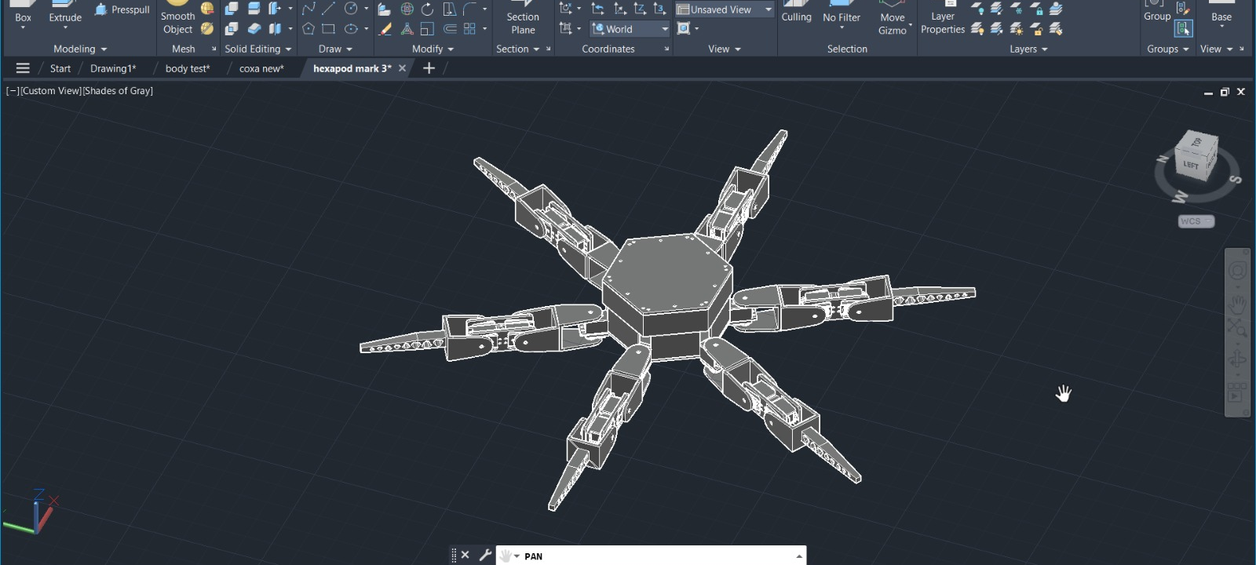
Why a hexapod
Six legs turn balancing into a geometry problem
• Wheels need continuous ground. Legs only need somewhere to place a foot.
• Stable when the centre of mass sits inside the triangle of feet on the ground.
• Three feet is the minimum for a triangle, so three legs can lift at once.
• Stability is checked with geometry, not controlled continuously.
AutoCAD assembly, six legs about a hexagonal chassis
Notes:
Why legs and not wheels. Wheels need continuous ground, legs only need places to put a foot.
Why six legs. A robot is stable when its centre of mass sits inside the triangle of feet touching the ground. Three feet is the minimum for a triangle, so a hexapod can lift three legs and stay stable. Stability becomes something we CHECK with geometry rather than something we control every instant, like a biped must.

Slide 3
Objectives
1
Accurate model
AutoCAD to ROS 2, with measured masses and inertia
2
Solve the leg exactly
Closed form forward and inverse kinematics
3
Analyse the motion
Foot path, velocity, acceleration and force in MATLAB
4
Check the structure
ANSYS on the loaded parts
5
Make it walk
Tripod gait from a velocity command, simulated in Gazebo
6
Stay hardware ready
Moving to servos is a settings change
Notes:
Our objectives. Read them, do not linger.
Objective two is the mechanical core: an exact closed form solution for the leg, not a numerical one.
Objective six is what matters for the next phase. The software is arranged so that moving to real servos is a settings change, not a rewrite.

Slide 4
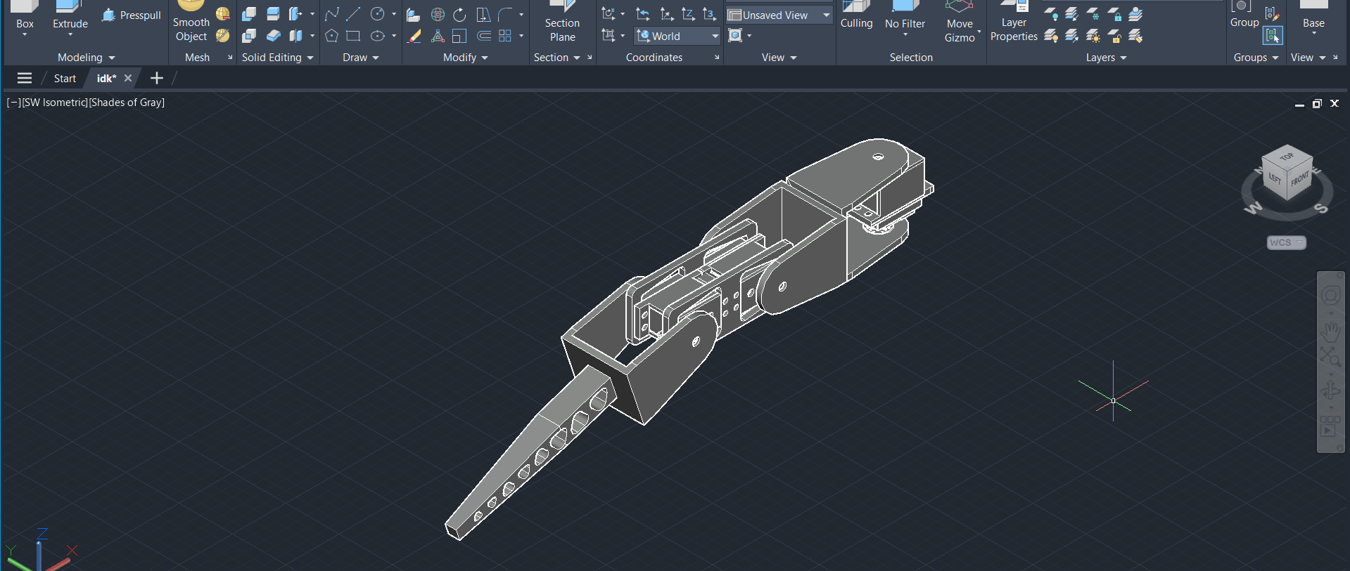
The leg
Three joints per leg, eighteen in the robot
Joint functions
Coxa θ₁ swings the leg sideways, about a vertical axis
Femur θ₂ lifts and lowers, about a horizontal axis
Tibia θ₃ extends the foot, about a parallel axis
18
6
joints
legs
3.39
25
AutoCAD, single leg assembly
kg
links
Notes:
This is one leg. Three joints, named after insect anatomy, which is the convention in legged robotics.
Coxa turns about a vertical axis and swings the leg sideways. Femur and tibia both turn about horizontal axes and move the foot in a vertical plane.
Point at the CAD: the three pivots, and the servo mounting at each.

Slide 5
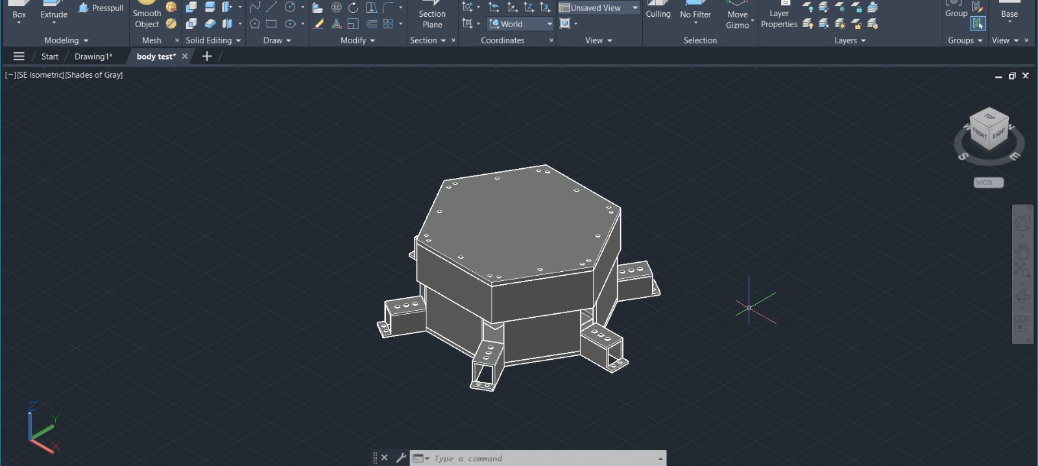
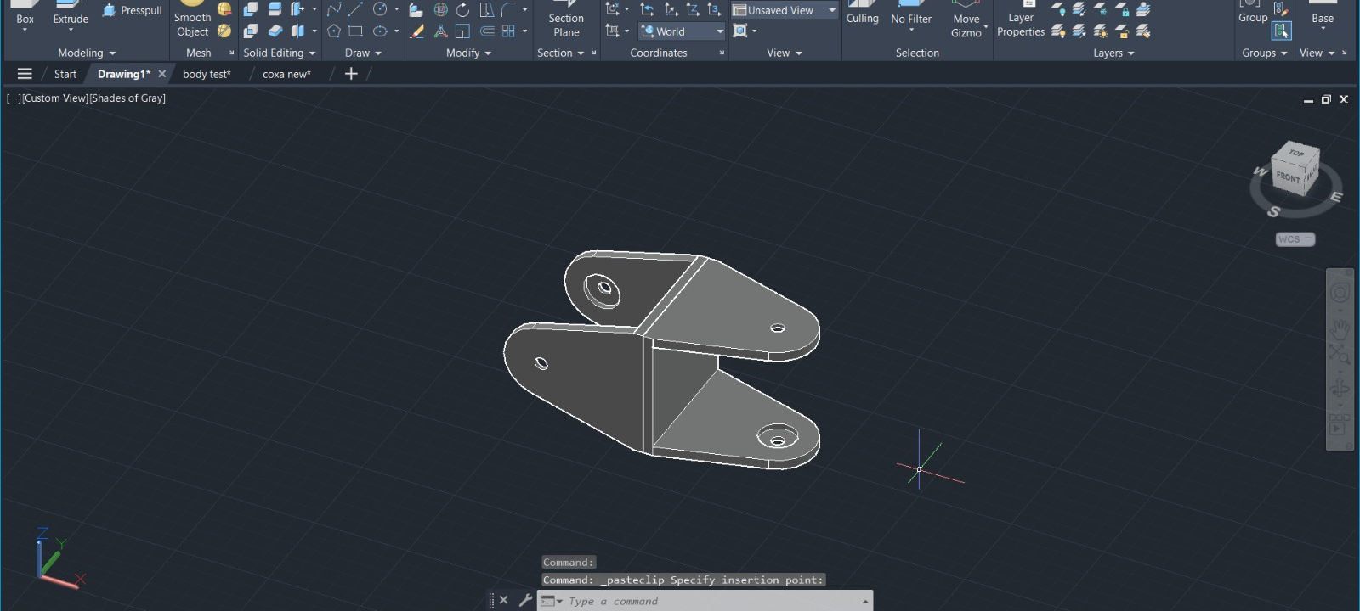
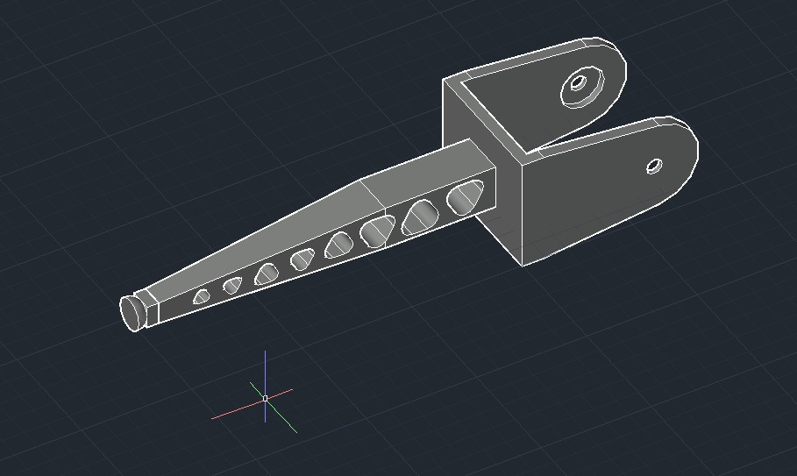
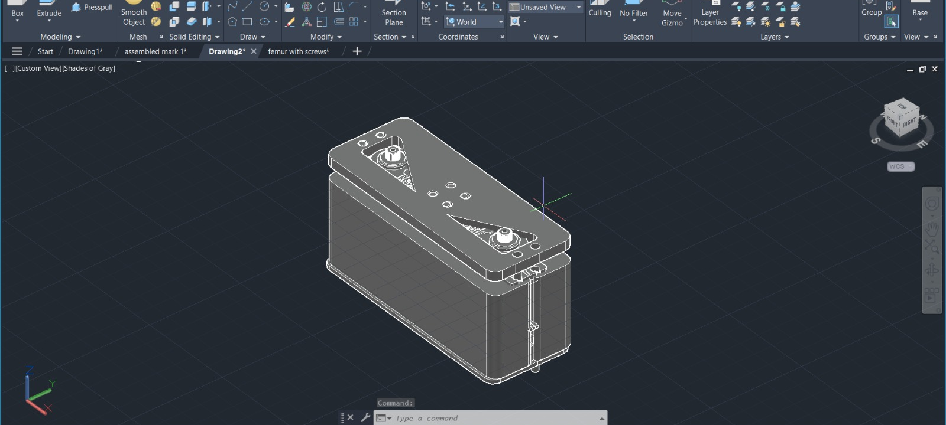
Mechanical parts
Every part modelled in AutoCAD and designed for 3D printing
Chassis
Femur bracket
Tibia
Battery housing
Notes:
The individual parts, all modelled by us in AutoCAD.
The chassis is a hexagonal frame carrying six coxa servos, the battery and the electronics. The femur is a bracket. The tibia is the long reaching member that touches the ground.
All parts are designed for 3D printing in PLA, which is what sets the masses we use in simulation.

Slide 6
The leg as a mechanism
An RRR serial chain, and one deliberate axis choice
• Three revolute joints in series, so three degrees of freedom per leg.
• Coxa axis vertical. Femur and tibia axes horizontal and parallel to each other.
• Because those two axes are parallel, the leg beyond the coxa stays in ONE vertical plane.
• The coxa angle only selects which plane that is.
• So a 3D positioning problem reduces to a 2D two-link problem, which has an exact solution.
• In stance, the loaded legs plus the ground and body form closed chains.
Why this matters
A general 3-DOF chain needs a numerical solver, which is slower and can fail to converge in the middle of a step.
Our arrangement gives a closed form answer every time, in a fixed number of operations.
Six identical legs, mounted at different yaw angles, so one solution serves all of them.
Notes:
Treating the leg as a mechanism. It is an open serial chain of three revolute joints, an RRR chain, so it has three degrees of freedom and can place its foot anywhere in a three dimensional workspace.
The important structural point is the axis arrangement. The coxa axis is vertical. The femur and tibia axes are horizontal AND PARALLEL to each other. Because those two are parallel, everything beyond the coxa is confined to one vertical plane.
In stance, three legs plus the ground and the body form closed kinematic chains, which is what carries the load.

Slide 7
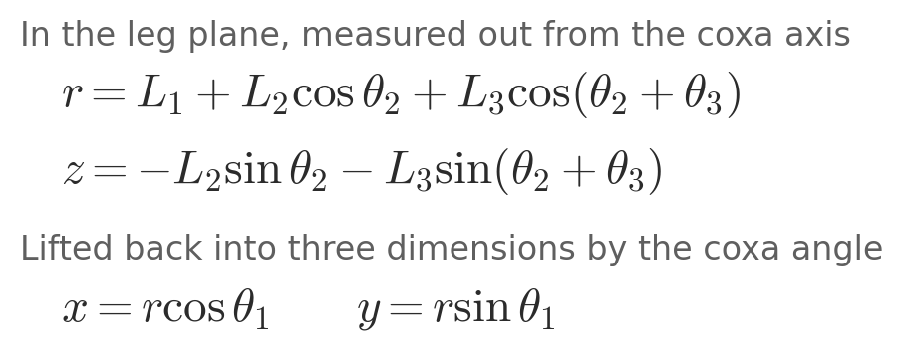
Forward kinematics
Given the joint angles, where is the foot?
Link lengths
L₁ = 150.0 mm coxa
L₂ = 116.6 mm femur
L₃ = 150.0 mm tibia
Positive θ₂ and θ₃ move the foot downward, from the right handed axis convention.
Verified stance solution: θ₁ = 0°, θ₂ = 15.44°, θ₃ = 67.82°, giving a foot 0.280 m out and 0.180 m below the body.
Notes:
Forward kinematics. Given the three joint angles, where is the foot.
Work in the leg plane first. r is how far out the foot is from the coxa axis, z is how far down. Each term is one link projected onto that plane.
Then lift it back into three dimensions by rotating through the coxa angle.
The minus signs on z come from the axis convention: rotation about the positive Y axis carries the X direction toward negative Z, so a positive femur angle moves the foot DOWN. We kept the mathematically clean right handed axes and documented the consequence.

Slide 8
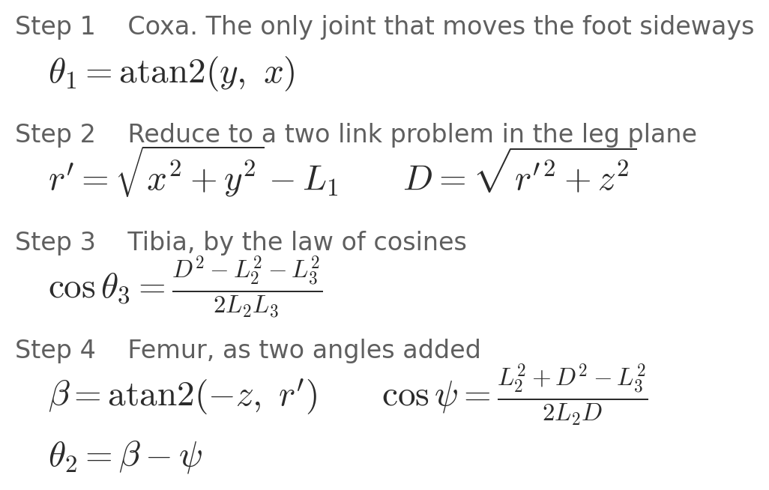
Inverse kinematics
Given the foot position, what should the joint angles be?
Why it matters
This runs 50 times a second, for all six legs, every time the robot takes a step.
Closed form means a fixed cost and no possibility of failing to converge part way through a step.
Checked numerically: forward → inverse → forward closes to 3.5 × 10⁻¹⁶ m, the precision limit of the computer.
Notes:
Inverse kinematics, the one that actually runs on the robot fifty times a second. Given where we want the foot, what should the joint angles be.
Step one: the coxa is the only joint that can move the foot sideways, so its angle comes straight from the horizontal direction to the target.
Step two: shift the origin out to the femur joint. Now it is two links reaching a point, and D is the straight line distance to it.
Step three: the tibia angle from the law of cosines on the triangle made by the two link lengths and D.
Step four: the femur angle is two angles added. Beta is the elevation of the target, psi is the angle between the femur and the line to the target.
No iteration anywhere. Same number of operations every time.

Slide 9
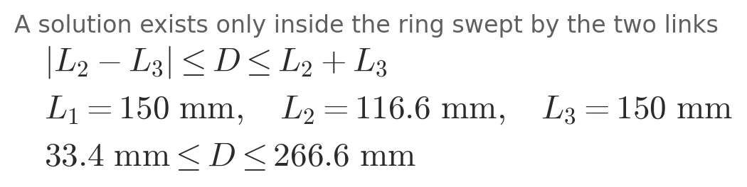
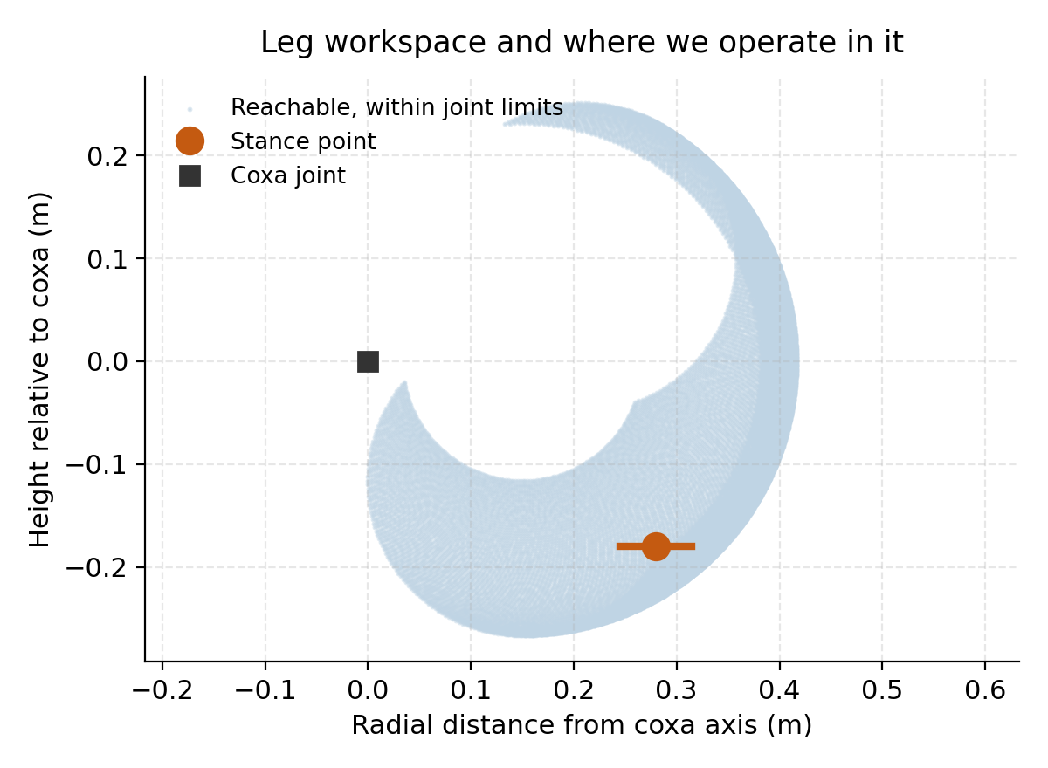
Workspace and reachability
Where the leg can reach, and where we chose to work
Choosing the stance
We stand at 0.280 m out and 0.180 m down. That leaves roughly 20° of travel before any joint limit, and keeps the knee well bent.
An earlier stance of 0.34 m out put the leg at 86% of full extension with the tibia nearly horizontal, which gave almost no ground clearance and no compliance to absorb touchdown.
Notes:
Where the leg can actually reach, and where we chose to operate.
A solution exists only when the target is inside the ring swept by the femur and tibia. Closer than 33 mm and the leg cannot fold enough; further than 267 mm and it cannot reach.
The blue cloud is every point reachable within the real joint limits. The orange dot is our standing position and the orange line is the stride the foot sweeps while walking.
The point to make: we operate well inside the boundary, with margin on all sides. A leg near full extension has almost no vertical compliance and very poor force transmission.

Slide 10
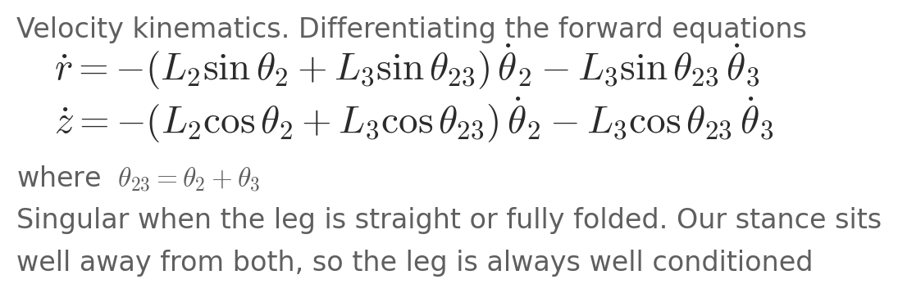
Velocity kinematics
How fast the joints must move to move the foot
Used for two things
Checking the leg never approaches a singularity, where a small foot movement would demand an enormous joint speed.
Feeding the expected joint velocity forward to the controller, so it anticipates the motion instead of lagging behind it.
Peak joint speed in our envelope stays inside the servo rating with margin.
Notes:
Velocity kinematics. Differentiating the forward equations gives how fast the foot moves for a given joint speed.
We use this in two ways. First, to check the leg is never near a singularity, which is where a small foot movement would demand enormous joint speed. Second, we feed the expected joint velocity forward to the controller, so it anticipates the motion instead of chasing it.
A leg is singular when it is fully straight or fully folded. Our stance sits far from both, so the leg is always well conditioned.

Slide 11
Mass and inertia
Calculated from the CAD volumes, then the servos added
Part | Length | Mass | Made up of
Body | 312.7 mm | 1.310 kg | frame, 6 coxa servos, battery, electronics
Coxa | 150.0 mm | 0.201 kg | printed 0.141 + femur servo 0.060
Femur | 116.6 mm | 0.101 kg | printed 0.041 + tibia servo 0.060
Tibia | 150.0 mm | 0.035 kg | printed part only
Inertia tensors
Computed in closed form for a box and for cylinders, about each part's own centre of mass. These are exact, not estimates.
Total mass 3.39 kg. Standing on three legs, each foot carries about 10.9 N.
Servo mass belongs to the part it is bolted to, not the part it moves.
Notes:
The masses that go into the simulation. These are calculated from the measured volume of each CAD part at PLA density, then the servo masses added.
One detail that is easy to get backwards: a servo's mass belongs to the part it is BOLTED TO, not the part it drives. The tibia servo sits on the femur. All six coxa servos sit on the body.
What matters most is not the absolute mass but the RATIO across each joint, because the physics solver inverts the mass matrix every step and its conditioning depends on those ratios.

Slide 12
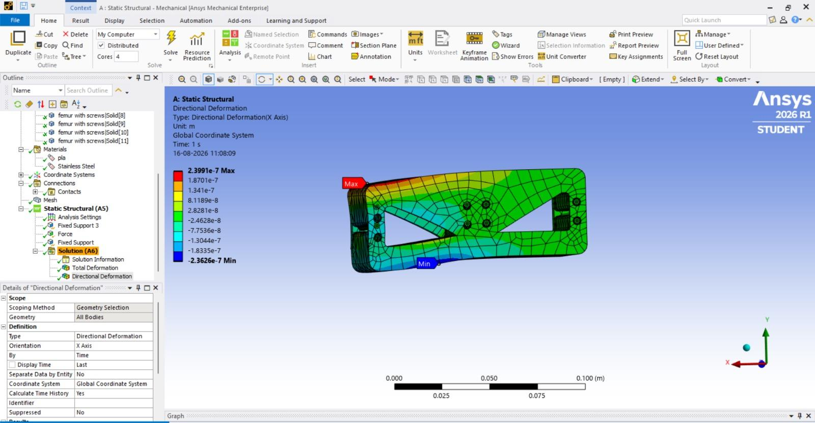
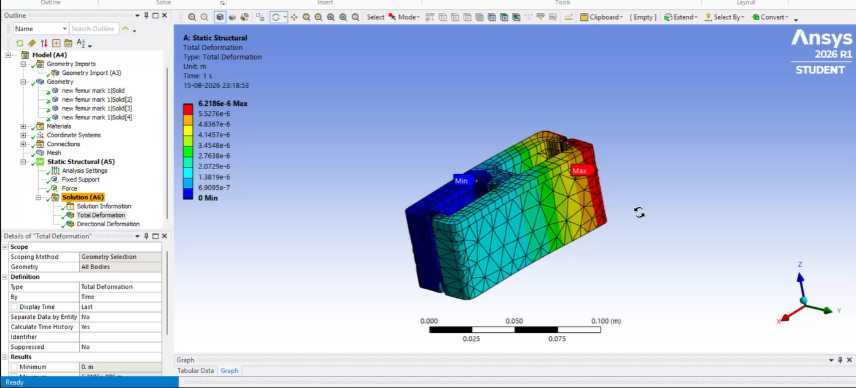
Structural analysis
ANSYS on the parts that carry the standing load
Static structural, femur bracket
Total deformation, chassis
Load case: 3.39 kg standing on three legs → about 10.9 N per foot Peak stress [ ] Max deformation [ ] Factor of safety [ ]
Notes:
Structural analysis in ANSYS on the loaded parts.
The load case comes straight from the mass figure on the previous slide. The robot weighs 3.39 kg, it stands on three legs at a time, so each foot carries about 10.9 newtons.
Give your peak stress and the factor of safety, then the maximum deflection. If the parts passed, say so plainly.

Slide 13
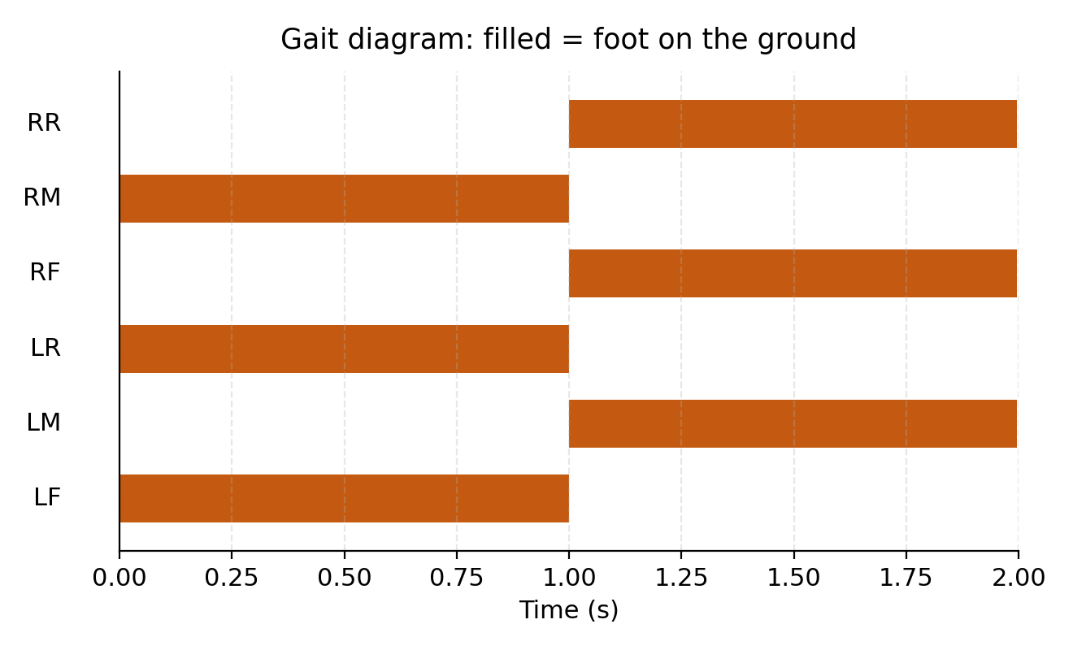
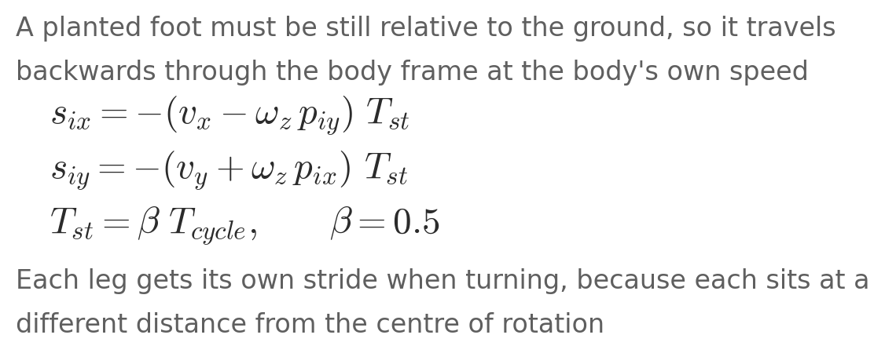
Tripod gait
Three feet always down, and the stride follows from the speed
Step length is not a tuning knob. It is forced by the commanded speed and the time a foot spends on the ground. Choosing it freely would make the feet slide.
Notes:
The walking pattern. Six legs in two groups of three, exactly half a cycle apart. One group pushes while the other swings forward.
The diagram: filled bars are feet on the ground. Read down any vertical line and you always cross exactly three filled bars. That is the stability condition, satisfied at every instant.
The equation is the important part. We do not choose the step length. A foot on the ground must be still relative to the ground, so it has to travel backwards through the body frame at exactly the body's speed. That forces the stride.
And because each leg sits at a different distance from the centre of rotation, each gets its own stride when turning. That single expression is why walking, strafing and turning are one piece of code.

Slide 14
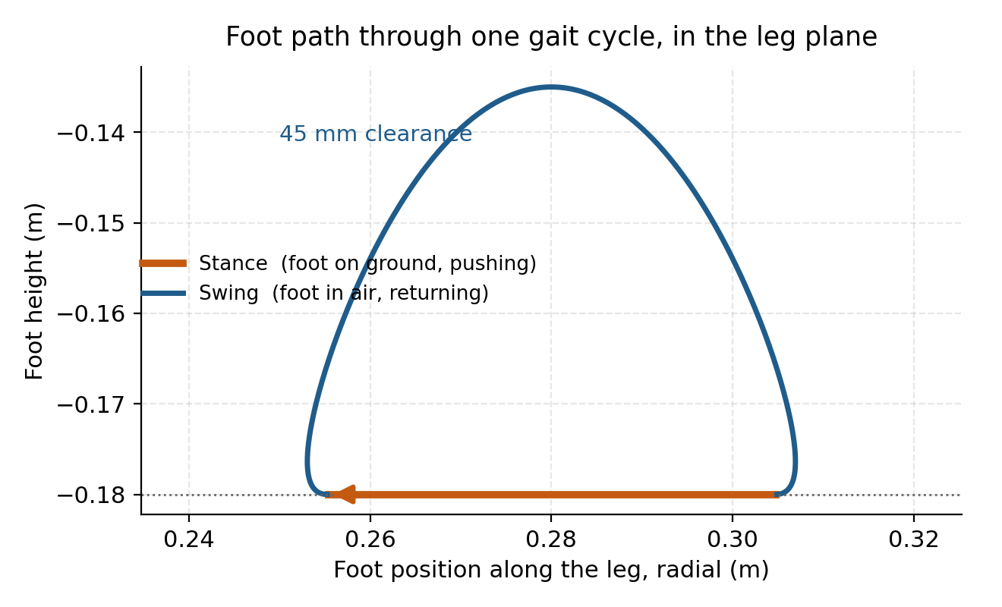
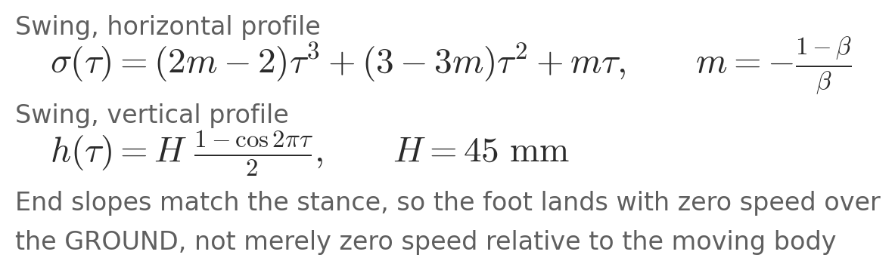
Swing trajectory
The shape of one step, and why the ends matter
The end slopes are matched to the stance, so the foot touches down with zero speed over the ground rather than zero speed relative to the moving body.
Notes:
The path a foot follows through one full cycle, drawn in the leg plane.
Orange is stance, a straight line along the ground, sweeping backwards to push the robot forwards. Blue is swing, lifting 45 mm clear and returning to the front.
The equations define that shape. The vertical profile is a raised cosine, which arrives with zero downward speed. The horizontal profile is a cubic.
The subtle part is the end slopes. We match them to the stance velocity, so the foot lands with zero speed relative to the GROUND. An earlier version landed with zero speed relative to the BODY, which sounds right but means the foot is moving at full body speed across the ground at the moment it touches.

Slide 15
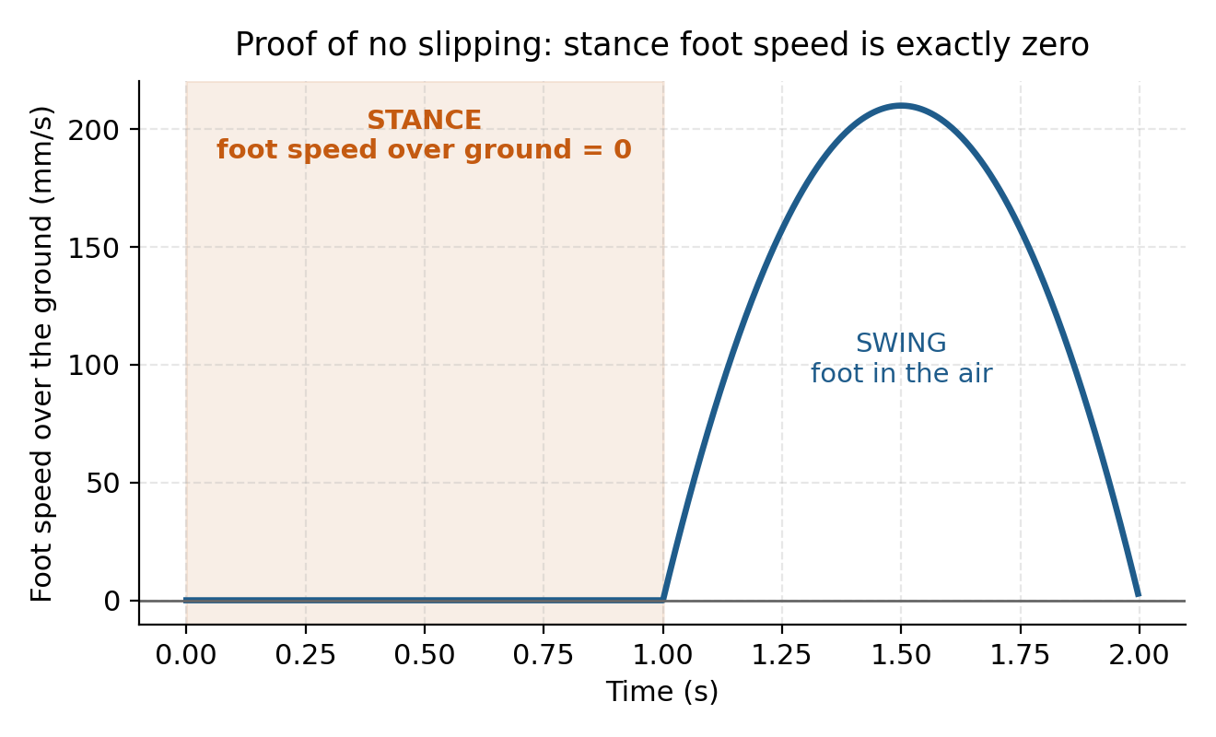
No-slip verification
The stance foot does not move relative to the ground
Why this is the key plot
A foot that slides while carrying load wastes energy, wears the contact surface and destroys odometry.
The flat zero through the whole stance is what says the gait geometry is right.
Checked automatically at every phase, on every code change.
Notes:
This plot is the proof that the gait is correct, and it is the one to dwell on.
The vertical axis is the speed of the foot over the GROUND, not relative to the robot. During stance, shaded orange, it is exactly zero for the whole phase. The foot is planted and does not slide.
During swing the foot moves, which is fine, it is in the air.
If the stance part of this curve were not flat at zero, the robot would be scuffing its feet and losing energy and odometry. This is checked automatically at every phase, every time we change the code.

Slide 16
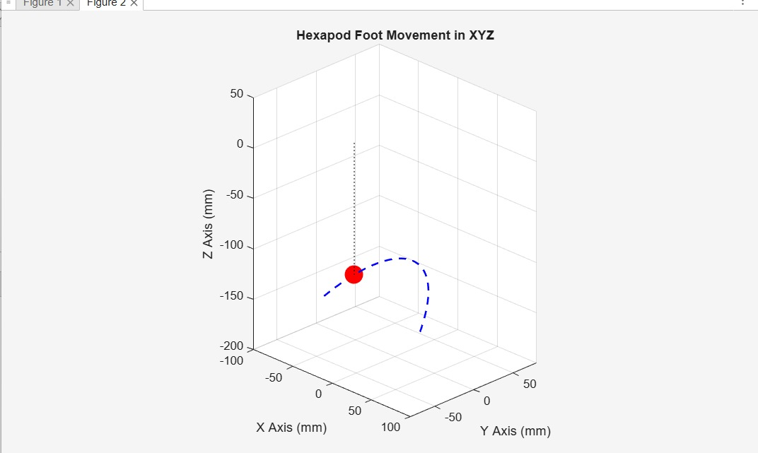
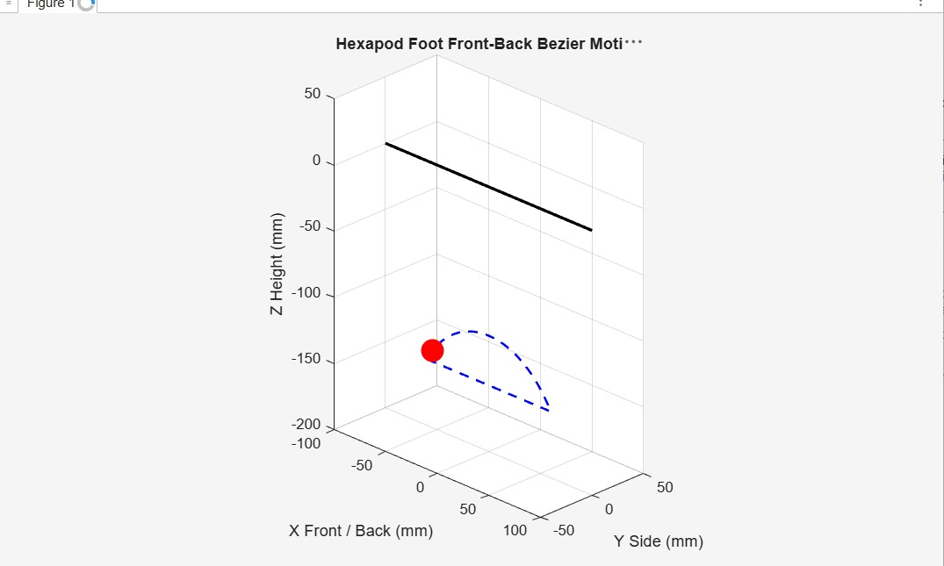
MATLAB study: the foot path
Modelling one step as a Bézier curve before implementing it
Foot movement in XYZ
Fore and aft view of the same path
The path is smooth and closed. Lift height and stride length are set by the control points of the curve.
Notes:
Now the MATLAB study. Before implementing anything we modelled the foot trajectory as a Bezier curve and analysed it.
These two views show the path of one foot through a complete step. The dashed blue curve is the trajectory, the red marker is the foot. The left view is the full three dimensional path, the right shows the fore and aft travel against the reference line.
What we take from it: the path is smooth and closed, it returns exactly to where it started, and the lift height and stride are set by the control points of the curve.

Slide 17
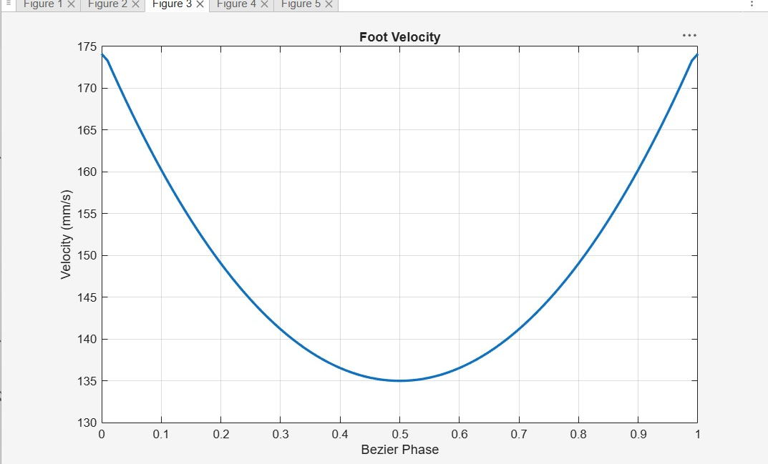
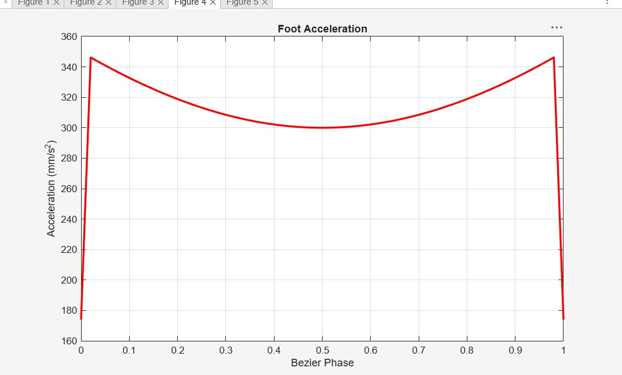
MATLAB: velocity and acceleration
Differentiating the path gives the servo requirements
Foot velocity through the step
Foot acceleration through the step
Peak velocity sets the speed the servo must deliver. Peak acceleration times the moving mass gives the inertial load on top of holding the robot up. Both curves are smooth, so there is no impulsive load on the gearbox.
Notes:
Differentiating that path gives velocity and acceleration through the step.
Velocity: 174 mm/s at the start, falling to 135 at mid phase, back to 174 at the end. So the foot is fastest at the transitions and slowest in the middle of the curve.
Acceleration: the same U shape, 345 down to 300 and back, in mm per second squared.
Why we care. The peak velocity sets the speed a servo must be able to deliver. The peak acceleration, times the moving mass, gives the inertial load the servo has to overcome on top of holding the robot up. Both curves are continuous with no spikes, which is what you want, because a discontinuity here would be an impulsive load on the gearbox.

Slide 18
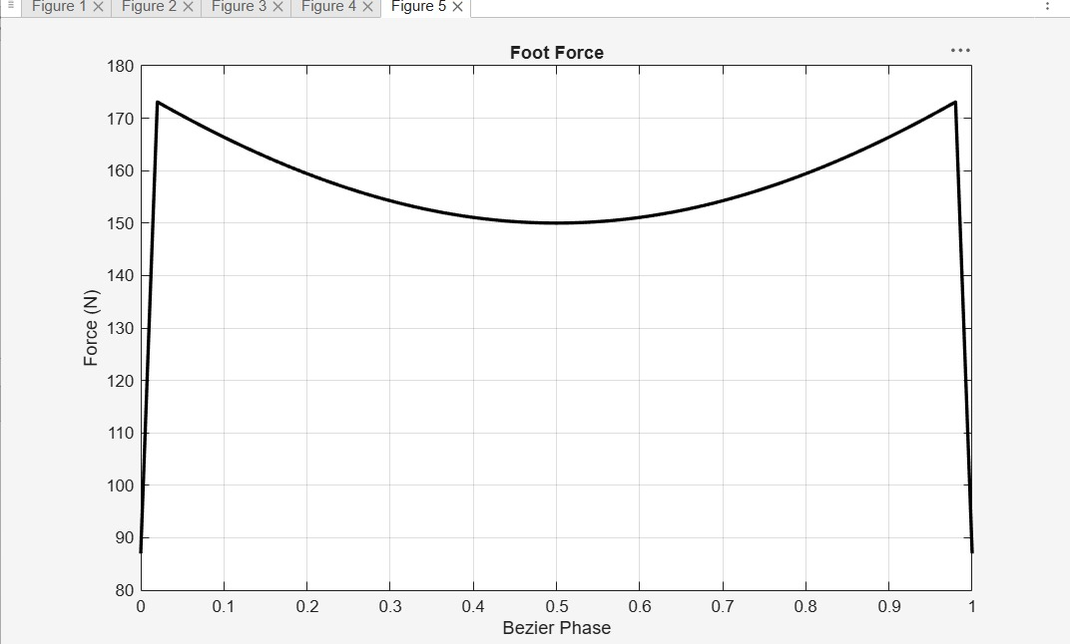
MATLAB: foot force
What the leg has to carry through a step
Why this sizes the servo
Force is highest at the start and end of the phase, lowest in the middle. It follows the acceleration curve.
Force multiplied by the link length gives the torque the joint must produce, which is how the servo class was chosen.
Static component: 10.9 N per foot from the mass budget.
Foot force against phase
Notes:
Foot force through the step, from the same MATLAB model.
The force is highest at the beginning and end of the phase and lowest in the middle, ranging from about 173 newtons down to 150.
The shape follows the acceleration curve, which is what you expect: where the foot is being accelerated hardest, the force is largest.
This is the number that sizes the joint. Combined with the link length it gives the torque the servo has to produce, and that is how we chose the servo class.
If asked how the force is derived, say it is the loaded foot force through the trajectory from the MATLAB model, and that the static component is the 10.9 N per foot from the mass budget.

Slide 19
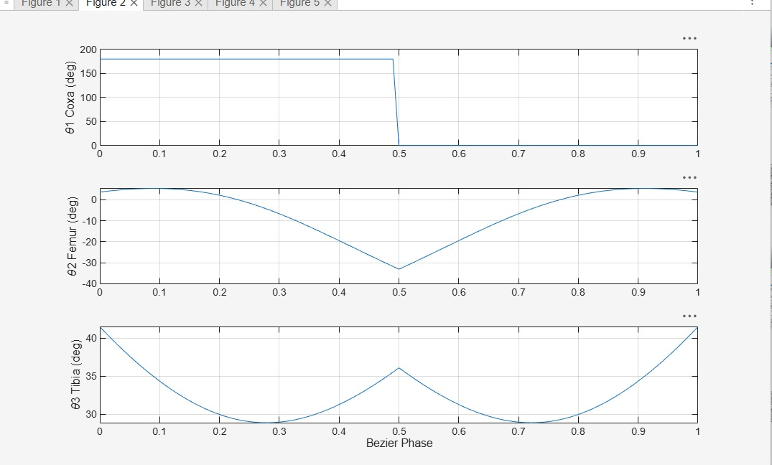
MATLAB: joint angles
The inverse kinematics applied along the whole path
What it confirms
Femur and tibia move smoothly through roughly 30 degrees, well inside their limits.
The whole trajectory is reachable. No point on the path asks the leg for something it cannot do.
These angles are what the controller receives.
θ₁ coxa, θ₂ femur, θ₃ tibia against phase
Notes:
Finally the joint angles that produce that path. This is the inverse kinematics from earlier, applied along the whole trajectory.
Top is the coxa, middle the femur, bottom the tibia, all in degrees against phase.
The femur and tibia curves are smooth and stay within a modest range, roughly 30 degrees of travel, which is comfortably inside the joint limits.
The coxa trace shows a change at mid phase where the leg switches from one side of its axis to the other. Note for us, not for the slide: that step is an angle wrap-around from atan2 and must be unwrapped before it is sent to a servo, or the joint would try to spin a full turn.

Slide 20
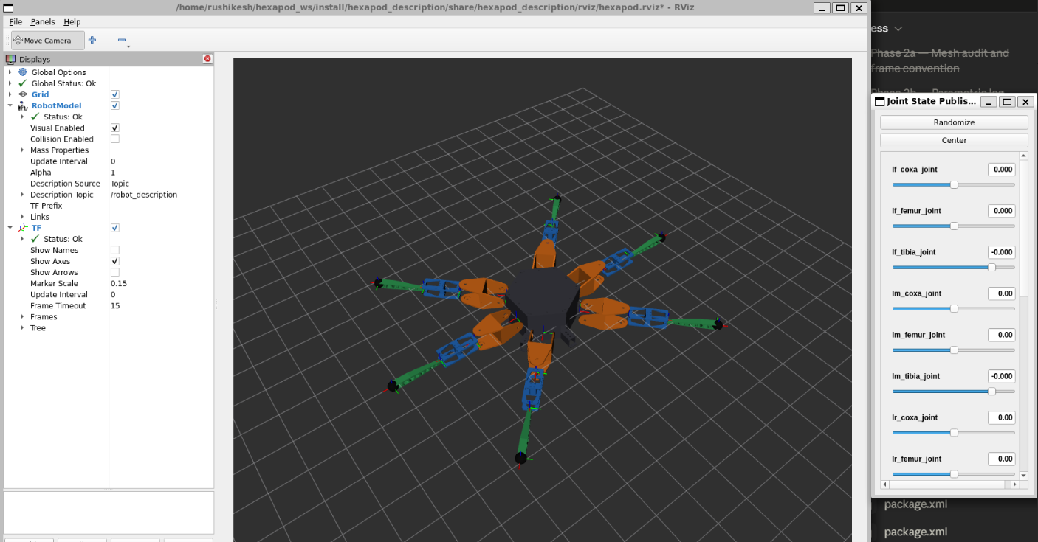
From CAD to simulation model
The same parts, in a form ROS 2 can use
What the model carries
• Shape of every part, from the CAD meshes
• Position and axis of all 18 joints
• Mass and inertia of each link
• Joint limits, friction and damping
Appearance uses the meshes. Contact and inertia use boxes and cylinders, which is far faster and, for the chassis, actually more correct.
RViz, the assembled model with all 18 joints
Notes:
Turning the mechanical design into something the simulator can use.
The CAD parts were exported as STL meshes and assembled into a URDF, which is the standard robot description format. It carries the shape of every part, the position and axis of all eighteen joints, the masses and inertias, and the joint limits.
One choice worth mentioning: the robot LOOKS like the CAD meshes, but for contact and inertia we use simple boxes and cylinders. Full mesh contact across twenty five links would be about a thousand times slower, and the chassis mesh is not watertight so its inertia is not even defined.

Slide 21
Gazebo physics setup
Tuned for a legged robot, not left on defaults
Parameter | Value | Why
Timestep | 1 ms | Contact forces need small steps to stay stable
Solver iterations | 100 | Force travels one joint per iteration along a 4-link leg
Contact stiffness kp | 5 × 10⁴ | Higher values make contacts ring at this timestep
Contact damping kd | 500 | Slightly overdamped, so contacts settle without bouncing
Foot friction μ | 2.0 | Rubber foot on a hard floor
Joint damping | 0.5 | Represents gearbox losses
One coupled decision
A contact behaves as a spring against the mass it supports. Its natural frequency has to be sampled often enough by the timestep.
Get that wrong and six ringing contacts sum to a small random force. The robot drifts while apparently standing still.
Notes:
The simulation is not run on default settings. A hexapod is twenty five bodies with up to six contacts making and breaking every cycle, and default physics settings are tuned for a wheeled robot with a couple of contacts.
Every number here answers a specific failure we saw. The timestep and contact stiffness are one decision, not two: a contact behaves like a spring, and if the timestep is too coarse for its natural frequency the contacts ring and the robot slowly drifts sideways while apparently standing still.
Solver iterations matter because force propagates one joint per iteration along a chain, and we have a four link chain six times over.

Slide 22
Software organisation
Five parts, each able to change without breaking the others
hexapod_description
model, meshes,
masses
hexapod_gazebo
world and
physics
hexapod_control
controller
settings
hexapod_gait
kinematics
and gait
hexapod_bringup
launch
files
The robot model depends on nothing else. That is what makes the move to real hardware a settings change instead of a rewrite.
github.com/rushikeshtangirala/hexapod_scratch
Notes:
How the software is organised. Five packages, and the split is deliberate.
The robot model package depends on nothing. That is what lets the same model be used by the simulator, by RViz, and later by the real robot, without dragging a simulator dependency along.
Because of that, switching to hardware next phase is a settings change rather than a rewrite. The code is public on GitHub.

Slide 23
How it decides to walk
One command in, everything else calculated
Velocity command
forward, sideways, turn
Gait
where each foot goes · 50 Hz
Inverse kinematics
6 foot positions → 18 angles
Controller
drives the joints · 200 Hz
Gazebo physics
contact and gravity · 1000 Hz
›
›
›
›
No motion is pre-recorded. Change the commanded speed and every leg trajectory changes with it.
Notes:
The control chain, end to end.
We send one thing: a velocity. Forward, sideways, and turn rate. Everything after that is calculated.
The gait works out where each foot should be at this instant. The inverse kinematics turns those six foot positions into eighteen joint angles. The controller drives the joints. Gazebo simulates the physics.
Note the three rates. The gait at 50 Hz is smooth enough for legs. The controller at 200 Hz so it corrects errors faster than the gait creates them. The physics at 1000 Hz because contact needs small steps.
Nothing is a recorded animation.

Slide 24
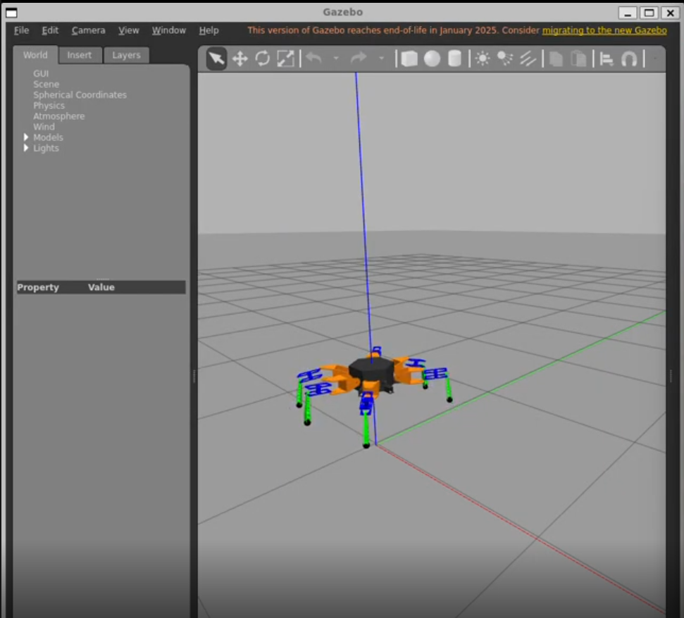
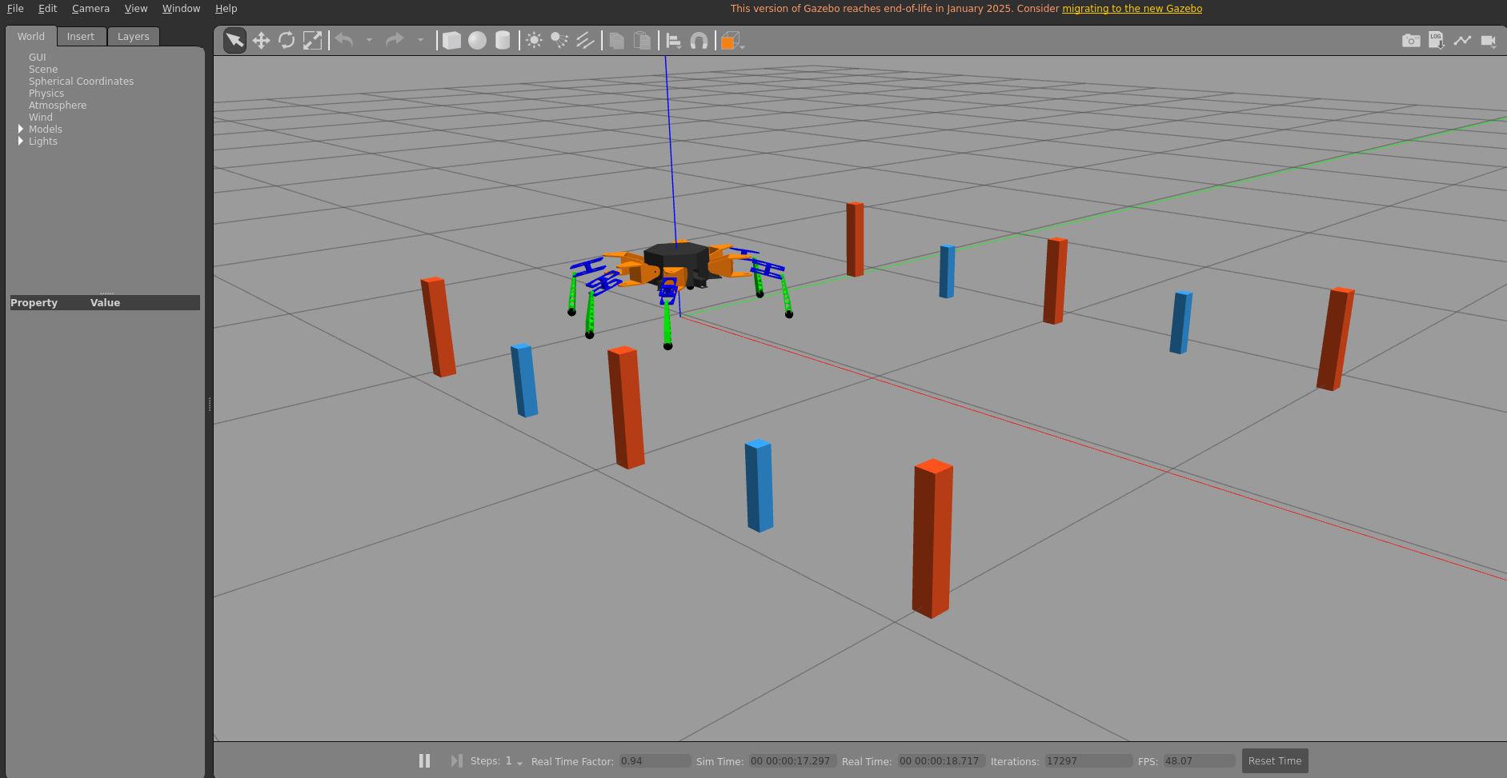
Gazebo simulation
The robot standing and walking under gravity and friction
Standing in the world
Walking, distance markers for scale
All 18 joints respond individually. The robot holds its stance under its own weight. The controller tracks commanded angles closely. Three feet stay on the ground throughout the cycle.
Notes:
The simulation running. Left, the robot standing in the Gazebo world under gravity, holding its stance. Right, walking, with the markers giving a sense of distance travelled.
What we verified in simulation: all eighteen joints respond individually and correctly, the robot holds its stance under its own weight with about two degrees of sag, the controller tracks commanded joint angles closely, and the tripod pattern keeps three feet down throughout.
The robot is driven by keyboard teleoperation, exactly as it would be on hardware.

Slide 25
Verification before simulation
The maths is tested on its own, in under a second
3.5 × 10⁻¹⁶ m
498
under 1 s
inverse kinematics round trip error
automatic gait checks passing
to run the whole suite
What the checks cover
Exactly three feet on the ground at every phase. The two leg groups exactly half a cycle apart. No jump in a foot's path at the stance-to-swing handover. Zero foot speed over the ground during stance. Full 45 mm clearance in swing. Every commanded velocity reachable within the joint limits.
Notes:
How we know the maths is right, rather than merely believing it.
We wrote the kinematics and the gait as plain Python with no connection to ROS or Gazebo. That means they can be tested in under a second instead of launching a whole simulation.
The leg maths is accurate to sixteen decimal places, which is the computer's limit, not the method's. The gait passes 498 separate automatic checks.
These run every time we change anything.

Slide 26
What the verification found
An error that watching the robot could not have shown
The error
The legs were pushing the robot backwards while the gait believed it was going forwards.
Commanded 8 cm/s forward, the planted foot was dragged at 16 cm/s the wrong way, on three legs at once.
Why our test missed it
It compared the distance the foot moved with the distance the body moved.
Both are distances, and a distance has no direction. The test now checks direction as well, and both are fixed.
Found by comparing our sign conventions against an independently written hexapod stack.
Notes:
And the testing paid for itself. We found a real error that watching the robot could never have revealed.
The stance phase was sweeping the foot the wrong way. Instead of pushing backwards to drive the robot forwards, it pushed forwards.
Measured: commanded 8 cm/s forward, and the planted foot was being dragged across the ground at 16 cm/s in the wrong direction, on three legs at once.
The more useful lesson is why our own test missed it. It compared the DISTANCE the foot moved with the DISTANCE the body moved. Both are distances, and a distance has no direction, so a backwards error was invisible to it. We fixed the code and the test.

Slide 27
Related work
Xiang et al., Frontiers in Robotics and AI, 2024
What they built
A bionic hexapod for agricultural field scouting. Six legs, three joints each, tripod gait as the base.
Their contribution is a terrain-adaptive gait. The robot switches between a 6 cm marching clearance and an 18 cm step-over clearance, so it climbs obstacles instead of going around them.
Validated by field trials on concrete, grass, slopes and obstacles.
Their reported results
• Slopes up to 17 degrees
• Pitch held between −11.5° and 8.6°
• 14.4 % energy saved per obstacle crossed
• Cost of transport 25.3, down from 30.2
• Dynamixel MX-106T servos, 8.4 N·m
• IMU plus one force sensor per foot
Same topology and same base gait as ours, so the comparison is meaningful rather than superficial.
Notes:
Our benchmark paper. Xiang and co-authors, Frontiers in Robotics and AI, 2024, a bionic hexapod for agricultural field scouting.
We chose it because the machine is almost the same as ours: six legs, three joints each, tripod gait as the starting point. So the comparison is meaningful rather than superficial.
What they add is a terrain-adaptive gait. The robot switches between a low clearance marching mode at 6 cm and a high clearance step-over mode at 18 cm, so it climbs over obstacles instead of walking around them. That saves 14.4 percent of the energy for every obstacle crossed.
They have hardware and field trials. We are at simulation, which is the honest difference in stage. Notice their sensing package, an IMU and a force sensor on every foot, is essentially our next phase list.

Slide 28
How our approach compares
Same machine, different engineering choices
 | Xiang et al., 2024 | Our project
Topology | 6 legs × 3 DOF, tripod base | Same
Structure | Carbon fibre and CNC aluminium | 3D printed PLA, 3.39 kg
Foot trajectory | Sinusoidal joint modulation, IK deliberately avoided at run time | Closed-form analytic IK, solved at 50 Hz
Commanding | A gait mode is selected | A body velocity is commanded, stride is derived
Simulation | SolidWorks → Simulink Simscape | AutoCAD → URDF → Gazebo, ros2_control
Validation | Field trials on four terrains | 498 offline assertions, IK to 3.5×10⁻¹⁶ m
Stage | Hardware built and field tested | Simulation complete, hardware next
They trade commandability for computation. We trade computation for commandability, because a closed-form solution makes that computation cheap.
Notes:
How our approach compares. Two rows matter more than the rest.
Foot trajectory. They deliberately AVOID inverse kinematics at run time. The paper states that computing landing points with IK generates many complex computations and costs time and energy, so they drive the joints with sinusoids instead. That is a real engineering trade: cheaper computation, but the foot path is whatever the sinusoids produce, and you cannot command a body velocity directly.
We do the opposite, on purpose. Our IK is closed form, so it is a fixed handful of trigonometric calls with no iteration. It is cheap. And it buys commandability: the operator asks for a velocity and the stride for every leg follows from geometry. That is what makes walking, strafing and turning one piece of code.
Say it in these words: they trade commandability for computation, we trade computation for commandability, and closed form is what makes that trade affordable.
Second row, validation. They validate empirically in the field, which is the gold standard and needs hardware. We validate formally offline. The two are complementary, and ours caught a sign error that field testing would probably have dismissed as needing tuning.

Slide 29
Where we are
Completed
• All parts modelled in AutoCAD
• Structural analysis in ANSYS
• Foot trajectory studied in MATLAB
• Closed form kinematics, verified numerically
• Tripod gait, verified by 498 checks
• Full ROS 2 and Gazebo simulation
• Robot walks under our control
Next phase
• Walking under the full dynamic simulation
• Tuning the joint controllers
• Foot contact sensors to measure slip directly
• Writing the servo driver
• Assembling the physical robot
• Mapping and navigation
Notes:
Where we are. Left column is finished and demonstrated today.
Right column is what remains. Do not skip it. A clear statement of what is not yet done reads as competence.
The main outstanding item is walking under the full dynamic simulation with our measured masses. We have measured the behaviour precisely and are working through it.

Slide 30
Thank you
Questions
Notes:
Thank you. Open for questions.
The question to be ready for is whether the walking demonstration is real. Answer: the legs are driven by the real gait and the real inverse kinematics, nothing is animated, and the body moves by the amount those legs geometrically require, because we have proved the feet do not slip.

