Slide 1
BATCH-B | PROJECT REVIEW
Digitize and Showcase Monasteries of Sikkim for Tourism and Cultural Preservation
A Comprehensive 360° Virtual Reality Portal, Interactive GIS Map, Festival Calendar & Cultural Heritage Platform
TEAM NUMBER
Team No. 25
Batch-B
TEAM MEMBERS
Jakeer, Shamilini, Rushil,
Sravan, Ashritha
5 Members
DOMAIN / FOCUS
Web & Cultural Tourism
Monastery360 Web Portal
SUBMISSION DATE
15 October 2026
Tentative Final Review

Slide 2
BATCH-B | PROJECT REVIEW | TEAM NO. 25
1. Problem Statement
02
THE PROBLEM
YOUR SOLUTION & BENEFICIARIES
Core Problem Definition
• Monastery and cultural tourism information in Sikkim can be difficult to explore in one single place.
• Information regarding locations, historical background, visiting hours, and ongoing festival events is scattered across fragmented, outdated websites.
Who Faces This Problem?
• Domestic and international tourists who want to experience Sikkim's spiritual heritage but lack consolidated travel itineraries.
• Devotees and elderly pilgrims who find remote high-altitude monasteries physically and geographically challenging to reach.
• Cultural researchers seeking accurate archival documentation of murals, stupas, and thangkas.
Why Is Solving It Important?
• Remote monasteries risk digital obscurity without modern showcase platforms.
• Directs tourism flow sustainably to regional communities, promoting local homestays, transport providers, and rural handicrafts.
The Monastery360 Solution
• A centralized, high-performance web portal uniting 360° virtual tours, interactive geo-mapping, festival timelines, and verified accommodation directories.
• Equirectangular panorama engine (Pannellum WebGL) bringing virtual access to sacred shrines without requiring specialized hardware.
Primary Stakeholder Benefits
• Tourists & Pilgrims: Seamless exploration, panoramic 360° previews, route navigation, and integrated trip budgeting.
• Local Communities: Increased eco-tourism revenue for regional homestays, cab operators, and authentic cultural artisans.
• Cultural-Preservation Stakeholders: Long-term digital twin documentation of endangered architecture, centuries-old thangkas, and sacred rituals.

Slide 3
BATCH-B | PROJECT REVIEW | TEAM NO. 25
2. Technology Stack & Key Features
03
TECHNOLOGY STACK
KEY FEATURES
• Frontend: HTML5, CSS3, Vanilla JavaScript (Modern ES6+ modular architecture, zero front-end framework bloat)
• Backend: Client-side only (Ultra-lightweight, browser-based prototype ensuring instant loading and zero server maintenance cost)
• Storage: Browser localStorage + centralized JavaScript data object (window.M360Data) for persistent user bookmarks, trip plans, and history
• Tools & Libraries: • Pannellum (WebGL 360° equirectangular virtual tour engine)
• Leaflet & OpenStreetMap (Interactive GIS map navigation)
• Google Fonts (Baloo 2 & Poppins typography)
• HTML5 Canvas (Dynamic 360° fallback placeholder generator)
• Development Tools: VS Code, Git & GitHub repository, PowerShell optimization scripts
1. 360° Virtual Tours of Monasteries
Immersive WebGL equirectangular panoramas of 8 renowned monasteries (Rumtek, Pemayangtse, Tashiding, Enchey, Ralang, Dubdi, Dodrul, Phensang) with mouse/touch drag navigation.
2. Interactive Monastery Map
Interactive Leaflet GIS map with GPS pin markers across East, West, South, and North Sikkim, complete with turn-by-turn Google Maps direction linking.
3. Comprehensive Festival Calendar
Dynamic 12-month cultural calendar tracking sacred Tibetan and Sikkimese festivals (Losar, Bumchu, Saga Dawa, Pang Lhabsol) with slide-in detail drawers.
4. Cultural Art & Photo Gallery
Curated multimedia archive showcasing golden stupas, centuries-old thangkas, and ancient vegetable-dye wall murals categorized by theme.
5. Accommodation & Travel Integration
Integrated hotel, homestay, and travel distance listings helping visitors plan lodging near remote monasteries.

Slide 4
BATCH-B | PROJECT REVIEW | TEAM NO. 25
3. Project Workflow / System Architecture
04
A. PROJECT WORKFLOW & EXPECTED OUTCOME
1. INPUT
User selects monastery from map, filters by sect/district, picks travel dates, or searches heritage keywords
2. PROCESS
Client-side router parses query IDs, retrieves metadata from M360Data, and prepares panorama texture assets
3. DATA / AI
LocalStorage loads user favorites; Pannellum WebGL decodes 360° equirectangular panorama with canvas fallbacks
4. OUTPUT
User immerses in 360° VR tour, views festival details, launches GPS navigation, and saves trip itinerary
→
→
→
B. SIMPLE SYSTEM ARCHITECTURE
CLIENT / FRONTEND LAYER
• 7 Responsive Pages: index.html, tours.html, stay.html, calendar.html, gallery.html, login.html, profile.html
• Modular Components: Navbar, Search Modal (Ctrl+K), Accordion Gallery, Lightbox
• Leaflet.js Mapping & Pannellum WebGL 360° Tour Viewer
CLIENT-SIDE APPLICATION LOGIC
• Data Router (js/app.js): Handles dynamic DOM injection and search index matching
• Virtual Tour Engine: Equirectangular projection with auto-rotation & compass pitch
• Dynamic Canvas Fallback: Generates synthetic panorama previews if asset is offline
STORAGE & DATA ASSET LAYER
• Centralized Heritage Data (js/data.js): 8 Monasteries, 12 Festivals, 8 Hotels
• LocalStorage State: User session, visited gompa history, favorite bookmarks
• Asset Pipeline: Web-optimized JPEG/PNG panoramas and thumbnails (<5.5 MB total)

Slide 5
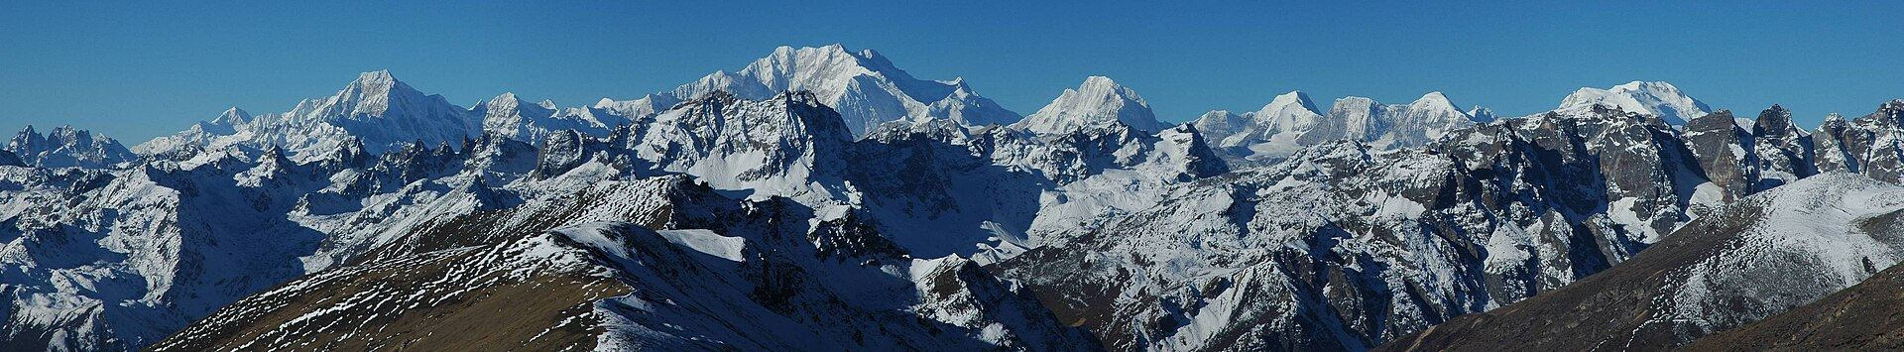
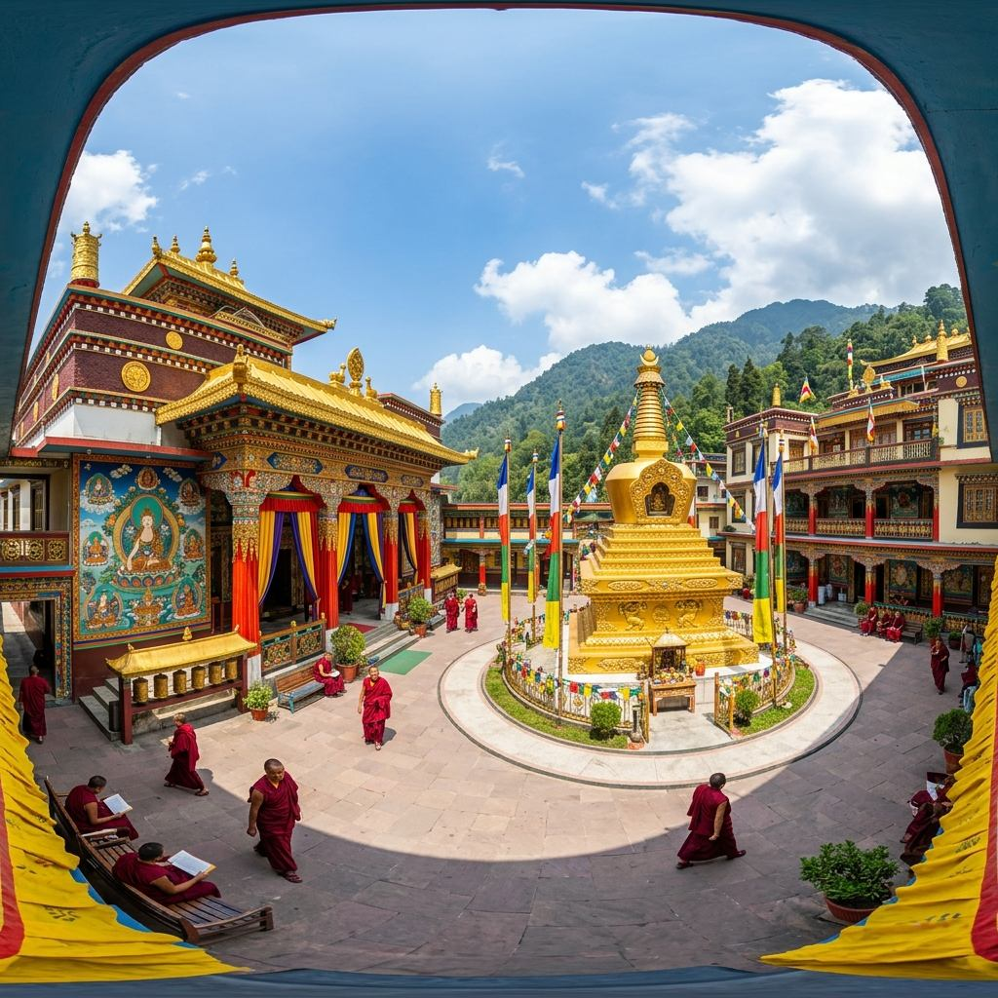
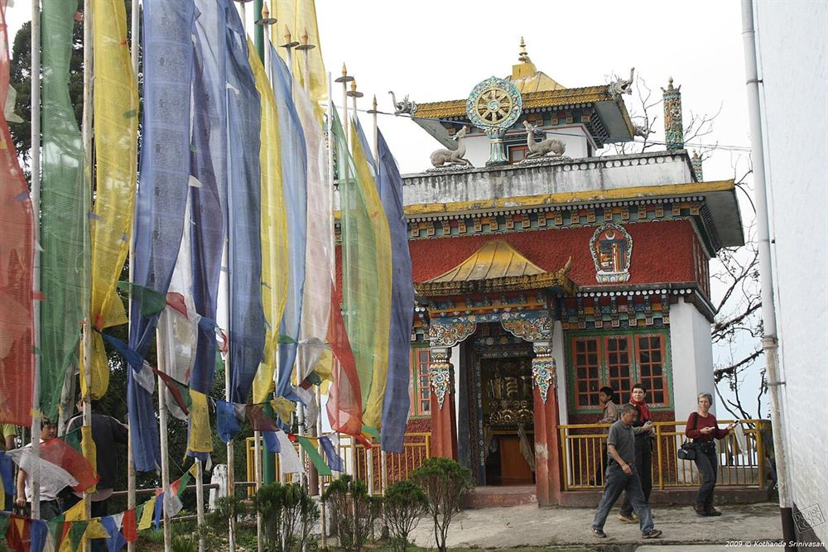
BATCH-B | PROJECT REVIEW | TEAM NO. 25
4. Project Screenshots / Output
05
IMPLEMENTATION STATUS: Completed: 7 core pages, 360° tours, calendar | Remaining: End-to-end testing, content checks & demo polish | Working demo ready? [In Progress / Prototype Stage]
MAIN EXPLORER & MAP
360° VIRTUAL TOUR
CULTURAL CALENDAR & STAYS
Interactive Monastery Map & Explorer
• Real-time interactive Leaflet GIS map with 8 monastery markers.
• Demonstrates monastery filtering, direct search, and turn-by-turn navigation.
Pannellum 360° Virtual Tour Viewer
• High-resolution equirectangular panorama viewer of sacred gompas.
• Full drag controls, pitch/yaw rotation, and fallback placeholder handling.
Festival Calendar & Stay Filters
• Demonstrates interactive 12-month Buddhist festival timeline.
• Showcases cultural gallery and verified nearby hotel/homestay directory.

Slide 6
BATCH-B | PROJECT REVIEW | TEAM NO. 25
5. Team Members & Contributions
06
TEAM NO. 25 CONTRIBUTIONS MATRIX
TEAM MEMBER | TASK / MODULE | WHAT THEY CONTRIBUTED
Jakeer | Accommodation & Travel Management | • Developed stay.html directory and nearby accommodation filters (Luxury, Heritage, Boutique, Budget). • Integrated distance calculations and transport guide for travelers near monasteries.
Shamilini | Virtual Tour Development | • Implemented Pannellum.js WebGL 360° virtual tour viewer across 8 monasteries. • Handled equirectangular panorama image loading, thumbnail switching, and fallback preview canvas.
Rushil | Authentication & UI Integration | • Engineered dual-mode authentication (localStorage session state + optional Supabase cloud schema). • Integrated responsive navigation bar, search modal (Ctrl+K), and core multi-page UI architecture.
Sravan | Interactive Map & Navigation | • Built Leaflet.js interactive GIS map with custom monastery markers across Sikkim districts. • Implemented coordinate popups with one-click direct Google Maps turn-by-turn navigation.
Ashritha | Festival Calendar & Cultural Gallery | • Designed calendar.html interactive monthly timeline for sacred events (Losar, Bumchu, Saga Dawa). • Created cultural gallery (gallery.html) with category filters (Art, History, Architecture) and lightbox.

Slide 7
BATCH-B | PROJECT REVIEW | TEAM NO. 25
6. AI Project Video & Conclusion
07
MANDATORY AI VIDEO SUBMISSION
REVIEW TALKING POINTS & CONCLUSION
VIDEO DURATION: 1 MIN 20 SEC | AI VOICE-OVER
0:00 – 0:20 | Problem & Heritage Context
Introduces Sikkim's remote monasteries and the challenge of accessing scattered cultural information.
0:20 – 0:45 | Virtual Tour & Map Demo
Live demonstration of selecting a monastery, launching the 360° Pannellum viewer, and exploring the GIS map.
0:45 – 1:05 | Festival Calendar & Gallery
Showcasing annual ritual events (Losar, Bumchu) and filtering the sacred art and thangka gallery.
1:05 – 1:20 | Benefits & Conclusion
Summary of cultural preservation benefits and impact on sustainable regional tourism.
• Why This Stack?: Lightweight, browser-based prototype requiring zero server overhead, loading instantly on any standard device.
• What Is Working?: 360° virtual tour viewer, interactive Leaflet map, cultural gallery, festival calendar, and tourism stay pages.
• Key Challenge Identified: Creating awareness about lesser-known remote monasteries and collecting authentic high-resolution 360° assets.
• Remaining Work Ahead: Adding more monasteries to the interactive map and capturing more panoramic street views for full coverage.
• Tentative Final Submission Date: 15 October 2026
AI Video Submission Link / File Name:
Monastery360_AI_Voiceover_Demo_1m20s.mp4
Thank You | Questions & Answers

