Slide 1

Statistics/Analysis for trending YouTube videos

Slide 2

DATA SET
TRENDING YOUTUBE VIDEO STATISTICS
Daily statistics for trending YouTube videos
Notes:
DATASET of this project

Slide 3
Tools used in this Project
Excel 2016
MS SQL Server Management Studio 18.4 + SQL Server 2019
Tableau Desktop
MS POWER POINT
Notes:
Tools that are going to be used in completing this project.

Slide 4

Section 1 Data Understanding
Notes:
Section 1 : Data Understanding

Slide 5

CONTEXT
This is a large dataset of thousands of YouTube channels. YouTube which is the world-famous videos sharing website where most trending videos are kept maintained.
Coming to this dataset, it has ample amount of data in this dataset from different countries with each and every moment is being recorded for business purpose.
Notes:
The main reason behind creating this large dataset and storing ample amount of data to measure users interactions like (Number of views, Shares, Comments, and likes). In order to improve overall performance or to analyze the past users behaviour or reactions on particular channels. The dataset is being daily recorded to keep an eye on the reactions it receives. Thus, it helps to improve one’s business growth.

Slide 6

→This is very large dataset which includes continuous measurement since some past months of data on daily trending YouTube videos.
→In this particular dataset, YouTube dataset of 10 countries is being measured such as Canada, USA, Great Britain, Germany, France, Russia, India, Japan, South Korea, and Mexico.
CONTENT
Notes:
Talking about the history of this dataset, dataset is being collected since last few months and a lot of people have viewed and downloaded it.
Moreover, each and every category of the YouTube videos are mentioned. In the dataset columns data includes the video title, channel title, published time, tags, likes, dislikes, views, description and comments.
This Dataset was gathered using YouTube API.

Slide 7

Original Source of DATASET
KAGGLE
https://www.kaggle.com/datasnaek/youtube-new#FRvideos.csv
Notes:
Original source of DATASET – Kaggle.com

Slide 8
Number of Columns :-
16 columns
Number of Rows :-
8 Rows
Size Of Data Set
Notes:
Size of the data set

Slide 9


Section 2 Business Questions
Notes:
Section 2 : Business Questions

Slide 10
Which category videos were removed even after being in trend in GREAT BRITIAN?
Which are the top YouTube channels which are trending in USA?
Which category videos are more trending amongst USA,CANADA & GREAT BRITIAN individually?
Notes:
After analyzing the given dataset, we came up with a lot of business question and then we studied each and every business question with all the possible perspective and then identified three questions which we are going to analyze.

Slide 11


Section 3
Data Preparation
Notes:
Section 3 – Data Preparation

Slide 12
ETL Process
CSV files of all the given data of trending YouTube video statistics are extracted into excel sheets to perform ETL process.
So all the data brought up into a common format from the multiple sources.
Then changed data types of some columns, changed formats and added new columns as per the business questions need. So, cleaned the data and transformed.
So, by doing ETL process the performance will be increased.
It would be easy to use and analyze the data through automated processes.
Notes:
Language Translate :- We have got data of different countries and the data is in the different languages according to the country. So here we have got one solution and that is Translate function. The translate function is used to read the data in understandable language.
Data Cleaning :- Then we have cleaned our data according to the business questions and according to our need for analysis.
Column Elimination :- We did elimination of the columns which are not required or in which there missing values in order to answer the business questions.
Data Type Change :- Then we changed data types of some columns where required.

Slide 13

Section 4
SQL Queries
Notes:
Section 4 – SQL Queries

Slide 14
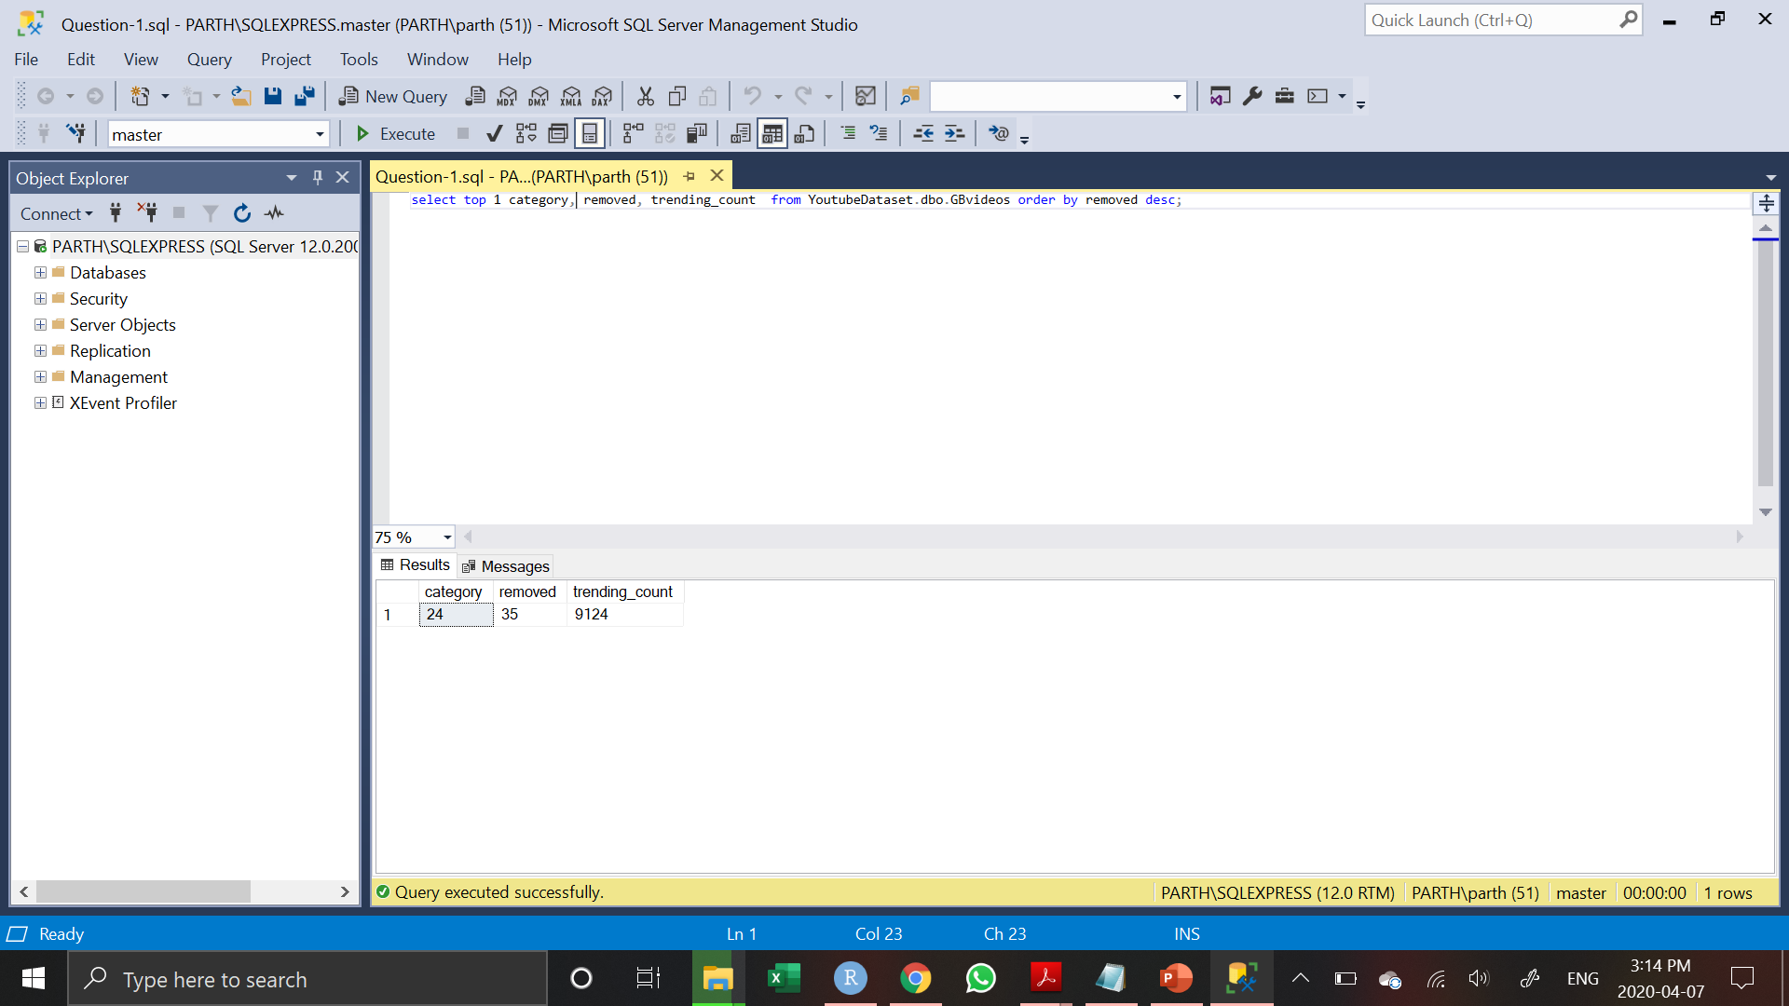
Business Question 1 Sql Queries
Query:-
select top 1 category, removed, trending_count from YoutubeDataset.dbo.GBvideos order by removed desc;
Notes:
We have selected three columns such as category, removed and trending count which are required to look the result.
By selecting these three columns we can look that which category videos are removed even after trending the most.
So by looking at the answer of business question 1 we can have an idea that which were the mistakes done by that videos or for what reason that videos were deleted so that the same mistakes can not repeated.

Slide 15
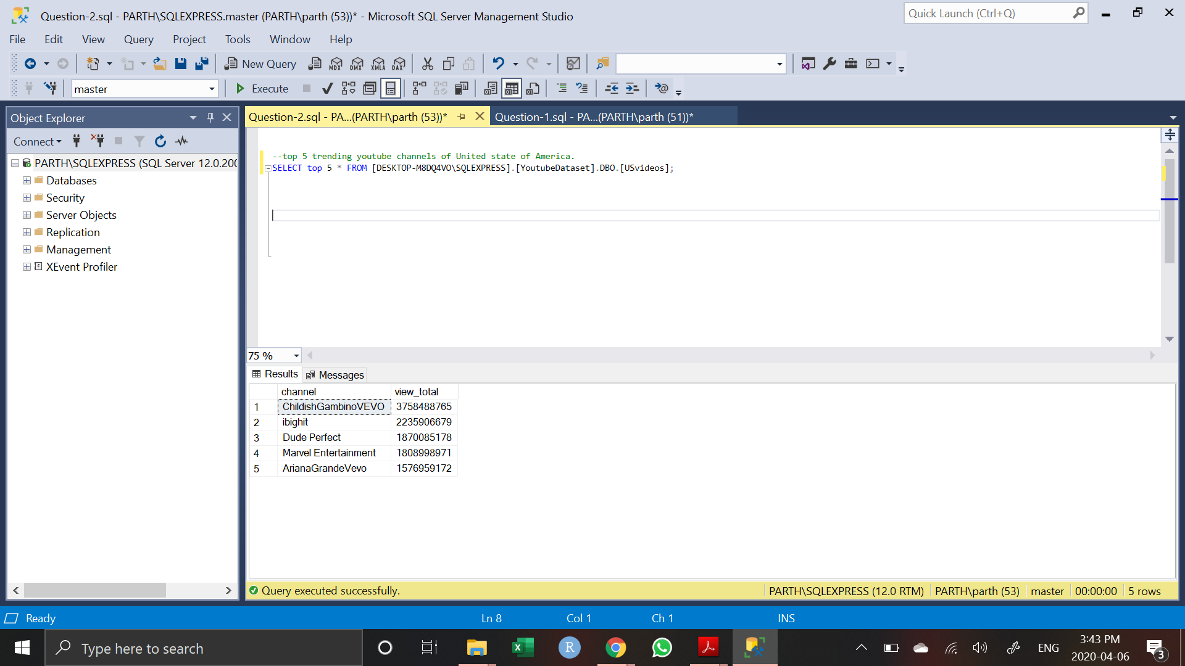
Business Question 2 Sql Queries
Query:-
SELECT top 5 * FROM [DESKTOP-M8DQ4VO\SQLEXPRESS].[YoutubeDataset].DBO.[USvideos];
Notes:
We have performed query for the second business question in which it will give the result supporting the business question.
The query will look at the top 5 YouTube channel names and based on the highest views. By looking at the result we will be able to look at the top 5 trending YouTube channels in the USA.

Slide 16
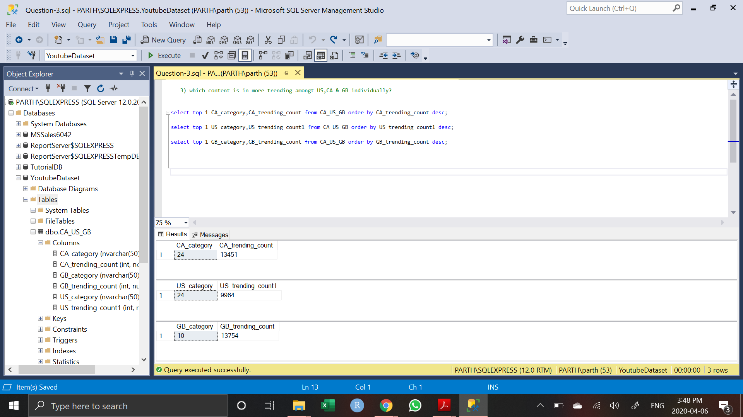
Business Question 3 Sql Queries
Query:-
→ select top 1 CA_category, CA_trending_count from CA_US_GB order by CA_trending_count desc;
→ select top 1 US_category,US_trending_count1 from CA_US_GB order by US_trending_count1 desc;
→ select top 1 GB_category,GB_trending_count from CA_US_GB order by GB_trending_count desc;
→ select * from CA_US_GB;
Notes:
Here we have created some queries in order to look into the data that which type of category videos are more popular in the taken three countries.
We have taken three countries USA, Canada and Great Britain where we are looking and comparing the categories which are famous into their respective regions.
By running the following queries we will have an overlook idea about the people in their respective countries that which type of content and which type of videos they like to watch the most.
Moreover, now we will represent all of our data relevant to the business question in the Tableau for easy to understand purpose by looking at the visualization or graphical representation.

Slide 17

Section 5
Descriptive Analysis
Notes:
Section 5 – Descriptive analysis

Slide 18

Pivot Table & Pivot Chart Business Question 1
Count of video_error_or_removed | Column Labels
Category Id | Video removed | Grand Total
1 | 12 | 12
10 | 22 | 22
24 | 35 | 35
Grand Total | 69 | 69
Notes:
We have gone through our dataset into the excel sheets and created pivot tables and pivot charts. It can be clearly seen in the table and charts that it is showing the result of removed videos with category id and total number of videos per id. As we can see these videos were trending in the Great Britain.
It can be seen that highest number of videos were removed in the category id number 24 and least number of videos are removed in the category number 1.

Slide 19
Pivot Table Business Question 2
CHANNEL NAME | VIEWS
ChildishGambinoVEVO | 3758488765
ibighit | 2235906679
Dude Perfect | 1870085178
Marvel Entertainment | 1808998971
ArianaGrandeVevo | 1576959172
MalumaVEVO | 1551515831
jypentertainment | 1486972132
Sony Pictures Entertainment | 1432374398
FoxStarHindi | 1238609854
BeckyGVEVO | 1182971286
20th Century Fox | 1082872611
CalvinHarrisVEVO | 1042564430
Ed Sheeran | 1032288961
Grand Total | 21300608268
Notes:
As we have got YouTube videos of 10 country data. So if we look country vise individually. We have used YouTube data of USA.
There are some YouTube channels which are trending in the USA.
In the pivot table and pivot chart the result is showing channel names which are trending in the USA with their number of views for each and every trending channel.

Slide 20
Pivot Chart Business Question 2
Notes:
These are some YouTube channels which are trending in the USA shown in the above pie chart.

Slide 21
Pivot Table Business Question 3
Category Id | Canada | Great Britain | USA | Grand Total
1 | 2060 | 2577 | 2345 | 6982
2 | 353 | 144 | 384 | 881
10 | 3731 | 13754 | 6472 | 23957
15 | 369 | 534 | 920 | 1823
17 | 2787 | 1907 | 2174 | 6868
19 | 392 | 96 | 402 | 890
20 | 1344 | 1788 | 817 | 3949
22 | 4105 | 2926 | 3210 | 10241
23 | 3773 | 1828 | 3457 | 9058
24 | 13451 | 9124 | 9964 | 32539
25 | 4159 | 1225 | 2487 | 7871
26 | 2007 | 1928 | 4146 | 8081
27 | 991 | 457 | 1656 | 3104
28 | 1155 | 518 | 2401 | 4074
29 | 74 | 90 | 57 | 221
30 | 6 |  |  | 6
43 | 124 | 20 | 57 | 201
Grand Total | 40881 | 38916 | 40949 | 120746
Notes:
Now as we have gone through only individual YouTube data of Great Britain and USA.
This business question is basically comparing the YouTube data of three countries such as USA, Canada and Great Britain.
The pivot table and pivot chart are illustrating that which categories are more trending or which type of videos are more being watched in these three countries which are taken for analysis.

Slide 22
Pivot Chart Business Question 3
Notes:
As we can see that category number 24 is more trending in Canada and USA whereas in Great Britain category number 10 is on highly trending.

Slide 23

Section 6
Data Visualization
Notes:
Section 6 - Data Visualization

Slide 24
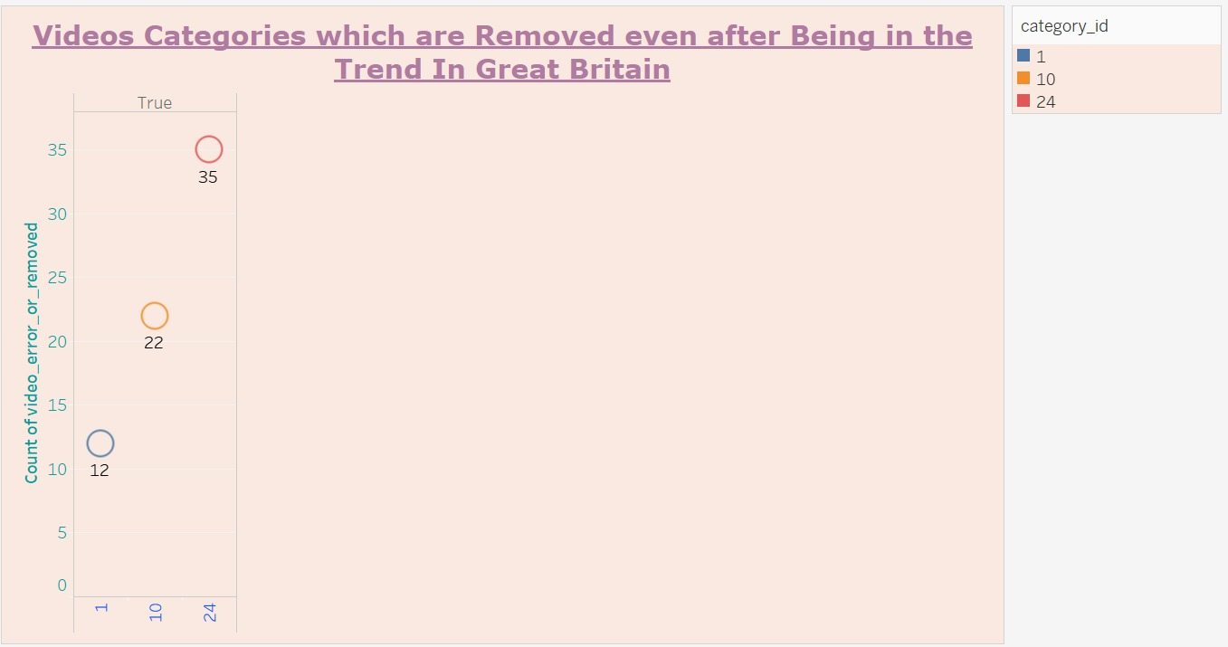
Tableau Chart – Business Question 1
Notes:
To find the desired visualization, here we have taken / used video_error_or_removed field in the measure of count at row side and used category_id field at column side.
In the following output, it is very clear that there are three categories and all the three categories were in trend and later on removed in the Great Britain.

Slide 25
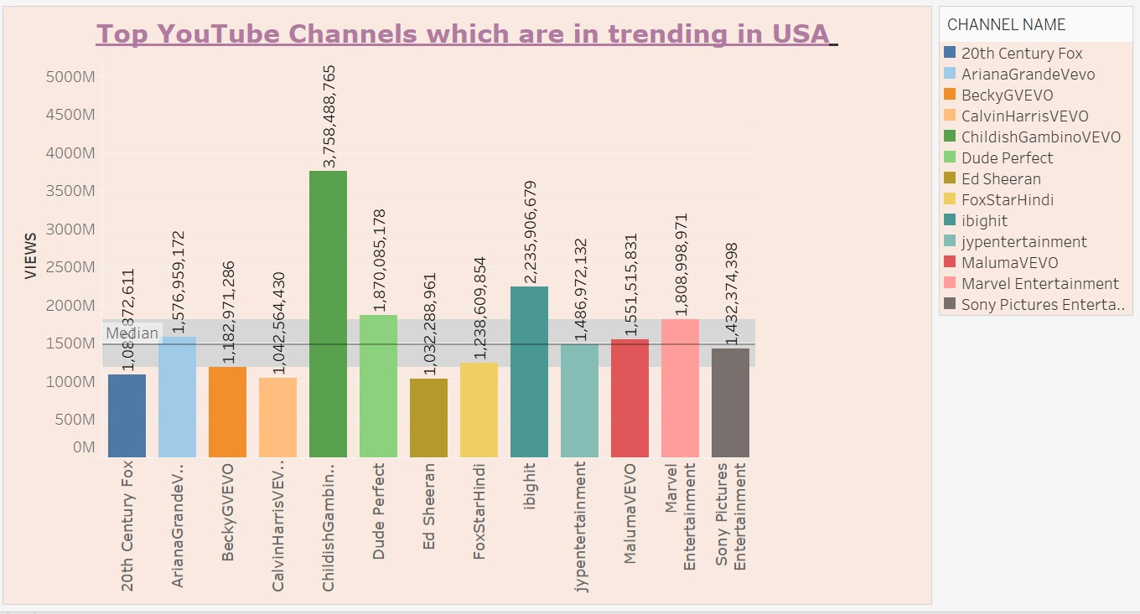
Tableau Chart - Business Question 2
Notes:
To find out the YouTube channels which are trending in the US we have used channel name and sum of the views.
We have used bubble graph here to represent the outcome of this business question.

Slide 26
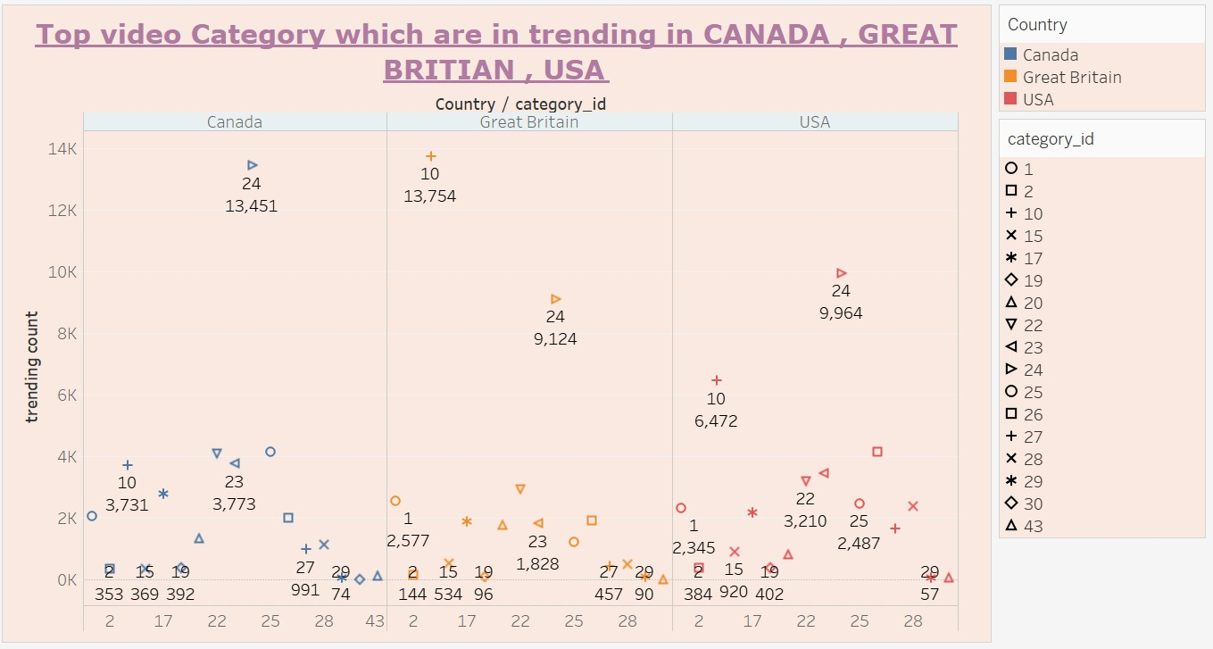
Tableau Chart - Business Question 3
Notes:
In order to come up with the most trending YouTube videos in the three countries USA, Canada and Great Britain.
Here we have loaded country and category fields in the column area and sum of trending videos in the row area.

Slide 27
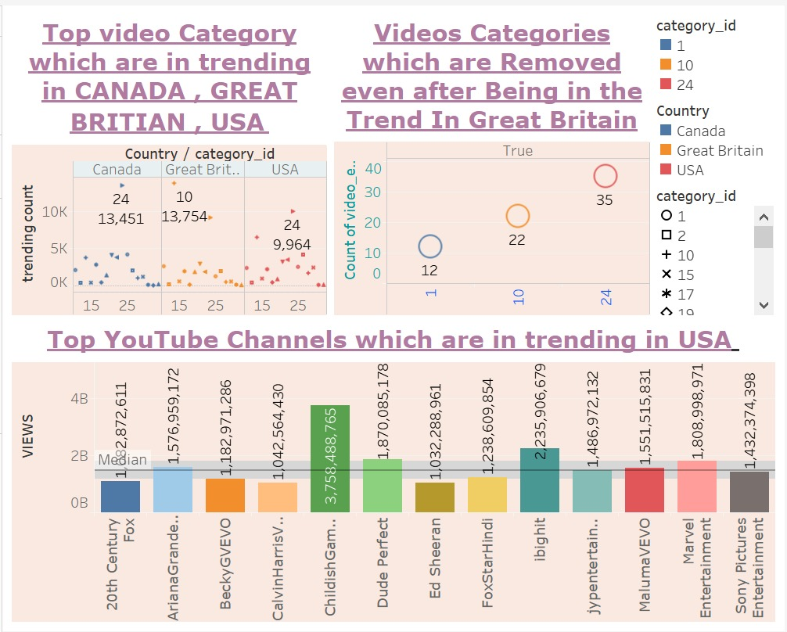
Dashboard Chart
Notes:
This is dashboard that contains all the three outcomes we have come up with by analysis of the three business questions.

Slide 28

Any Questions ?

Slide 29

Thank You…

