Slide 1
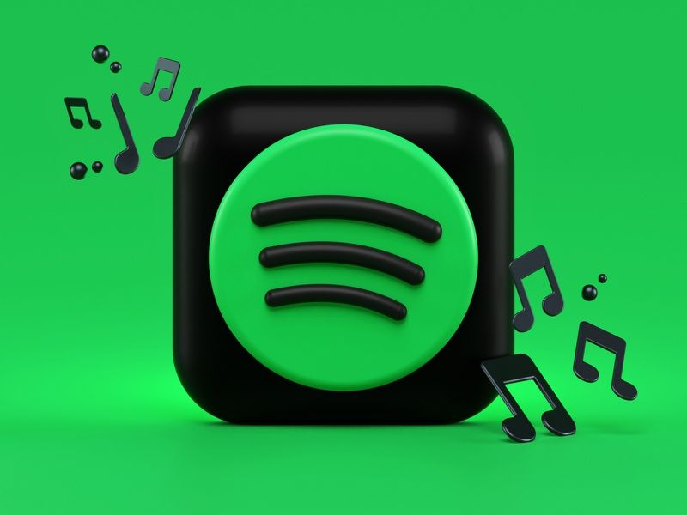
Spotify
Project Marketing Analytics

Slide 2
Industry Summary
Spotify is a music streaming company delivering services to 75 million active users globally.
Spotify is currently offering two type of subscriptions: a free and a premium subscription.
This marketing plan is about Spotify finding why do customer churn.

Slide 3
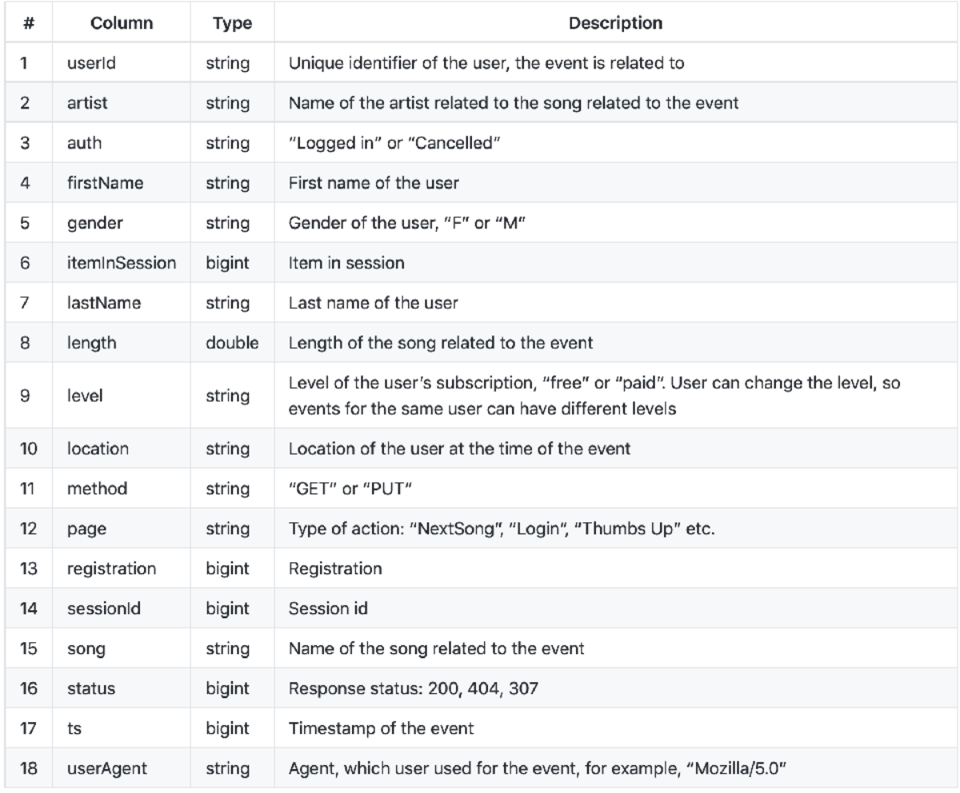
Data columns with description

Slide 4
For data cleaning we have converted timestamp(ts) column into date and time and separated Hour, Day, Month and year.
Removed duplicate values and null values.
Cleaned location column by keeping last characters only that represents state ( eg. CA-California)
Created churn column using page column where if page == Cancellation Confirmation && page == Downgrade && page == Submit Downgrade then customers has churned (1) else not churned(0).
Data cleaning
& transformation

Slide 5
Data Modeling
Data modeling is a process used to define and analyze data requirements needed to support the business processes within the scope of corresponding information systems in organizations.
We have used following models so that we can determine which model is best.
We have also used correlation matrix heatmap to show the relation between the data.

Slide 6
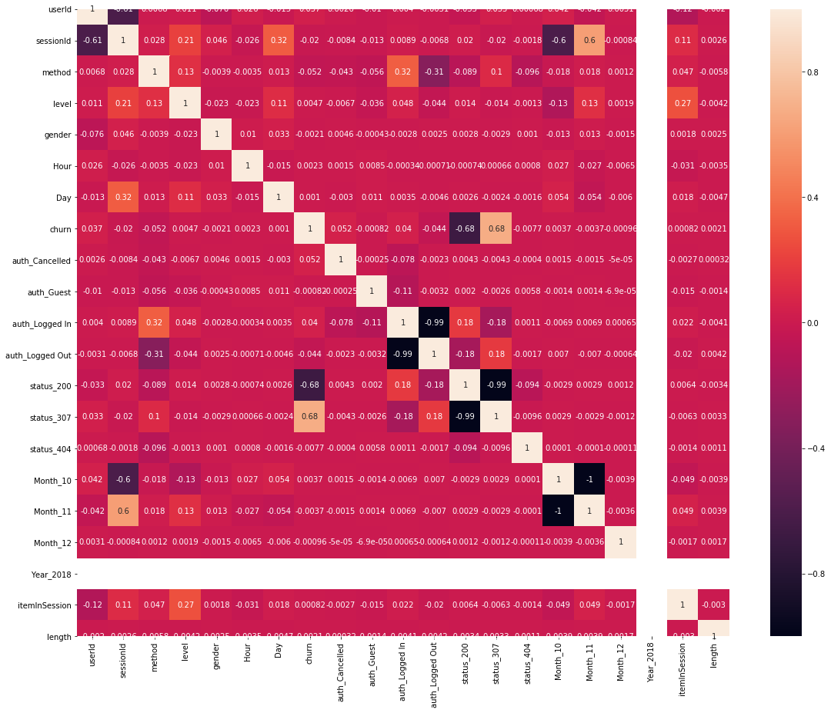
Correlation matrix heatmap

Slide 7
Models
Logistic Regression
Decision tree classifier
Random forest Classifier.
Linear SVC
Navie Bayes

Slide 8
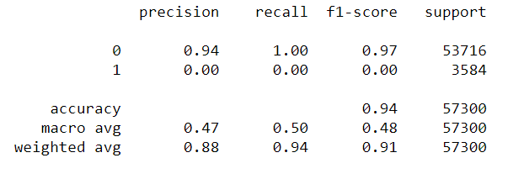
Logistic Regression
The accuracy is 94%

Slide 9
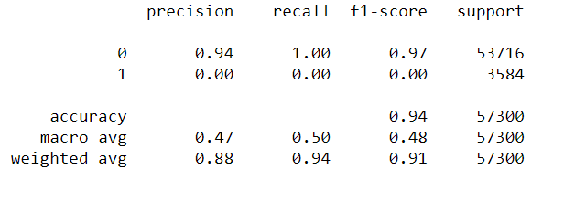
Decision Tree Classifier
The accuracy is 94%

Slide 10
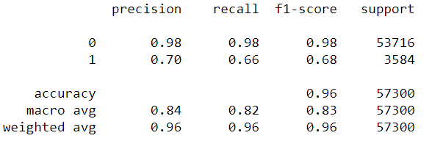
Random Forest Classifier
The accuracy is 96%.

Slide 11
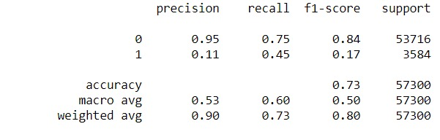
Linear SVC
The accuracy is 73%

Slide 12
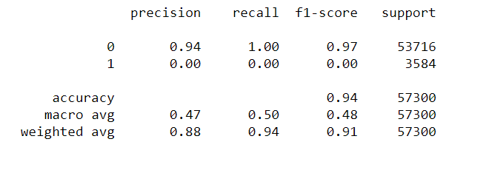
Naive Bayes
The accuracy is 94%.

Slide 13

Model Preferred.
The analysis shows Random forest classifier has the best accuracy which is 96%.

Slide 14
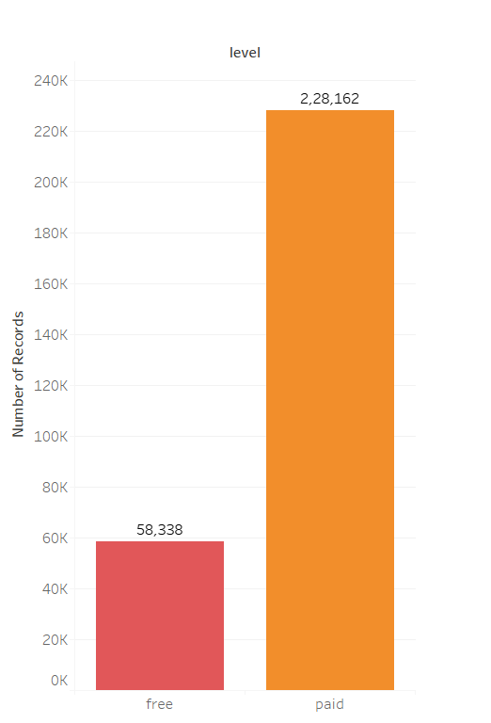
What we got more Subscribers or free users?
Visualization
We have more Paid users than Free users.
Number of Paid users are 2,28,162.
Number of Free users are 58,338.

Slide 15
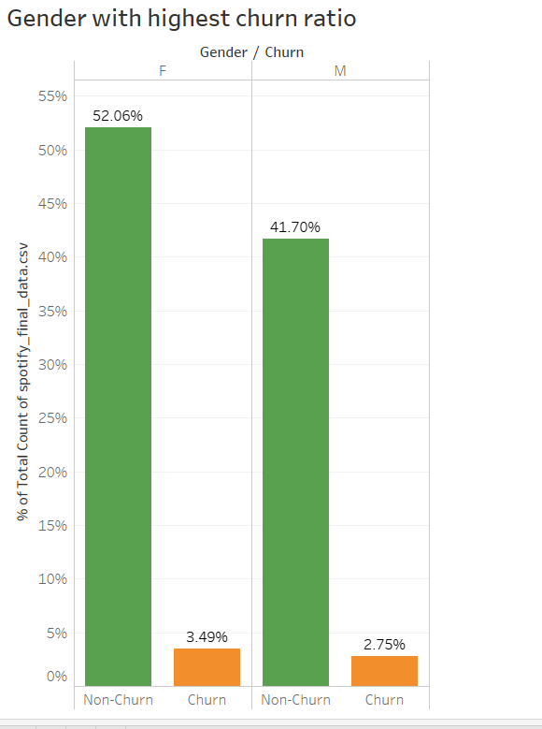
Which gender group churned more??
Comparing churn with overall percentage for male and female.
As result we found that:
Female users are more than male and likewise their churn ratio is also high.

Slide 16
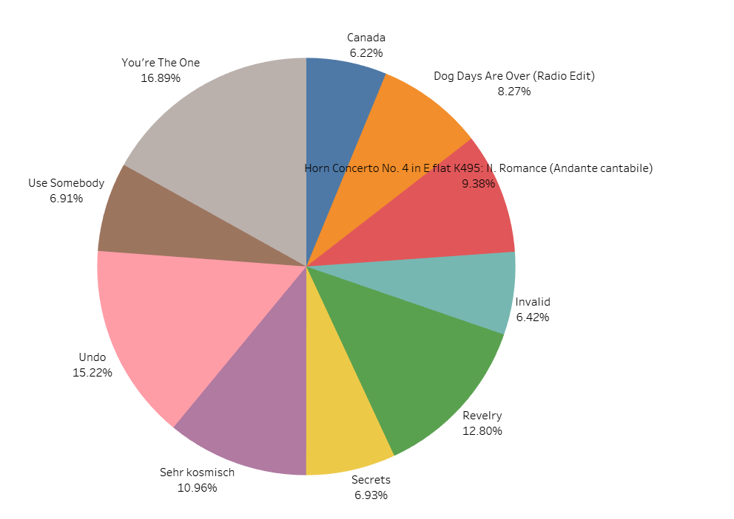
Which are top 10 songs?
A percentage wise ratio can be seen in this pie chart.
“You’re the One” seems to be more popular than any other song with 16.89%, followed by “Undo” at 15.22% among top 10 songs.

Slide 17
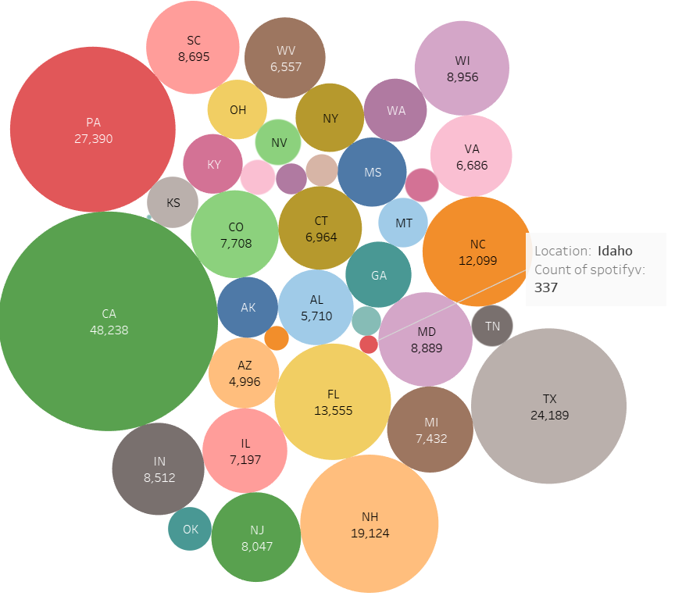
From which state do Spotify get more listeners?
This bubble chart gives a glimpse at what area Spotify got more listeners and where less.
California tops it with 48,238 songs played and Idaho has least with just 337 songs listened.

Slide 18
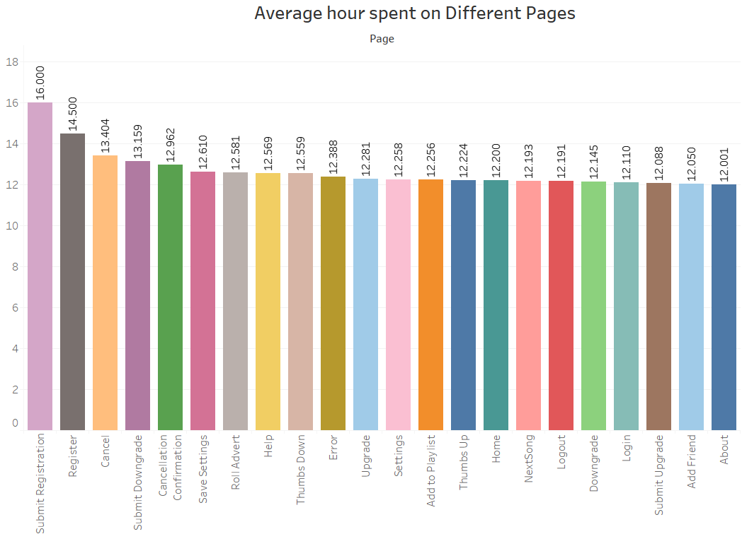
Time spent in Application for other cause.
As noticed 16 hours are spent for the registration process only.
Nearly 12 hours are spent just to know about the application

Slide 19
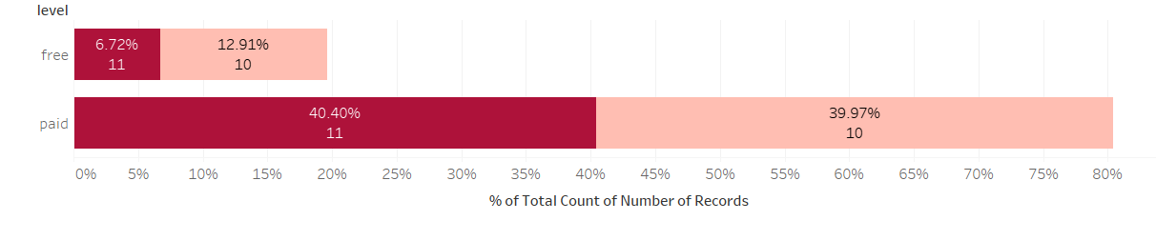
Type of services used by churn customers
Are people using free services or paid service?
Which month is affected more?
From the analysis we can say that paid subscribers are getting more churn compare to free users in the month of November.
Where dark pink is for October and light pink color represents November

Slide 20
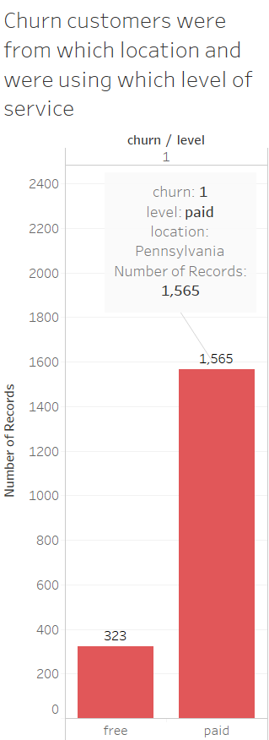
Location where people got more churned.
This graph gives us knowledge about the churn customers, were they using free services or paid services.

Slide 21
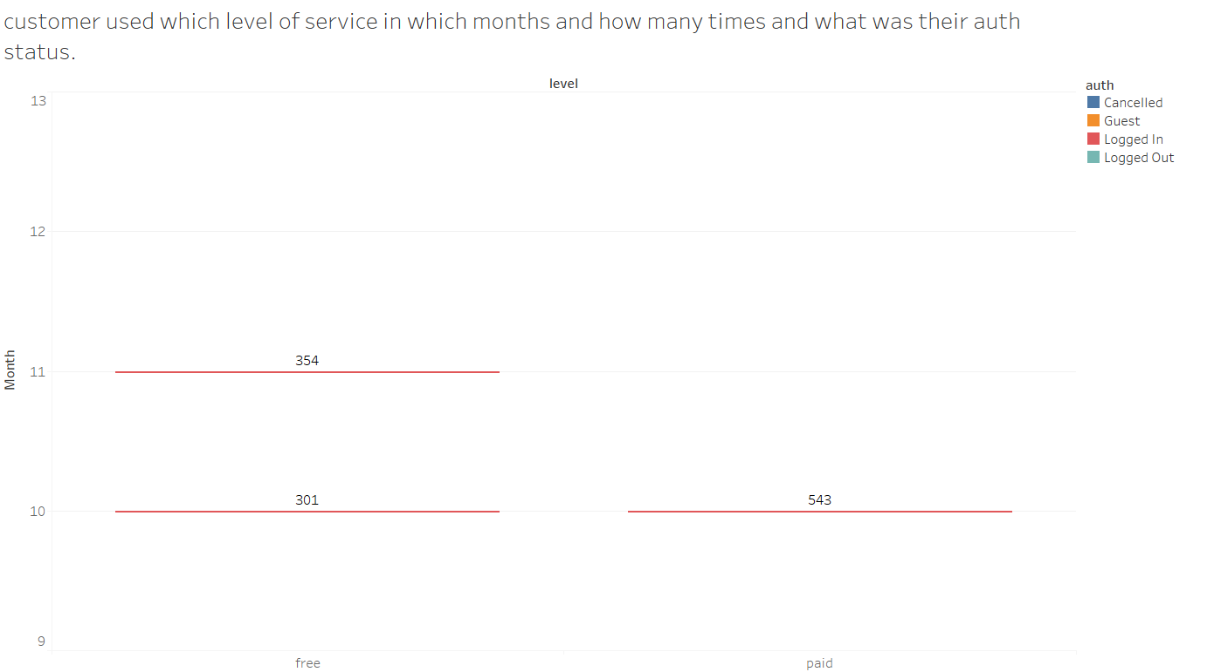
Level of service, Authentication Status and No. of time used.
We have made a survey where we can have all these information at once by monthly basis.

Slide 22
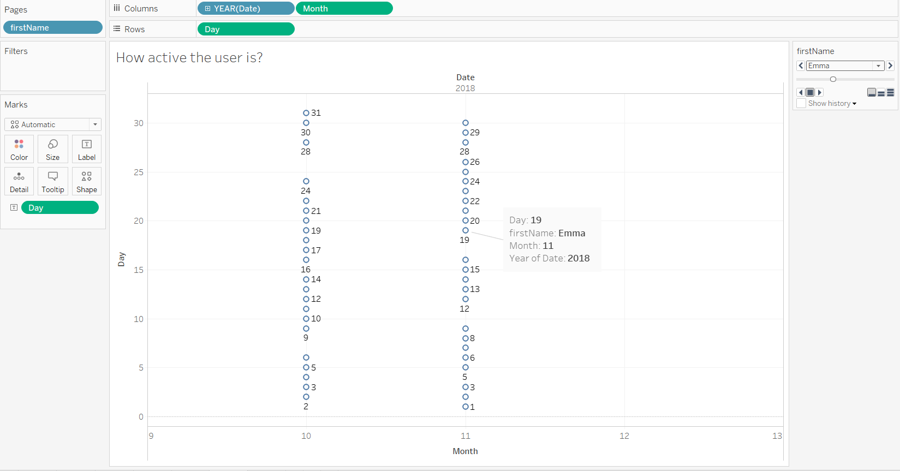
Active users
The data shows activity of the user each day of the months.
The data currently shows the activity of Emma

Slide 23
Thank you
Group 25:
Anant Patel (0756333)
Darshan Patel (0753849)
Parth Sutariya (0756042)
Rushil Patel (0755980)
Ruchita Tamboli (0756325)

