Slide 1
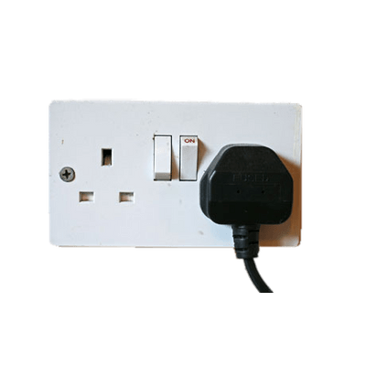
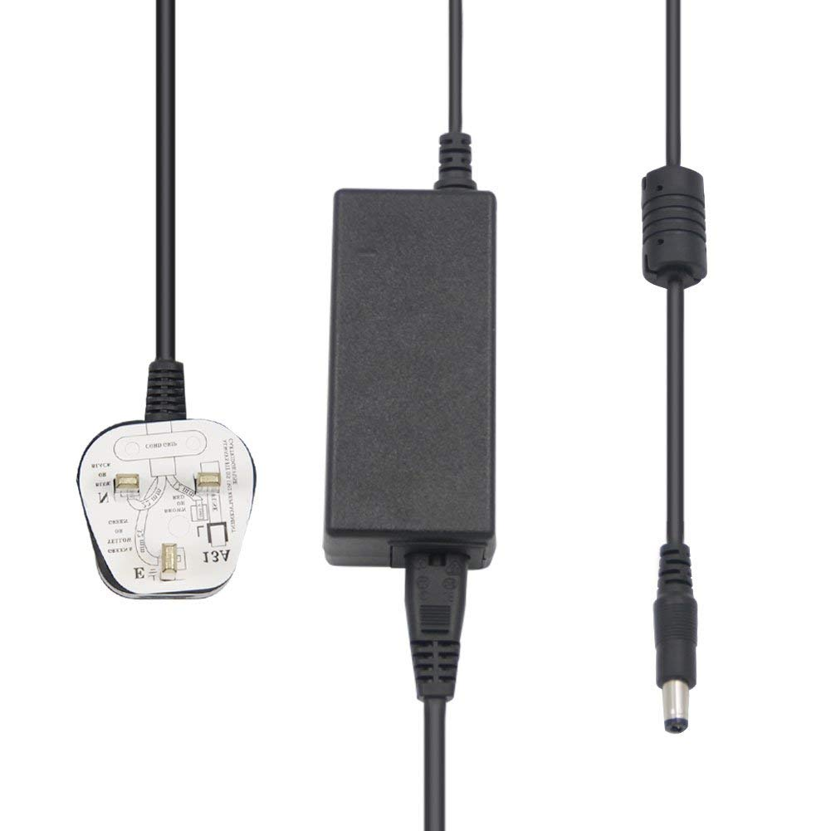
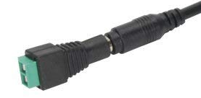
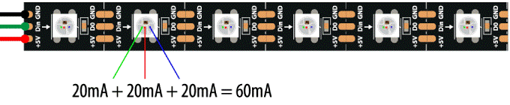
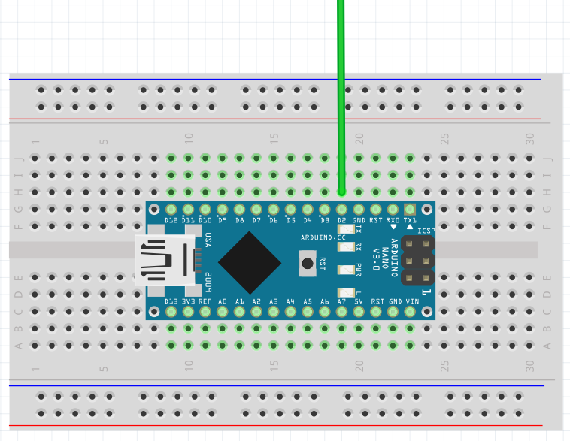

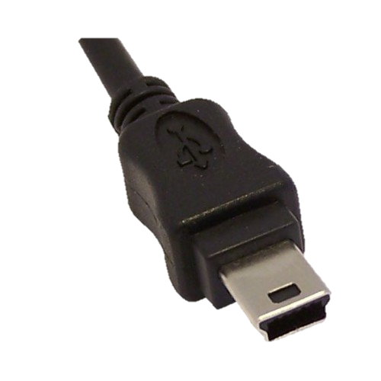
{
Power Supply
UK Plug
Connector
Adapter
Black Wire – Negative – Ground
12V 6A
2.1mm DC
2.1mm DC
to screw terminals
Red Wire – Positive/ Live – 12V
Green Wire – Data – 5V
WS2811 RGB LED Light Strip
5m of 60 LEDs/m = 300 LEDs
72 Watts / 12 Volts = 6 Amps
100 Addressable WS2811 ICs
P O W E R
{
400 Point
Computer
Mini USB Connector
Arduino – C/C++
FastLED Library
or NeoPixel Library
C O N T R O L
Solderless Breadboard
Arduino Nano V3

