Slide 1

umbraco.
AN INTRODUCTION

Slide 2
what is umbraco?
Content Management System framework
Open-Source (there is a paid for cloud hosting)
Technology Stack:
ASP.NET
MS SQL Server
Angular 1.0

Slide 3
what is umbraco?
Front End
Backoffice
umbraco
database

Slide 4
the bits & pieces
think of this as the blueprint of your model – definition of your content (model)
content is created by creating instances of a document type – instances are referred to as nodes
templates can be linked to multiple document types.
document types are hierarchical – can define parent and child document types
can access properties in document type in the template – all content models implement IPublishedContent
Document Type
Document Type
Property
Template (razor)
name
css
Editor (type)
js
master page
Property
Property

Slide 5

the flow
request
received by http module
request preparation
request preparation
Rules used to determine this
web forms
mvc / web forms
mvc
default / custom controller action
RenderMvcController
SurfaceController
ApiController
AuthorizedController
default / custom controller action
Can use umbraco helper / service context (exposes many services incl. ContentService for CRUD)
build model
build model
render content
response

Slide 6
i want more control
route hijacking
changing the default controllers
searching (examine/lucene.net/apache lucene)
customize the backoffice
custom property editors
macros

Slide 7
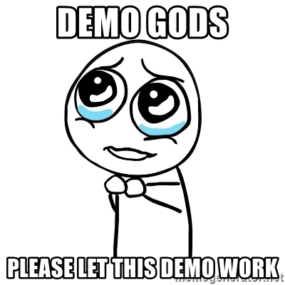
basic demo – sigma docs

