Slide 1

Data Structures and Algorithm
ENCRYPTION
Review-3

Slide 2


Table of contents
Introduction
Types of encryption
Implemented algorithms
Pseudo code
Output References

Slide 3
Abstract
Cyber security is a crucial part in today’s world. Be it a multi-national company or just a regular citizen, everyone is looking for ways to safeguard their personal information on the internet. This is not limited to the internet alone, it can be applicable for any digitalized information. There are numerous needs to securing data. For example, denying access to private chats, classified documents, and passwords. This information can be secured in a variety of ways. One can be using firewalls so hackers can’t get through such information in the first place. The other very important method being Encryption. Encryption is method of converting a normal file/text in a non human readable way. This prevents unauthorized access of such texts. If a hacker gets into a database they will gain access to all private information there.

Slide 4
Introduction
Problem statement: Cryptographic Algorithms
Main Objectives: Implementation of encryption algorithms
Application: Encrypting any highly confidential information like passwords, messages, documents and so on.

Slide 5
Encryption
In cryptography, encryption is the way toward encoding a message or data so that just approved gatherings can get to it and the individuals who are not approved can't. Encryption does not itself avert obstruction, however denies the clear substance to an eventual interceptor. In an encryption plot, the proposed data or message, alluded to as plaintext, is encrypted utilizing an encryption algorithm– a figure – creating cipher text that can be perused just whenever unscrambled. For specialized reasons, an encryption plot more often than not utilizes a pseudo-random encryption key created by an algorithm. It is on a fundamental level conceivable to decrypt the message without having the key, be that as it may, for a very much planned encryption plot, impressive computational assets and aptitudes are required. An approved recipient can without much of a stretch decrypt the message with the key given by the originator to beneficiaries but not to unapproved clients.

Slide 6
Symmetric Encryption
Asymmetric Encryption
Asymmetrical encryption is also known as public key cryptography, which is a relatively new method, compared to symmetric encryption. Asymmetric encryption uses two keys to encrypt a plain text. Secret keys are exchanged over the Internet or a large network. It ensures that malicious persons do not misuse the keys. It is important to note that anyone with a secret key can decrypt the message and this is why asymmetrical encryption uses two related keys to boosting security. A public key is made freely available to anyone who might want to send you a message. The second private key is kept a secret so that you can only know.
A message that is encrypted using a public key can only be decrypted using a private key, while also, a message encrypted using a private key can be decrypted using a public key. Security of the public key is not required because it is publicly available and can be passed over the internet. Asymmetric key has a far better power in ensuring the security of information transmitted during communication.
This is the simplest kind of encryption that involves only one secret key to cipher and decipher information. Symmetrical encryption is an old and best-known technique. It uses a secret key that can either be a number, a word or a string of random letters. It is a blended with the plain text of a message to change the content in a particular way. The sender and the recipient should know the secret key that is used to encrypt and decrypt all the messages. Blowfish, One time Pad, AES, RC4, DES, RC5, and RC6 are examples of symmetric encryption. The most widely used symmetric algorithm is AES-128, AES-192, and AES-256.
The main disadvantage of the symmetric key encryption is that all parties involved have to exchange the key used to encrypt the data before they can decrypt it.

Slide 7
RSA Algorithm
RSA algorithm is an asymmetric cryptography algorithm.That is,It works on Public Key and Private Key.
Only the browser can decrypt the data.No third party can have the public key of this browser.
The basic logic implemented here is that factorization of an integer is quite hard to do.The public key consists of two numbers where one number is the result of the multiplication of two large prime numbers.The private key is also derived from the same.
The strength of encryption depends on the key size.If the key size is doubled or tripled, the encryption strength increases exponentially.In general, keys from this algorithm can be around 1024 to 2048 bits long.
To generate the Public Key,
First two prime numbers “P” and “Q” are selected.The first part of the public key will be the multiplication product “n” of these two numbers where n=P*Q.A small exponent “e” is also required that must be an integer.This value should not be a factor of the multiplication product “n” of the two integers. Of course this value of “e” should be greater than one.
Thus, the public key is generated from the value of the multiplication product “n”of the two prime numbers and the value of “e”.
To generate the Private Key,
A function should be implemented on the product of the prime numbers such that the function should be equal to the product of each prime number minus 1.
That is, F(n)=(P-1)*(Q-1)
From this we generate our private key “d”: d=(K*F(n) +1)/e
Where k is an integer.
With the public key(“n” and “e”) and private key(“d”),words and numbers can be encrypted.
In case of words, The letters are converted into numbers based on the alphabetical order.
The Encrypted data c will be in the form of the digits put together whole to the power e and this modulus n.
The data will be decrypted as coo the power “d” modulus n.

Slide 8
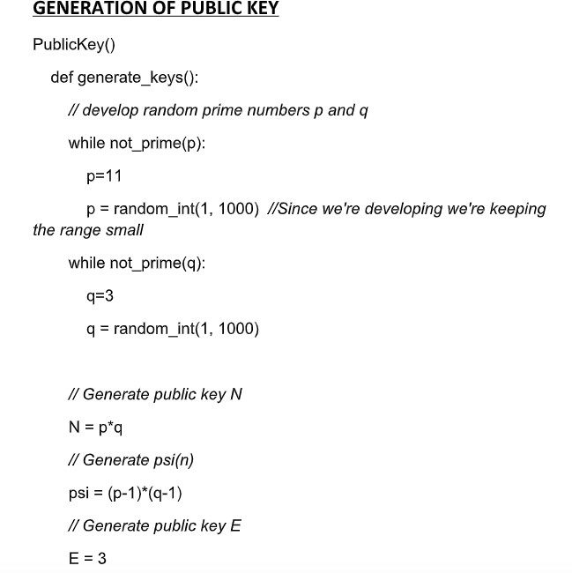
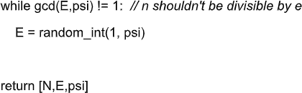
RSA Pseudocode
GENERATION OF PRIVATE KEY
PrivateKey()
def get_keys():
//collect keys
l =PublicKey.generate_keys()
//storing public keys N = l[0]
E = l[1]
psi=l[2]
#d is the private key d=modular_inverse(E, psi)
return [d,N,E]

Slide 9
GENERATION OF CIPHERTEXT
num = 0
Ciphertext()
ascii_val = ordinal(x)
// convert message into numbers
num = num*1000 + ascii_val
def to_num(s, N):
if i==(len(s)-1):
m = []
m.append(num)
num = 0
// convert every character to its ascii value
return m
for i=0 to (len(s)-1):
x=s[i]
def generate_ciphertext(m,N,E):
if num*100 &lt;= N:
ascii_val = ordinal(x)
c=[]
num = num*1000 + ascii_val
for i in m:
else:
// Split, append to list
//DEVELOP CIPHER TEXT
m.append(num)
t = (i**E)%N

Slide 10
DECRYPTION
Decryption()
m1=[]
def decrypt(c,d,N):
for i=every element in c: //c is list of ciphertext t= (i**d) % N
m1.append(t)
return (m1)
//convert the numeric value back to message def to_message(m2):
s=&#39;&#39;
for i =len(m2)-1 to 0:
n=m2[i] while n!=0: t2=n%1000
n=n//1000 ch=chr(t2) s=ch + s return s

Slide 11
RSA Code
#include<stdio.h>
#include<conio.h>
#include<stdlib.h>
#include<math.h>
#include<string.h>
long int p,q,n,t,flag,e[100],d[100],temp[100],j,m[100],en[100],i;
char msg[100];
int prime(long int);
void ce();
long int cd(long int);
void encrypt();
void decrypt();
void main() {
printf("\nENTER FIRST PRIME NUMBER\n");
scanf("%d",&p);
flag=prime(p);
if(flag==0) {
printf("\nWRONG INPUT\n");
getch();
exit(1);
}
printf("\nENTER ANOTHER PRIME NUMBER\n");
scanf("%d",&q);
flag=prime(q);
if(flag==0||p==q) {
printf("\nWRONG INPUT\n");
getch();
exit(1);
}
printf("\nENTER MESSAGE\n");
fflush(stdin);
scanf("%s",msg);
for (i=0;msg[i]!=NULL;i++)
m[i]=msg[i];
n=p*q;
t=(p-1)*(q-1);
ce();
printf("\nPOSSIBLE VALUES OF e AND d ARE\n");
for (i=0;i<j-1;i++)
printf("\n%ld\t%ld",e[i],d[i]);
encrypt();
decrypt();

Slide 12
RSA Code
getch();
}
int prime(long int pr) {
int i;
j=sqrt(pr);
for (i=2;i<=j;i++) {
if(pr%i==0)
return 0;
}
return 1;
} void ce() {
int k;
k=0;
for (i=2;i<t;i++) {
if(t%i==0)
continue;
flag=prime(i);
if(flag==1&&i!=p&&i!=q) {
e[k]=i;
flag=cd(e[k]);
if(flag>0) {
d[k]=flag;
k++;
}
if(k==99)
break;
}
}
}
long int cd(long int x) {
long int k=1;
while(1) {
k=k+t;
if(k%x==0)
return(k/x);
}
} void encrypt() {
long int pt,ct,key=e[0],k,len;
i=0;
len=strlen(msg);
while(i!=len) {
pt=m[i];
pt=pt-96;
k=1;

Slide 13
RSA Code
for (j=0;j<key;j++) {
k=k*pt;
k=k%n;
}
temp[i]=k;
ct=k+96;
en[i]=ct;
i++;
}
en[i]=-1;
printf("\nTHE ENCRYPTED MESSAGE IS\n");
for (i=0;en[i]!=-1;i++)
printf("%c",en[i]);
}
void decrypt() {
long int pt,ct,key=d[0],k;
i=0;
while(en[i]!=-1) {
ct=temp[i];
k=1;
for (j=0;j<key;j++) {
k=k*ct;
k=k%n;
}
pt=k+96;
m[i]=pt;
i++;
}
m[i]=-1;
printf("\nTHE DECRYPTED MESSAGE IS\n");
for (i=0;m[i]!=-1;i++)
printf("%c",m[i]); }

Slide 14
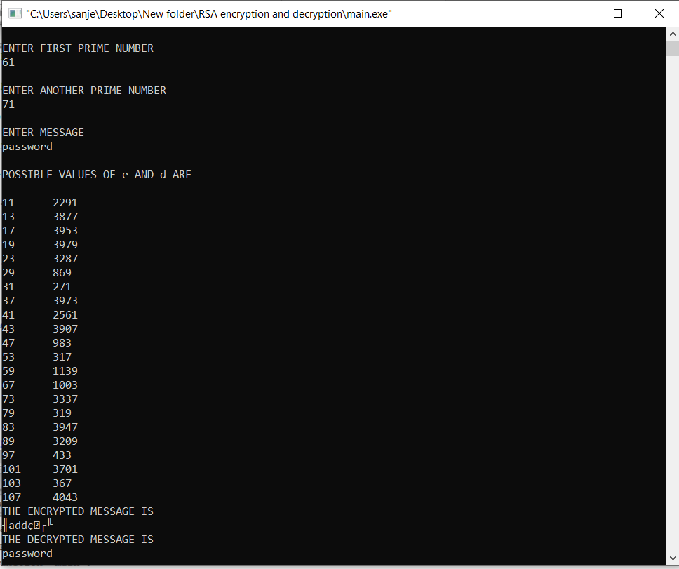
Output Snippet

Slide 15



User End:Sign Up
Input:Email
B
Input:Password
A
Public key 1.n
RSA Encryption
2.e
(A)
End User
RC4
(e)
RC4
(n)
Input:Email ID
Database
Input:Password
Encrypted (e)
Encrypted (n)
Encrypted password
Usr ID

Slide 16
Database (having x user inputs)
User ID
Encrypted (e)
Encrypted (n)
Encrypted password
B
(e’)
(n’)
(A’)
End User:(Sign In)
Input:Email ID (C)
for(i in x){
i++
Decrypt (e’)
Decrypt(n’)
If (C==B ){
E
N
RSA encryption (D)
D’
If (D’==A’)
{“Entry Successful”} Else {fail} }

Slide 17
Steps Involved and Applications of RSA algorithm
FACT 1. Prime generation is easy: It’s easy to find a random prime number of a given size.
FACT 2. Multiplication is easy: Given p and q, it’s easy to find their product, n = pq.
CONJECTURE 3. Factoring is hard: Given such an n, it appears to be quite hard to recover the prime factors p and q.
Despite hundreds of years of study of the problem, finding the factors of a large number still takes a long time in general. The fastest current methods are much faster than the simple approach of trying all possible factors one at a time. (Such a method would take on the order of n steps.) However, they are still expensive. For instance, it has been estimated recently that recovering the prime factors of a 1024-bit number would take a year on a machine costing US $10 million. A 2048-bit number would require several billion times more work.
FACT 4. Modular exponentiation is easy: Given n, m, and e, it’s easy to compute c = me mod n.
FACT 5. Modular root extraction – the reverse of modular exponentiation – is easy given the prime factors: Given n, e, c, and the prime factors p and q, it’s easy to recover the value m such that c = me mod n.
Applications of RSA Algorithm-
Public-key cryptography finds its strongest application when parties who have no prior relationship (and therefore no opportunity to establish shared secret keys) want to exchange sensitive data with each other. Applications that didn’t have centralized control – like e-mail – were meanwhile growing without much attention to security. Therefor they became an application of RSA algorithm. Soon online shopping websites felt the need to encrypt their user data and thus took the help of RSA algorithm.

Slide 18
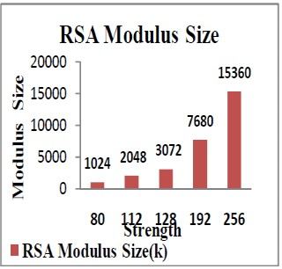
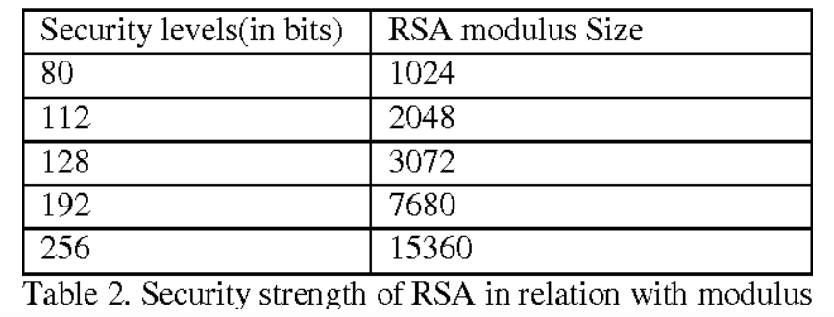
SECURITY STRENGTH OF RSA
Cryptographic algorithms provide various “strengths” of security, depending on the algorithm and the key size used. The algorithms are considered and compared the strength for the given key sizes. If the amount of task needed to “smash the algorithms” or establish the keys [14] is approximately the same using a given resource. The security strength of an algorithm for a given key size is conventionally described in terms of the quantity of work it takes to try all keys for a symmetric algorithm with a key size of "X" that has no short cut attacks (i.e., the most efficient attack is to try all possible keys). In this case, the best attack is said to be the fatigue attack. An algorithm that has a Y-bit key, but whose strength is equivalent to an X-bit key of such a symmetric algorithm is said have a “security strength of X bits” or to provide “X bits of security” based on Integer Factorization Cryptography.
NIST key management guidelines further suggest that 15360-bit RSA keys are equivalent in strength to 256-bit symmetric keys.

Slide 19
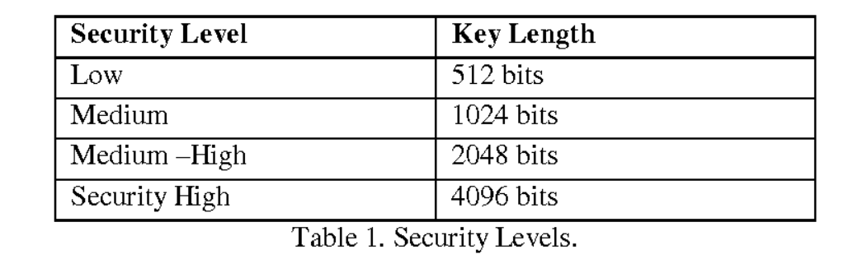
Security Level of RSA
The space complexity of RSA can be expressed as O(n^2).

Slide 20

RC4 Algorithm
A key input is pseudorandom bit generator that produces a stream 8-bit number that is unpredictable without knowledge of input key, The output of generator is called key-stream, is combined one byte at a time with the plaintext stream cipher using X-OR operation.
1.Key-Generation Algorithm –
A key of variable length from 1 to 256 bytes is used to initialize a 256-byte state vector S, with elements S[0] to S[255].
For encryption and decryption, a byte k is generated from S by selecting one of the 255 entries in systematic fashion, then the entries in S are permuted again.
K is repeated as many times as necessary to fill T.
current configuration of S. After reaching S[255] the process continues, starting from S[0] again.
2.Key-Scheduling Algorithm: Initialization: The entries of S are set equal to the values from 0 to 255 in ascending order, a temporary vector T, is created.
If length of the key k is 256 bytes, then k is assigned to T. Otherwise, for a key with length(k-len) bytes, the first k-len elements of T as copied from K and then
3.Pseudo random generation algorithm (Stream Generation):
Once the vector S is initialized, the input key will not be used. In this step, for each S[i] algorithm swap it with another byte in S according to a scheme dictated by
4.This is followed by encryption using XOR.

Slide 21
Strengths of RC4
•
•
The difficulty of knowing where any value is in the table.
The difficulty of knowing which location in the table is used to select each value in the
sequence.
Encryption is about 10 times faster than DES.
Limitations of RC4
•
•
RC4 is no longer considered secure.
One in every 256 keys can be a weak key. These keys are identified by cryptanalysis
that is able to find circumstances under which one of more generated bytes are strongly
correlated with a few bytes of the key.
A particular RC4 Algorithm key can be used only once.
Performance
Each of the UDI implementations is a hardware block specifically designed for the
implementation. RAM space is required by the key byte generator to locally maintain
the state table for key generation. This state would need to be preserved and restored
in case of a context switch if other processes would need the same functionality. This
overhead is not considered in the above performance projections. Encryption and
decryption state data may be stored in separate state memories to allow for
independent processes.
•
The following table summarizes the number of MIPS required for the algorithm
encryption/decryption for 1 million bits per second for each of the three
implementations.

Slide 22
RC4 Pseudocode
PSEUDOCODE RC4
ENCRYPTION:
STEP1:
key=>list(ASCII VALUES(key)) #repeat the same with the text also
STEP2: j=0,s=[0,1..,255]
for i in range(256) j=(j+s[i]+key[i%keylength])%256 swap(s[i],s[j])
return s
STEP3:
i=0,j=0,key=[]
while lengthoftext>0 i=(i+1)%256 j=(j+s[i])%256
swap(s[i],s[j])
K=s[(s[i]+s[j])%256]
key.append(K) lengthoftext-=1
return key
STEP4:
cipher=XOR(text,key) #the value of text after STEP1 return hexadecimal(cipher)
DECRYPTION:
STEP1:
cipher=decimal(cipher) #convert hexadecimal to decimal #repeat step1,step2,step3 of encryption with the key entered text=XOR(cipher,key)
STEP2:
return chr(text) #returns the character values of the ASCII given

Slide 23
RC4 Code (Python)
import sys
import binascii
def key_to_bytes(key):
keyinput = list(range(len(key)))
for c in range(0, len(key)):
keyinput[c] = ord(key[c])
return keyinput
def make_stream_source(key):
keylen = len(key)
stream = list(range(256))
j = 0
for i in range(0, 256):
j = (j + stream[i] + key[i % keylen]) % 256
temp = stream[i]
stream[i] = stream[j]
stream[j] = temp
return stream
def gen_stream(key, source):
i = 0
j = 0
while True:
i = (i + 1) % 256
j = (j + source[i]) % 256
temp = source[i]
source[i] = source[j]
source[j] = temp
k = source[(source[i] + source[j]) % 256]
yield k
def main():
if len(sys.argv) == 2:
keyinput = sys.argv[1]
else:
keyinput = input('enter a key to use: ')
plaintext = input('enter a string for encrypting: ')
if len(keyinput) < 5 or len(keyinput) > 32:
print("Key must be between 5 bytes and 32 bytes long")
exit()
keyinput = key_to_bytes(keyinput)
print('key:', keyinput)
stream_source = make_stream_source(keyinput)
print('stream source:', stream_source)
stream = gen_stream(keyinput, stream_source)
for char in plaintext:
sys.stdout.write("%02X" % (ord(char) ^ next(stream)))
print()
if __name__ == '__main__':
main()

Slide 24
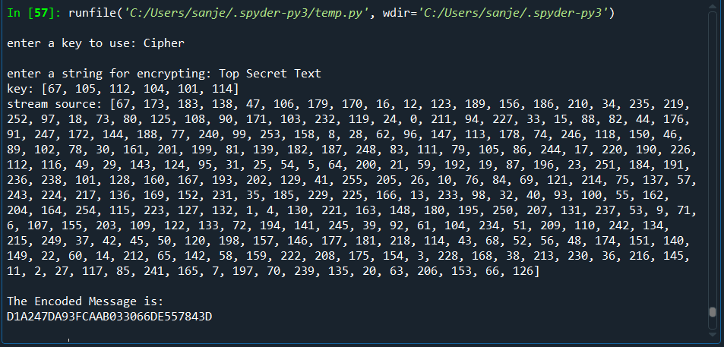
Output Snippet

Slide 25
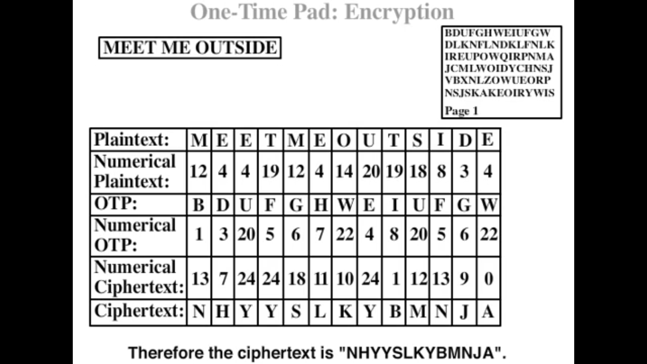
One-Time-Pad Algorithm
In cryptography, the one-time pad (OTP) is an encryption technique that cannot be cracked, but requires the use of a one-time pre-shared key the same size as, or longer than, the message being sent. In this technique, a plaintext is paired with a random secret key(also referred to as a one-time pad). Then, each bit or character of the plaintext is encrypted by combining it with the corresponding bit or character from the pad using modular addition. If the key is (1) truly random, (2) at least as long as the plaintext, (3) never reused in whole or in part, and (4) kept completely secret, then the resulting ciphertext will be impossible to decrypt or break. It has also been proven that any cipher with the property of perfect secrecy must use keys with effectively the same requirements as OTP keys. Digital versions of one-time pad ciphers have been used by nations for critical diplomatic and military communication, but the problems of secure key distribution have made them impractical for most applications.

Slide 26
Applicability
Despite its problems, the one-time-pad retains some practical interest. In some hypothetical espionage situations, the one-time pad might be useful because it can be computed by hand with only pencil and paper. Indeed, nearly all other high quality ciphers are entirely impractical without computers. In the modern world, however, computers (such as those embedded in personal electronic devices such as mobile phones) are so ubiquitous that possessing a computer suitable for performing conventional encryption (for example, a phone that can run concealed cryptographic software) will usually not attract suspicion.
The one-time-pad is the optimum cryptosystem with theoretically perfect secrecy.
The one-time-pad is one of the most practical methods of encryption where one or both parties must do all work by hand, without the aid of a computer. This made it important in the pre-computer era, and it could conceivably still be useful in situations where possession of a computer is illegal or incriminating or where trustworthy computers are not available.
One-time pads are practical in situations where two parties in a secure environment must be able to depart from one another and communicate from two separate secure environments with perfect secrecy.
The one-time-pad can be used in super encryption.
The algorithm most commonly associated with quantum key distribution is the one-time pad.
The one-time pad is mimicked by stream ciphers.
The one-time pad can be a part of an introduction to cryptography.
Why is it Unbreakable?
The key is unbreakable owing to the following features −
The key is as long as the given message.
The key is truly random and specially auto-generated.
Key and plain text calculated as modulo 10/26/2.
Each key should be used once and destroyed by both sender and receiver.
There should be two copies of key: one with the sender and other with the receiver.

Slide 27
LIMITATIONS AND STRENGTH OF ONE TIME PAD
LIMITATIONS
1.The key is long as the message
2.Only secure if each key is used to encrypt a single message
STRENGTHS
The only unbreakable cryptosystem known - the Vernam cipher or One Time Pad (OTP). Of all the methods of encryption ever devised, only one has been mathematically proved to be completely secure. It is called the Vernam cipher or one-time pad. The worth of all other ciphers is based on computational security.
The key is truly random and specially auto-generated.
Key and plain text calculated as modulo 10/26/2.

Slide 28
ENCRYPTION CODE
#include<stdio.h>
#include<string.h>
#include<ctype.h>
main() { //All the text which ever entered is converted to upper and without spaces
int i,j,len1,len2,numstr[100],numkey[100],numcipher[100];
char str[100],key[100],cipher[100];
printf("Enter a string text to encrypt\n");
gets(str);
for(i=0,j=0;i<strlen(str);i++)
{
if(str[i]!=' ')
{
str[j]=toupper(str[i]);
j++;
}
}
str[j]='\0';
//obtaining numerical plain text ex A-0,B-1,C-2
for(i=0;i<strlen(str);i++)
{
numstr[i]=str[i]-'A';

Slide 29
}
printf("Enter key string of random text\n");
gets(key);
for(i=0,j=0;i<strlen(key);i++)
{
if(key[i]!=' ')
{
key[j]=toupper(key[i]);
j++;
}
}
key[j]='\0';
//obtaining numerical one time pad(OTP) or key
for(i=0;i<strlen(key);i++)
{
numkey[i]=key[i]-'A';
}
for(i=0;i<strlen(str);i++)
{
numcipher[i]=numstr[i]+numkey[i];
}
//To loop the number within 25 i.e if addition of numstr and numkey is 27 then numcipher should be 1
for(i=0;i<strlen(str);i++)

Slide 30
{
if(numcipher[i]>25)
{
numcipher[i]=numcipher[i]-26;
}
}
printf("One Time Pad Cipher text is\n");
for(i=0;i<strlen(str);i++)
{
printf("%c",(numcipher[i]+'A'));
}
printf("\n"); }

Slide 31
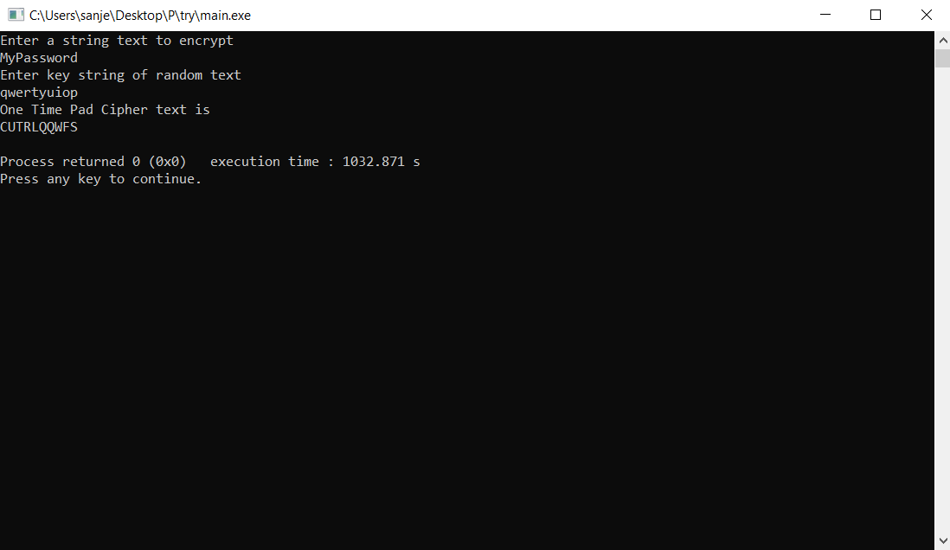
Encryption Output Snippet

Slide 32
DECRYPTION CODE
#include<stdio.h>
#include<string.h>
#include<ctype.h>
main()
{
//All the text which ever entered is converted to upper and without spaces
int i,j,len1,len2,numstr[100],numkey[100],numcipher[100];
char str[100],key[100],cipher[100];
printf("Enter an Encrypted string text to Decrypt\n");
gets(str);
for(i=0,j=0;i<strlen(str);i++)
{
if(str[i]!=' ')
{
str[j]=toupper(str[i]);
j++;
}
}
str[j]='\0';
//obtaining numerical plain text ex A-0,B-1,C-2
for(i=0;i<strlen(str);i++)
{
numstr[i]=str[i]-'A';

Slide 33
}
printf("Enter key string of random text\n");
gets(key);
for(i=0,j=0;i<strlen(key);i++)
{
if(key[i]!=' ')
{
key[j]=toupper(key[i]);
j++;
}
}
key[j]='\0';
//obtaining numerical one time pad(OTP) or key
for(i=0;i<strlen(key);i++)
{
numkey[i]=key[i]-'A';
}
for(i=0;i<strlen(str);i++)
{
numcipher[i]=numstr[i]-numkey[i];
//changed from + to - for decryption
if(numcipher[i]<0)
{
numcipher[i]=numcipher[i]+26; //If cipher is negative we have to add 26
}

Slide 34
numcipher[i]=numcipher[i]%26;//To loop within 1 to 26 for alphabets from A-Z
}
printf("Decrypted One Time Pad Cipher text is\n");
for(i=0;i<strlen(str);i++)
{
printf("%c",(numcipher[i]+'A'));
}
printf("\n");
}

Slide 35

Decryption Output Snippet

Slide 36
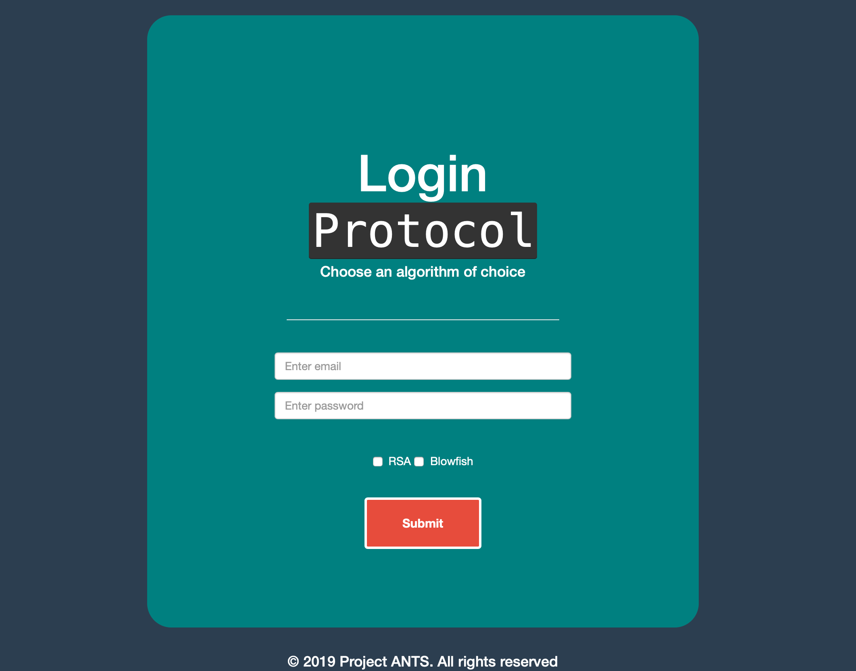
Login
As simple as just entering your email, password and selecting the method of encryption for your password.
Once submit is clicked, the selected algorithm runs and encrypts the password using it.

Slide 37
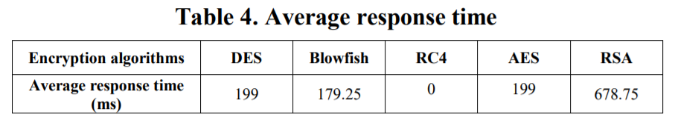
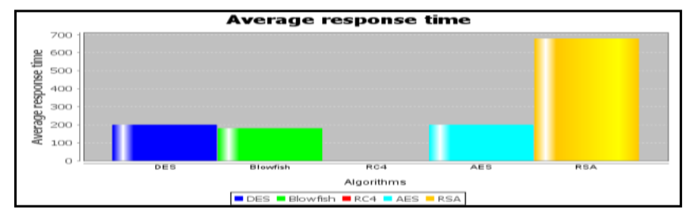
Response Time Comparison
We calculated the average response time (see Table 4), in order to compare the speed of execution with the five algorithms.
The results presented in Figure show that RC4 has better behavior compared to the other four algorithms. From the Table, we can estimate an average gain for the RC4 to 100% compared to DES, Blowfish, AES and RSA. .The efficiency of the RC4 algorithm in terms of response time, space memory and security becomes very high once we change the size of the rules base.

Slide 38
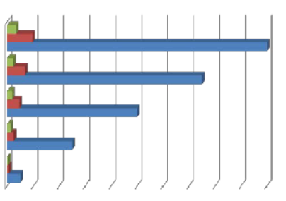
RC4 Vs RSA Execution Time
RC4 TE (Secs)
RSA TE (Secs)
File Size (Kb)
0 20 40 60 80 100 120 140 160 180 200
RC4 using five text files and five graphic files of different sizes of 10, 50, 100, 150, and 200 kilobyte respectively. The major factor considered for measuring the performance of the algorithms (RSA and RC4) is the speed of execution using time of execution (TE) as parameter for the evaluation. The RSA TE and RC4 TE were measured for both text file, and the graphic file. The result was tabulated as in table 1, and 2 below.
CONCLUSION - From the evaluations of both RSA and RC4 algorithms and the comparison presented, it was concluded that between RC4 and RSA, RSA is the most reliably secure algorithm. However, the RC4 seems to be faster in encryption and decryption process but rather less secure, as it can be broken using a relatively inexpensive device in a short time when compare with RSA.

Slide 39
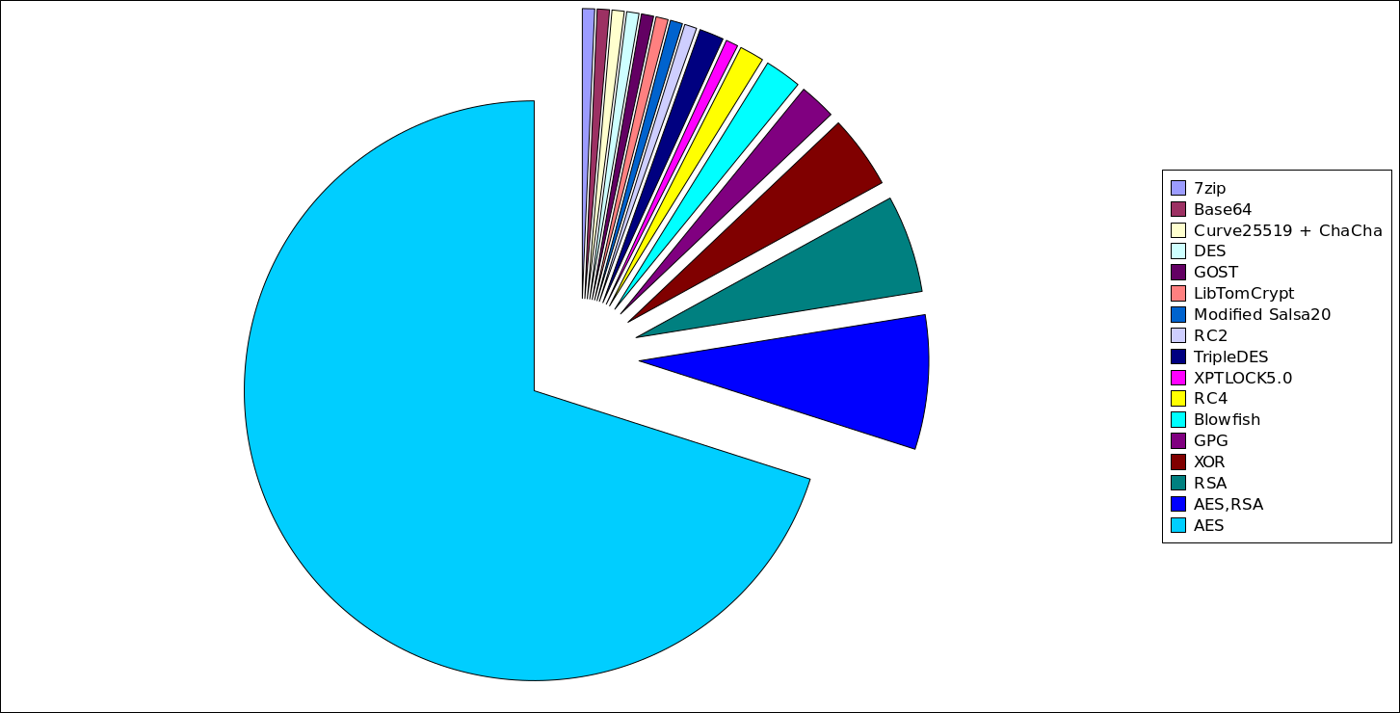
Most Popular cipher in ransomware families

Slide 40
Which is more secure – Symmetric or Asymmetric encryption?
In this Project we implemented 3 cryptography algorithms namely, RSA, RC4 and OTP. While RSA was asymmetric cryptography algorithm, RC4 and OTP are symmetric cryptography algorithm. After understanding their implementation and application in real world, We are now capable of concluding Which is more secure – Symmetric or Asymmetric encryption.
This is a difficult question to answer.
Most people believe that asymmetric encryption is more secure since it has both a public and a private key. But comparing the strength and resistance to attack of symmetric and asymmetric encryption isn’t that easy.
What is important here is the context.
Symmetric encryption is better used when trying to share information between a smaller number of people. It is easier to use and understand, so there are lower chances of the information being misinterpreted.
On the other hand, asymmetric encryption work way better on large groups of people (such as the internet).

Slide 41
Conclusion
Encryption is a complex topic, but it usually boils down to what you want to use it for.
This makes it hard to say that “asymmetric is better than symmetric” or vice-versa. While symmetric encryption might be the best fit for certain situations, in other cases asymmetric encryption might be the better choice.
Most of today’s systems (such as SSL or TLS) use a combination of both symmetric and asymmetric encryption, as well as other algorithms.
And while it might seem easy to say that encryption is strictly the concern of developers, that’s simply wrong. All of us should have a basic idea of how internet security works. That will help us better defend against potential attacks and will foster a responsible behavior when it comes to online activity.

Slide 42
References:
Geeks for Geeks
Wikipedia
https://www.vocal.com/cryptography/rc4-encryption- algoritm/
https://www.tutorialspoint.com/
https://dl.acm.org/

Slide 43
Contributors
RUSHIL GOEL 19BCE0361
ADARSH MISHRA 19BCE0437
AASHISH SARRAF 19BCE0433

