Slide 1
CS/COE 445 Data Structures
Lab 4 – Reversing a Linked List
(Based on Dr. Hoot’s Lab Manual for Data Structures and Abstractions with Java ™)

Slide 2
Reverse
The reverse operation is often supplied as a basic operation of a list.
One example is used to convert a list that was sorted from smallest to largest into a list that is sorted in the other direction.
To implement the reverse method, we will be using list surgery.
The order that operations are done can be critical.
  If you are not careful, the list will not survive the surgery.
To avoid problems with surgery, it is always a good idea to trace carefully the intended operation of methods before implementing the code.

Slide 3
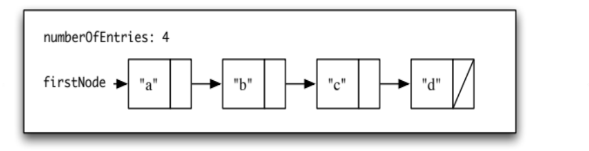
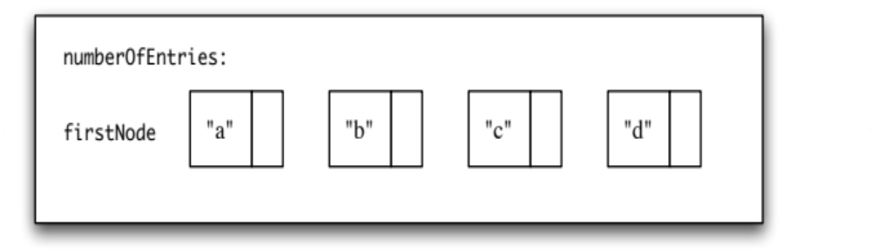
Visualization
The links (the next portions of the Nodes) will be altered in a single pass over the list.
Suppose there is a list with the following state:
What will the final state be after reverse()?
To reach the final state, follow these steps. Show the state of the list after each step.

Slide 4

Visualization
Start in the initial state. Use three variables to reference the first three nodes. (From now on, when referring to a position, it will be with respect to the order in the following diagram).
Make the first node’s next reference be null.
Make the second node’s next reference be the first node.
Change all three reference variables so that they move forward by one position.
Make the third node’s next reference be the second node.
Change all three reference variables so that they move forward by one.
Make the fourth node’s next reference be the third node.
Change the variable firstNode so that it references the fourth node.

Slide 5
Visualization
To be general, a loop will be needed. Write an algorithm for the reverse operation.
Consider each of the following cases and decide if the algorithm handles it correctly.
  A list with no elements
  A list with one element
  A list with two elements

