Slide 1
CS 0445 Algorithms and Data Structures 1
Bonus Lab – Iterators and Linear Probing

Slide 2
Hash Table that supports iteration
HashLLDS<V> is a hybrid of a linear-probing hash table and a linked list
It stores a list of (key, value) pairs
Key type is String, and Value type is a generic type parameter V.
Hash table access using get()
FIFO sequential access using an Iterator

Slide 3
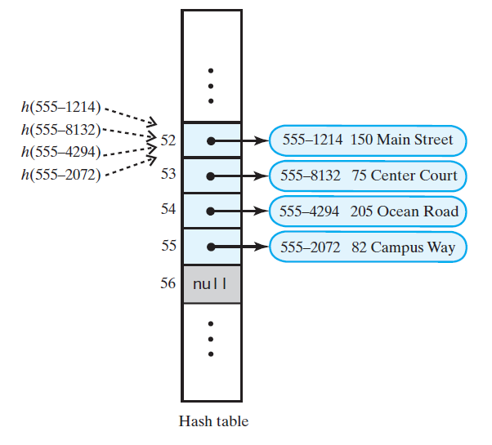
Search with Linear Probing
If another key is stored at index i = hash(key)
Check i+1, i+2, i+3 … until
  Key is found
  Empty (null) location is found
  We circle through the buffer back to i
555-1264

Slide 4
Linear probing example
h(x) = x mod 11
Insert 14, 17, 25, 37, 34, 16, 26
0
1
2
3
4
5
6
7
8
9
10
34
14
25
37
17
16
26
Notes:
Discuss implementing as a symbol table
Delete 17, look for 26
How to resolve?
Could flag deleted, and eventually redo whole table
Or redo rest of the cluster on every delete

Slide 5
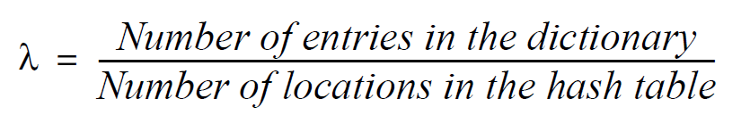
Load Factor
  Never negative
  For open addressing, 1 ≥ λ
  Restricting λ improves performance

Slide 6
Maintaining Performance of Hashing
To maintain efficiency, restrict load factor λ as follows:
  λ < 0.5 for open addressing
Should the load factor exceed these bounds
  Resize the hash table

Slide 7
Rehashing
When load factor λ is too large, resize the hash table
table’s new size?
  Double its present size
  Increase the result to the next prime number
  Use put to add current entries to new hash table

Slide 8
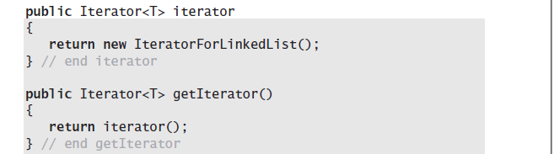
Iterator for LinkedList

Slide 9
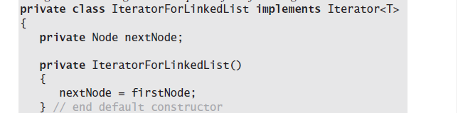
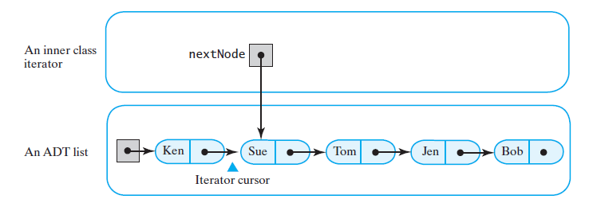
Iterator for Linked List

Slide 10
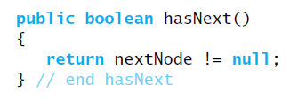
hasNext

Slide 11
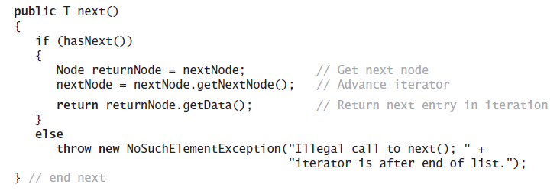
next

Slide 12
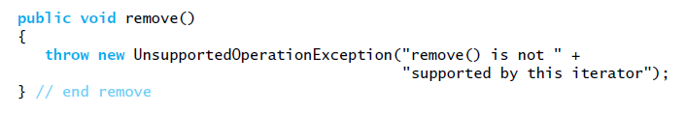
remove

