Slide 1
CS 0445 Algorithms and Data Structures 1
Lab 3 – Reversing a Linked List
(Based on Dr. Hoot’s Lab Manual for Data Structures and Abstractions with Java ™)

Slide 2
Reverse
The reverse operation is often supplied as a basic operation of a list
One example is used to convert a list that was sorted from smallest to largest into a list that is sorted in the other direction
To implement the reverse method, we will be using list surgery
The order that operations are done can be critical
  If you are not careful, the list will not survive the surgery
To avoid problems with surgery, it is always a good idea to trace carefully the intended operation of methods before implementing the code

Slide 3
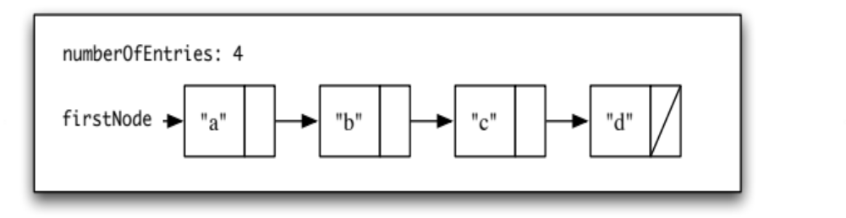
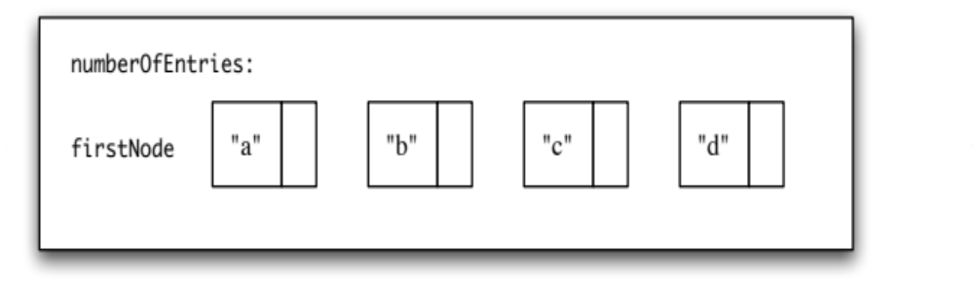
Visualization
The links (the next portions of the Nodes) will be altered in a single pass over the list
Suppose there is a list with the following state:
What will the final state be after reverse()?
To reach the final state, follow these steps. Show the state of the list after each step.

Slide 4

Visualization
Start in the initial state. Use three variables to reference a current node, the node before, and the node after. (From now on, when referring to a position, it will be with respect to the order in the following diagram).
Make the current node’s next reference be the previous node
Change all three reference variables so that they move forward by one step
Change the variable firstNode so that it references the last node that was processed

Slide 5
Visualization
To be general, a loop will be needed. What is the condition of the loop?
Write an algorithm for the reverse operation
Consider each of the following cases and decide if the algorithm handles it correctly.
  Empty list
  A list with one element (singelton)
  A list with two elements

