Slide 1
CS 445 Data Structures
Lab 5 – Stack Sort
(Based on Dr. Hoot’s Lab Manual for Data Structures and Abstractions with Java ™)

Slide 2
Stack Sort
Sorting is a general problem where given a collection of items, you arrange them in order from smallest to largest.
We will restrict ourselves to a collection of integer values in an array.
For example, if given the integers 8, 2, 9, 1, 1, 3; their sorted order is 1, 1, 2, 3, 8, 9.
You will examine a number of different sorting techniques in Chapters 8 and 9.
While it is not obvious, the sort that we will be doing in this lab is equivalent to the insertion sort from Chapter 8 and has the same performance.
As with any of the sorts from Chapter 8, the stack sort should not be used in general applications.

Slide 3
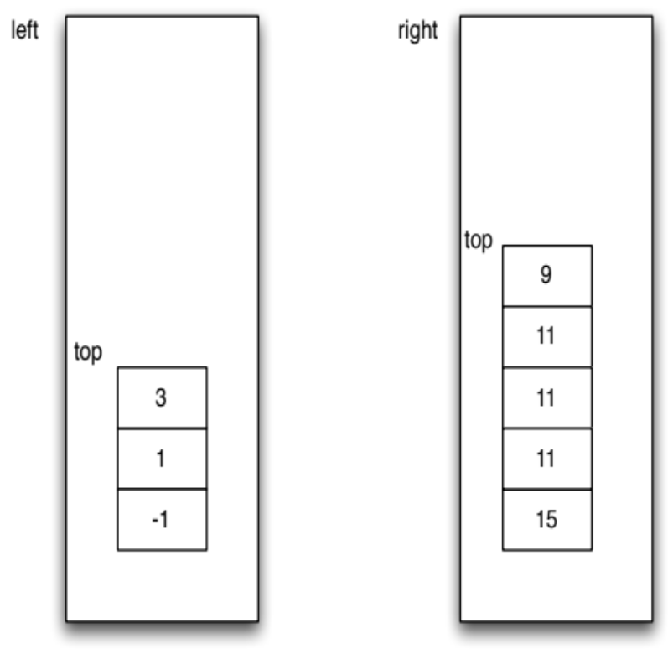
Visualization
In order to sort values we will use two stacks which will be called the left and right stacks.
The values in the stacks will be sorted and the values in the left stack will all be less than or equal to the values in the right stack.
The example illustrates a possible state for our two stacks.
Notice that the values in the left stack are sorted so that the smallest value is at the bottom of the stack.
The values in the right stack are sorted so that the smallest value is at the top of the stack.
If we read the values up the left stack and then down the right stack, we get -1, 1, 3, 9, 11, 11, 11, 15, which is in sorted order.

Slide 4
Visualization
Suppose that we have a new value that we want to put into our sorted collection. We will want to put it on the top of one of the two stacks, but we may have to first move values around.
Case 1: No moves required:
  Consider adding the value 5 to the example shown here.
  We do not have to move any values and can place the 5 on the top of either stack and still have a sorted collection.
  Which values would not require that the contents of the stacks be changed?

Slide 5
Visualization
Case 2: Moves from left to right required:
  Consider adding the value 0.
  We must move values from the left stack to the right stack.
  How many values must be moved and what is the state of the two stacks before we add the value 0?
  What condition should we use to determine if enough values have been moved?
  Consider adding the value -2. Again we must move values from the left stack to the right stack. How many values must be moved and what is the state of the two stacks before we add the value -2? What condition should we use to determine if enough values have been moved?
  Write code using iteration that will move values from the left to the right stack as required.

Slide 6
Visualization
Case 3: Moves from right to left required:
  Consider adding the value 11.
  We must move values from the right stack to the left stack.
  How many values must be moved and what is the state of the two stacks before we add the value 11?
  What condition should we use to determine if enough values have been moved?
  Consider adding the value 20 to the example shown above. Again we must move values from the right stack to the left stack.
  How many values must be moved and what is the state of the two stacks before we add the value 20?

Slide 7
Visualization
Adding all the values from an array into the two stacks:
1
We can add the values from the array one at a time to the stacks.
Putting together the pieces from the previous questions, write an algorithm for this task.
Putting the values into a new array:
2
For our particular sorting algorithm, we are going to create a second array with the values from the original array in sorted order.
Therefore, the final task we need to do before we return is to put the values into the result array.

Slide 8

Visualization
Suppose we pop the values off of the left stack one at a time. What order do we get?
Suppose we pop the values off of the right stack one at a time. What order do we get?
This suggests that if we move the values from the left stack to the right stack, we can then directly pop them off of the right stack into the result array.
Write an algorithm that accomplishes this task.

