Slide 1
Predicting Sepsis 6 Hours Before It Happens
Proof of concept · 40,336 ICU patients · path to live deployment

Slide 2
The Problem
• Sepsis kills roughly 1 in 3 ICU patients who develop it.
• Each hour of delayed antibiotics raises mortality by ~7%.
• Today the diagnosis is reactive — we recognise sepsis when the patient is already crashing.
Our question:
Can we use the data already being collected — vitals every hour, labs as drawn — to flag deterioration 6 hours before clinical onset?
Sepsis Early-Warning · 1 / 13

Slide 3
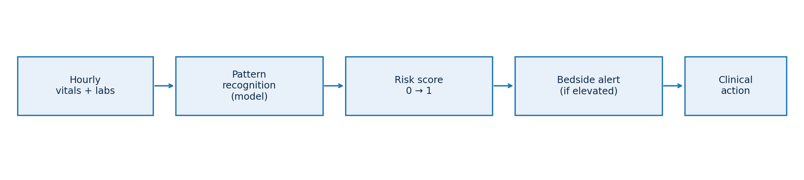
What We Built
• Reads each patient's hourly vitals and labs — exactly what nurses already chart.
• Learns patterns from 40,336 ICU patients (open PhysioNet dataset, 2 hospitals).
• Produces a single risk score, every hour, per patient.
• Runs in milliseconds on a regular server — no GPU, no internet, no cloud required.
Sepsis Early-Warning · 2 / 13

Slide 4
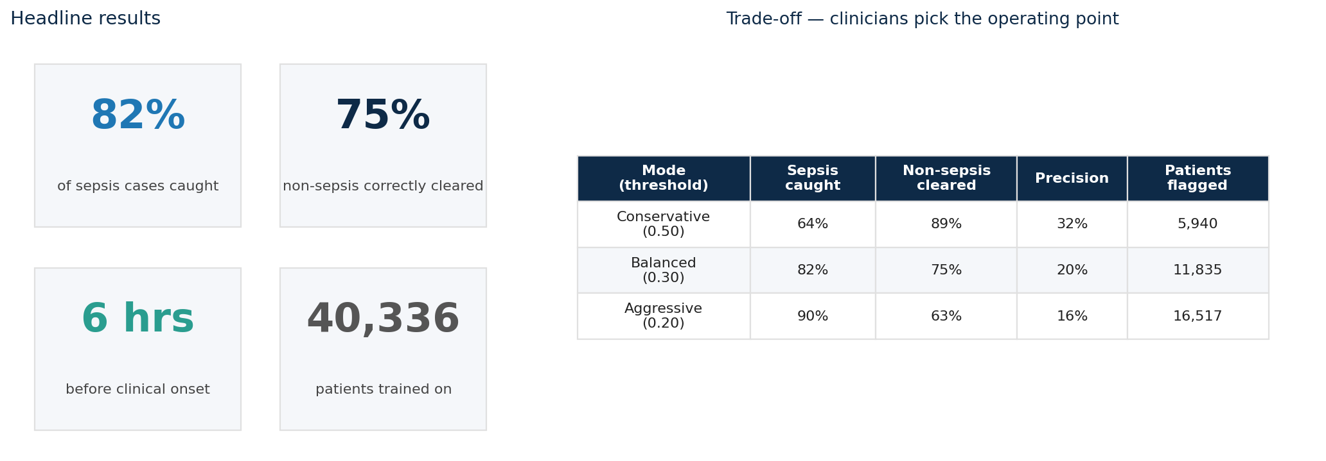
Results
Validated honestly: every patient is scored by a model that has never seen them. The threshold is a clinical knob — sensitivity vs. alert burden is a unit-level decision.
Sepsis Early-Warning · 3 / 13

Slide 5
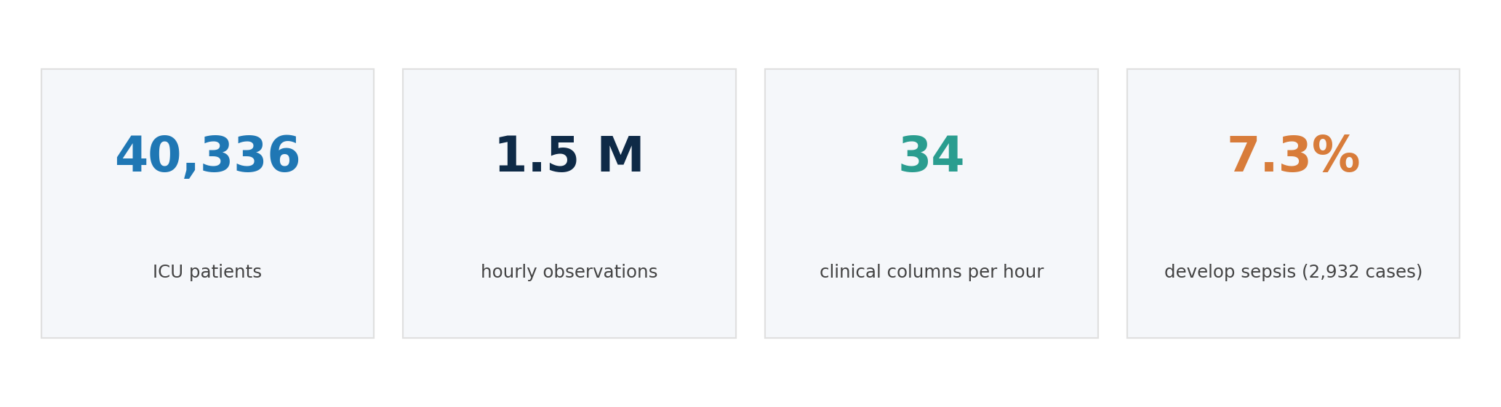
The Data
Source: PhysioNet / CinC Challenge 2019 — open ICU dataset, 2 hospitals.
• Per hour, per patient: 8 vitals (HR, BP, respiratory rate, O₂ sat, temperature, etc.) + 26 labs (lactate, creatinine, WBC, FiO₂, etc.).
• Sepsis is rare (7.3% patient-level / 1.8% hour-level) — drives how we measure success and how we sample during training.
• Label is provided by the dataset and flips to 1 exactly 6 hours before clinical sepsis onset (Sepsis-3 definition).
Sepsis Early-Warning · 4 / 13

Slide 6
Features — What We Built and Why
From 34 raw clinical columns we engineered ~300 features — every category answers a different clinical question.
Feature categories
Example assumption we challenged
• Raw vitals + labs — current values.
• 6-hour rolling stats — mean, max, min, std (trend).
• Hour-over-hour deltas — acute change.
• Personal-baseline deviation (CUSUM) — drift from THIS patient's normal.
• Missingness flags + time-since-last-draw — what's NOT measured is informative.
• Clinical scores — SIRS, qSOFA, MEWS, Shock Index.
• Age & gender-stratified normal ranges.
We had hospital ID, ICU unit, and admission-time as candidate features. Early models ranked these as the #1 and #2 most important — meaning the model was learning "this is Hospital B," not "this patient is sick." We dropped them. Same with raw ICU length-of-stay (longer stay → more sepsis is tautological — we'd be predicting the past, not the future). Lesson: features that correlate with the outcome are not always features that PREDICT it. We force the model to learn biology, not bookkeeping.
Sepsis Early-Warning · 5 / 13

Slide 7
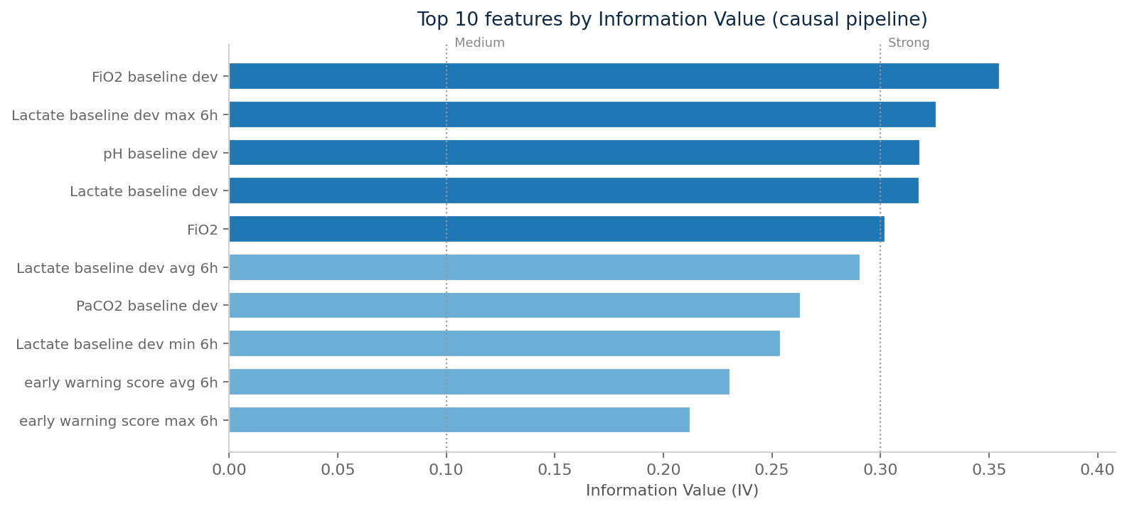
Feature Selection — From 309 to 100
Two filters: keep what predicts, drop what duplicates.
Information Value (IV)
How strongly does this feature, on its own, separate sepsis from non-sepsis? IV > 0.30 = strong predictor · 0.10–0.30 = medium · < 0.10 = weak. We rank every feature and keep the top discriminators.
Collinearity
When two features carry the same information (e.g., Lactate and Lactate-rolling-mean over 6h are 95% correlated), we keep one and drop the other. Reduces noise, shrinks overfitting, and makes the model easier to audit.
Result
Pruned 309 → 100 features. AUROC essentially unchanged (0.850 → 0.844). Overfit gap shrinks slightly. Inference is faster, the model is leaner.
Sepsis Early-Warning · 6 / 13

Slide 8
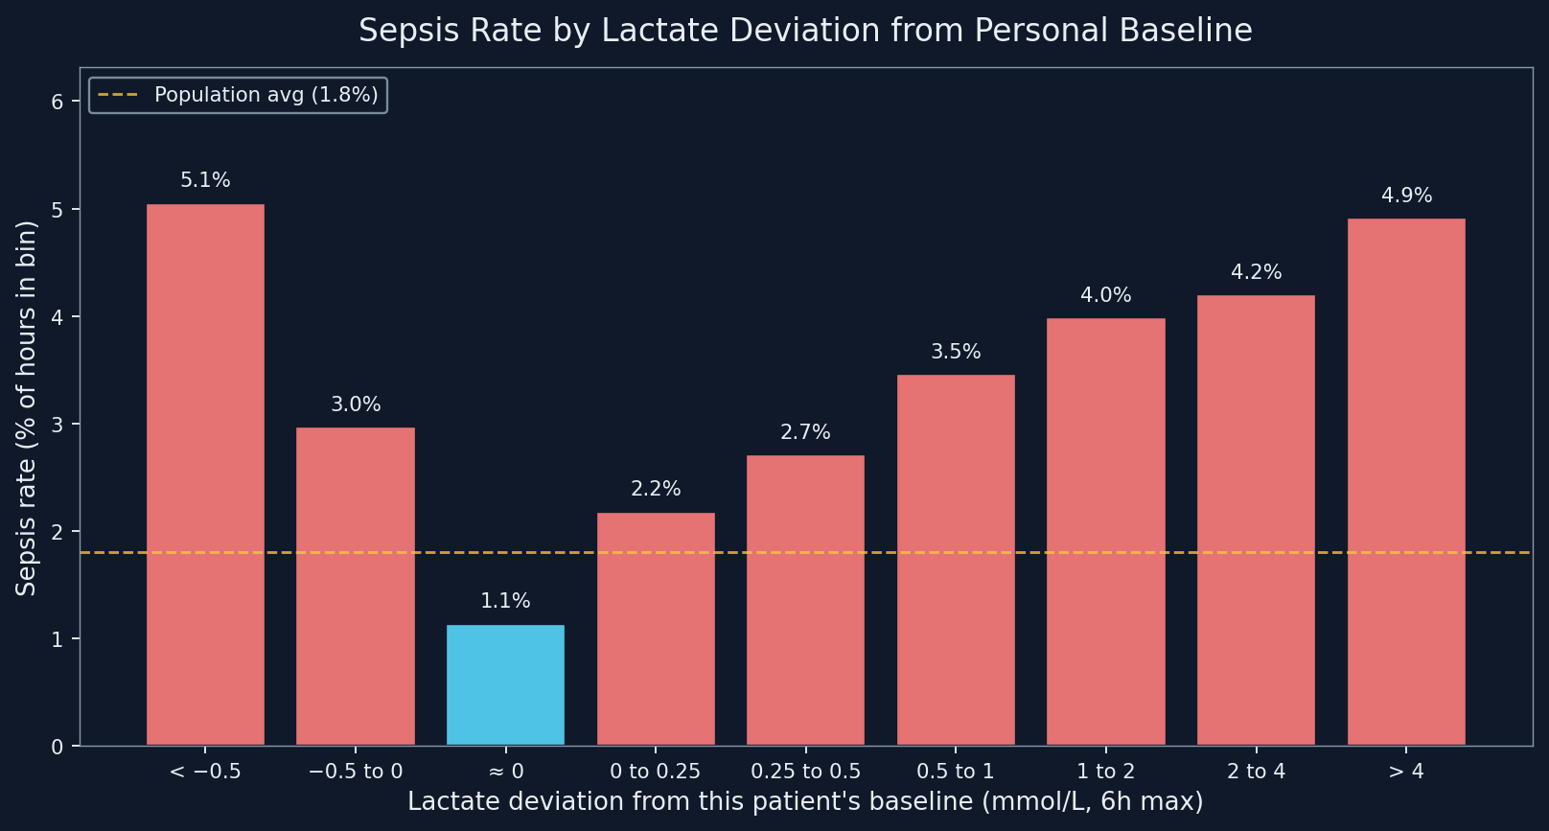
How One Feature Separates Sepsis
Lactate deviation from each patient's own baseline (6-hour rolling max) — as the deviation grows, sepsis rate climbs.
What this shows
• X-axis = how far lactate is above this patient's own baseline
• Y-axis = % of those hours flagged as sepsis
• Cyan bars = below population average
• Red bars = above population average
• Yellow line = overall sepsis rate (1.8%)
• Pattern is monotonic — bigger drift, higher risk
Near baseline
Deviation > 4
1.1%
4.9%
Sepsis hour-rate at ≈4× the population average when lactate has drifted more than 4 mmol/L above the patient's own baseline. The model uses ~300 such features together — no single one is the answer, but each one moves the score.
Lactate baseline-deviation (6h max) by hour · 1.54M hourly observations · both hospitals · 7 / 13

Slide 9
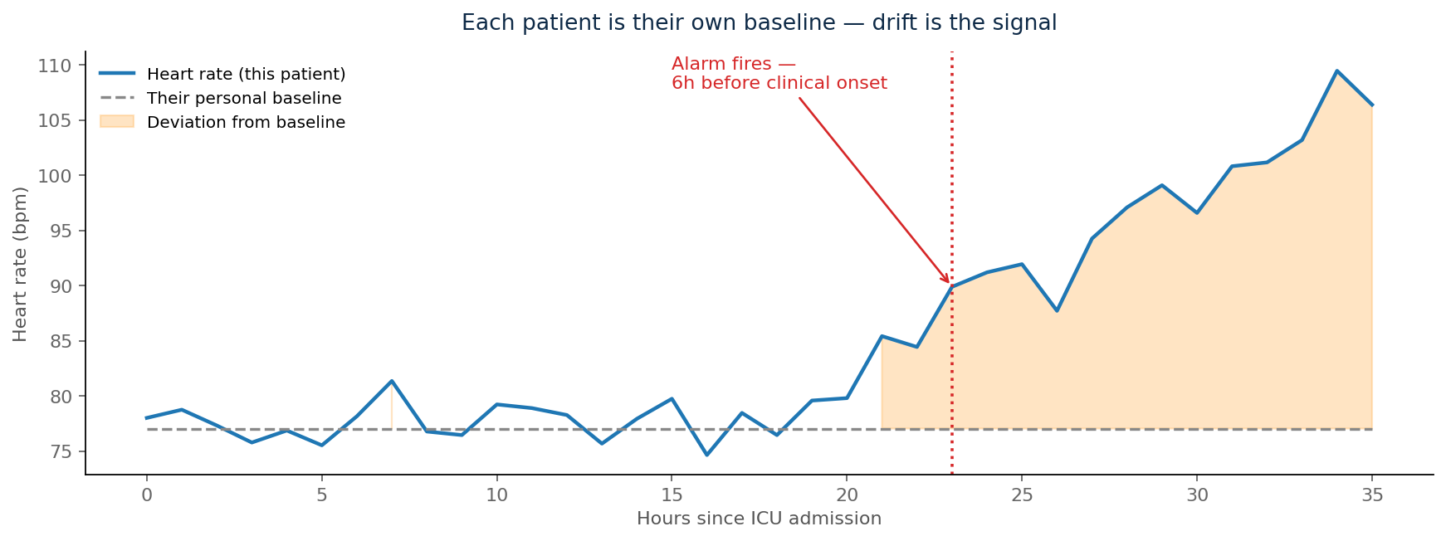
How We Detect Deviation
Each patient is their own baseline — and that's the point.
• First ~6 hours establish this patient's personal normal.
• Each subsequent hour is compared against THEIR baseline, not a textbook range.
• We accumulate small deviations (a method called CUSUM) — sustained drift trips the alarm.
• Crucially: at hour t we only use data through hour t. No peeking at the future.
• 70 bpm may be normal for one patient and abnormal for another — absolute thresholds miss this. Personal baselines don't.
Sepsis Early-Warning · 8 / 13

Slide 10
What the Model Assumes
Six standing assumptions — anywhere these break, the model needs revisiting.
• Hourly vitals and labs capture enough of the patient's state
If a unit charts only every 4–6 hours, the rolling trends become coarse and the personal baseline takes longer to establish.
• The 6-hour-before-onset label is clinically meaningful
We rely on the Sepsis-3 definition encoded in the dataset. A different definition (e.g., site-specific protocols) shifts what we're predicting.
• A patient's first hours represent their stable baseline
If they arrive already deteriorating, there is no clean baseline to deviate from. We exclude these patients from training.
• Patterns learned on PhysioNet patients transfer to similar ICUs
Same broad demographics, similar instrument set. We assume the relationship between vital trajectories and sepsis is biological, not site-specific.
• Missingness is itself informative
Which labs get ordered, and how often, reflects clinical concern. Sicker patients get tested more — the model uses this signal.
• The model is a recommender, not a decision-maker
It outputs a risk score. The clinician chooses the action. Liability and trust both rest there, by design.
Sepsis Early-Warning · 9 / 13

Slide 11
From Research Data to Live Hospital Data
Our PoC runs on a clean, retrospective dataset. A live ICU is messier — and richer.
What gets harder
What gets better
• Real-time data quality: lab delays, sensor dropouts, charting lag.
• EHR integration: every hospital's HL7 / FHIR feed is different.
• Alert fatigue: the threshold must be tuned for that unit's workflow.
• Drift: patient mix and protocols change. Model needs monthly review.
• Workflow trust: clinicians must understand what the alert is saying.
• Variables we don't have today — urine output, vasopressors, ventilator status, procalcitonin, CRP, cultures.
• Outcome data — discharge status, mortality, antibiotic timing — feeds back into retraining.
• Patient-baseline learning: re-train on YOUR population, not Boston ICU patients.
• Cross-system signals: nurse notes, imaging timestamps, escalation patterns.
• Multi-outcome triage: sepsis is just the first label.
Sepsis Early-Warning · 10 / 13

Slide 12
Why This Matters More in India
• Sepsis burden is higher: India accounts for ~3 million sepsis cases annually, with case-fatality rates substantially above OECD averages.
• ICU capacity is constrained: ~2.3 ICU beds per 100,000 vs. ~30 in the US. Better triage = better use of scarce beds.
• Nurse-to-patient ratios are tighter — automated, reliable alerting compensates for what continuous bedside vigilance can't.
• Antimicrobial resistance is steeper: carbapenem-resistant organisms are common. Earlier identification means earlier (and narrower) antibiotic choices.
• Lab access varies hospital-to-hospital — the model is designed to degrade gracefully when lactate or procalcitonin isn't available hourly.
• Cost-of-deployment matters: this model runs on commodity CPU. No GPUs, no cloud dependency, no per-query LLM cost.
• EHR landscape is fragmented — but a deterministic, auditable model is much easier to get past Indian regulators than a black-box LLM.
Sepsis Early-Warning · 11 / 13

Slide 13
Beyond Sepsis — A General ICU Triage Platform
Sepsis is the proof of concept. The pipeline is outcome-agnostic.
Reusable across outcomes:
Outcomes the same approach can target:
• Same data layer — hourly vitals, labs, missingness patterns.
• Same feature engineering — rolling trends, personal-baseline drift, clinical scores.
• Same validation discipline — patient-level cross-validation, no leakage.
• Same alerting + explanation layer.
• Only the label changes — what we're predicting.
• Acute kidney injury (AKI)
• Respiratory failure / impending intubation
• Hemodynamic collapse / shock
• Cardiac arrest within X hours
• ICU readmission risk at discharge
• Delirium onset
Run several in parallel → each ICU bed gets a vector of risks, not a single label. One platform, many early-warnings, one triage dashboard per unit.
Sepsis Early-Warning · 12 / 13

Slide 14
Path Forward
Three steps from proof of concept to bedside.
1. Partner with a hospital
Pilot on de-identified EHR data from one ICU. Re-train on the local patient population. Validate on outcomes that matter — antibiotic timing, mortality, length of stay.
2. Wire it into the workflow
Live HL7 / FHIR feed → hourly scoring → alert routed to the nurse station. Run silent (shadow mode) for 4–8 weeks before any clinical action is taken.
3. Expand label-by-label
Add AKI, then respiratory failure, then shock — same pipeline, new labels. Each new outcome compounds the platform's value without rebuilding the foundation.
Sepsis Early-Warning · 13 / 13

