Slide 1
HACKHOUND 3.0
/01
Skill Forge
A clear view into your learning journey
28 February 2025
Team Name: NINZAS
Team id:
Project Name:Problem 2

Slide 2
Pitch Creation
/02
Meet Sarah – A Professional Lost in the Learning Maze
Sarah wants to transition into digital strategy, but with thousands of courses available, she’s overwhelmed. She wastes time on irrelevant courses, lacks a clear learning path, and misses out on high-demand skills.
Like millions of professionals, Sarah doesn’t need more courses—she needs guidance on what to learn and why.
AI Skill Assessment – Instantly analyzes resumes, LinkedIn profiles, or a quick test.
  Smart Course Recommendations – Matches users with top-rated courses from LinkedIn Learning, Coursera, and Udemy.
  Industry Demand Insights – Tracks high-demand skills and salary trends using real-time job market data.
  Gamified Learning Path – Engages users with milestone-based tracking for career growth.
Sarah now has clarity—she knows exactly what skills to build, which courses to take, and how they impact her career.

Slide 3
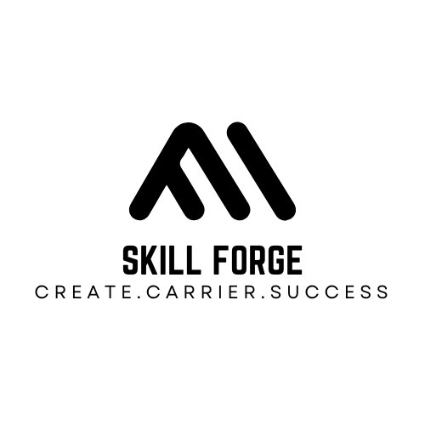
Problem
/03
Creative Presentation
With thousands of courses available, professionals struggle to identify the right skills for career growth. Many waste time on irrelevant learning paths without knowing which courses align with industry demands. Platforms like LinkedIn Learning and Coursera offer vast content but lack personalized guidance based on skills and career goals.
As industries evolve, professionals fail to track in-demand skills, making them less competitive in the job market. Companies also struggle with efficient employee upskilling due to a lack of AI-driven skill mapping. The challenge isn’t access to learning—it’s knowing what to learn, why it matters, and how it impacts career success.

Slide 4
Proposed Solution:
/04
  Our AI-driven career assistant analyzes resumes to extract key skills and experience.
  It provides personalized course recommendations
based on expertise level and career goals.
  Users can connect with domain-specific mentors for guidance and industry insights.
  AI-powered automation bridges the gap between skills, learning, and mentorship.
  The platform ensures a seamless user experience to
help professionals stay competitive.
  Smart course recommendations help users upskill efficiently and stay industry-relevant.
  Real-time insights on market trends enable informed career decisions.
  The system supports continuous learning and career growth through AI-driven strategies.
Our Servives

Slide 5

/05
The Techs:
  Resume Parsing & Skill Extraction – Uses LLMs (GPT-based NLP) to analyze resumes and extract key skills.
  AI-Powered Course Recommendation – Matches skills with courses using LLMs & TF-IDF models.
  Mentor Matching & Career Guidance – AI suggests industry experts & chatbots for personalized guidance.
  Frontend Development – Built with Streamlit for an interactive UI, styled with HTML & CSS. Backend & API – Uses Python (FastAPI) for ML processing & database handling (MongoDB/PostgreSQL).

Slide 6
Skill Forge
/06
Subscription-Based Revenue Model
  Freemium Model – Free skill assessment; premium users unlock personalized learning paths & career analytics.
  Pro Plan – Monthly/Yearly subscription for advanced AI insights, mentor sessions, and market trend reports.
  Corporate Upskilling – B2B partnerships with companies for employee skill tracking & training solutions.

Slide 7
Value Proposition and Market Validation
Problem:
  Professionals lack clear guidance on skill development and career growth.
  Wasted time and money on irrelevant courses.
  No AI-driven roadmap for structured upskilling.
Target Customers:
  Early and mid-career professionals seeking growth.
  Companies investing in workforce upskilling.
/07
Metrics and Growth Strategies
Key Metrics:
  Skill assessments completed.
  Free-to-paid conversion rate.
  Course enrollments.
  Monthly active users.
Growth Plan:
  Acquire 1,000 users via LinkedIn & ed-tech partnerships.
  Referral incentives for mentorship & enrollments.
  Scale through B2B upskilling partnerships.
February 2025

Slide 8
Customer Persona and Feedback
Primary Customer Segment:
  Professionals seeking career advancement.
  Job seekers aiming to upskill.
  Companies investing in workforce development.
Behavioral Insights:
  Users want personalized and efficient learning paths.
  They seek real-world validation of skill choices through job market data.
  Lack of structured career guidance is a common pain point.
/08
Cost Structure and Revenue Stream
Revenue Model:
  Freemium: Free skill assessment; paid personalized learning roadmap.
  B2B Training: Companies pay for AI-driven upskilling.
  Affiliate Revenue: Commissions from LinkedIn Learning, Udemy, etc.
Pricing Strategy:
  Free: Basic assessment.
  Premium: Career roadmap, mentorship, salary insights.
  Custom B2B pricing.
Cost Structure:
  AI development & cloud hosting.
  Marketing & ed-tech partnerships.
  Web maintenance & support.
February 2025

