Slide 1


Slide 2

JOB
SEEKER
Group: 0504-12
Date:12/02/2018

Slide 3


Background

Slide 4

The Jobseeker website will be used by candidates to search jobs and companies to list their job opportunities
The Jobseeker website will use following data:
data of candidates who are searching different jobs
different companies having various job openings
details of the available jobs

Slide 5

Introduction

Slide 6
Mission Statement
To create an effective platform to bring together jobs, students and organisations to synthesize a symbiotic environment
Mission Objectives
Develop a platform for students to search different job openings
Enhance features of the platform to improve search based on their preferences
Implement functionality to view corresponding details of jobs
Make the platform available to organisations to post job openings
Put into effect a functionality such that organisations can search for candidates based on their requirement

Slide 7






Tools Used

Slide 8

Design

Slide 9
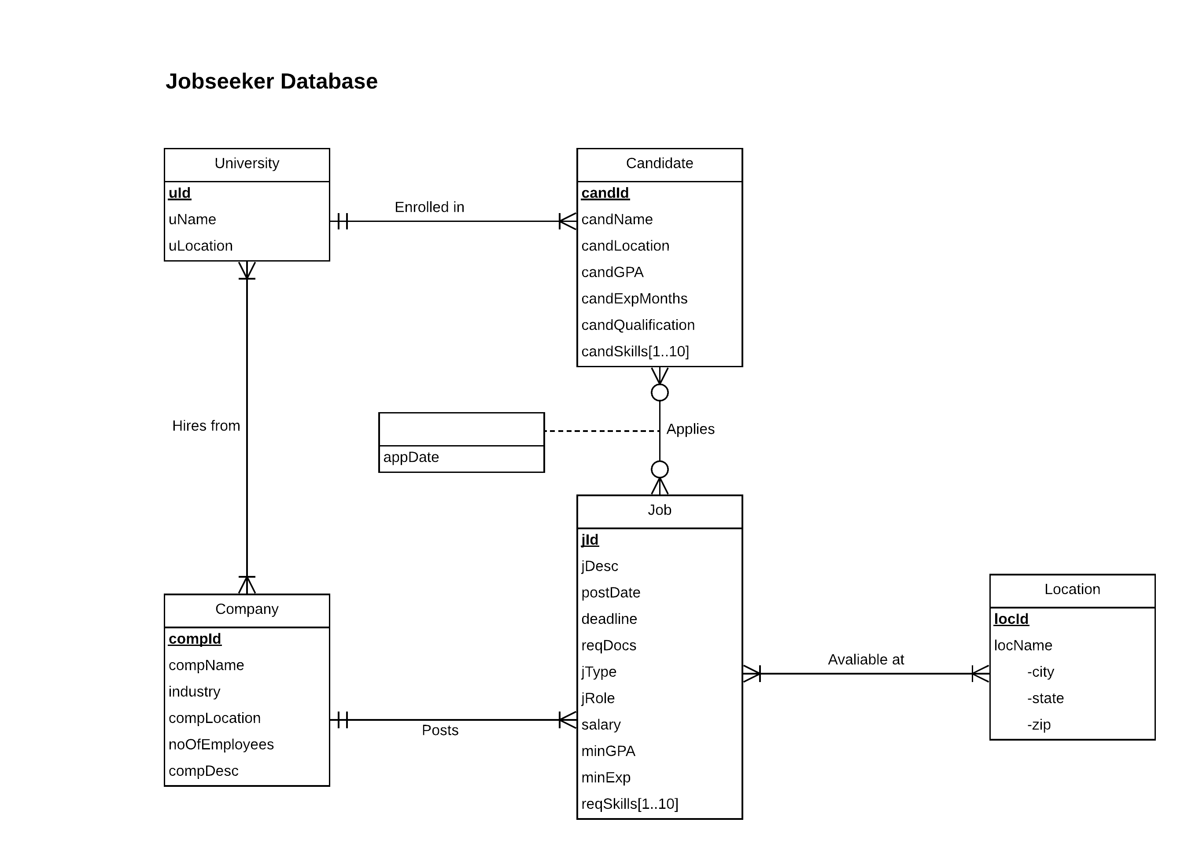
ER diagram

Slide 10
Logical Database Design
Company →(compId, compName, industry, compLocation, noOfEmployees, compDesc)
Job →(jId, jDesc, postDate, deadline, reqDocs, jType, jRole, salary, minGPA, minExp, postDate compId)
Required_Skills →(skill, jId)
Location →(locId, city, state, zip)
Candidate →(candId, candName, candLocation, candGPA, candExpMonths, candQualification, uid)
Candidate_Skills →(candSkill, candId)
University →(uId, uName, uLocation)
Hires_From →(compId, uId)
Applies →(candId, jId, appDate)
Available_at →(jId, locId)

Slide 11
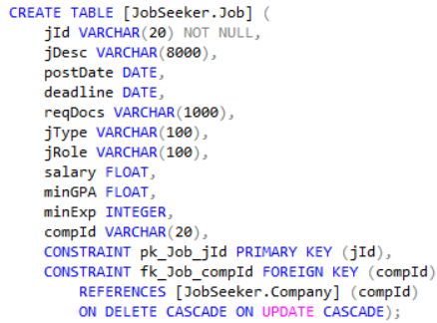
Physical Database Design
SQL CREATE TABLE for the table Job:

Slide 12
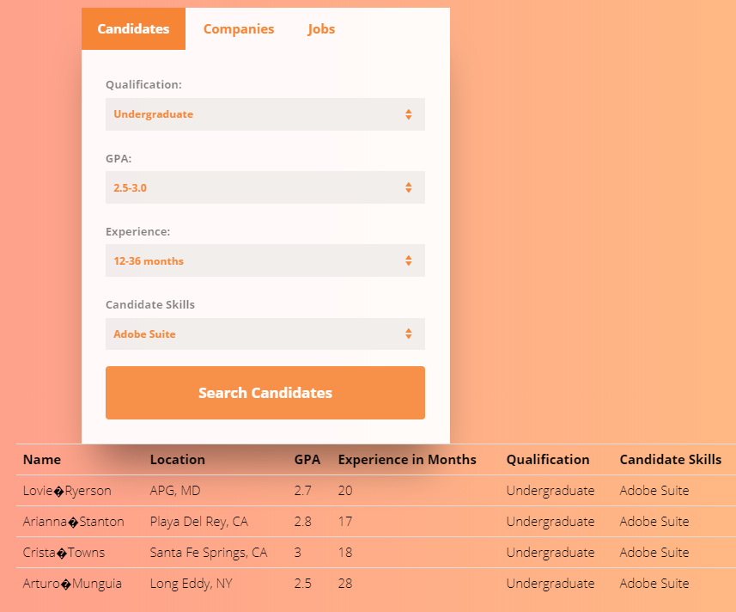
Use Cases and Applications
Who are the candidates with an undergraduate degree, GPA between 2.5-3.0 and having an experience between 12-36 months and has skill – Adobe Suite?
SELECT DISTINCT c.candId, c.candName, c.candLocation, c.candGPA, c.candExpMonths, c.candQualification,s.candSkill
FROM [Jobseeker.Candidate] c, [Jobseeker.Candidate_Skills] s
WHERE c.candId = s.candId AND c.candQualification='undergraduate' AND s.candSkill LIKE '%Adobe Suite%' AND (c.candGPA >= 2.5 AND c.candGPA <= 3) AND (c.candExpMonths >= 12 AND c.candExpMonths <= 36)
ORDER BY s.candSkill;

Slide 13
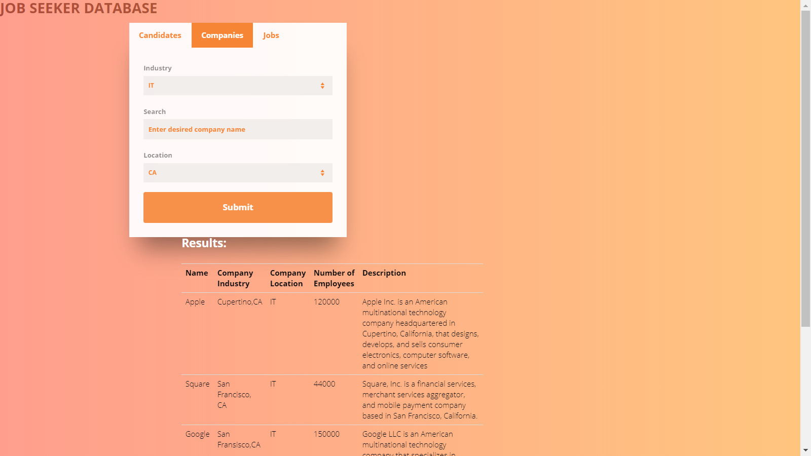
Use Cases and Applications
Which are the companies in IT industry located in California?
SELECT compName, industry,
compLocation, noOfEmployees, compDesc
FROM [Jobseeker.Company]
WHERE industry = 'IT' AND
compLocation LIKE '%CA%' AND
compName LIKE '%%' ;

Slide 14

Jobseeker is supposed to act as a bridge between where a prospective candidate is right now to where she wants to be.
Ideated By-
Aashay Kedar
Aditya Ratnaparkhi
Punya Mishra
Rushi Maniar
Shivam Raj

Slide 15
THANK
YOU!

