Slide 1


Adarsh Institute of Technology &
Research Centre, Vita
Department of Computer Science & Engineering
Class-TY
Mini project Presentation on:
“Aptitude Quiz Website”
Team members :
1. Mr. Akshay Sarjerao Bandgar (CS3010)
2. Mr. Adarsh Rupesh Jadhav (CS3015)
3. Mr. Rushikesh Pravin Mhetre (CS3016)
4. Mr. Pranav Dilip Suryawanshi (CS3017)
Academic Year
2023-2024
Under Guidance of:
Asst.Prof. Miss.S.L.Jadhav

Slide 2
INDEX
Introduction
Literature Survey
Existing System
Proposed System
Requirement Analysis
System Design
User Interface
Future Scope
Conclusion
References

Slide 3
INTRODUCTION
This project aims to create a user-friendly website where users can access a wide range of aptitude quizzes across various categories, such as mathematics, logical reasoning, verbal ability, and more.
The quizzes are designed to challenge and stimulate critical thinking, problem-solving, and analytical skills.

Slide 4
Literature Survey
Sr.no | Title of Paper | Author | Year | Advantages
1. | Aptitude Test With Fuzzy Algorithm | Dony Tontiardo | 2021 | Aptitude become one of major problem to determine the specialization in college. Aptitude test hopefully can reduce the tuition fee of the Scholar.

Slide 5
Sr.no | Title of Paper | Author | Year | Advantages
2. | Automated Aptitude Test | Apoorva Anand | 2018 | The question-answer module gives career and personality with conscious answers given by individuals This product will acquaint the user with various career domains.
3. | Assesment of Vocational Aptitude | Igor Petukhov | 2014 | The paper offers the model of an operator’s vocational aptitude.
.

Slide 6
Existing System
Existing systems often present users with static question sets, lacking the interactivity necessary for an engaging learning experience.
The absence of comprehensive performance analytics makes it challenging for users to assess their strengths and weaknesses accurately.
lacking features that encourage a sense of community and healthy competition among users.

Slide 7
Proposed System
The proposed project is to create a user-friendly website Personalized to the needs of students.
Aptitude Quiz Website incorporates users to monitor their progress systematically.
Aptitude Quiz Website project seeks to create an interactive, dynamic, and inclusive learning platform.

Slide 8
Requirement Analysis
HARDWARE REQUIREMENT:
• RAM - 4GB.
• Space - 256GB.
• CPU - 2GHz or faster.
• Architecture - 32-bit or 64-bit.
SOFTWARE REQUIREMENT:
• Operating System – Windowa 8 -Windows 11.
• Languages - HTML,CSS,Javascript.
• IDE - Visual Studio code.

Slide 9
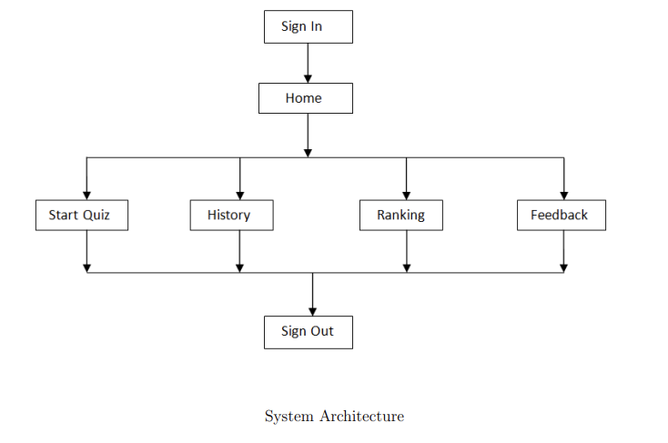
System Design

Slide 10
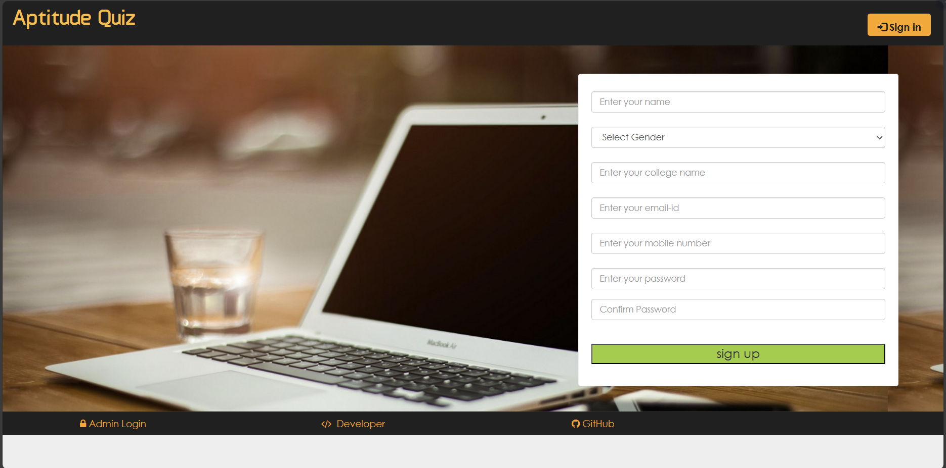
User Interface

Slide 11
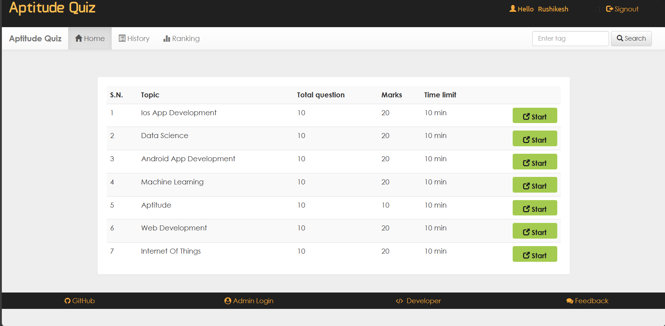

Slide 12
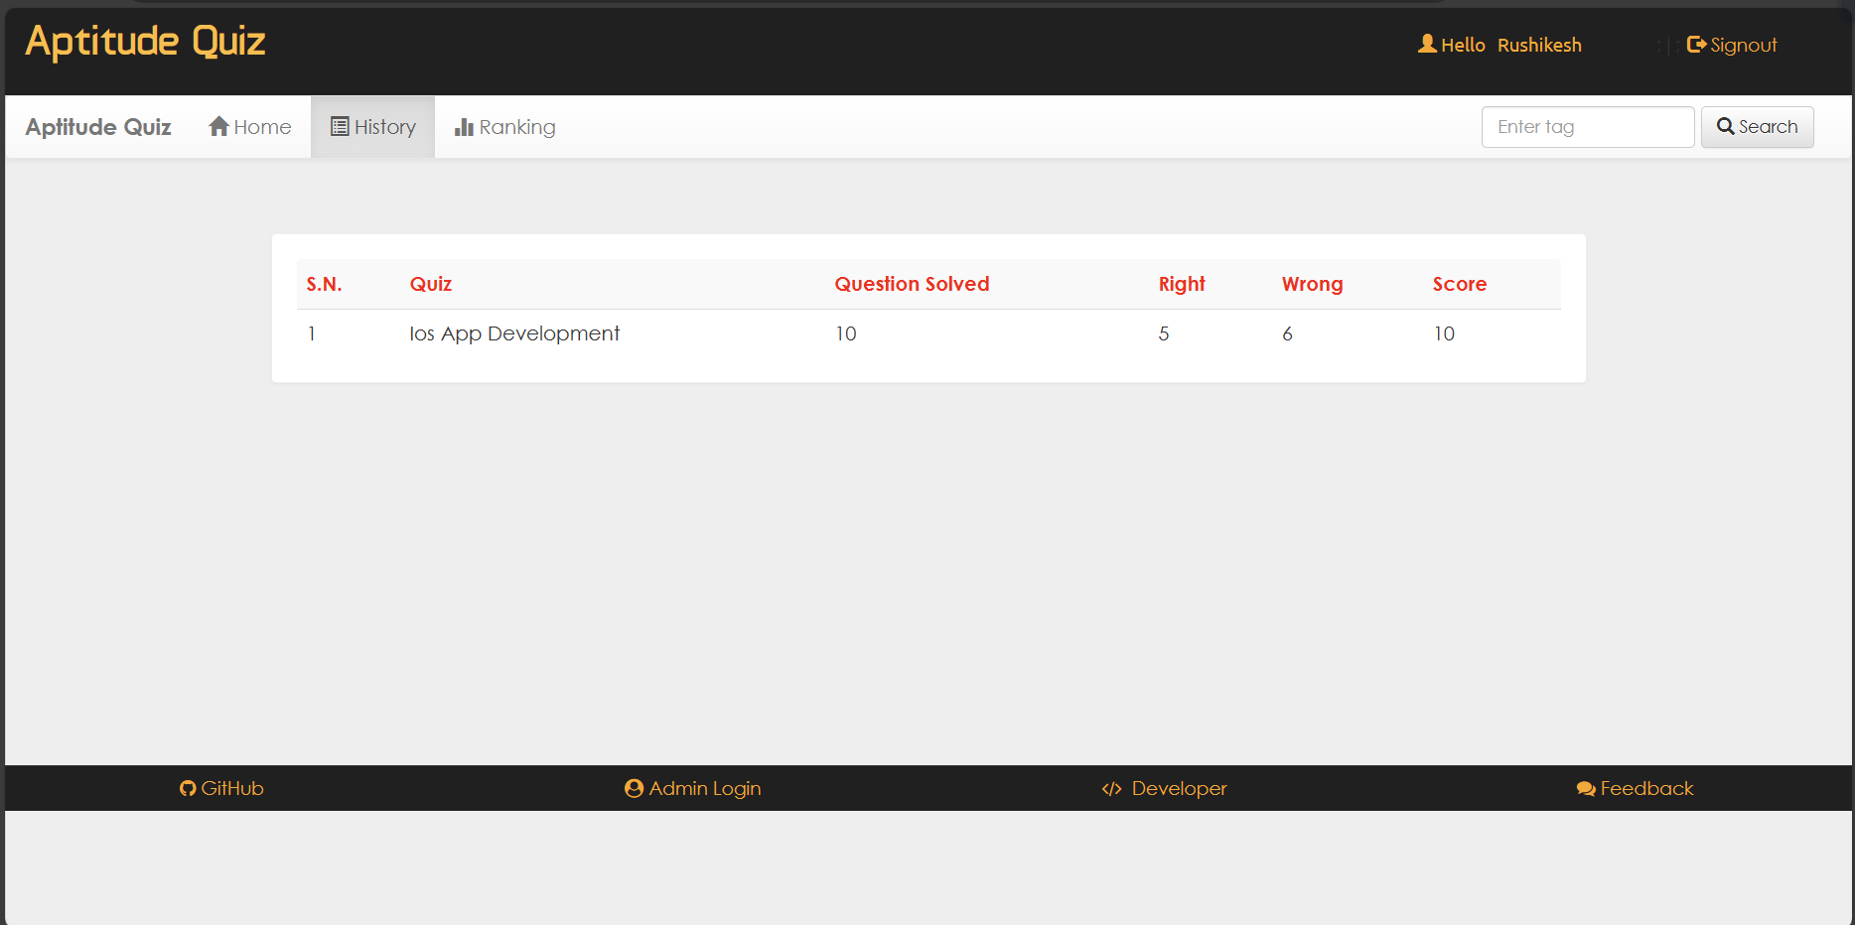

Slide 13
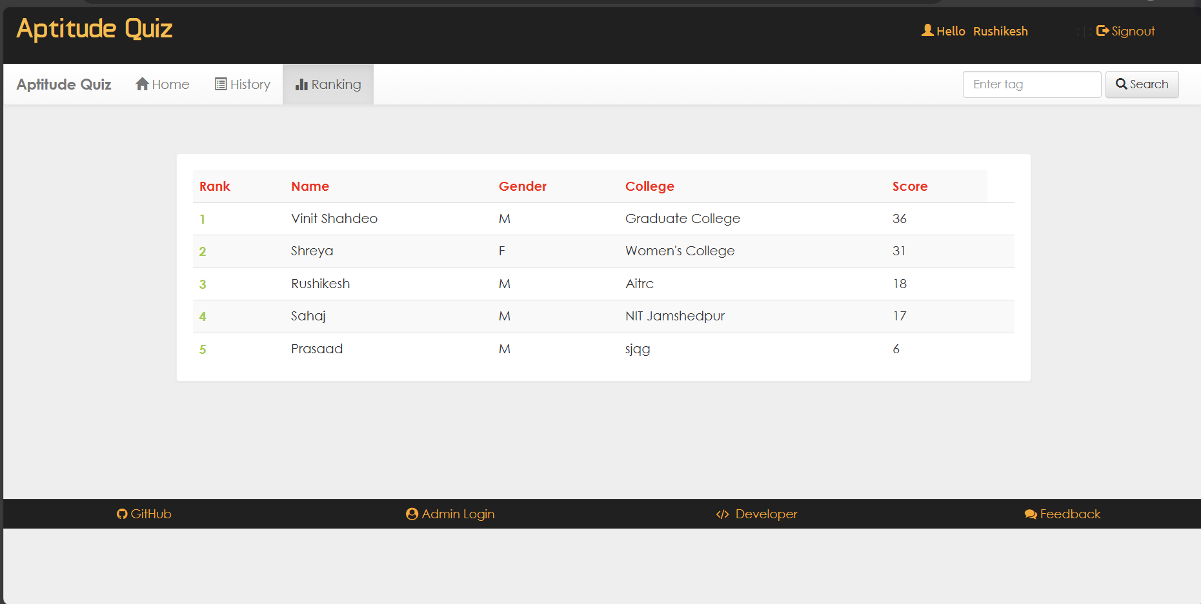

Slide 14
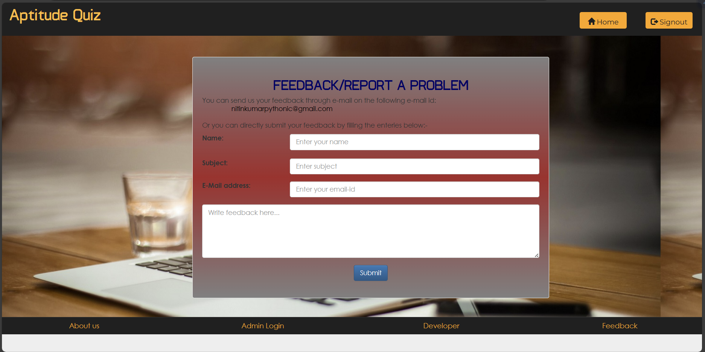

Slide 15
Future Scope
Responsive Design.
Regular Updates.
Enhanced Search Functionality.
Questions With Answers.

Slide 16
Conclusion
Aptitude quiz website represents more than just a platform for testing one’s knowledge and abilities.
We have strived to create an environment where users can engage with a diverse range of quizzes and assessments, tailored to various subjects and skills.

Slide 17
References
www.indiabix.com
www.aptitudequiz.com
www.placementpreparation.io
www.prepinsta.com
www.practiceaptitudetests.com

Slide 18
THANK YOU

