Slide 1
Image captioning
Using deep learning
Presented by:
Sr No. | Name | Enrollment No.
1 | Rushi Patel | 1721BECE30225
2 | Hardh Patel | 1721BECE30090
3 | Meet Patel | 1721BECE30099
4 | Divyarajsinh Chudasama | 1721BECE30020

Slide 2
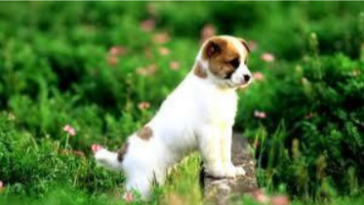
INTRODUCTION
What do you see in the picture?

Slide 3
Well some of you might say “A white dog in a grassy area”, some may say “White dog with brown spots” and yet some others might say “A dog on grass and some pink flowers”.
Definitely all of these captions are relevant for this image and there may be some others also. But the point I want to make is; it’s so easy for us, as human beings, to just have a glance at a picture and describe it in an appropriate language. Even a 5 year old could do this with utmost ease.
But, We can make a computer program that takes a images as input and produce a predicate output this process is called as Image captioning.

Slide 4
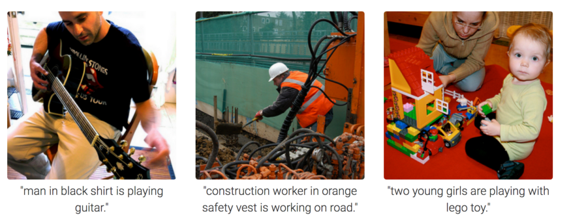
What is Image captioning?
Image Captioning is the process of generating textual description of an image. It uses both Natural Language Processing and Computer Vision to generate the captions.

Slide 5




Language Used:
Python
Technologies Used:
Tensorflow
Keras
Jupyterlab
Flask

Slide 6
Libraries Used:
Tensorflow
Keras
Pillow
Numpy
Tdqm
Tensorflow: TensorFlow is a free and open-source software library for dataflow and differentiable programming across a range of tasks. It is a symbolic math library, and is also used for machine learning applications such as neural networks.
Keras: Keras is an open-source neural-network library written in Python. It is capable of running on top of TensorFlow. Designed to enable fast experimentation with deep neural networks, it focuses on being user-friendly, modular, and extensible.
Pillow: Python Imaging Library (abbreviated as PIL) is a free and open-source additional library for the Python programming language that adds support for opening, manipulating, and saving many different image file formats.
Numpy: NumPy is a python library used for working with arrays. It also has functions for working in domain of linear algebra, fourier transform, and matrices.
Tdqm: Tqdm package is one of the more comprehensive packages for progress bars with python.
Flask: Flask is a python based Web Framework.

Slide 7
Why we make this Image Processing Project?
Aid to the blind
Self-driving cars
Google Image Search
CCTV Cameras

Slide 8
Aid to the blind:- We can create a product for the blind which will guide them travelling on the roads without the support of anyone else. We can do this by first converting the scene into text and then the text to voice.
Self-driving cars:- Automatic driving is one of the biggest challenges and if we can properly caption the scene around the car, it can give a boost to the self driving system.
Google Image Search:- Automatic Captioning can help, make Google Image Search as good as Google Search, as then every image could be first converted into a caption and then search can be performed based on the caption.
CCTV Cameras:- CCTV cameras are everywhere today, but along with viewing the world, if we can also generate relevant captions, then we can raise alarms as soon as there is some malicious activity going on somewhere. This could probably help reduce some crime and/or accidents

Slide 9
Proposed Image captioning:
Image caption generation has emerged as a challenging and important research area in statistical language modelling and image recognition.
There are two main approaches to Image Captioning:
bottom-up
top-down
bottom-up approaches such as those by generate items observed in an image, and then attempt to combine the items identified into a caption.
Top-down approaches such as those by attempt to generate a semantic representation of an image that is then decoded into a caption using various architectures, such as recurrent neural networks.

Slide 10
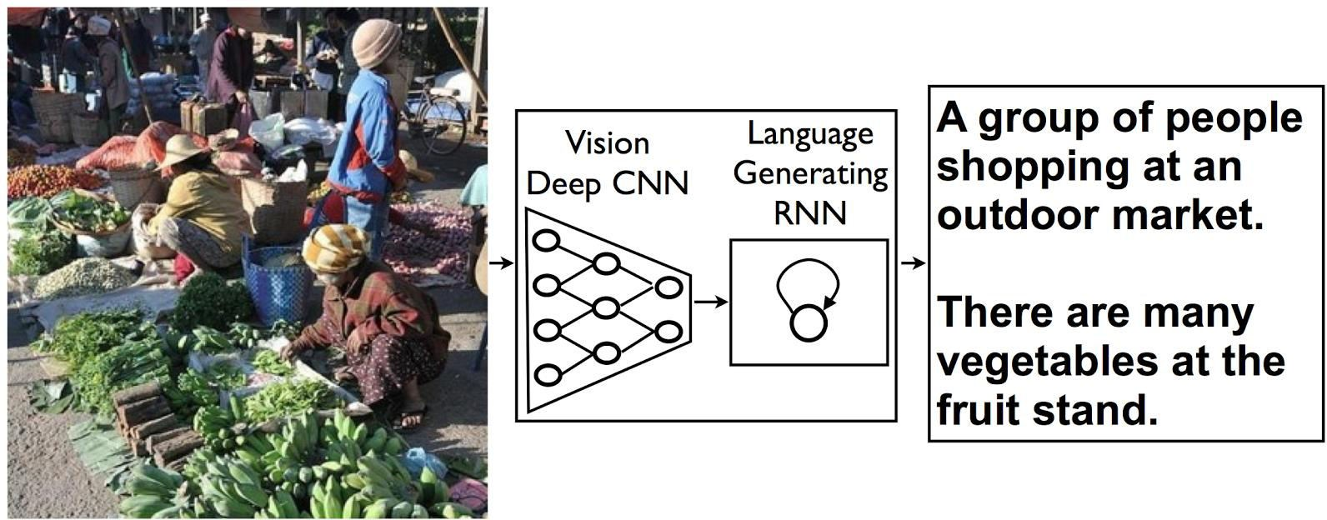
Our approach draws on the success of the top-down image generation models listed above. We use a deep convolutional neural network to generate a vectorized representation of an image that we then feed into a Long-Short-Term Memory (LSTM) network, which then generates captions.
We use a deep convolutional neural network to create a semantic representation of an image, which we then decode using a LSTM network. (Right) A unrolled LSTM network for our CNN-LSTM model. All LSTMs share the same parameters. The vectorized image representation is fed into the network, followed by a special start of sentence token. The hidden state produced is then used by the LSTM predict/generate the caption for the given image.

Slide 11
What is CNN?
Convolutional neural network (CNN) is one of the main categories to do images recognition, images classifications. Objects detections, recognition faces etc., are some of the areas where CNNs are widely used.
CNN image classifications takes an input image, process it and classify it under certain categories (Eg., Dog, Cat, Tiger, Lion). Computers sees an input image as array of pixels and it depends on the image resolution. Based on the image resolution, it will see h x w x d( h = Height, w = Width, d = Dimension ). Eg., An image of 6 x 6 x 3 array of matrix of RGB (3 refers to RGB values) and an image of 4 x 4 x 1 array of matrix of grayscale image.

Slide 12

Technically, deep learning CNN models to train and test, each input image will pass it through a series of convolution layers with filters (Kernals), Pooling, fully connected layers (FC) and apply Softmax function to classify an object with probabilistic values between 0 and 1. The below figure is a complete flow of CNN to process an input image and classifies the objects based on values.
Neural network with many convolutional layers

Slide 13
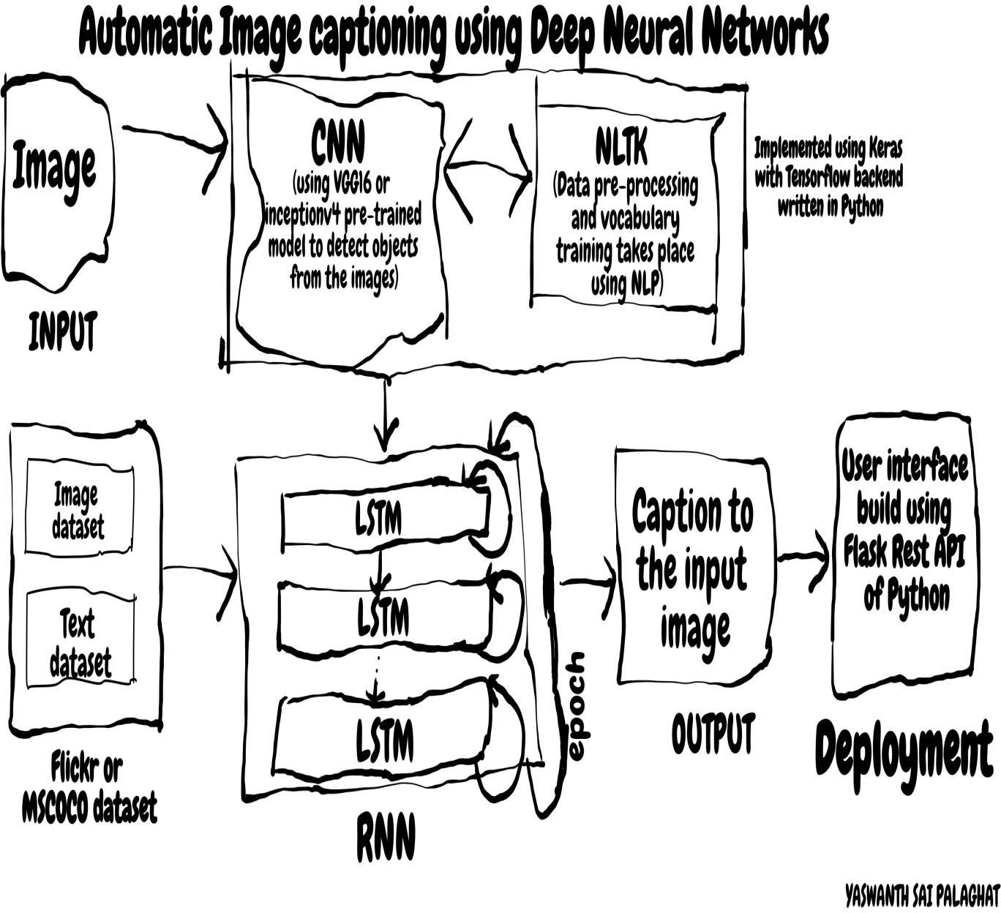
Architecture of our system

Slide 14
Finding the possible probability for sentences

Slide 15
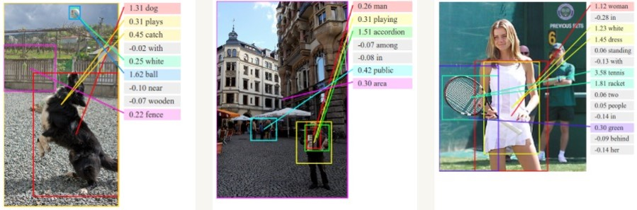
Example Alignments

Slide 16
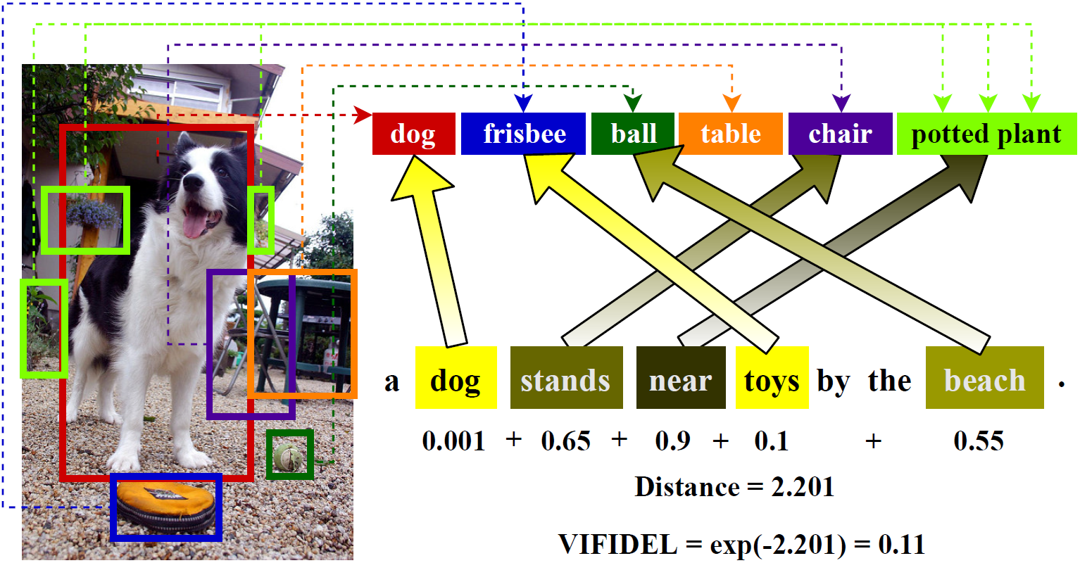
Extracting text from image and make sentence

Slide 17
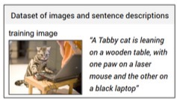
Datasets
Flickr8k
8000 images, each annotated with 5 sentences via AMT
1000 for validation, testing
Flickr 30k
30k images
1000 validation, 1000 testing
MSCOCO
123,000 images
5000 for validation, testing

Slide 18
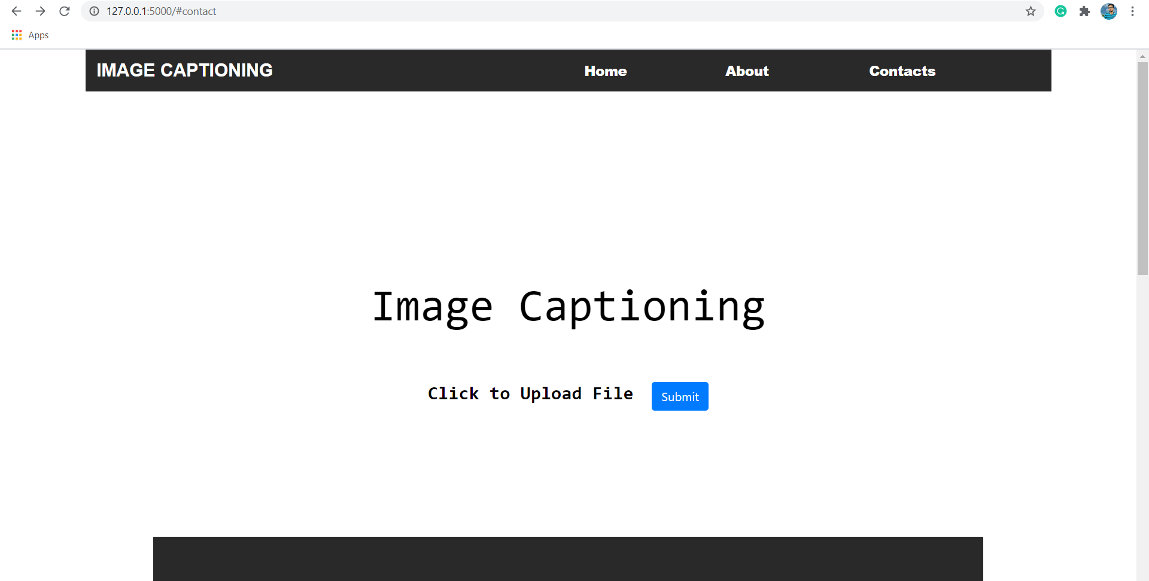
Web Application

Slide 19
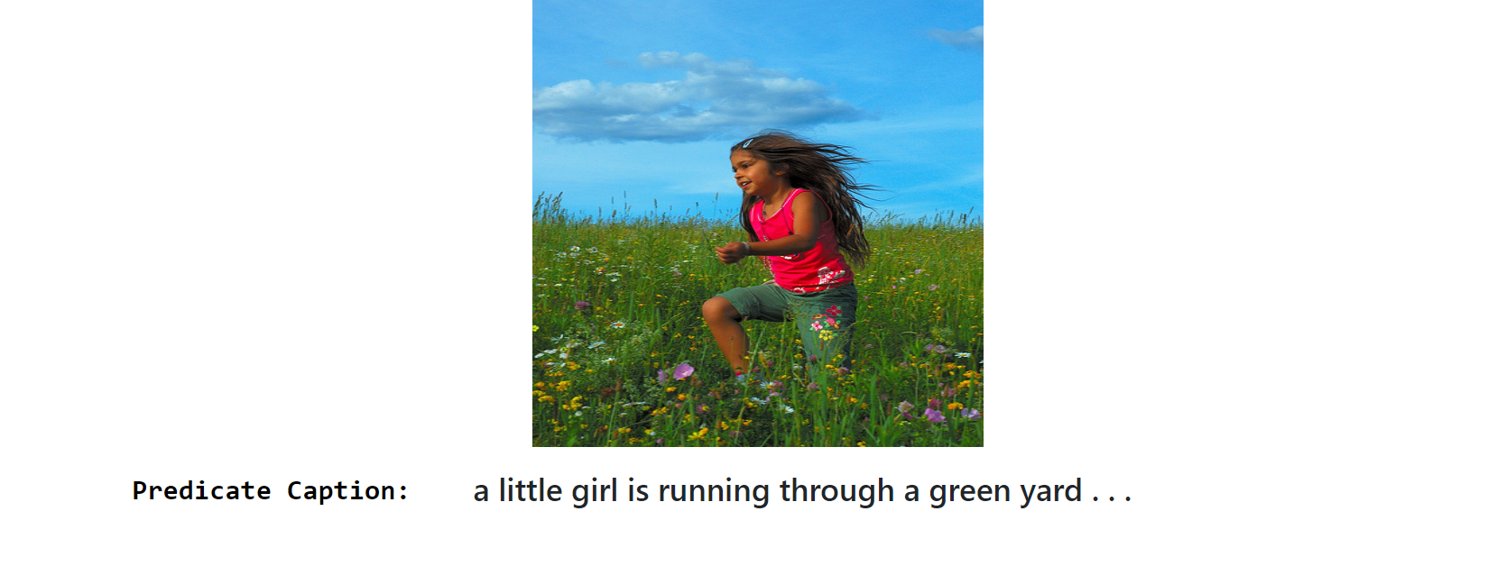
Predicate Output

Slide 20
Conclusion
Here we conclude that we can directly get captions through this program with just adding picture in this.
Reference
With the help of our internal faculty.
Also from the google and tutorialspoint.

Slide 21


