Slide 1
Airline Management System Case Study
Team Members:
1. Abhinav Kumar
2. Rushikesh Rajput
3. Samarth Gupta
4. Sai Vikrant
Date: 26th August, 2025

Slide 2
Problem Statement
Airline operations lack a unified system for managing passengers, check-ins, and in-flight services. The goal is to build a role-based platform for Admins and Staff to efficiently handle flight data, passenger details, and service management.

Slide 3
Objective
To provide a secure login and role-based access for Admins and Staff.
To enable Admins to manage flights, passengers, and flight services (ancillaries, meals, shopping).
To allow Staff to handle passenger check-in with seat allocation and special requirements.
To support in-flight service management, including meal, ancillary, and shopping selections.
To provide a secure login and role-based access for Admins and Staff.
To enable Admins to manage flights, passengers, and flight services (ancillaries, meals,
shopping).
To allow Staff to handle passenger check-in with seat allocation and special requirements.
To support in-flight service management, including meal, ancillary, and shopping selections.

Slide 4





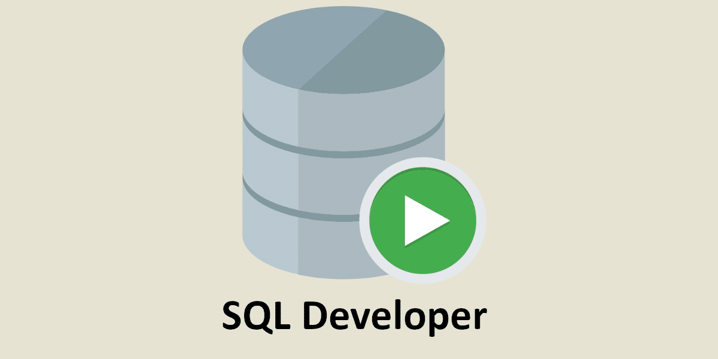




Tools & Technologies
Backend: Java, Spring Boot, Spring Framework, Jakarta EE, JPA, Hibernate, Lombok, JWT, RBAC Frontend: ReactJS, TypeScript, Tailwind CSS Database: Oracle 19c SQL, SQL Developer Build Tools: Maven Testing: Postman, Swagger Version Control: Git, GitHub IDE: Visual Studio Code

Slide 5
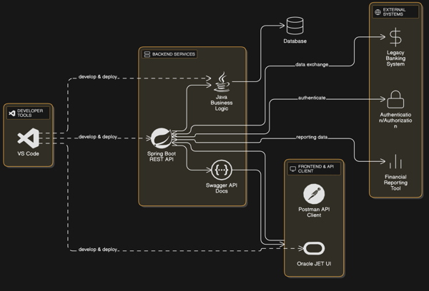
High-level Architecture

Slide 6
Key Components/ Features
Secure Access Control: Role-based login ensures that only authorized users can view or modify sensitive data, maintaining system security and compliance.
Interactive Frontend (React): A responsive and dynamic user interface built with React enables smooth navigation.
Robust API Layer (Spring + Swagger): RESTful APIs with Swagger documentation facilitate seamless integration, testing, and communication between frontend and backend services.
Modular Architecture: The system is designed with loosely coupled modules, allowing easy scalability, maintenance, and independent feature upgrades.

Slide 7
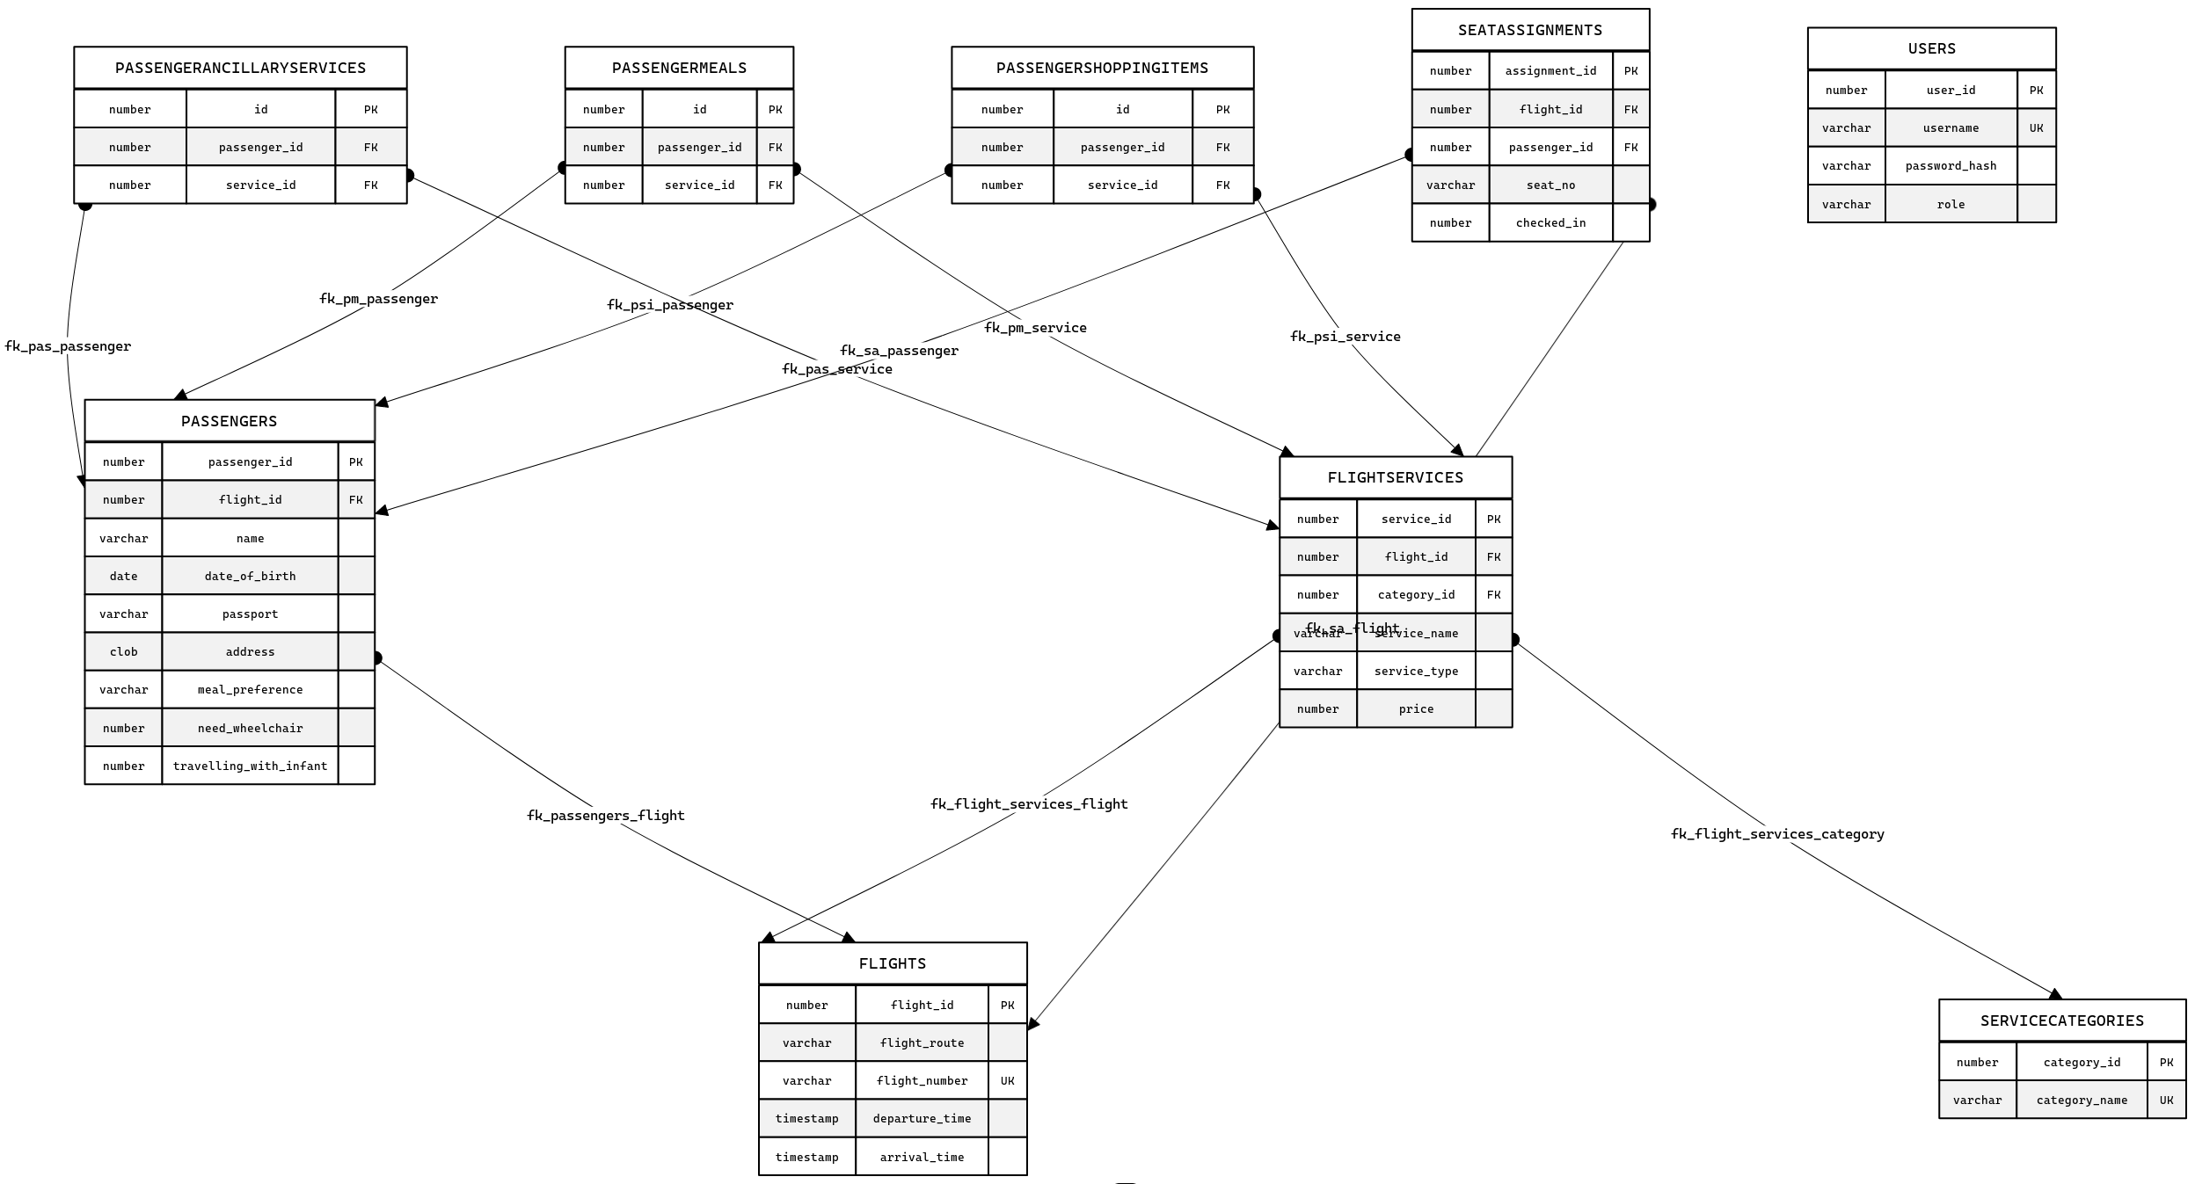
ER Diagram

Slide 8
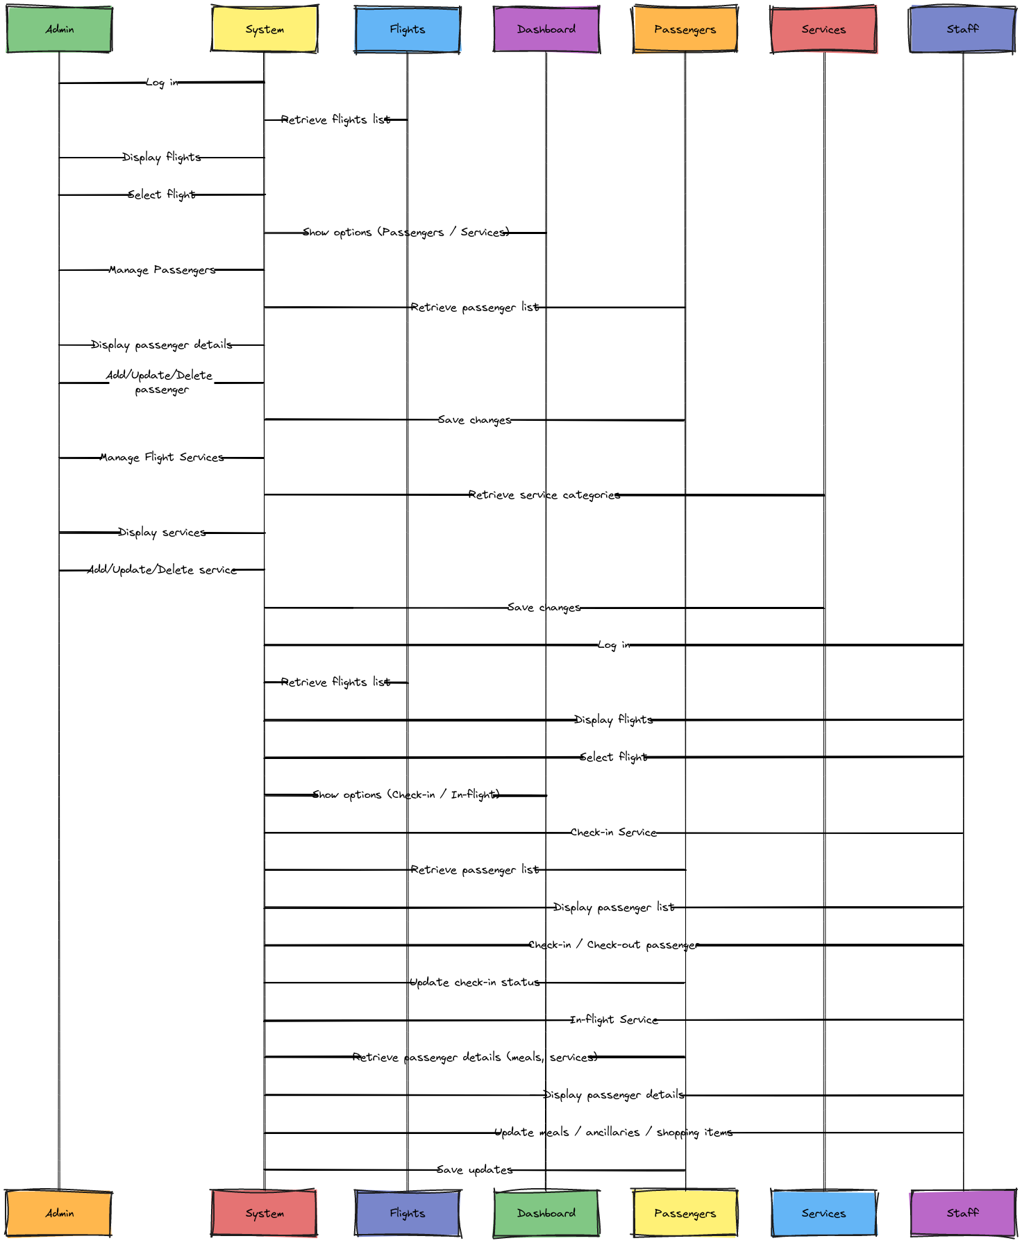
Sequence Diagram

Slide 9
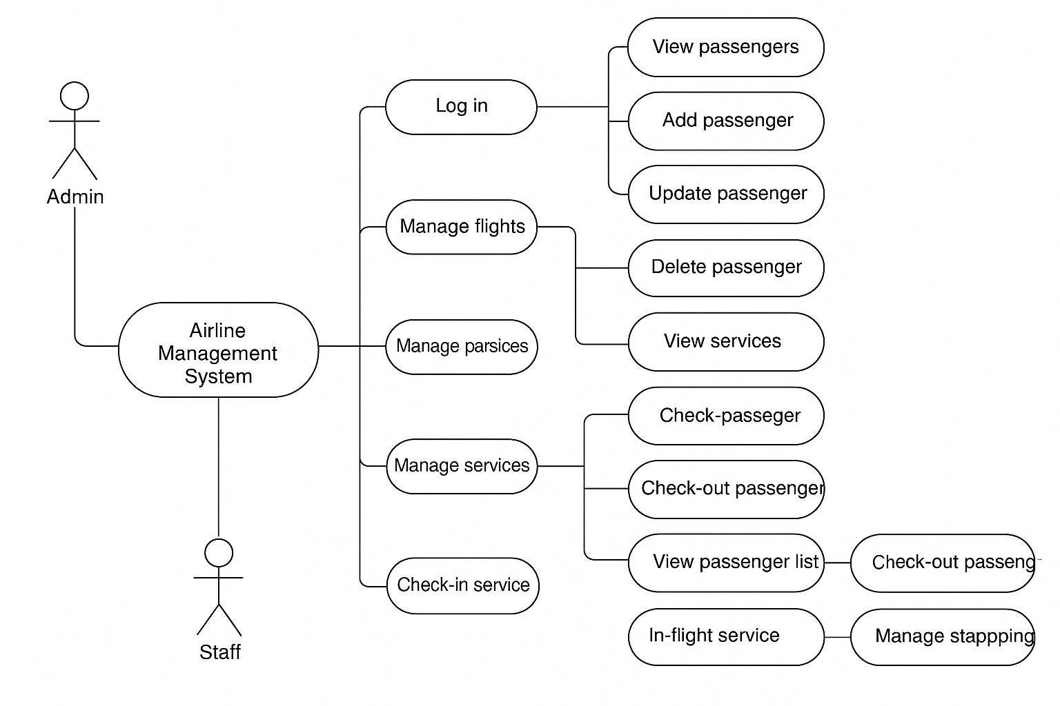
Use Case Diagram

Slide 10
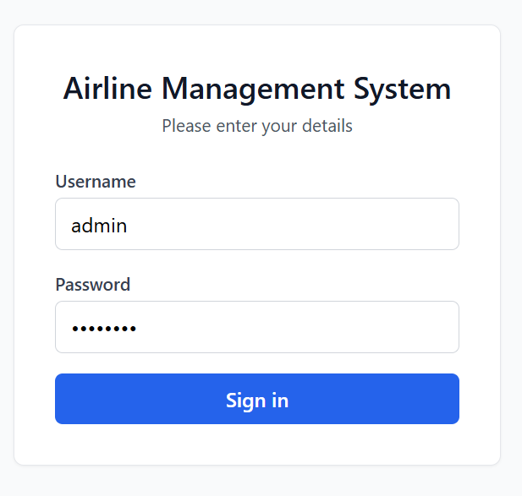
Screenshots of Implementation
Front End (Login Page) :

Slide 11
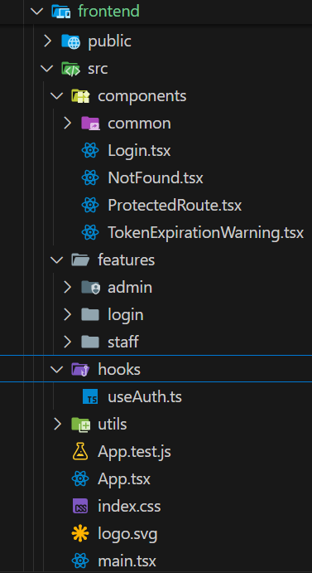
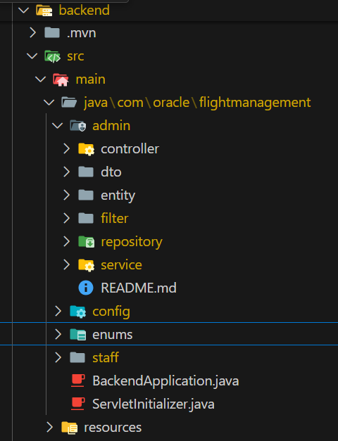
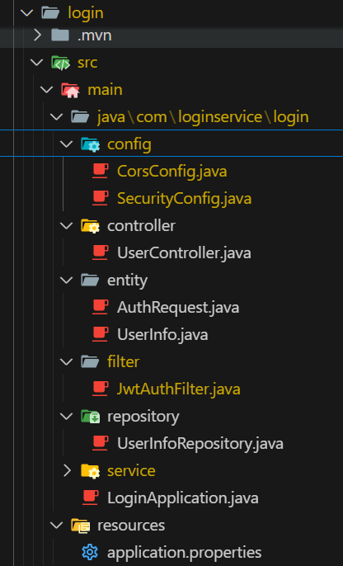
Project Structure
Front End :
Back End :

Slide 12
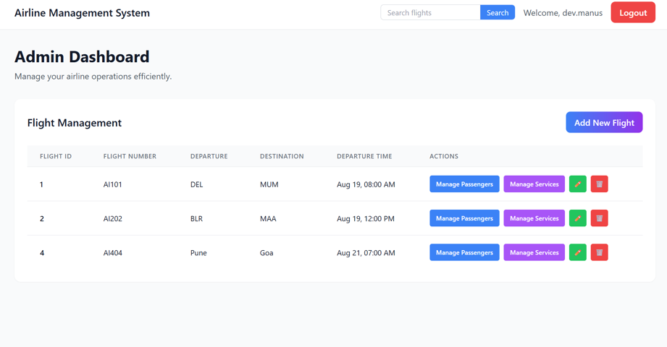
Admin Dashboard Screenshot

Slide 13
Admin Functions
1. Secure login with access to all flights.
2. Manage Passengers for each flight:
View passenger details (name, DOB, passport, address, meal preference, wheelchair need, infant).
Perform CRUD operations (add, update, delete).
Filter passengers based on missing information (DOB, passport, address).
3. Manage Flight Services, categorized into:
Ancillary services (e.g., extra baggage, lounge, Wi-Fi).
Meals (veg/non-veg, with type & price).
In-flight shopping items (products & prices).
Perform CRUD operations on services.

Slide 14
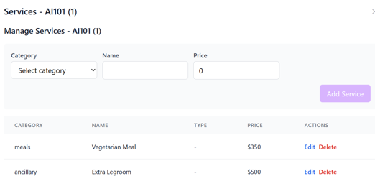
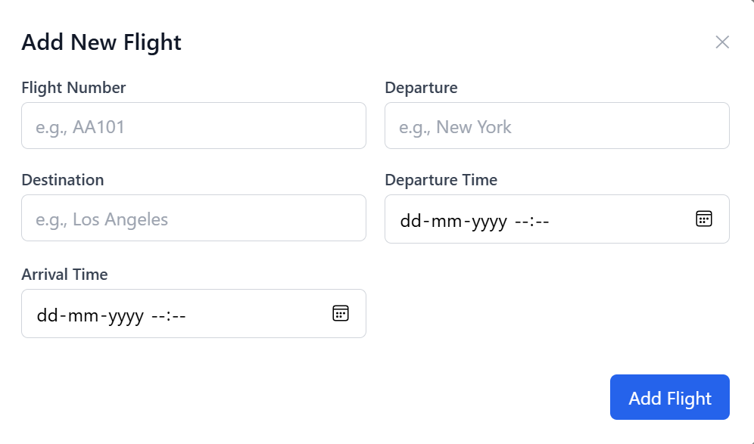
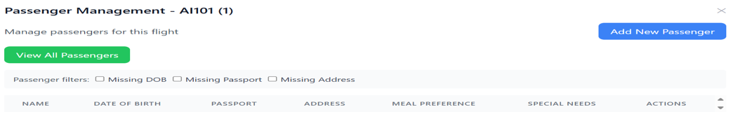
Admin Functionality Screenshots

Slide 15
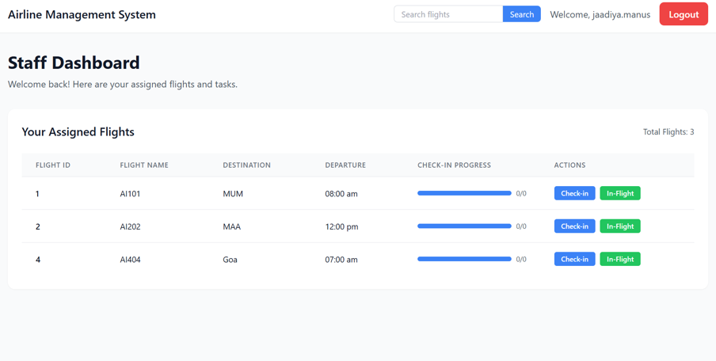
Staff Dashboard Screenshot

Slide 16
Staff Functions
1. Secure login with access to assigned flights.
2. Check-in Services:
View passenger list with details (including seat assignment & check-in status).
Filter by special needs (wheelchair, infant) or check-in status.
Assign/check-in seats using a seat map, and check-out if required.
3. In-flight Services:
View passengers with full details (seat, meal preference, selected ancillaries, meals, shopping items).
Modify/update passenger selections for services during flight.

Slide 17
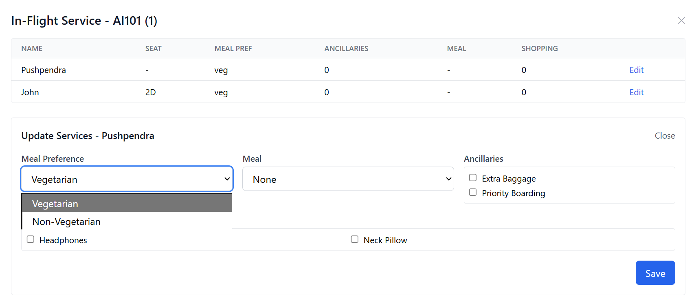
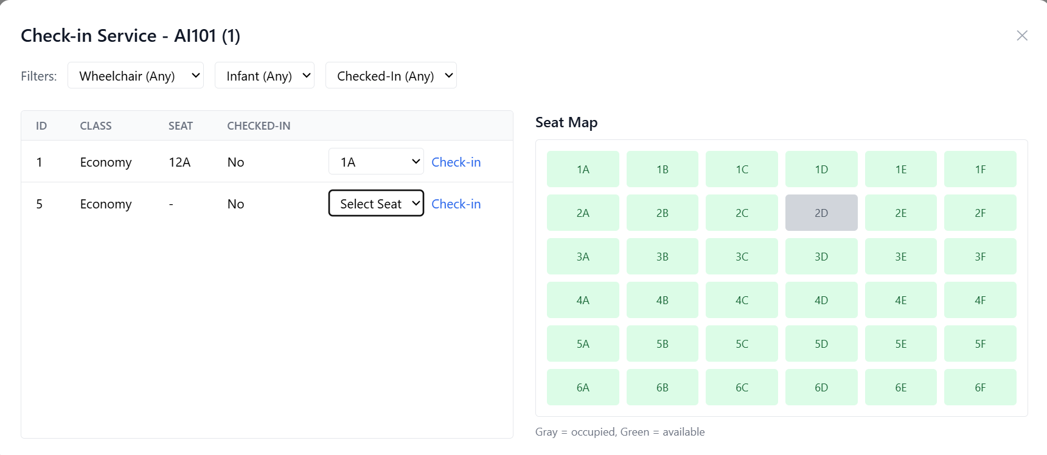
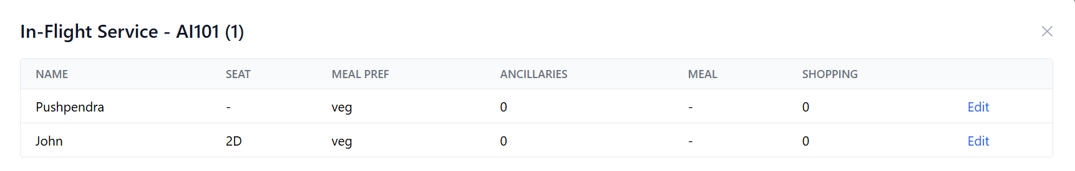
Staff Functionality Screenshots

Slide 18
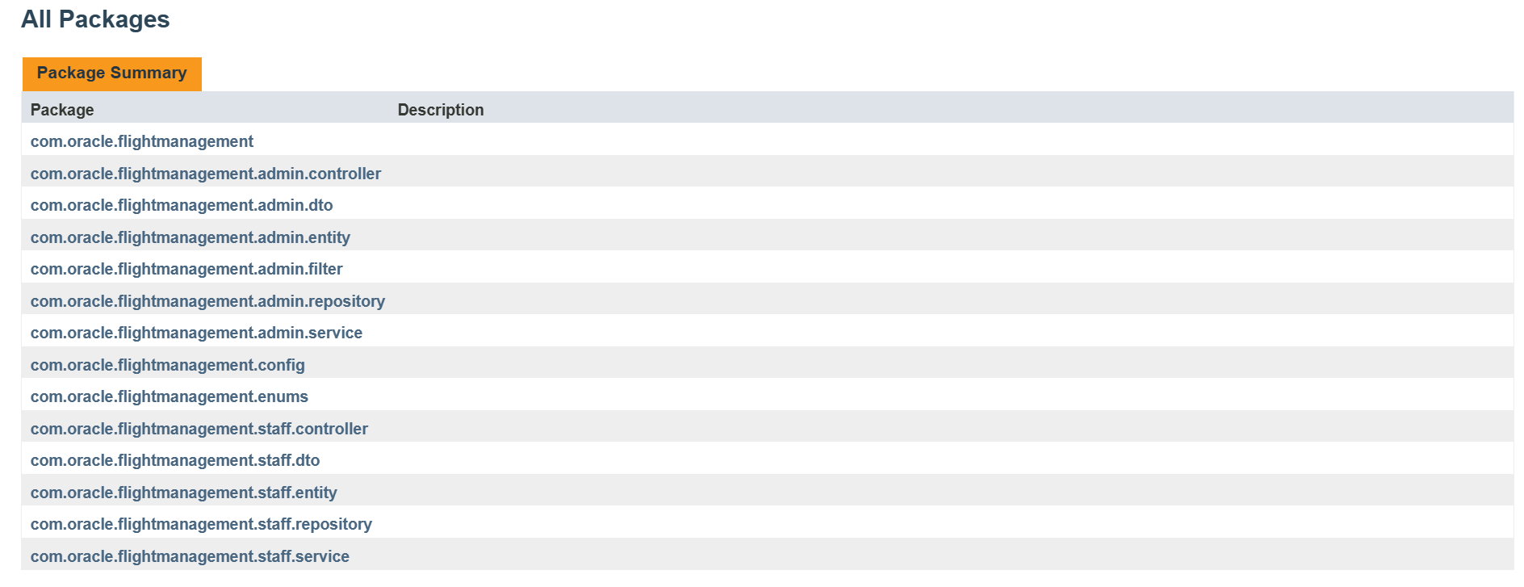
JavaDoc

Slide 19
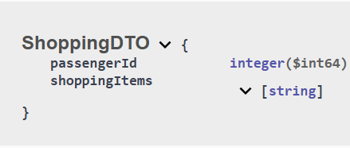
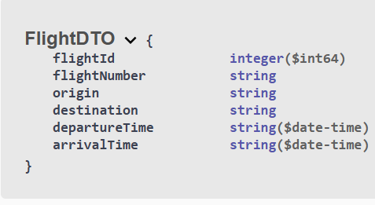
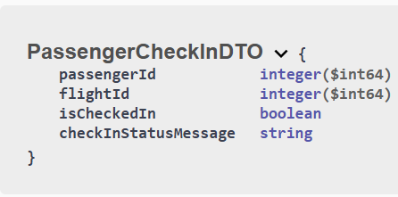
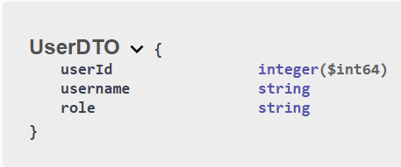
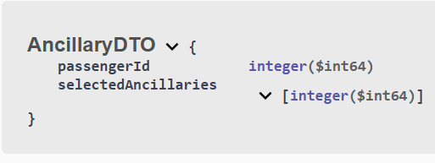
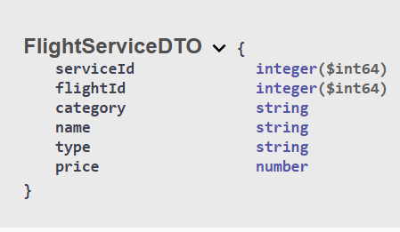
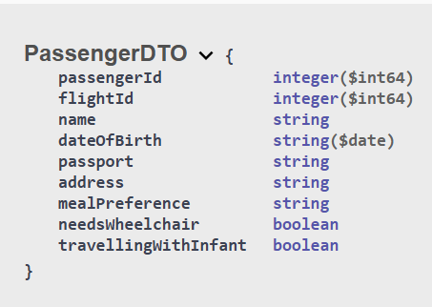
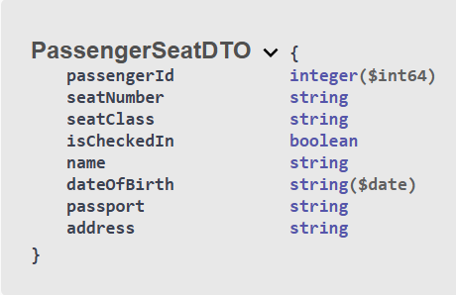
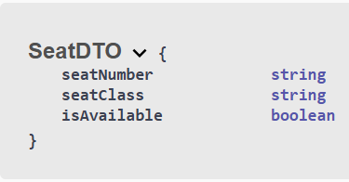
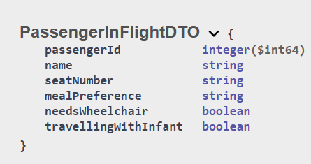
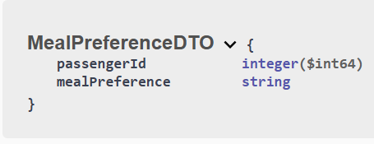
Schemas

Slide 20
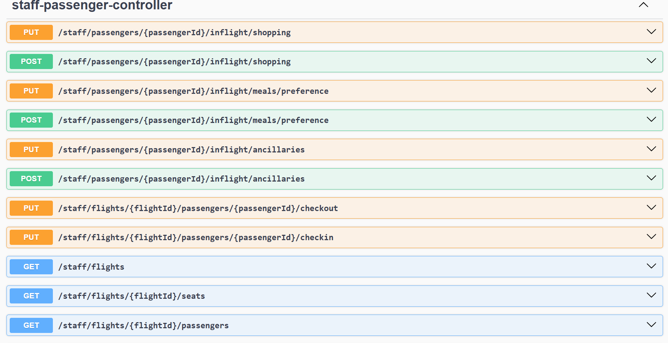
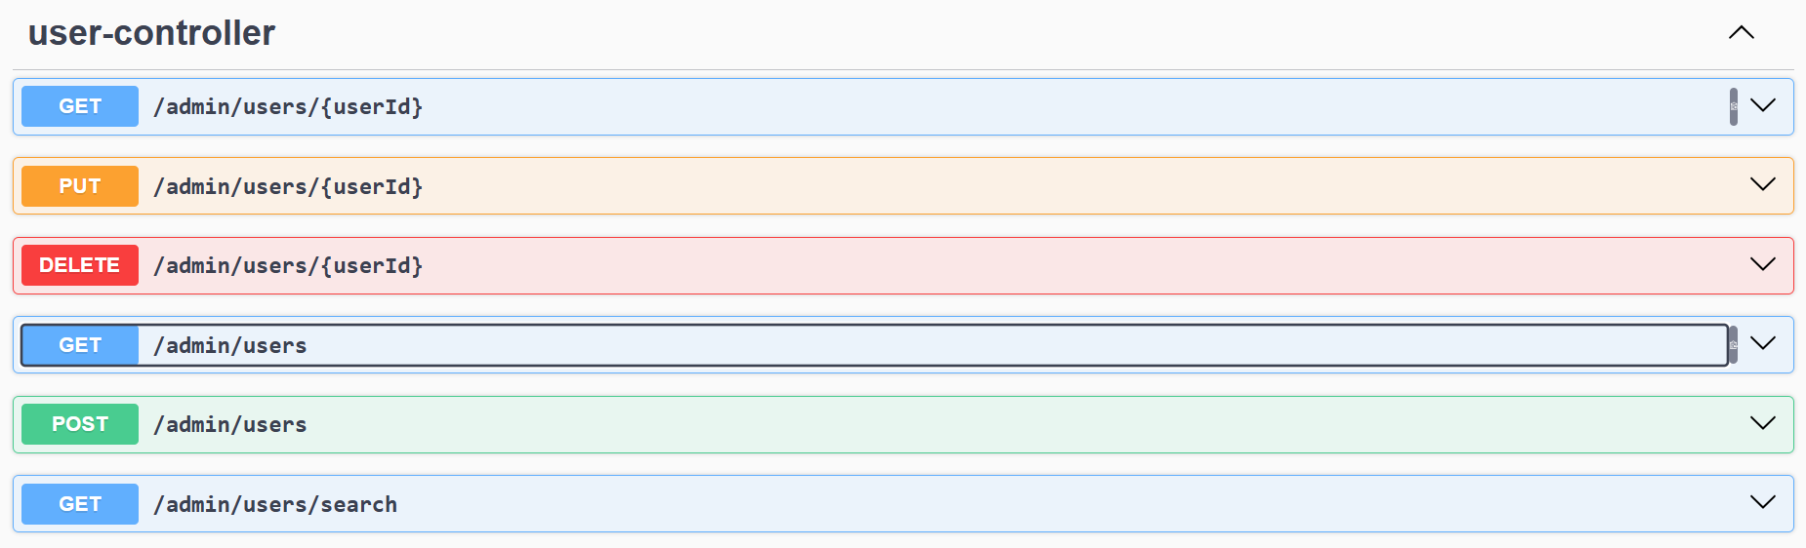
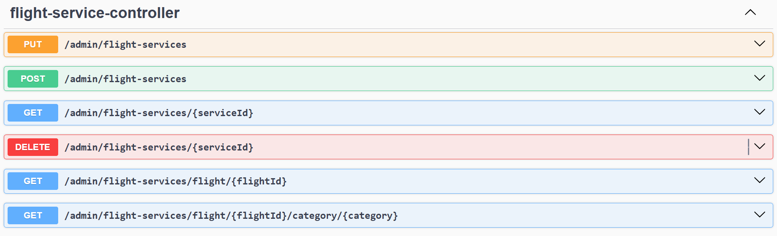
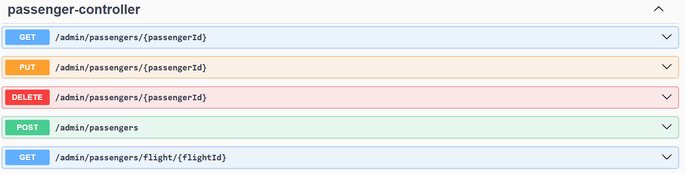
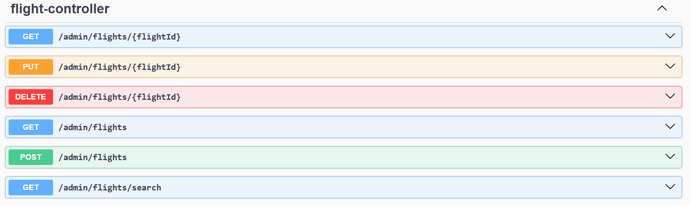
Rest API Documentation and Testing

Slide 21
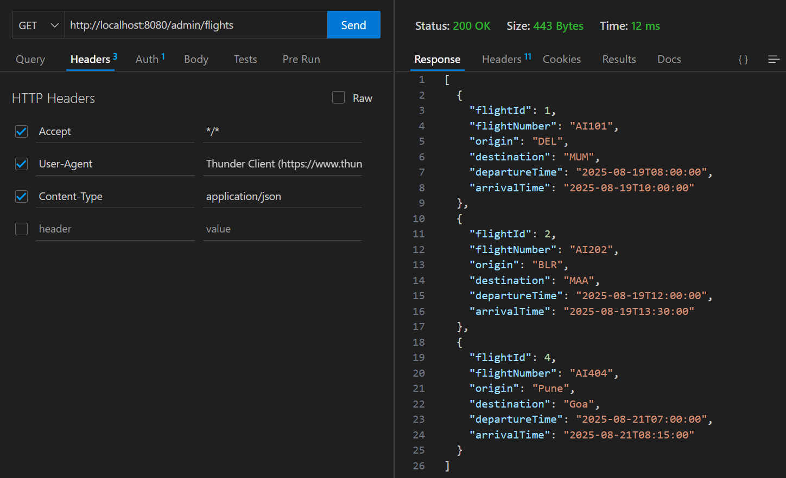
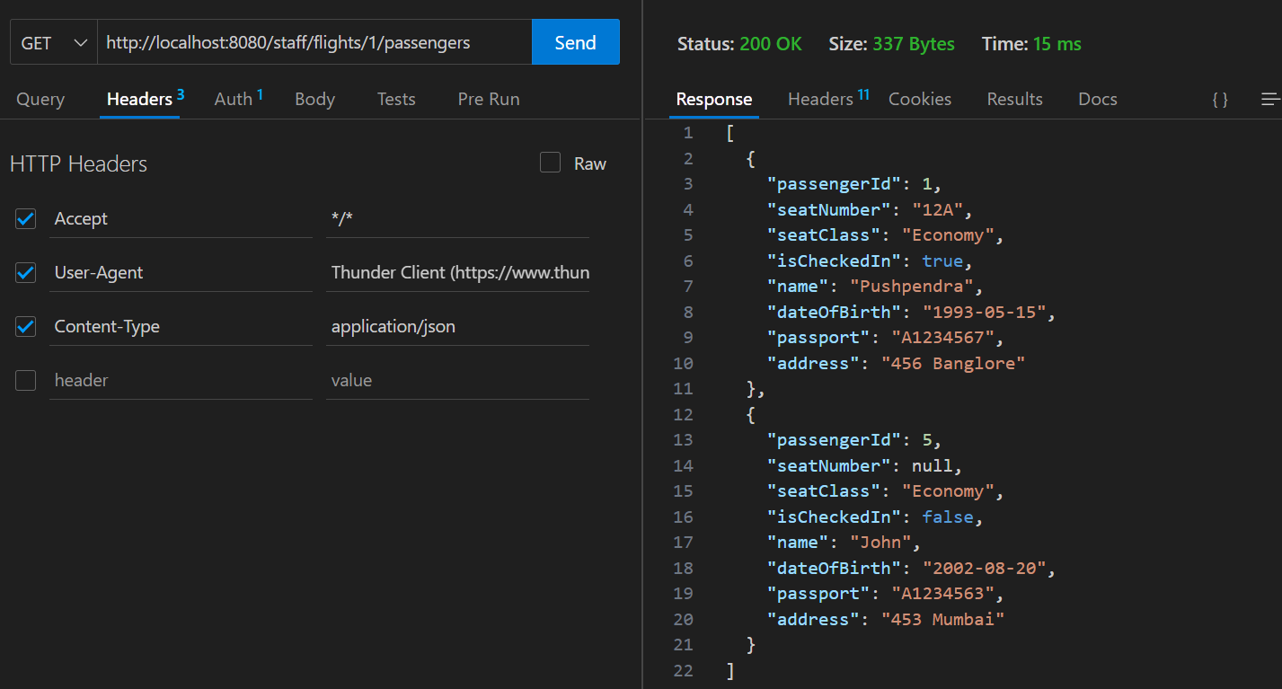
Testing REST Endpoints using Postman/Thunderclient
Admin-
Staff-

Slide 22
Challenges Faced
System Integration Complexity: Connecting multiple modules like flight scheduling, crew management, and booking systems requires careful orchestration and robust API design.
Security and Access Control: Protecting sensitive operational and passenger data while managing role-based access across departments is critical and complex.

Slide 23
Learnings & Takeaways
Hands-on Experience with Modern Technologies: Gained practical skills in Spring Boot, JPA, and Oracle 19c, enhancing backend development capabilities and database management proficiency.
RESTful API Development: Learned to design and implement clean, scalable APIs using industry best practices, improving system interoperability.
Debugging and Problem Solving: Improved ability to troubleshoot issues efficiently using tools like Postman, SQL Developer, and VS Code

Slide 24

Thank you!

