Slide 1



Ask Me Anything
Fall 2024
7th October 2024

Slide 2


Mission
We aim to create an inclusive, collaborative environment where students of all experience levels can learn, innovate, and develop solutions that benefit tech and society.
Vision
We aspire to be a community where innovation and creativity thrive, preparing leaders to tackle global challenges across disciplines like healthcare and the environment.
Notes:
Talk about current industry and how should we as student be prepared to conqueer that
AI advancements
Certifications
security

Slide 3



WHY GDG?
By joining GDG, students grow their knowledge in a peer-to-peer learning environment and build solutions for their community.
BENEFITS:
Hands-on Experience
Networking Opportunities
Skill Development
Notes:
Forums for mutual growth , can meet new people with whom u can take part in projects hacakthons

Slide 4

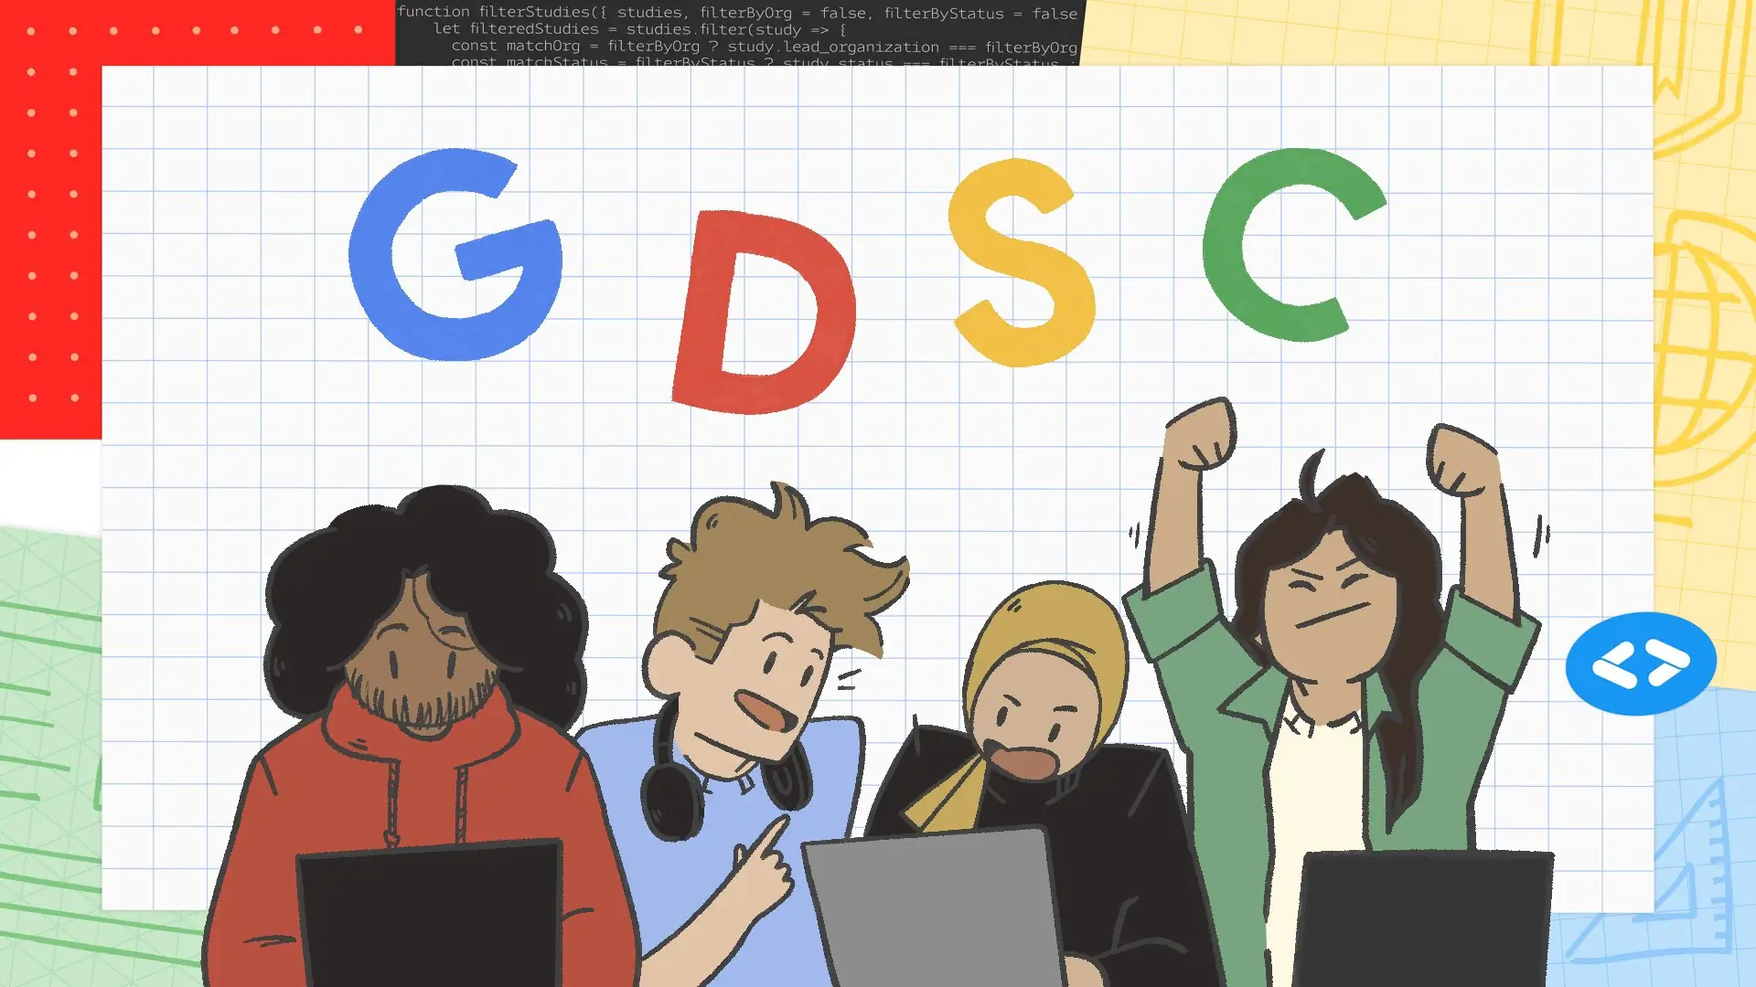

GDSC to GDG

Slide 5
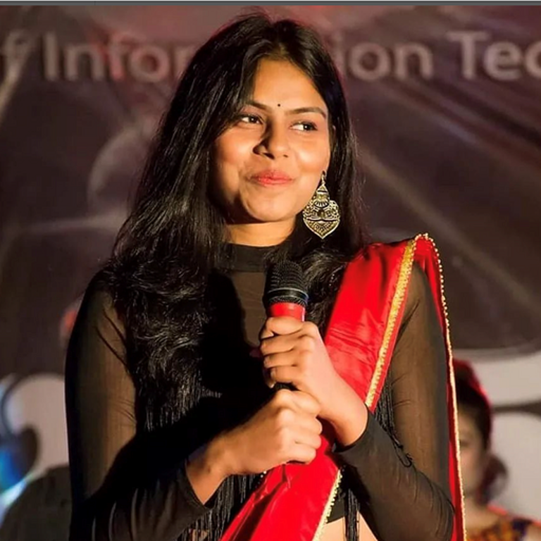
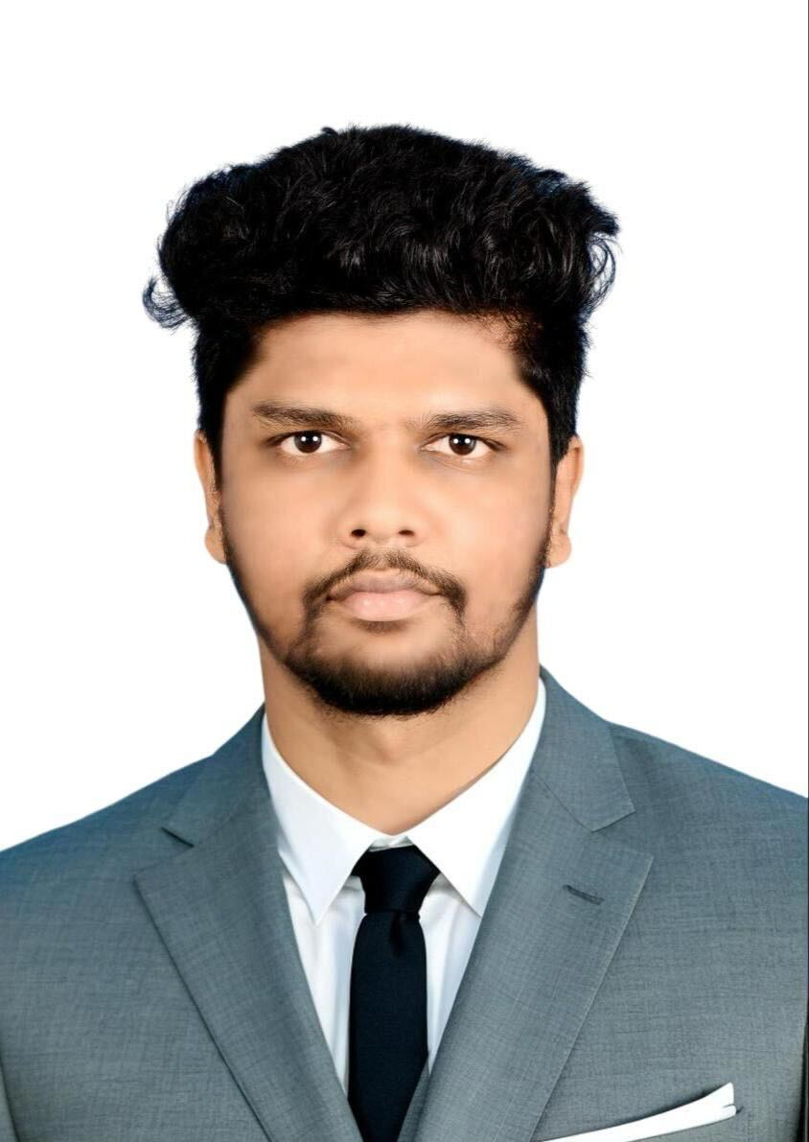
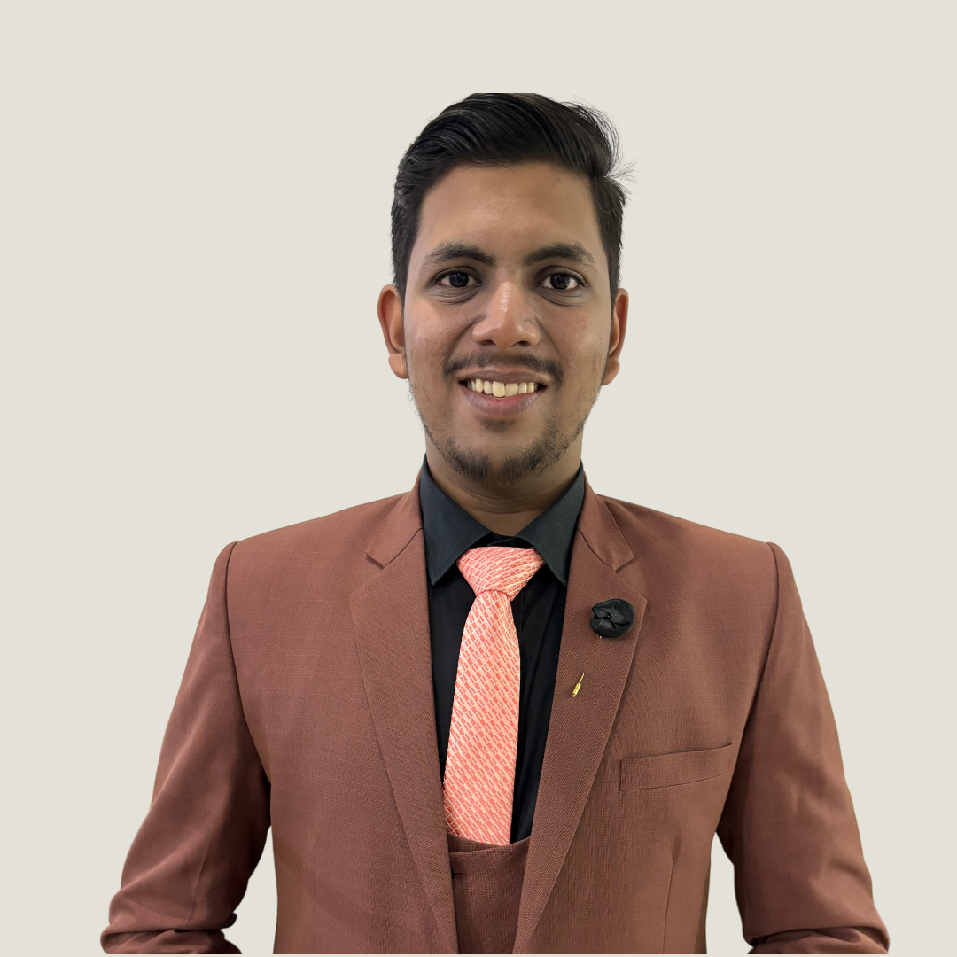
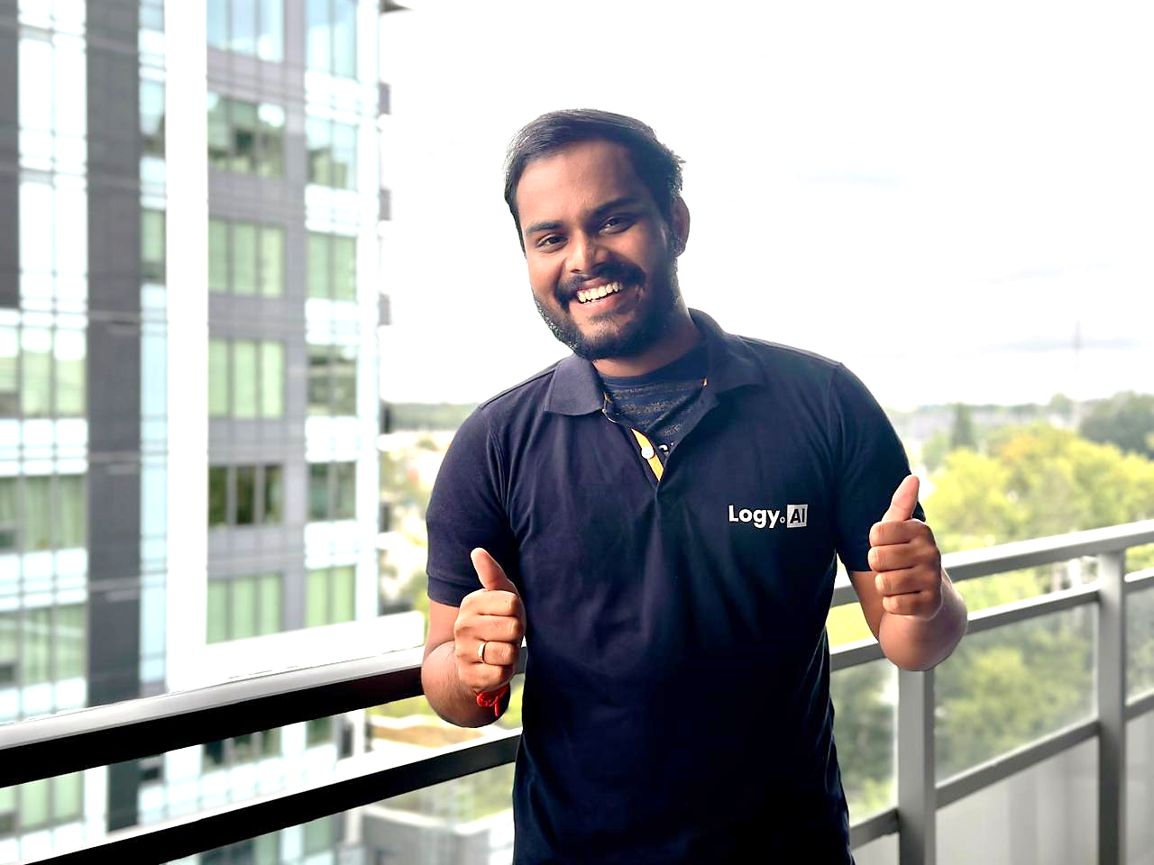
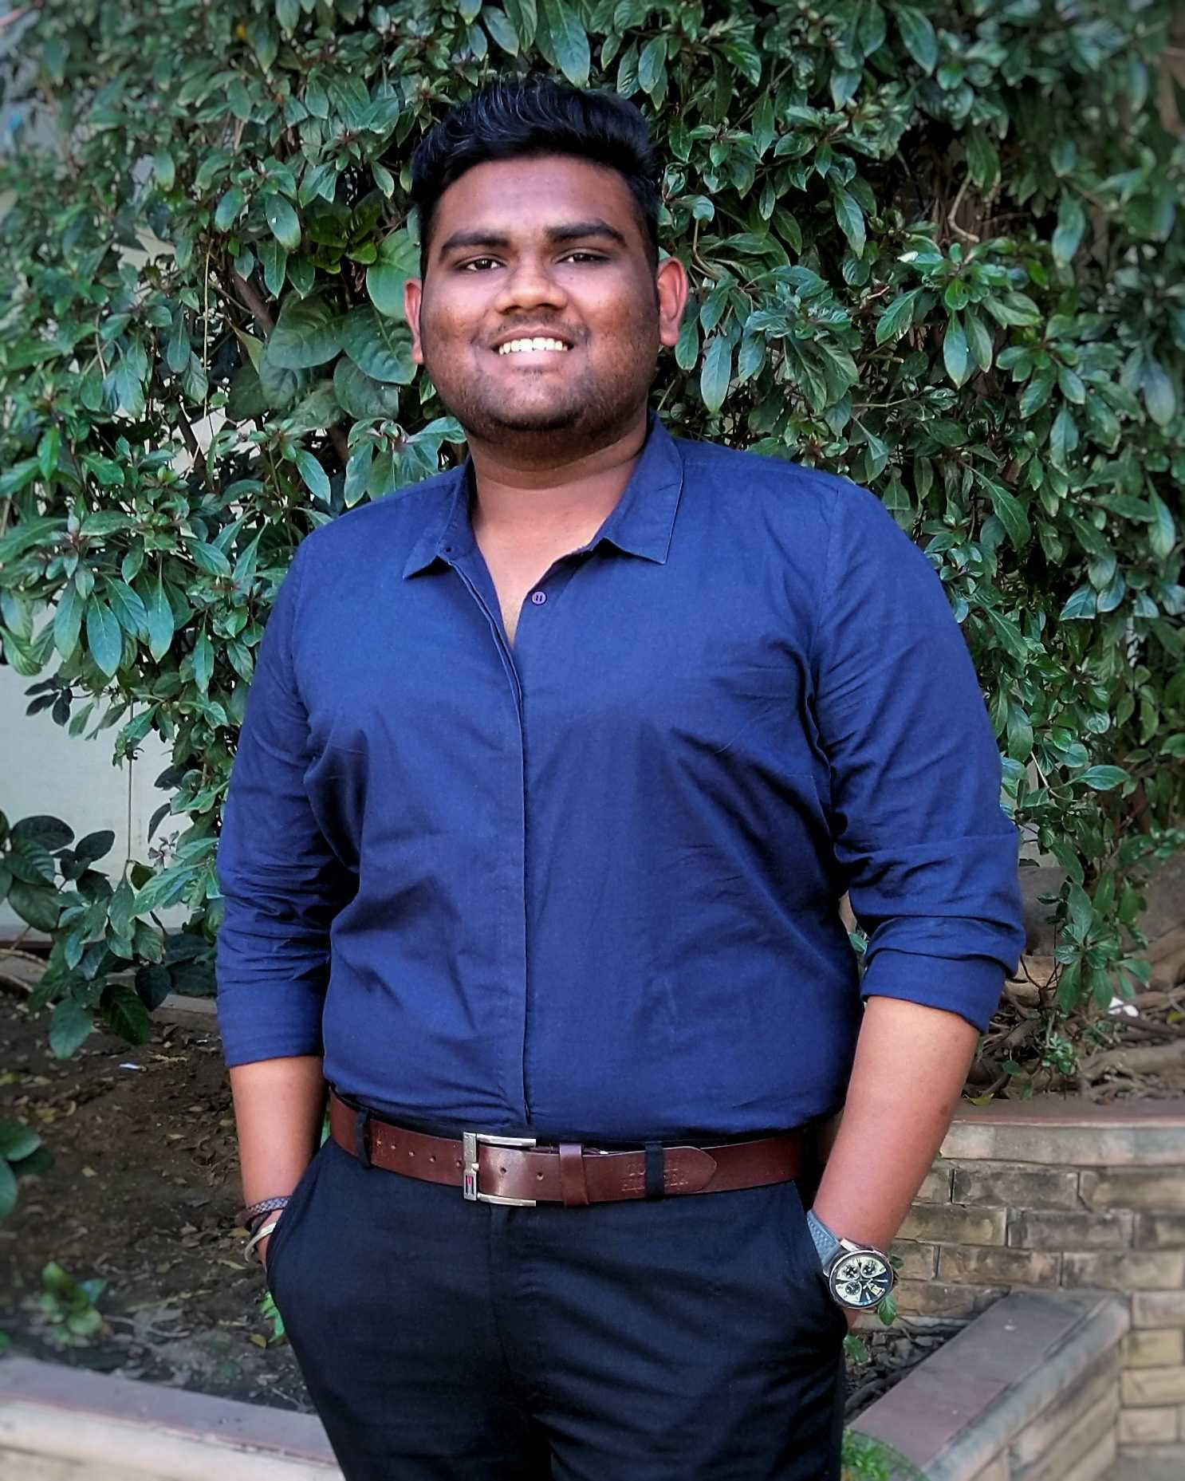
MEET THE EXECUTIVE(CORE) TEAM:-
Monisha Ranjan
Advisor
Pavala Cholai
Tech Co-Lead
JAYACHANDHRAN SARAVANAN
Vice President
Chirag Bansal
President

Slide 6
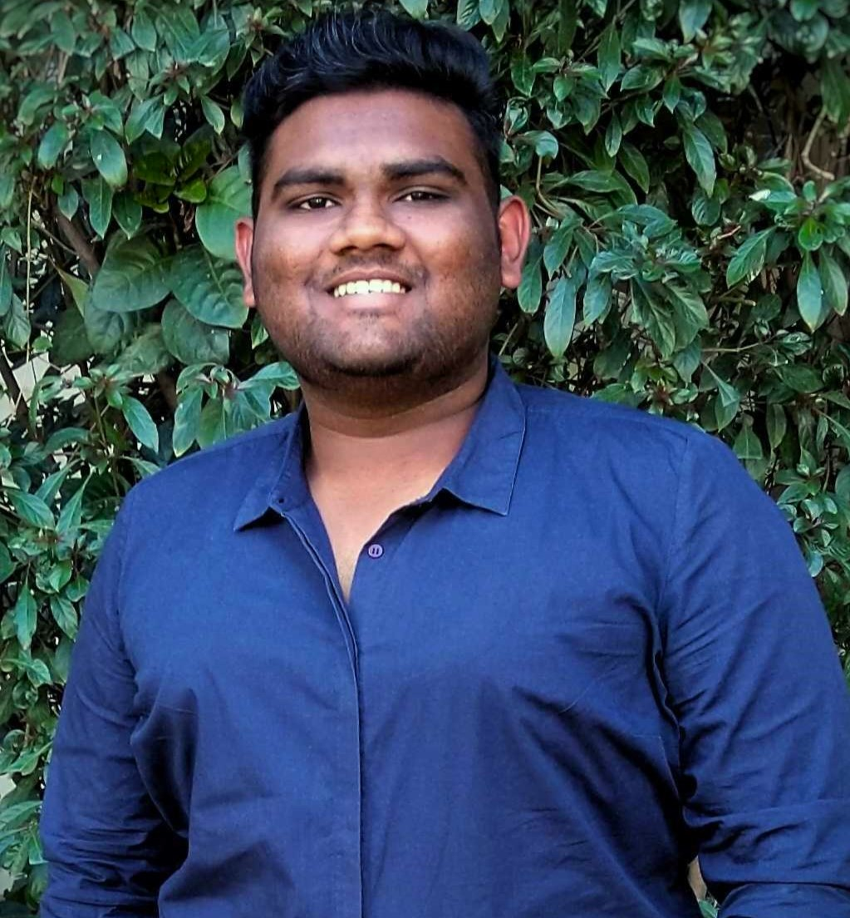
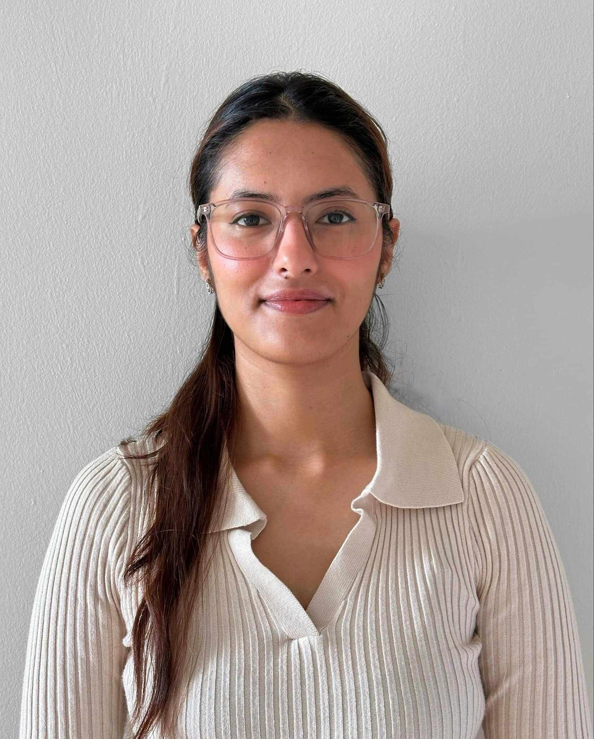
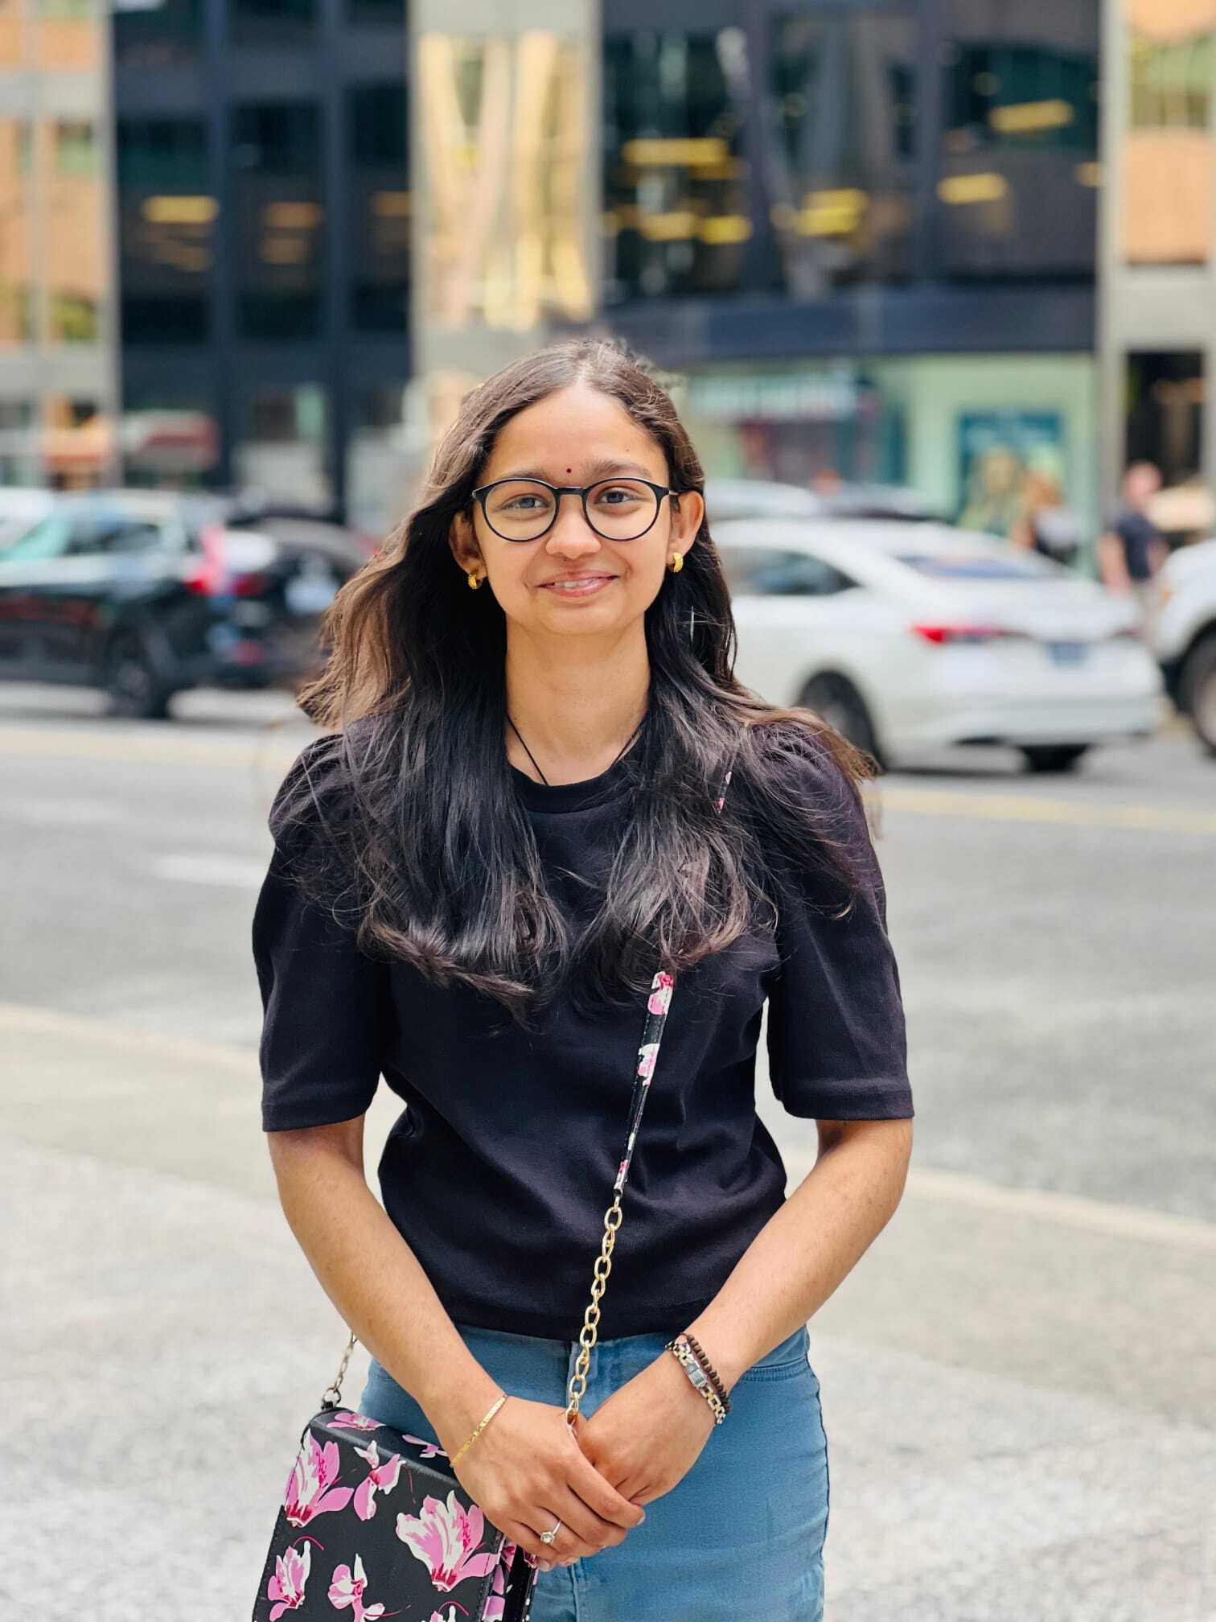
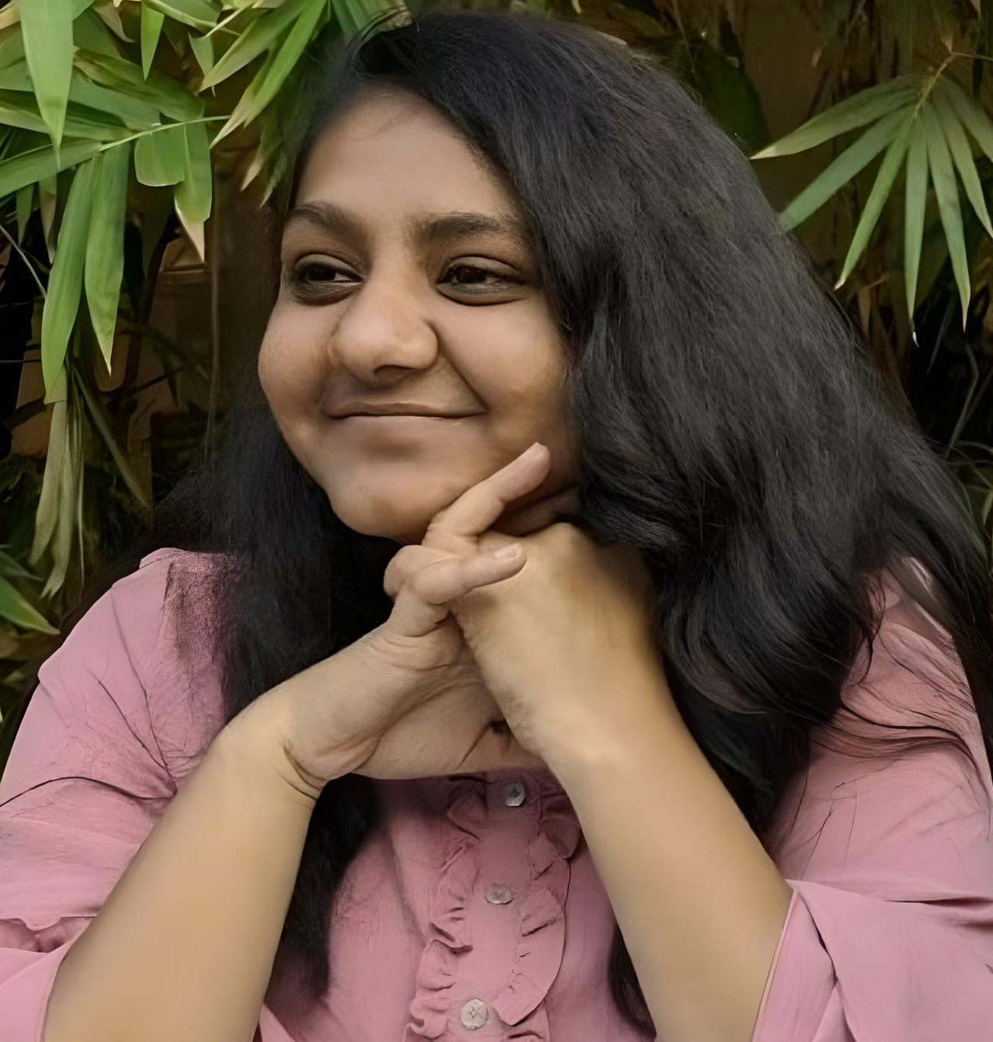
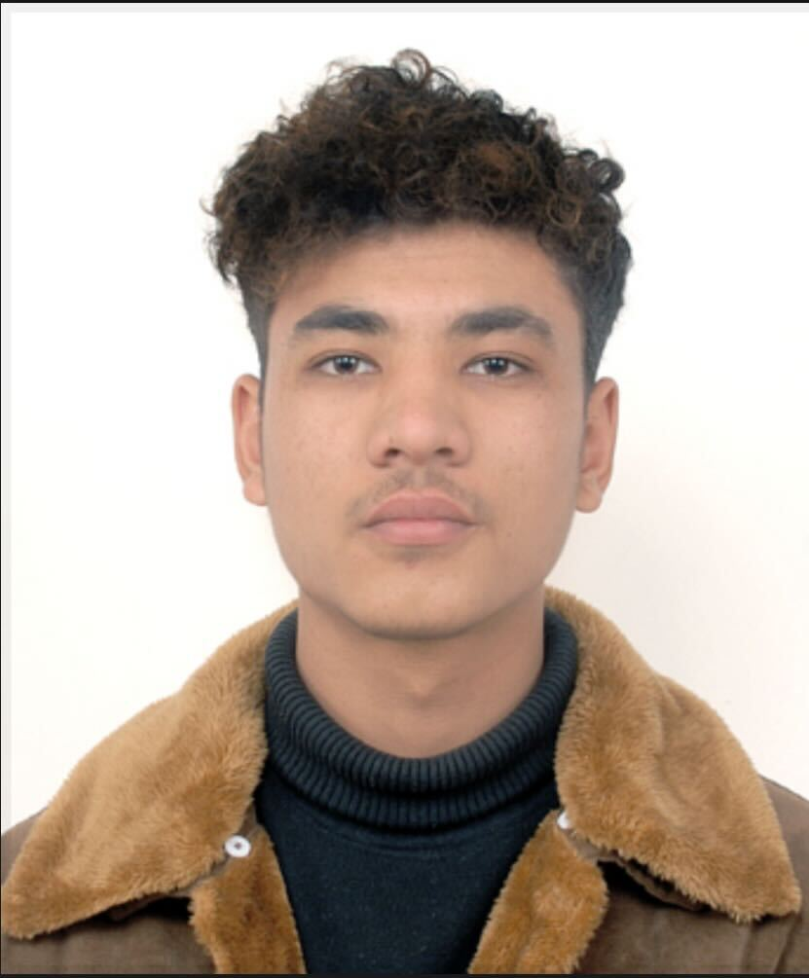
MEET THE EXECUTIVE(CORE) TEAM:-
Rushi Suthar
Designer Lead
Rachana Basnet
Tech-Co Lead
Deeksha Prabhu
Administrative Lead
Aanal Patel
Social Media & Outreach Lead
Anmol Budhathoki
Event Lead

Slide 7
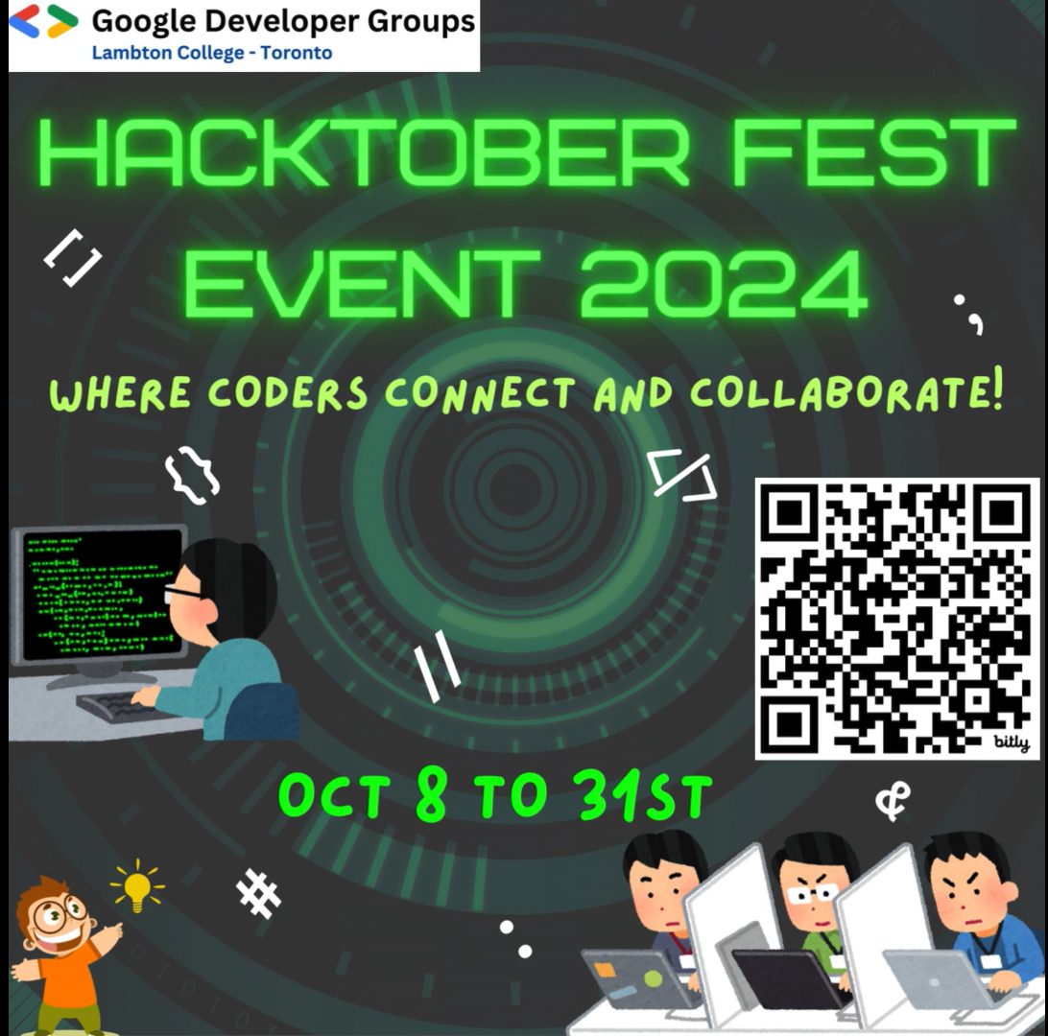
Our Next
Event:

Slide 8

Planned Activities:
Workshops
Hackathons
Talk Sessions - Industry Experts
Certification Bootcamp Series
Study Groups And Forums
DSA Sessions and Contests
Mock Interview
Notes:
Open to new ideas, importance of DSA for all fields in tech, talk from industry people, how to reach out to people for referral

Slide 9
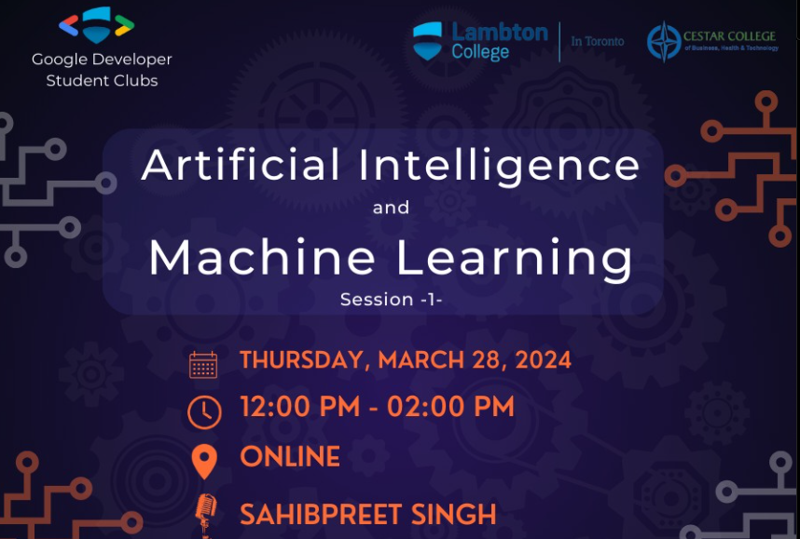
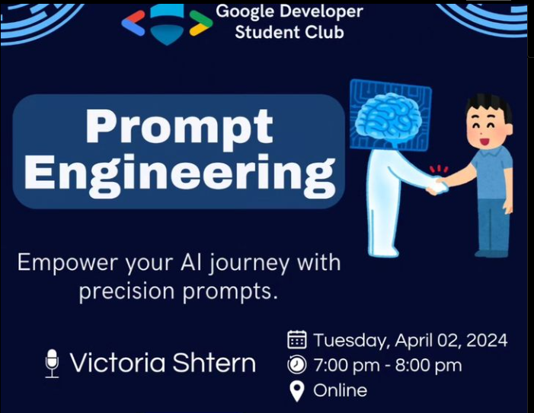
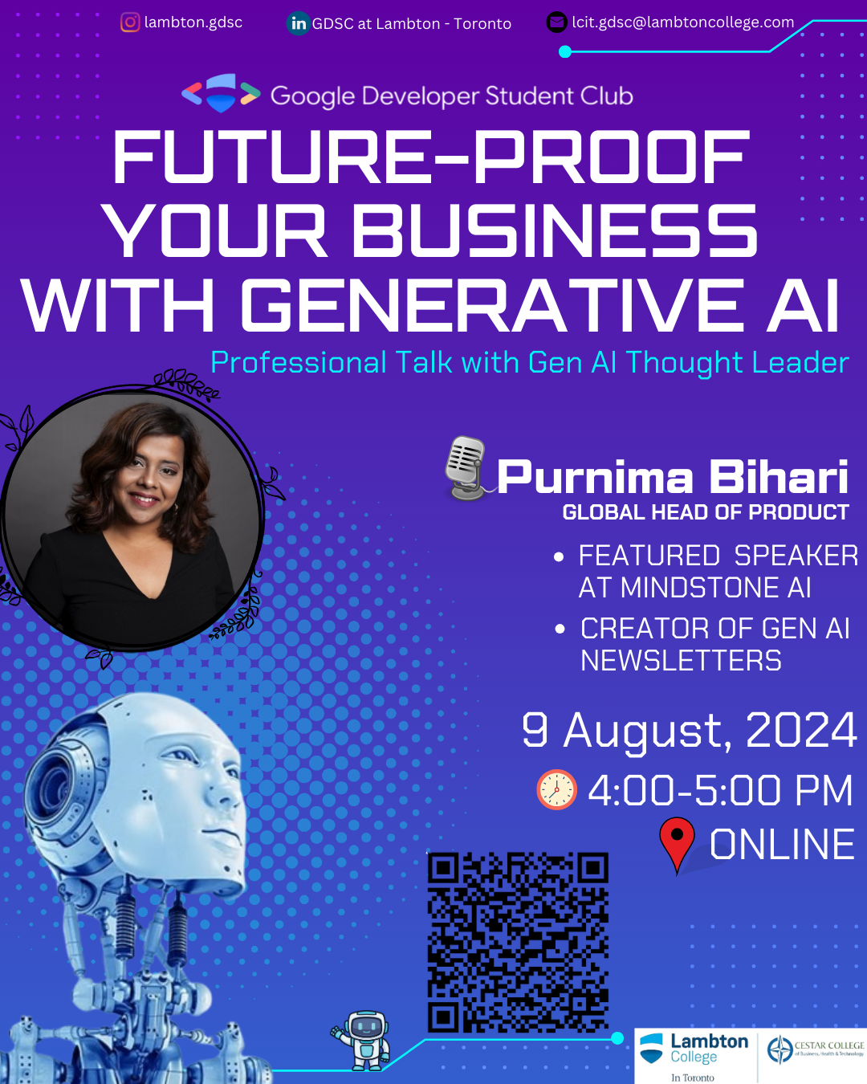
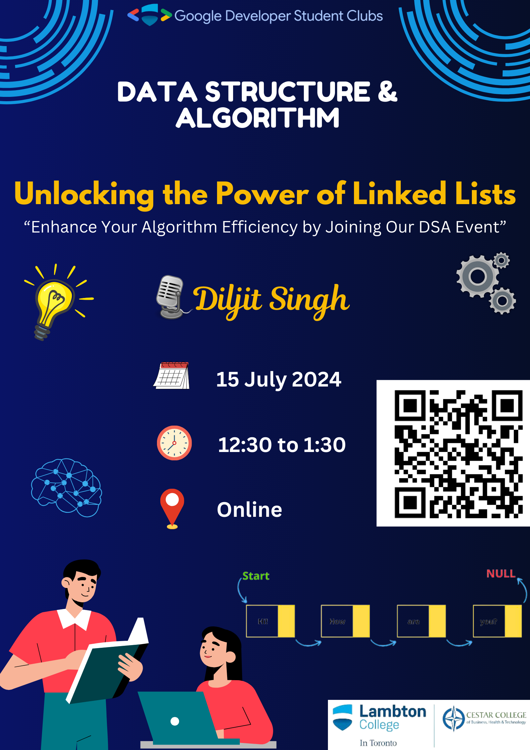
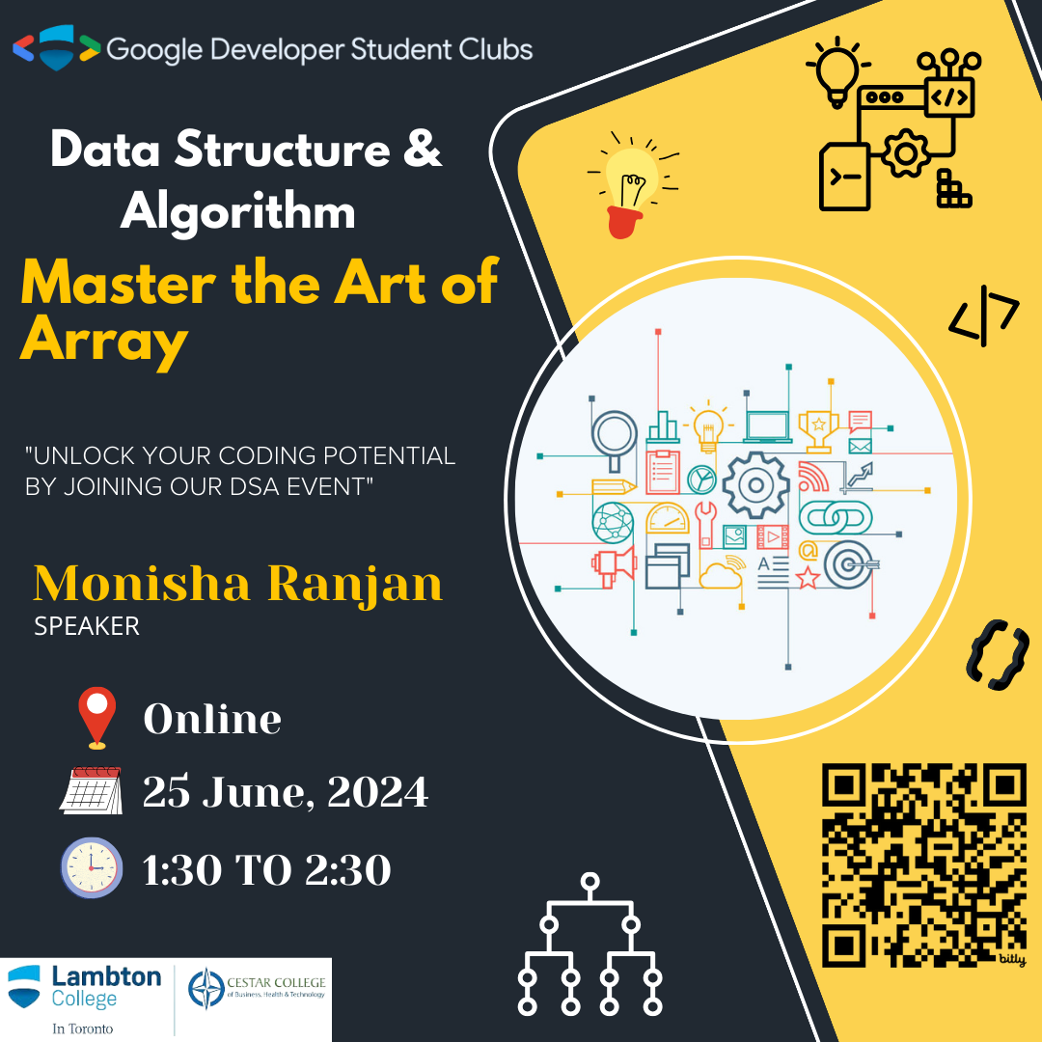
WHAT WE DID BEFORE

Slide 10
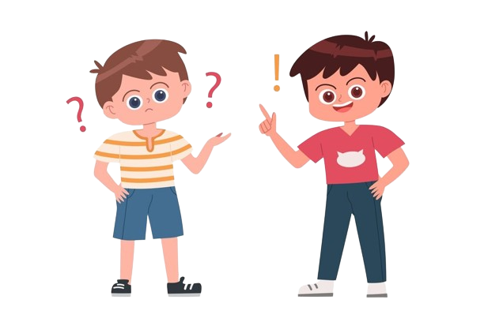
Q & A

