Slide 1

Problem Statement and Team Details
Problem Statement: Save time, prevent disputes, and maintain organizational trust with Smart Doc Checker, your AI-powered document assistant.
Team Name: Haahaa
Team Leader Name: Rushita Maguluri
Institute Name: KLH University
Team Leader Email ID: rushitamaguluri@gmail.com
GitHub Repository Link: https://github.com/charvi64/Hack_india.git
Working Model: https://hack-india-git-main-charvi64s-projects.vercel.app?_vercel_share=oJ6VXHdOZvuouQ3eTMyS5bamB0tnL7IX

Slide 2
Problem → Solution
Problem:
Organizations rely on multiple documents such as rules, contracts, policies, and guidelines. Over time, these documents become inconsistent and contradictory. Manual checking of these conflicts is tedious, error-prone, and can lead to disputes, penalties, and confusion.
Solution:
The Smart Doc Checker is an AI-powered system that: •Uploads and scans multiple documents to detect contradictions automatically. •Highlights conflicts with clear explanations and suggests clarifications. •Generates detailed reports listing all inconsistencies. •Monitors external policy pages and triggers conflict detection on updates. • Integrates Flexprice for transparent pay-per-use billing with visible usage counters.
Ensuring accuracy, consistency, and trust across all organizational documents.

Slide 3
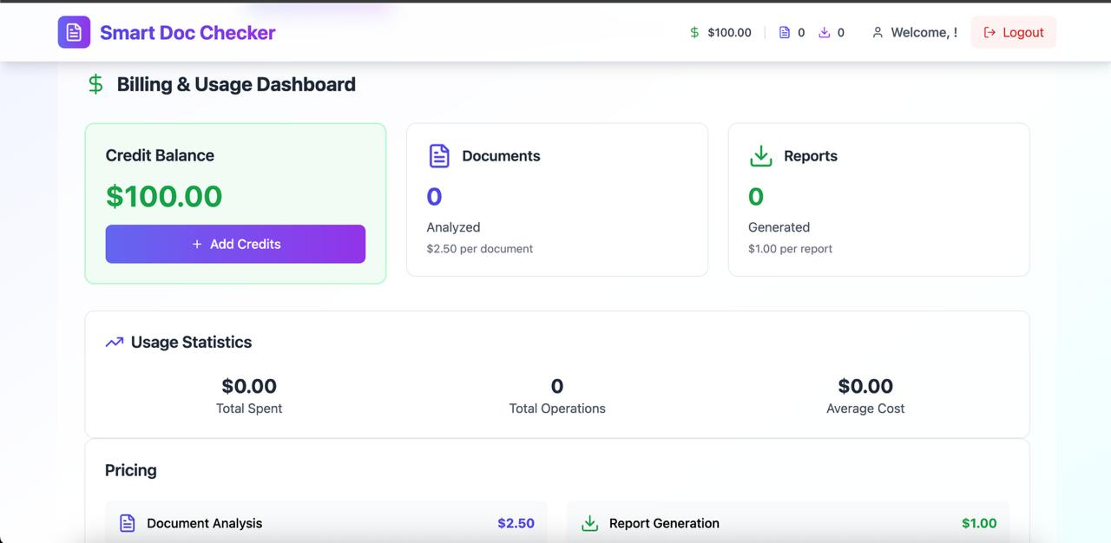
Methodology & Implementation
Upload & preprocess documents.
Detect conflicts using AI + rules.
Highlight issues & generate
reports.
Monitor external updates
automatically.
Pay-per-use billing via Flexprice.
Interactive dashboard for
viewing & downloads.

Slide 4
Technology Used
React + TypeScript + Vite – Frontend development; fast, type-safe, modern SPA setup.
Tailwind CSS + PostCSS – Styling and responsive UI design.
Lucide-react – Icons for buttons, alerts, and visual cues.
ESLint + NPM (Node.js) – Code quality, linting, and package management.
Hugging Face API – NLP and AI-powered conflict detection.
Monitoring & Updates (BeautifulSoup / Scrapy) – Scraping external policy pages and detecting updates.

Slide 5
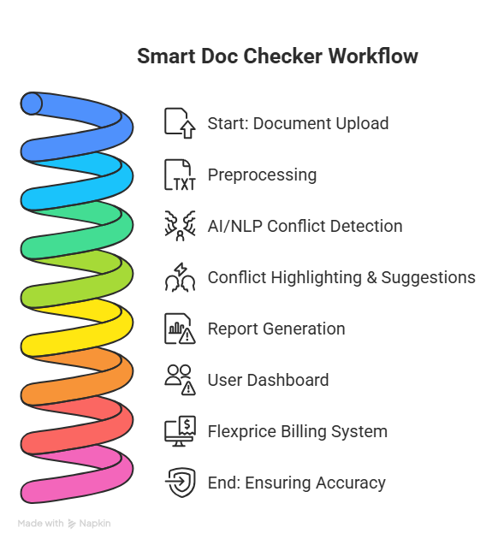
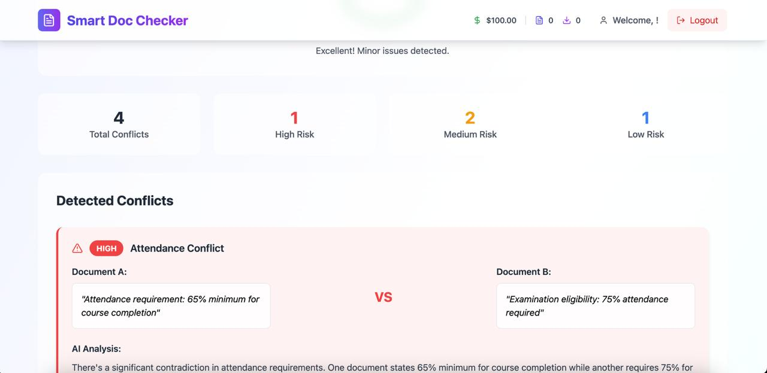
Flowchart & Supporting Images

Slide 6
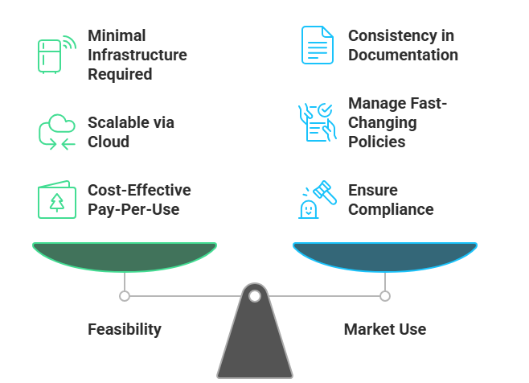
Feasibility and Market Use

Slide 7
Conclusion
Our project, Smart Doc Checker, is an AI-powered solution that transforms how organizations manage documents. It: • Automatically scans and detects contradictions across multiple documents, eliminating hours of manual review. • Highlights conflicts with explanations and suggests actionable clarifications to resolve inconsistencies. • Generates comprehensive reports for easy auditing and decision-making. • Monitors external policy updates in real-time, ensuring documents stay accurate and up-to-date. • Integrates Flexprice pay-per-use billing, displaying live usage counters for transparency and scalability.
Impact: By combining AI, automation, and smart monitoring, our solution prevents disputes, improves efficiency, and ensures organizational trust and clarity — all in one intelligent platform.

