Slide 1
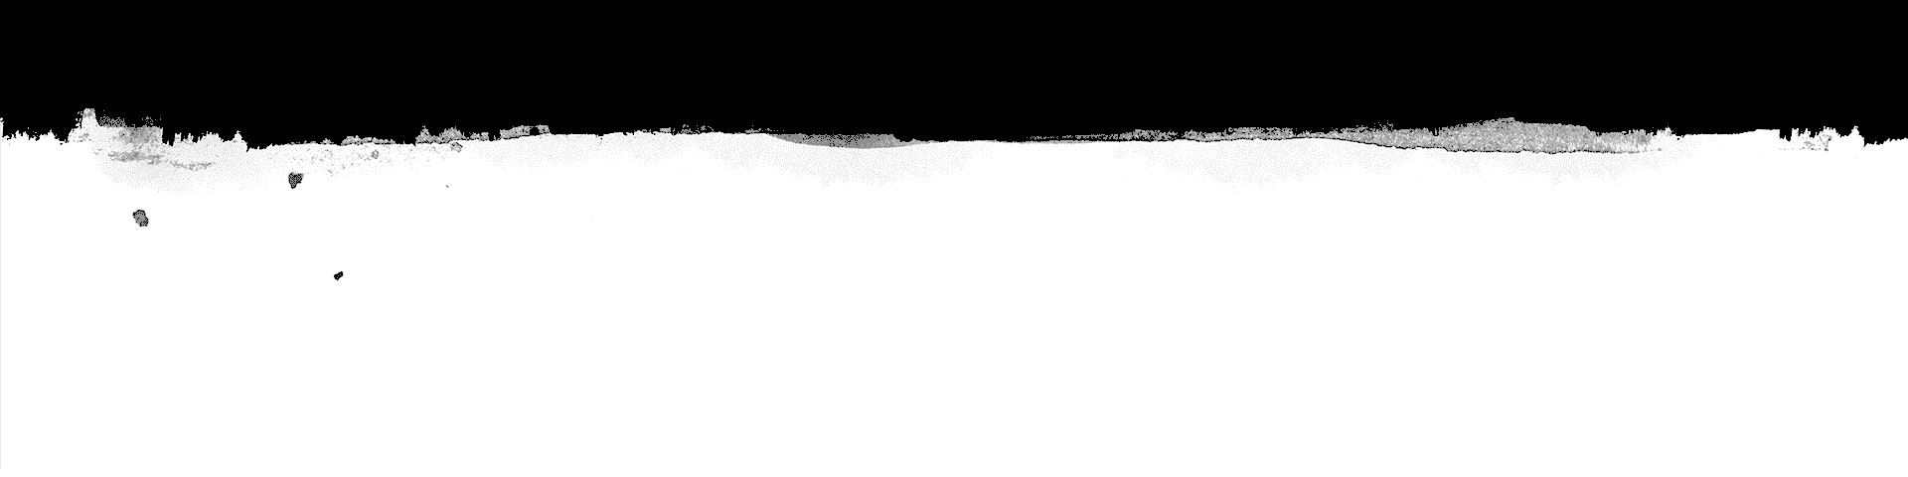
Text Generator using LSTMs
Tanmay Thakur 17BEE
Rushi Varun 17BEE0285

Slide 2
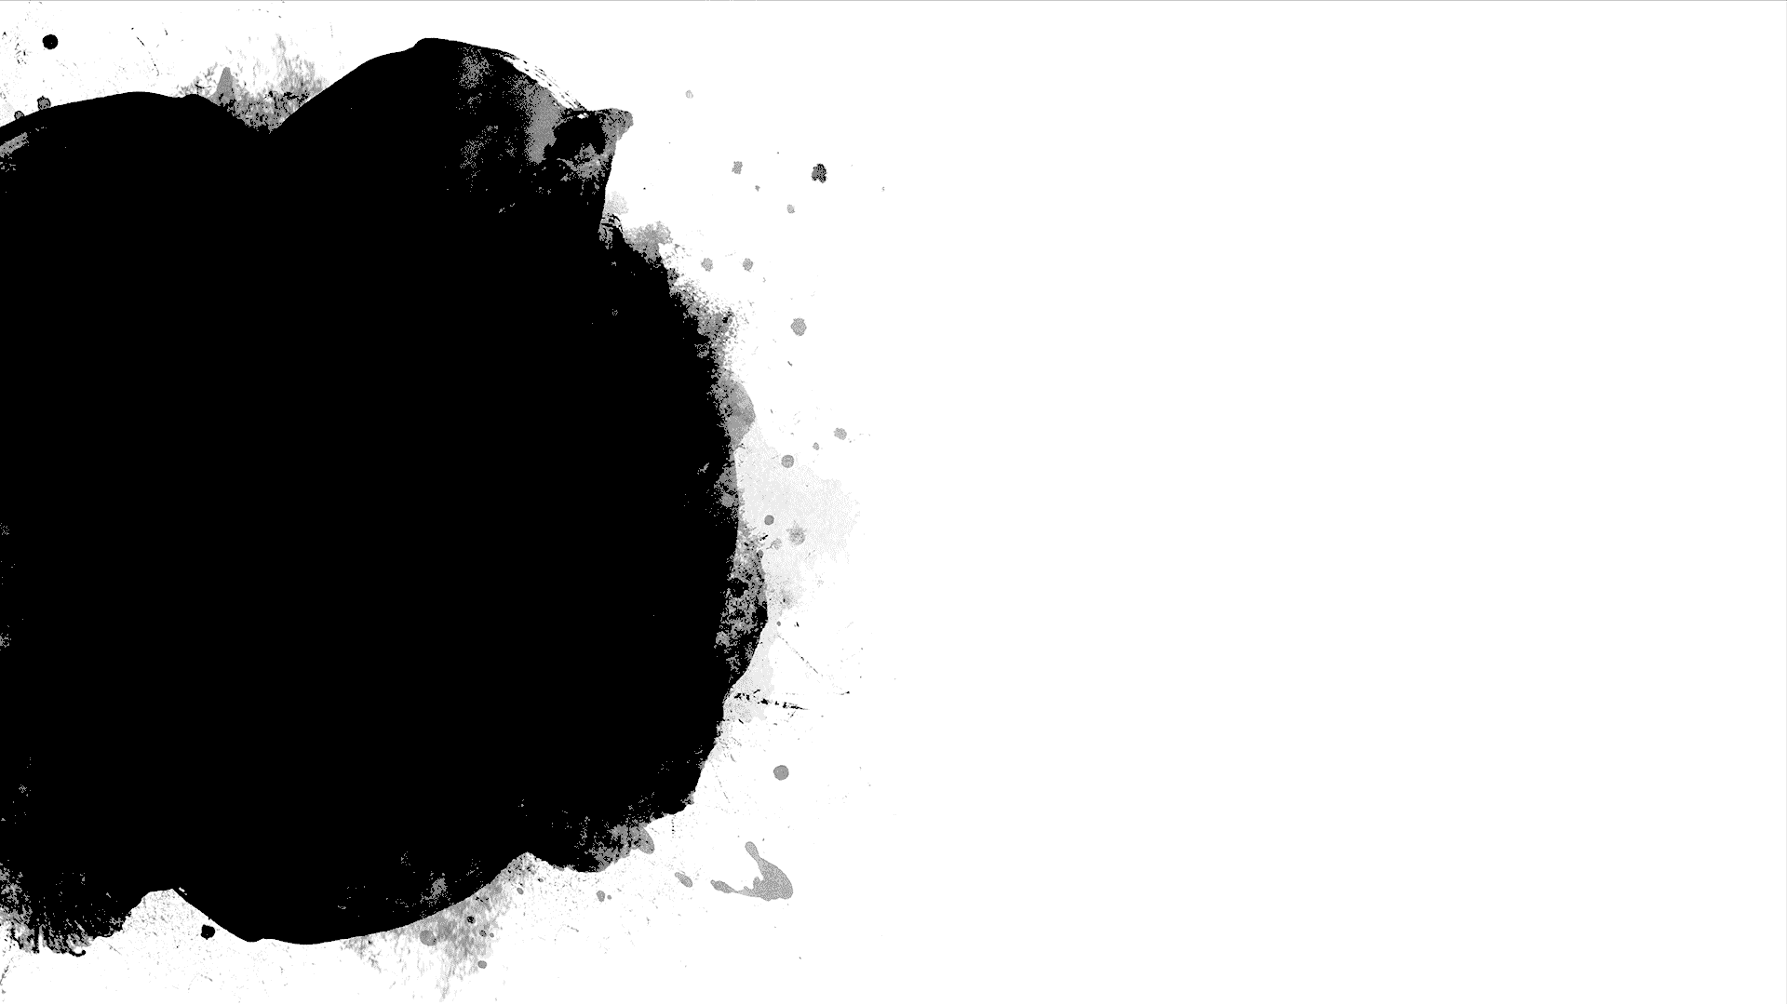
What is text generation?
A model when trained on a dataset being able to generate meaningful text without being explicitly programmed to do so.
Generative models like this are useful not only to study how well a model has learned a problem, but to learn more about the problem domain itself.

Slide 3
Recurrent Neural Networks
Recurrent Neural Networks (RNN) are a powerful and robust type of neural networks and belong to the most promising algorithms out there at the moment because they are the only ones with an internal memory.

Slide 4
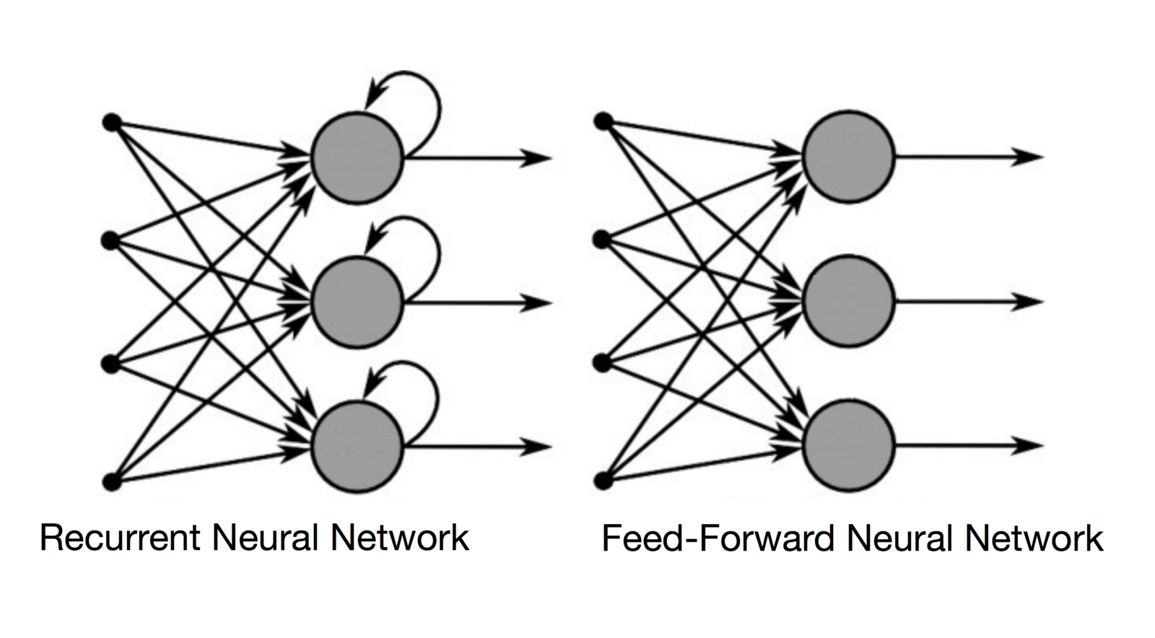
RNN

Slide 5
Long short term memory
Long Short-Term Memory (LSTM) networks are an extension for recurrent neural networks, which basically extends their memory. Therefore it is well suited to learn from important experiences that have very long time lags in between.

Slide 6
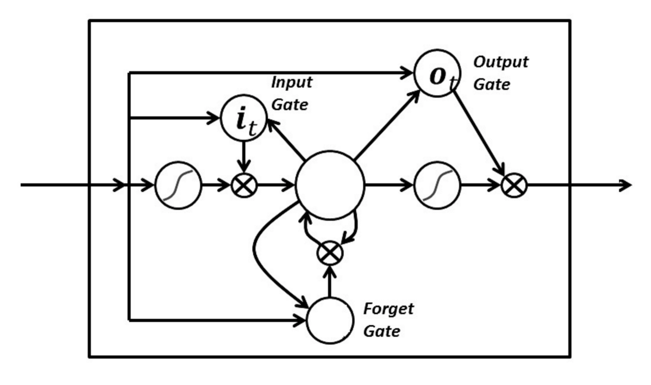
Architecture

Slide 7
Why LSTMs
LSTM’s enable RNN’s to remember their inputs over a long period of time. This is because LSTM’s contain their information in a memory, that is much like the memory of a computer because the LSTM can read, write and delete information from its memory.

Slide 8
Industrial Applications
Text suggestions on keyboards.
Scemantic approach to Natural Language Processing.
Auto fillers for ease.
Automated email generation systems
Chatbots
Etc…..

Slide 9
Dataset
Can be trained on storybooks
Articles
Lyrics of artists
For this project we have chosen song lyrics of the famous artist Drake.
We have trained the neural network on over 300000 words in his songs.

Slide 10
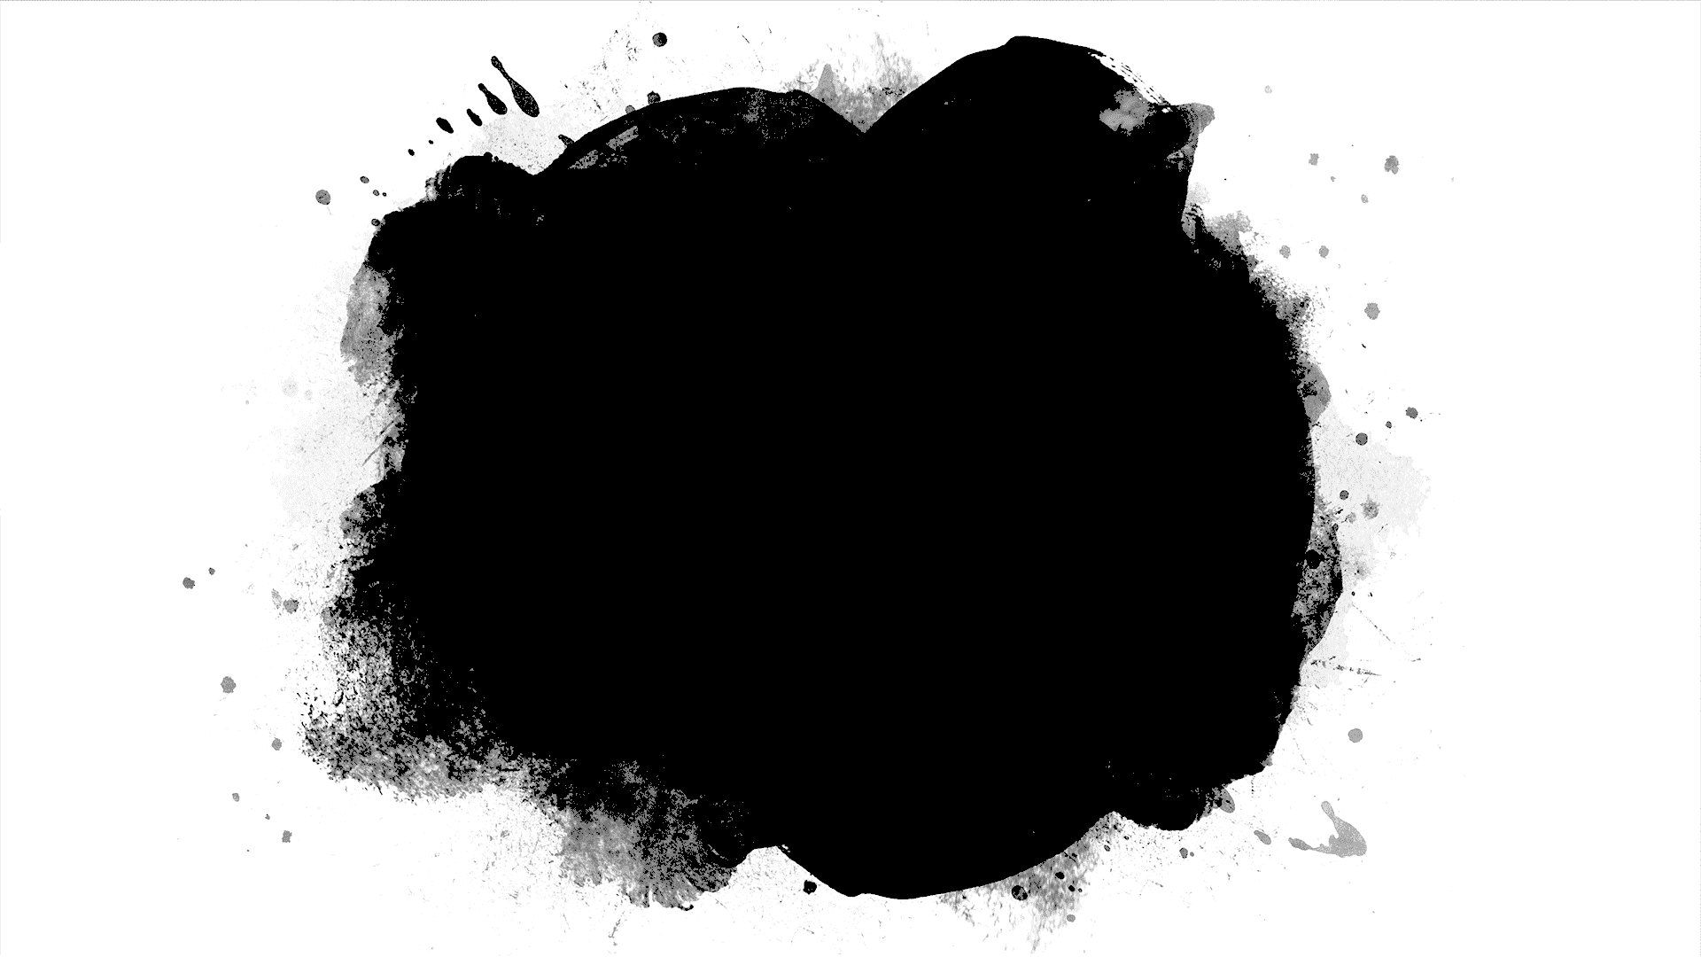
Implementation

Slide 11


Slide 12
Code
https://github.com/rushivarun/lyrics_generator_using-LSTM

Slide 13
Now lets rap………

Slide 14
References
https://arxiv.org/abs/1508.01745
https://arxiv.org/abs/1506.01057
The above are two references for generating texts using LSTMs

