Slide 1
PROJECT REVIEW 1 • August 2026
PropPulse
ML-Driven Property Valuation & Market Intelligence for Residential Real Estate
Member 1 Name Roll No. 1
Member 2 Name Roll No. 2
Member 3 Name Roll No. 3
Member 4 Name Roll No. 4
Member 5 Name Roll No. 5
Repository
github.com/rushmanthnalluri/prop-pulse
Dataset: Ames, Iowa (Kaggle)
Under the guidance of Guide Name, Designation
Department of Computer Science & Engineering • Institute Name
PropPulse — Project Review 1
1
Notes:
OPENING (15 s, Speaker 1): Good morning. We are team PropPulse. Our project is an end-to-end machine-learning platform that estimates a home's sale price, its probability of selling within 30 days, and the micro-market segment it belongs to — for residential real estate in Ames, Iowa. REPLACE the placeholder names/roll numbers, guide, and institute on this slide before the review.

Slide 2
SPEAKER 1 • ~45 S
Problem Statement
▪ Residential property pricing is opaque. Buyers, sellers and agents rely on rules of thumb; online estimates rarely explain why a home is worth what it is.
▪ Goal: given the attributes of a residential property in Ames, Iowa, build an ML system that estimates
  – Sale price (regression) with a prediction interval, in dollars
  – Probability of selling within 30 days (calibrated classification)
  – Micro-market segment (unsupervised clustering of 25 neighborhoods)
▪ Every estimate must be explainable (per-prediction SHAP factors) and served through a usable product (API + dashboard), not just a notebook.
Why it matters
• For sellers/agents: defensible listing prices and expected time-on-market.
• For buyers: a data-driven check on whether an asking price is fair.
• For analysts: interpretable drivers of value and a map of distinct micro-markets.
PropPulse — Project Review 1
2
Notes:
Speaker 1 (~45 s): State the problem — property valuation is opaque and existing tools don't explain their estimates. Our system answers three questions per property: how much, how fast, and which micro-market — and it explains every answer. Emphasize the product requirement: a working API and dashboard, not just a model.

Slide 3
SPEAKER 1 • ~40 S
Abstract
PropPulse is an end-to-end machine-learning platform for residential property valuation in Ames, Iowa (Kaggle “House Prices: Advanced Regression Techniques”, 1,460 sales, 2006–2010). The system predicts a home’s sale price (regression on log-price, reported in dollars with an ~80% prediction interval), the probability that it sells within 30 days (calibrated classification), and its micro-market segment (DBSCAN clustering of the 25 neighborhoods). Every prediction is explained with per-prediction SHAP factors.
Methodology is leakage-safe by construction: a time-based split (train ≤ 2008 / validation 2009 / sealed test 2010), all aggregate statistics fit on train only, and a single feature pipeline shared by training and serving. Models are served by a FastAPI backend, consumed by a React dashboard, tracked with MLflow, monitored for data drift with PSI, and packaged with Docker.
This review covers the problem statement, the completed exploratory data analysis (14 figures, reproducible notebook), and the project repository.
PropPulse — Project Review 1
3
Notes:
Speaker 1 (~40 s): Read the abstract at a high level — do not read it verbatim. Key beats: (1) three predictions per property, (2) honest, leakage-safe methodology with a sealed test set, (3) a full product stack. Close with: today's review covers the problem, the completed EDA, and our git repository.

Slide 4
SPEAKER 2 • ~40 S
Objectives & Scope
▪ O1 — Data pipeline: ingest → clean → validate → time-based split (945 / 338 / 175 rows)
▪ O2 — EDA: 14-figure reproducible analysis of the train split (this review)
▪ O3 — Feature engineering: 94 features, one pipeline shared by training and serving
▪ O4 — Models: 5 regression + 4 classification candidates, champion selection on validation; DBSCAN micro-markets
▪ O5 — Explainability: global + per-prediction SHAP
▪ O6 — Product: FastAPI backend, React dashboard, drift monitoring, Docker, CI + tests
Scope & honest boundaries
• One city (Ames), 1,460 labeled rows, sales from 2006–2010.
• No per-property coordinates → documented neighborhood-centroid lookup (ADR-2).
• No days-on-market in data → transparent, seeded simulation; all fast-sale metrics labelled SIMULATED (ADR-3).
• Test split (2010) stays sealed until final evaluation.
• Emphasis: correct methodology + reproducibility, not the lowest possible error.
PropPulse — Project Review 1
4
Notes:
Speaker 2 (~40 s): Six objectives — O1 and O2 are DONE and are the subject of this review; O3–O6 are in progress/completed per repo status. Be upfront about the two documented data gaps (coordinates, days-on-market) — reviewers appreciate honesty.

Slide 5
SPEAKER 2 • ~45 S
Dataset — Ames, Iowa Housing
▪ Source: Kaggle “House Prices: Advanced Regression Techniques” (De Cock, 2011, J. of Statistics Education)
▪ Raw: 1,460 rows × 81 columns of residential sales, 2006–2010
▪ Features: size, quality/condition, age, amenities, neighborhood, sale period — 23 nominal, 23 ordinal, 14 discrete, 20 continuous + target SalePrice
▪ Time-based split (no shuffle): train ≤ 2008 (945) • val 2009 (338) • test 2010 (175, sealed)
▪ Cleaning: structural NAs (“feature absent”) → “None”; only LotFrontage truly imputed (train-fit neighborhood medians); 2 partial-sale outliers removed on train
Headline numbers (train, n = 945)
• Median price $164,990 • mean $182,125
• Range $35,311 – $755,000
• Skew 1.967 → 0.175 after log1p
• 25 neighborhoods, median-price spread 3.18×
• Fast-sale (simulated): 25.3% of sales
Documented fallbacks
• lat/long = approximate neighborhood centroids (ADR-2)
• days_on_market = seeded simulation of price-vs-neighborhood, quality, seasonality (ADR-3)
• Both have drop-in adapters for real data later
PropPulse — Project Review 1
5
Notes:
Speaker 2 (~45 s): The dataset is the standard Ames benchmark — cite De Cock 2011. Stress the TIME-BASED split: we never shuffle across time, and the 2010 test split is sealed. Cleaning follows the official data description — most ‘missing’ values mean the feature is absent, so only LotFrontage is genuinely imputed.

Slide 6
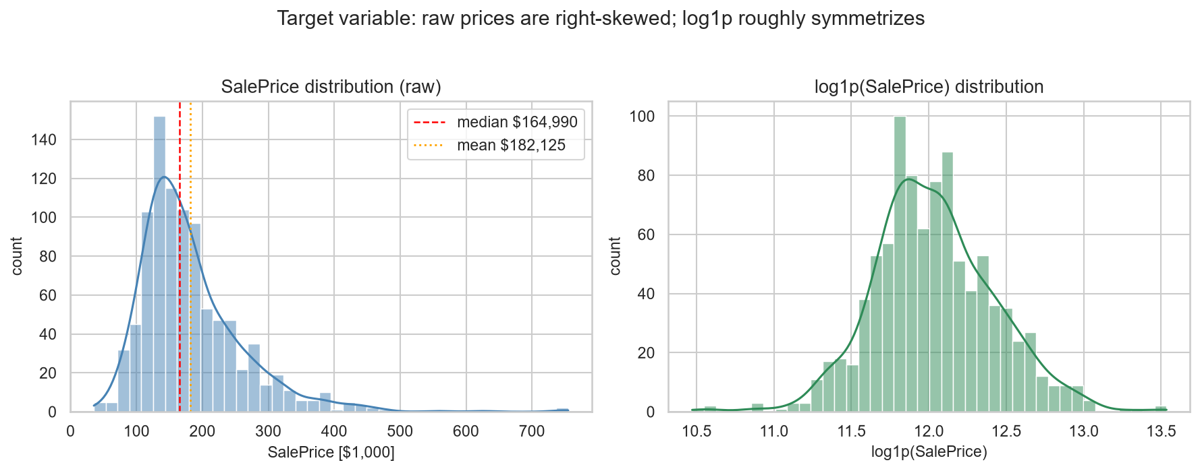
SPEAKER 3 • ~45 S
EDA — Target: Right-Skewed → Log Transform
▪ Raw SalePrice is strongly right-skewed: skew 1.967, kurtosis 7.55 — mean sits ~10% above median
▪ After log1p: skew 0.175, kurtosis 0.82 — near-symmetric
▪ Errors scale with price → multiplicative model
▪ Decision: train on log1p(SalePrice), RMSLE primary metric, report dollars via expm1 (ADR-10)
▪ $/sqft is tight (skew 0.43): most raw skew is a size effect, not a price-level effect
PropPulse — Project Review 1
6
Notes:
Speaker 3 (~45 s): First EDA finding — the target itself. Raw prices are heavily right-skewed with a premium tail to $755k; after log1p the distribution is nearly symmetric. That is why the model trains on log-price and we use RMSLE as the primary metric. Dollar-per-sqft is tight, so most of the skew is just house size.

Slide 7
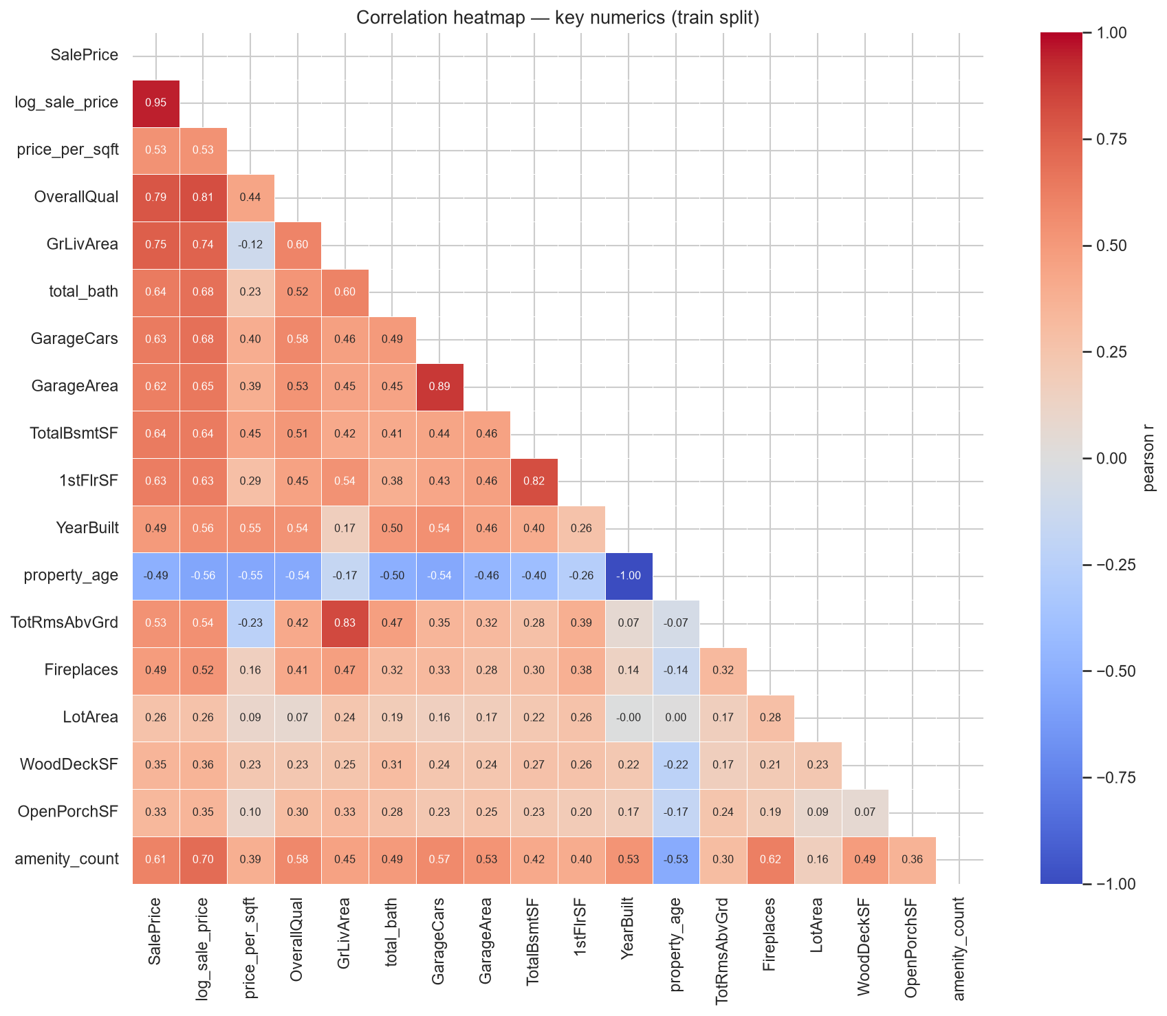
SPEAKER 3 • ~50 S
EDA — What Drives Price
▪ OverallQual dominates: r = 0.789; median price climbs $109k (Q4) → $466k (Q10) — roughly exponential in dollars
▪ Size block: GrLivArea 0.75, TotalBsmtSF 0.64, total_bath 0.64, GarageCars 0.63
▪ Engineered amenity_count r = 0.609 — medians rise $74k → $275k over 0→7 amenities
▪ Age r = −0.49 but non-monotone at the old end (character homes)
▪ Heavy multicollinearity (GarageCars↔GarageArea 0.89) → trees / regularized linear; read importance in groups
PropPulse — Project Review 1
7
Notes:
Speaker 3 (~50 s): OverallQual is the single strongest feature (r = 0.79) — the quality ladder is roughly exponential in dollars, which again supports the log target. Then the size block. Our engineered amenity_count already correlates at 0.61. Flag the multicollinearity inside the size block — it motivates regularization and grouped importance reading later.

Slide 8
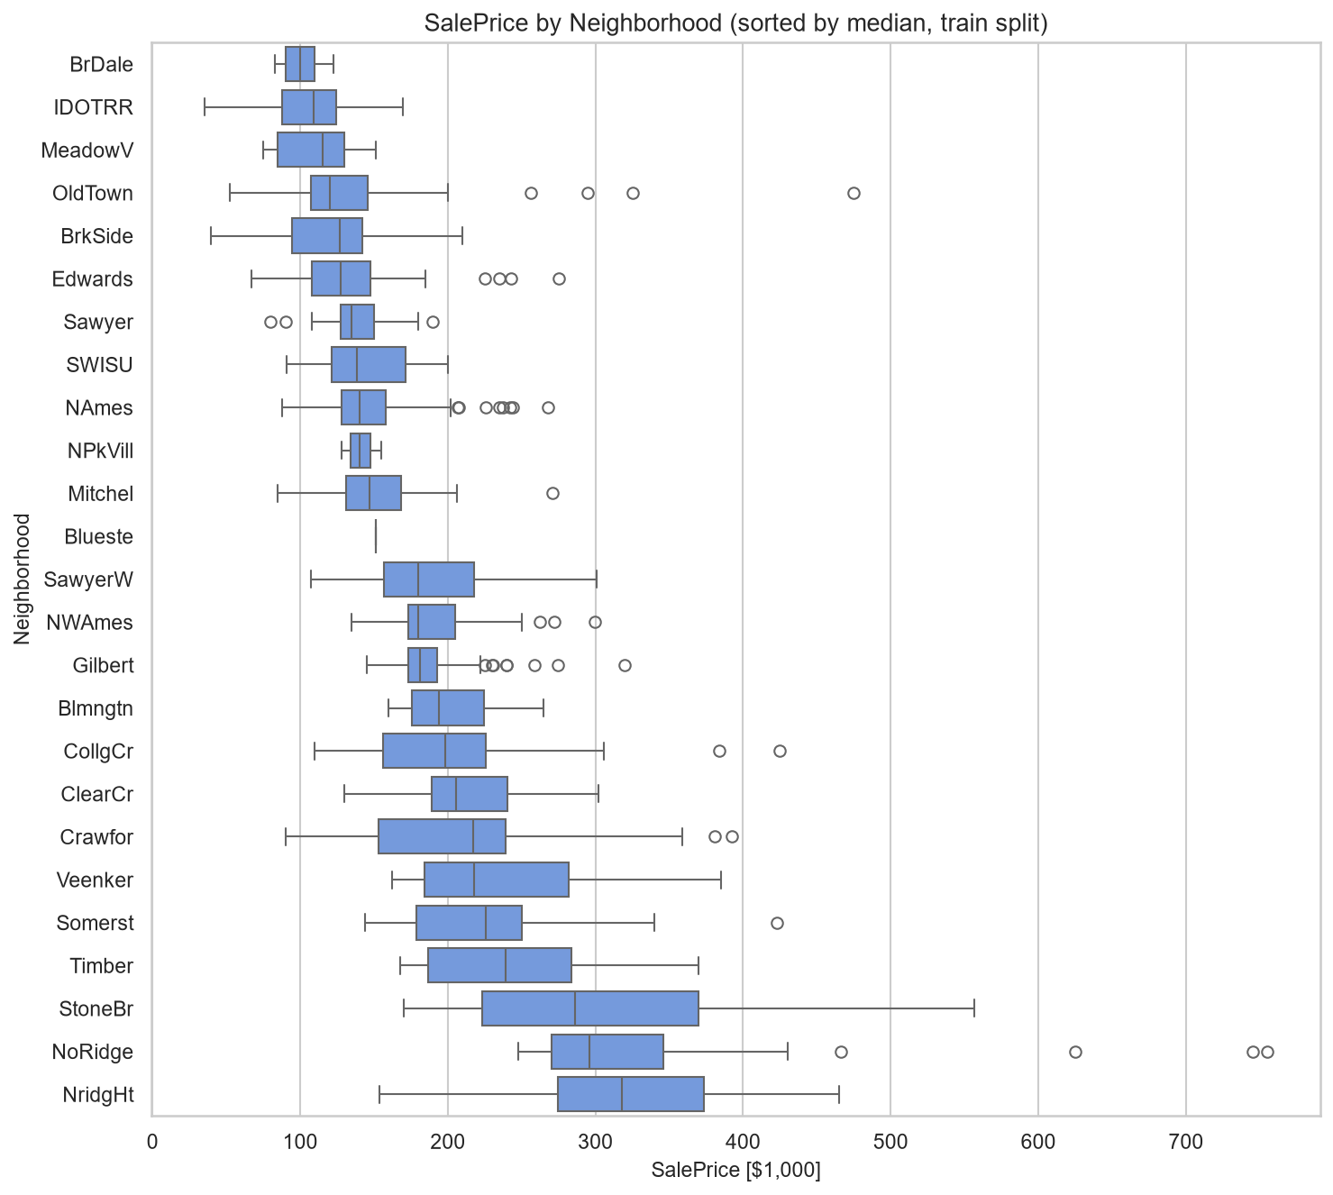
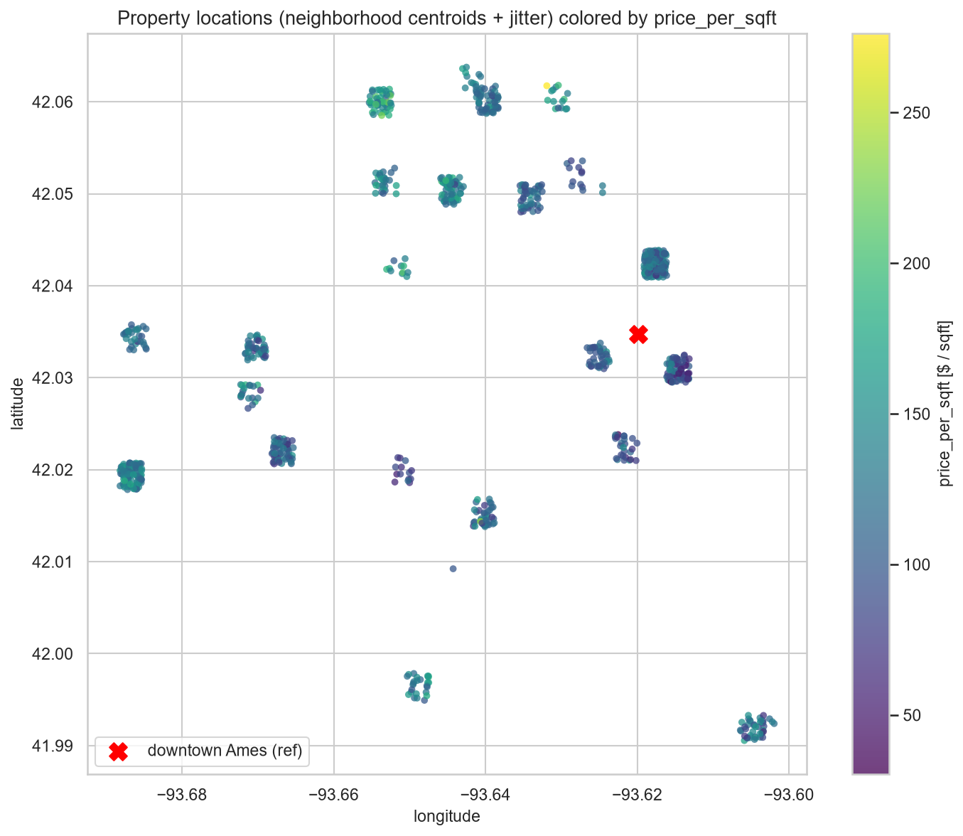
SPEAKER 4 • ~50 S
EDA — Location: Neighborhood Is the Signal
▪ Median prices span 3.18×: NridgHt $318k vs BrDale $100k
▪ Premium $/sqft concentrates north/northwest; distance to downtown only r = +0.28
▪ → neighborhood identity, not radial distance — supports neighborhood stats + DBSCAN micro-markets
PropPulse — Project Review 1
8
Notes:
Speaker 4 (~50 s): Left — all 25 neighborhoods sorted by median price: a 3.18× spread. Right — the geo scatter colored by $/sqft: premium areas sit in the north/northwest, and distance to downtown explains almost nothing (r = +0.28). Conclusion: location value lives in neighborhood identity — this justifies both the train-only neighborhood statistics and the DBSCAN micro-market clustering. Caution: rare neighborhoods (Blueste n=1) have noisy stats.

Slide 9
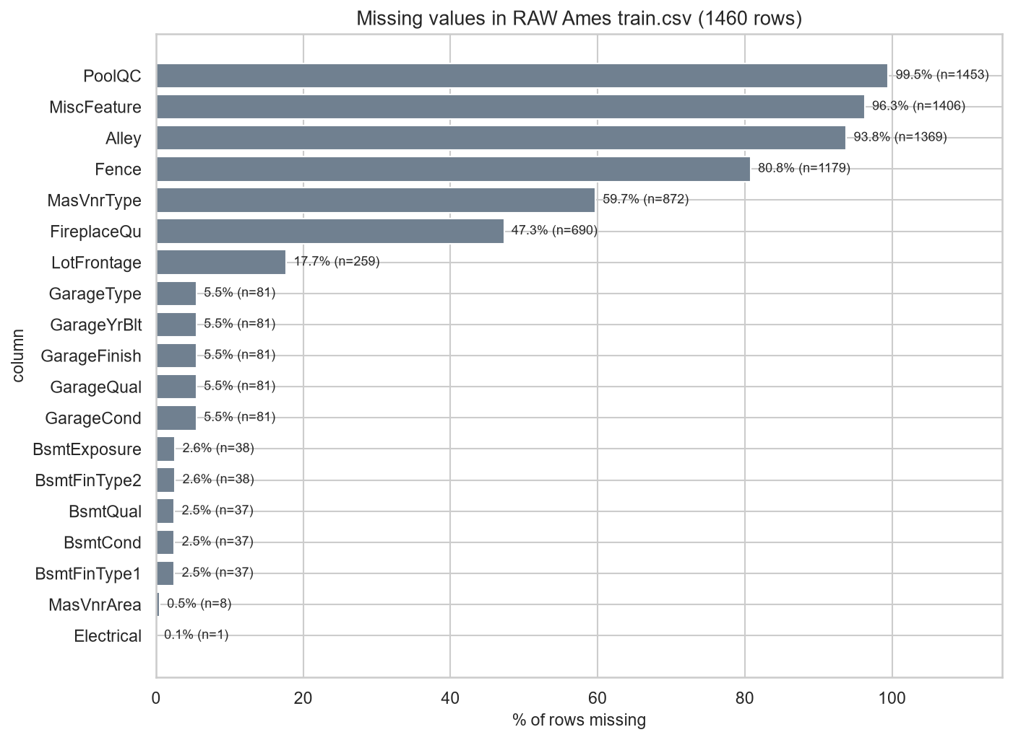
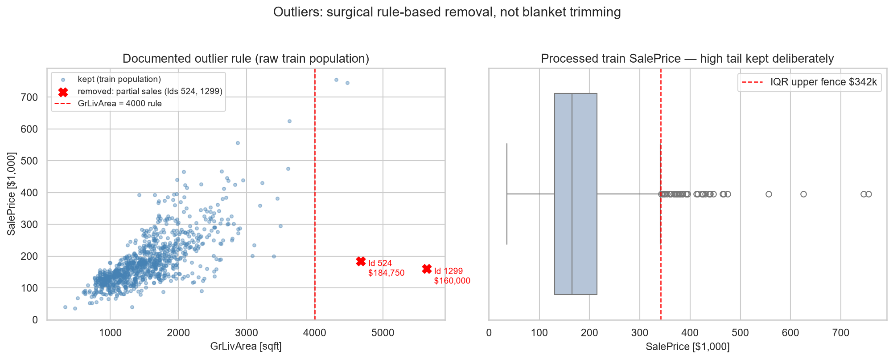
SPEAKER 4 • ~50 S
EDA — Data Quality: Missingness & Outliers
▪ 19 raw columns with NAs — nearly all structural (PoolQC 99.5%) → “None”, not imputed
▪ Only LotFrontage (17.7%) truly imputed — train-fit neighborhood medians
▪ Exactly 2 outliers removed (partial sales, Ids 524 & 1299); 39 luxury rows above the IQR fence kept — they are signal
PropPulse — Project Review 1
9
Notes:
Speaker 4 (~50 s): Missingness: 19 columns, but per the official data description almost all NAs mean the feature is ABSENT — filled as ‘None’, not imputed. The only genuine measurement gap is LotFrontage. Outliers: exactly two partial sales removed on train (verified SaleCondition=Partial); the 39 high-price rows above the IQR fence are genuine luxury stock — we keep them because blind trimming would destroy the high-end signal.

Slide 10
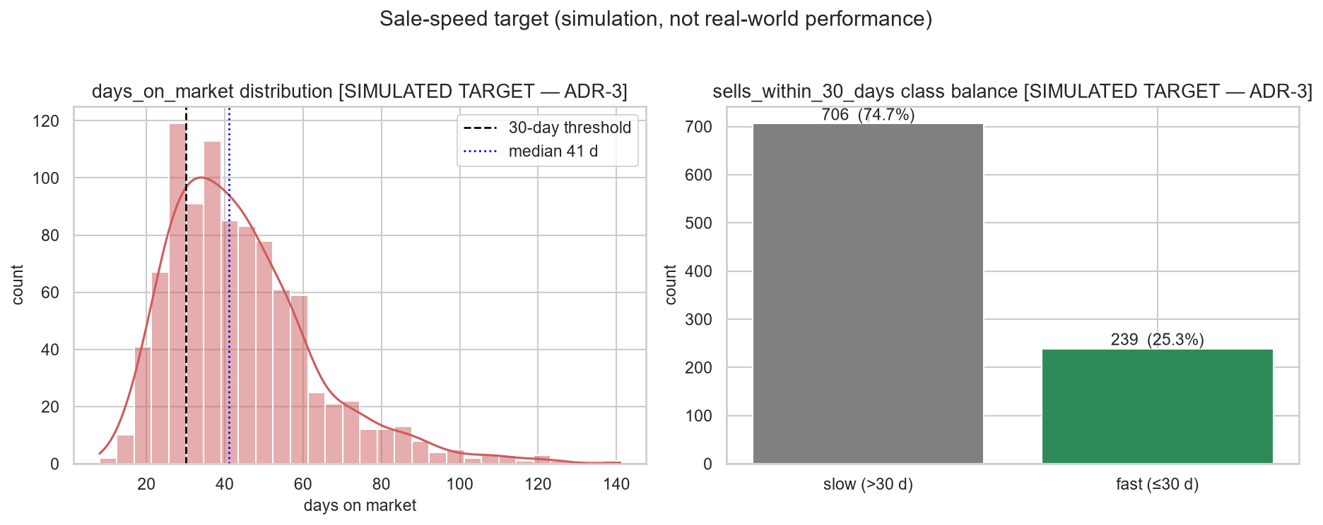
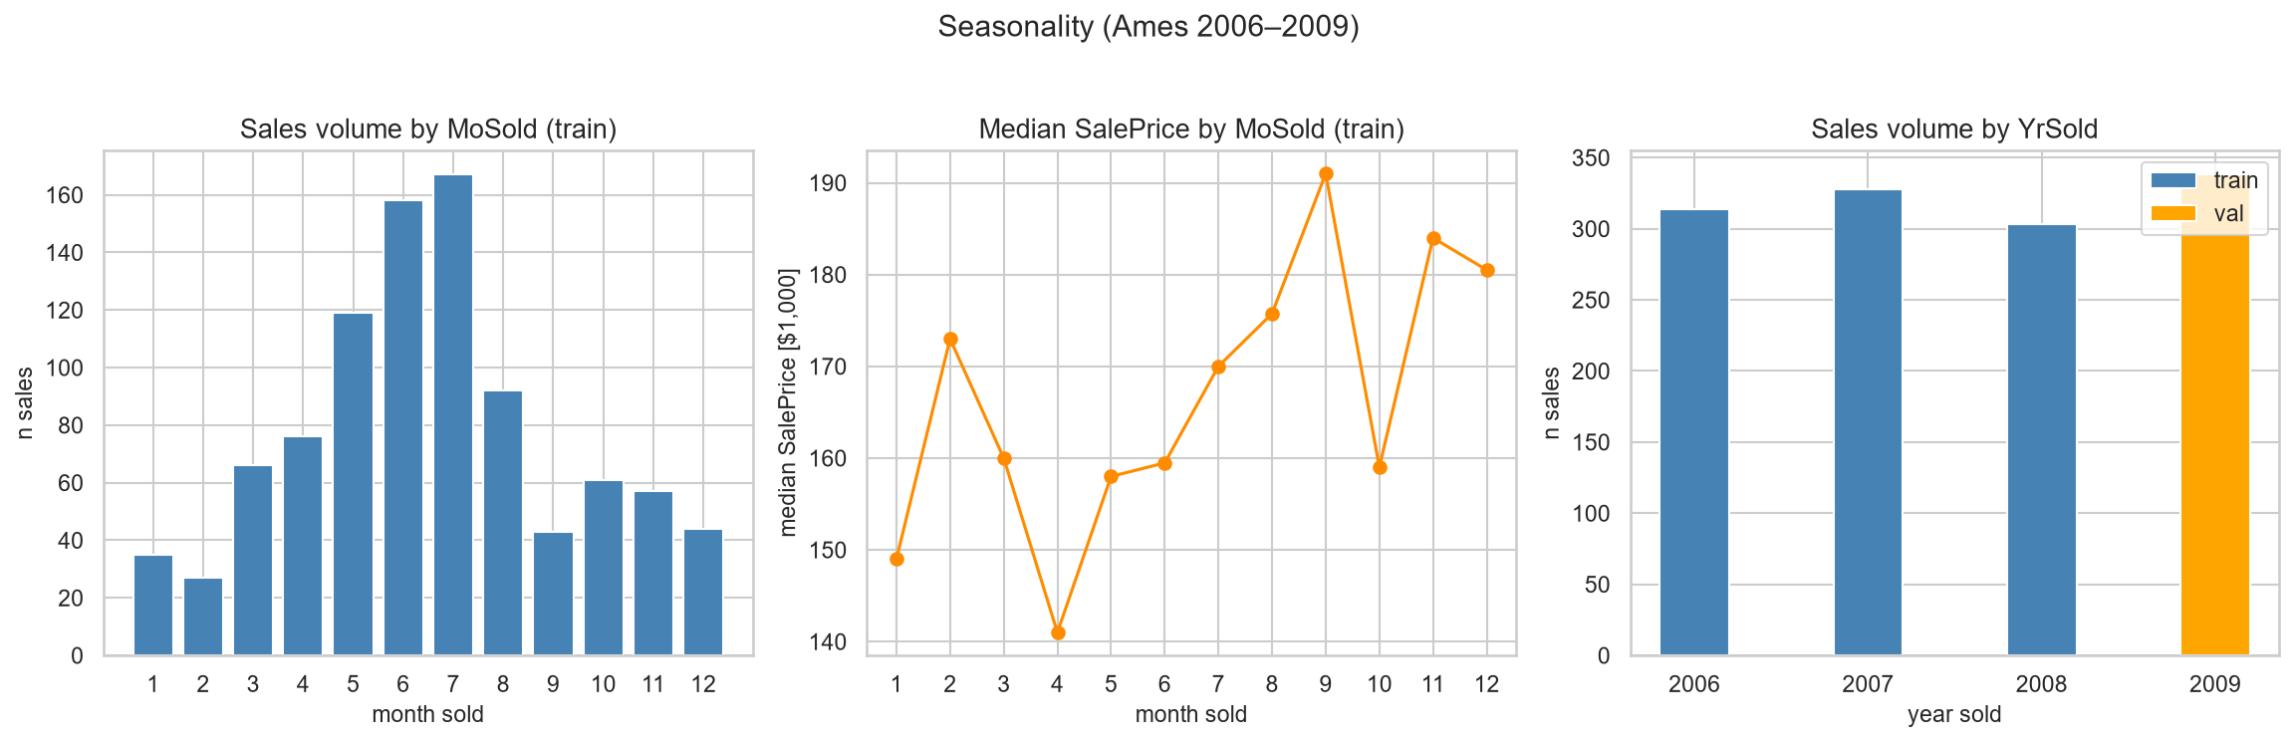
SPEAKER 4 • ~40 S
EDA — Seasonality & the Sale-Speed Target
▪ Volume strongly seasonal: July peak (167) vs Feb trough (27); price level barely moves
▪ Median price 2006→2008 +0.6% — no regime break at the split boundary
▪ Simulated DOM: median 41 d; 25.3% fast-sale → class-imbalance-aware modeling, PR-AUC primary
PropPulse — Project Review 1
10
Notes:
Speaker 4 (~40 s): Seasonality is a VOLUME effect, not a price effect — and prices are flat 2006→2008 (+0.6%), so our time-based split faces no distribution shock. Right: the simulated days-on-market target — median 41 days, 25.3% fast sales. Reminder: this target is simulated and every classification metric will be labelled as such; modeling must handle the class imbalance.

Slide 11
SPEAKER 5 • ~40 S
What the EDA Tells Us to Build
▪ 1. Log target is mandatory — skew 1.967 → 0.175 under log1p; RMSLE primary (ADR-10)
▪ 2. Tree ensembles should beat plain linear models — non-linear size effects, non-monotone age/condition, quality×neighborhood interactions; keep a regularized linear baseline for interpretability
▪ 3. Expected feature hierarchy — OverallQual > size block (GrLivArea, TotalBsmtSF, Garage*, total_bath) > neighborhood > age; read importance in groups
▪ 4. Leakage guards (hard rules) — price_per_sqft is EDA-only; all stats fit on train only; SaleType/SaleCondition excluded; DOM columns never features
▪ 5. Classification is imbalance-aware — 25.3% fast-sale (simulated) → class weights, PR-AUC primary, calibration check
▪ 6. Clustering grain — neighborhood-level median $/sqft + sale velocity + coordinates for DBSCAN micro-markets (3.18× spread)
PropPulse — Project Review 1
11
Notes:
Speaker 5 (~40 s): Every EDA finding maps to a concrete design decision. Walk the six quickly: log target; trees plus a regularized linear baseline; expected feature hierarchy; the four hard leakage rules; imbalance-aware classification; and the neighborhood grain for clustering. This slide is the bridge from analysis to the build plan.

Slide 12
SPEAKER 5 • ~45 S
Git Repository & Work Completed
▪ Repo: github.com/rushmanthnalluri/prop-pulse (branch: main)
▪ Reproducible EDA: notebooks/01_eda.ipynb fully executed (16/16 cells, 0 errors) + builder script; re-run reproduces all 14 figures identically
▪ Committed artifacts: data pipeline (train/val/test splits), EDA report (reports/EDA_REPORT.md), figures/, spec + ADRs in docs/
▪ Verified engineering: 454 automated tests pass, CI on every push, Docker build verified, 49/49 browser E2E tests
▪ Decisions tracked as ADRs in docs/DECISIONS.md (split, log target, geo fallback, simulated DOM, clustering)
Repository layout (top level)
ml/ data · features · training · evaluation · clustering
backend/ FastAPI service + API tests
frontend/ React dashboard (Vite)
notebooks/ 01_eda.ipynb (reproducible)
figures/ 14 EDA figures (PNG, 150 dpi)
reports/ EDA_REPORT · MODEL_EVALUATION · audits
models/ versioned artifacts + champion registry
docs/ SPEC · DECISIONS (ADRs) · ARCHITECTURE · API
tests/ unit + integration • e2e/ Playwright
docker/ Dockerfiles • .github/workflows CI
PropPulse — Project Review 1
12
Notes:
Speaker 5 (~45 s): Everything shown today is in the git repository — give the URL. The EDA notebook is fully executed and reproducible end-to-end; the report and all 14 figures are committed. Engineering hygiene: hundreds of automated tests, CI, Docker, and every design decision recorded as an ADR. Walk the layout briefly if asked.

Slide 13
SPEAKER 5 • ~30 S
Plan Toward Review 2
▪ Done ✓ problem definition · dataset + cleaning · time-based split · full EDA (this review) · repo + reproducibility
▪ Next — modeling: finalize 94-feature pipeline; train 5 regression + 4 classification candidates with 5-fold CV on train only
  – Champion selection on validation (RMSLE / PR-AUC) + paired-bootstrap significance test; evaluate sealed test once
▪ Then — productization: SHAP artifacts, FastAPI serving, React dashboard polish, drift monitoring, Docker packaging
▪ Stretch: real days-on-market + real geocoding via the ready adapters, then retrain
Thank you — questions welcome. github.com/rushmanthnalluri/prop-pulse
PropPulse — Project Review 1
13
Notes:
Speaker 5 (~30 s): Close with the plan — EDA and repository are complete; next is model training and champion selection, then the serving layer. Thank the panel and invite questions. TOTAL: ~5 minutes across the five speakers.

