Slide 1
PROJECT REVIEW 1 · AUGUST 2026
PropPulse
ML-Driven Property Valuation & Market Intelligence — Ames, Iowa
Rushmanth Nalluri 2500030215
Sk Mastan Saheb 2500030370
Rayala Deepak 2500030717
Under the guidance of Guide Name, Designation
Department of Computer Science & Engineering
github.com/rushmanthnalluri/prop-pulse
Notes:
OPENING (15 s, Rushmanth): We are team PropPulse — Rushmanth, Mastan and Deepak. Our project predicts a home's sale price, its probability of selling within 30 days, and its micro-market segment for residential real estate in Ames, Iowa, and explains every estimate. Speaker plan: Rushmanth slides 2–4 + closing, Mastan slides 5–7 (EDA part 1), Deepak slides 8–11 (EDA part 2 + repo). Total ~5 min. Fill in the guide name before presenting.

Slide 2
Problem Statement
Residential property pricing is opaque — buyers, sellers and agents get a number, but rarely an explanation why it is that number.
How much is it worth?
How fast will it sell?
Which market is it in?
Sale price in dollars, with an ~80% prediction interval (regression on log-price).
Calibrated probability of selling within 30 days (classification).
Micro-market segment from 25 Ames neighborhoods (DBSCAN clustering).
The bar we set: every estimate explained with SHAP factors and served as a real product — FastAPI backend + React dashboard — not just a notebook.
PropPulse · Project Review 1
2
Notes:
Rushmanth (~35 s): Property pricing is opaque. We answer three questions per home — how much, how fast, which micro-market — and the bar we set ourselves is that every number comes with an explanation and ships inside a working product.

Slide 3
Abstract
PropPulse is an end-to-end ML platform for residential property valuation in Ames, Iowa (Kaggle “House Prices”, 1,460 sales, 2006–2010). It predicts a home’s sale price in dollars, the probability it sells within 30 days, and its micro-market segment — and explains each prediction with SHAP factors.
The methodology is leakage-safe by construction: a time-based split (train ≤ 2008, validation 2009, sealed test 2010), all statistics fit on train only, and one feature pipeline shared by training and serving. Models are served by a FastAPI backend and a React dashboard, tracked with MLflow, monitored for drift with PSI, and packaged with Docker.
This review: problem statement, the completed exploratory data analysis (14 figures, reproducible notebook), and the project repository.
PropPulse · Project Review 1
3
Notes:
Rushmanth (~30 s): Summarize, don't read: three predictions per property, honest leakage-safe methodology with a sealed test set, and a full product stack. Then hand over to Mastan via the dataset slide.

Slide 4
Objectives & Dataset
Six objectives
Dataset — Ames, Iowa housing (Kaggle, De Cock 2011)
▪ O1 ✓ Data pipeline — clean, validate, time-split
▪ O2 ✓ EDA — 14 figures, reproducible (this review)
▪ O3 94-feature pipeline, shared train ↔ serve
▪ O4 5 regression + 4 classification candidates
▪ O5 SHAP explainability, global + per-prediction
▪ O6 FastAPI + React + drift monitoring + Docker
▪ 1,460 rows × 81 columns of residential sales, 2006–2010
▪ Time-based split: train ≤ 2008 (945) · val 2009 (338) · test 2010 (175, sealed)
▪ Cleaning: structural NAs → “None”; only LotFrontage imputed (train-fit medians); 2 partial-sale outliers removed
▪ Honest fallbacks: neighborhood-centroid coordinates (ADR-2); simulated days-on-market, always labelled (ADR-3)
$165k
3.18×
25.3%
median price
(train, n = 945)
price spread across
25 neighborhoods
fast-sale rate
(simulated target)
✓ = complete and in the repository today
PropPulse · Project Review 1
4
Notes:
Rushmanth (~35 s): Six objectives — O1 and O2 are done and are today's subject. The dataset is the standard Ames benchmark; emphasize the TIME-BASED split and the sealed 2010 test set, and be upfront about the two documented data fallbacks. Hand over to Mastan for the EDA.

Slide 5
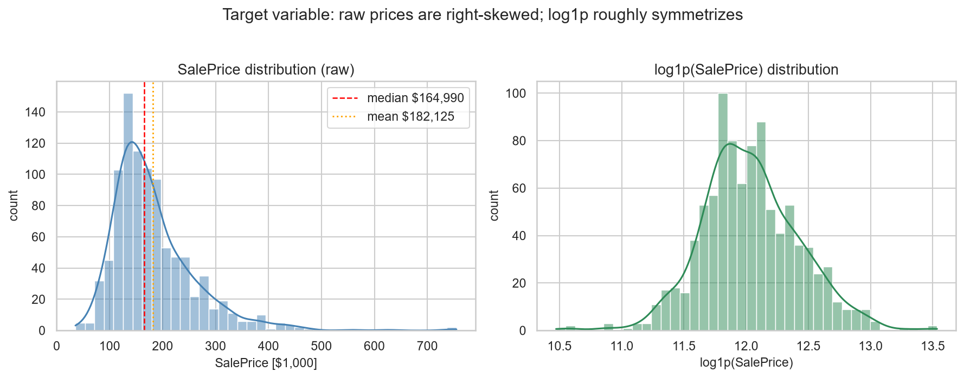
EDA — The Target Is Right-Skewed
▪ Skewness 1.967 → 0.175 after log1p — near-symmetric
▪ Mean sits ~10% above median — a premium tail to $755k
▪ Errors scale with price → multiplicative model
▪ $/sqft is tight (skew 0.43): the skew is a size effect, not a price-level effect
Decision (ADR-10): train on log1p(SalePrice), RMSLE as the primary metric, report dollars via expm1.
PropPulse · Project Review 1
5
Notes:
Mastan (~35 s): First finding is about the target itself — heavily right-skewed, near-symmetric after log1p. So we train on log-price and use RMSLE. Dollar-per-sqft being tight tells us most of the skew is just house size.

Slide 6
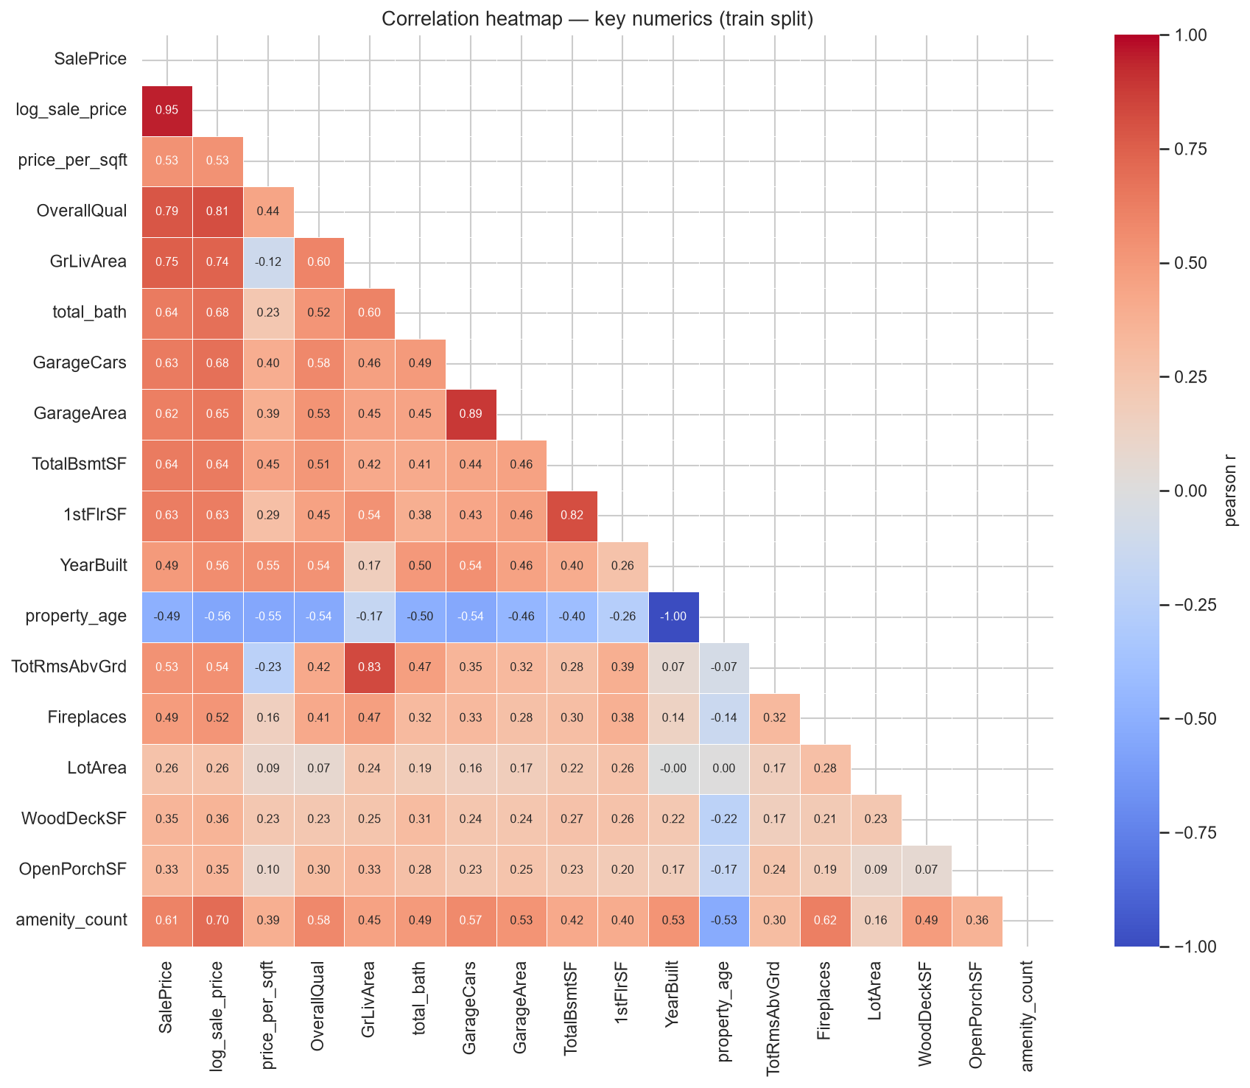
EDA — What Drives Price
0.79
0.75
0.61
OverallQual —
strongest correlate
GrLivArea —
strongest size feature
amenity_count
(engineered)
▪ Quality ladder is exponential: $109k → $466k median, grade 4 → 10
▪ Size block follows: TotalBsmtSF 0.64, total_bath 0.64, GarageCars 0.63
▪ Age r = −0.49, but non-monotone — old character homes command premiums
▪ Heavy multicollinearity (GarageCars↔GarageArea 0.89) → trees or regularized linear; read importance in groups
PropPulse · Project Review 1
6
Notes:
Mastan (~35 s): OverallQual dominates at r = 0.79 and the quality ladder is roughly exponential in dollars — more support for the log target. Then the size block; our engineered amenity_count already hits 0.61. Flag multicollinearity — it is why we keep trees plus a regularized linear baseline.

Slide 7
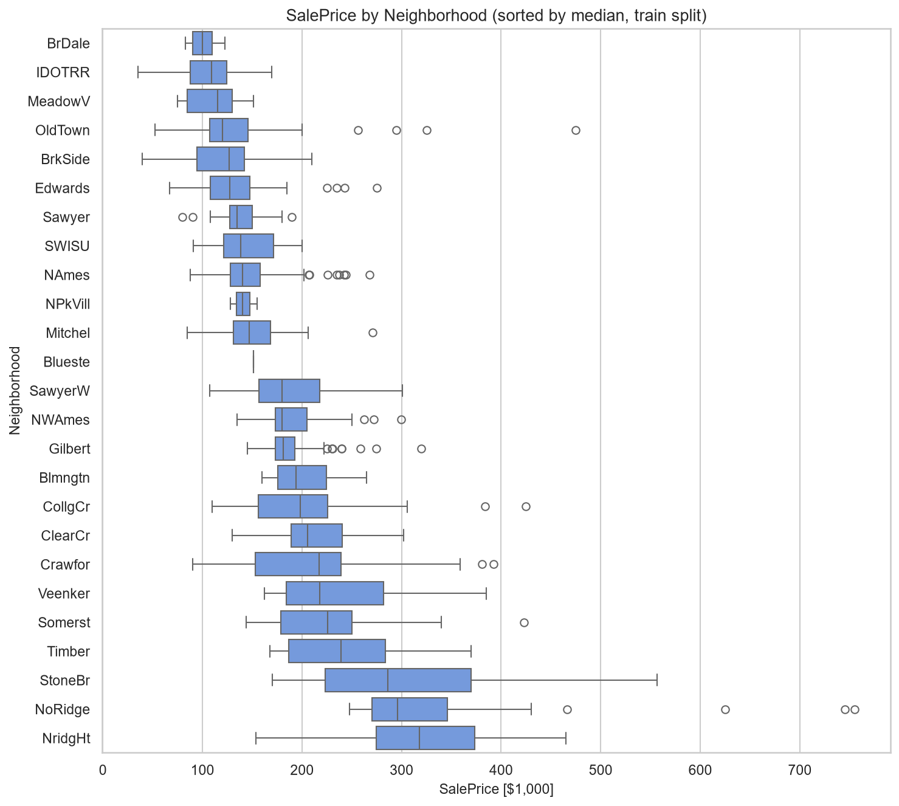
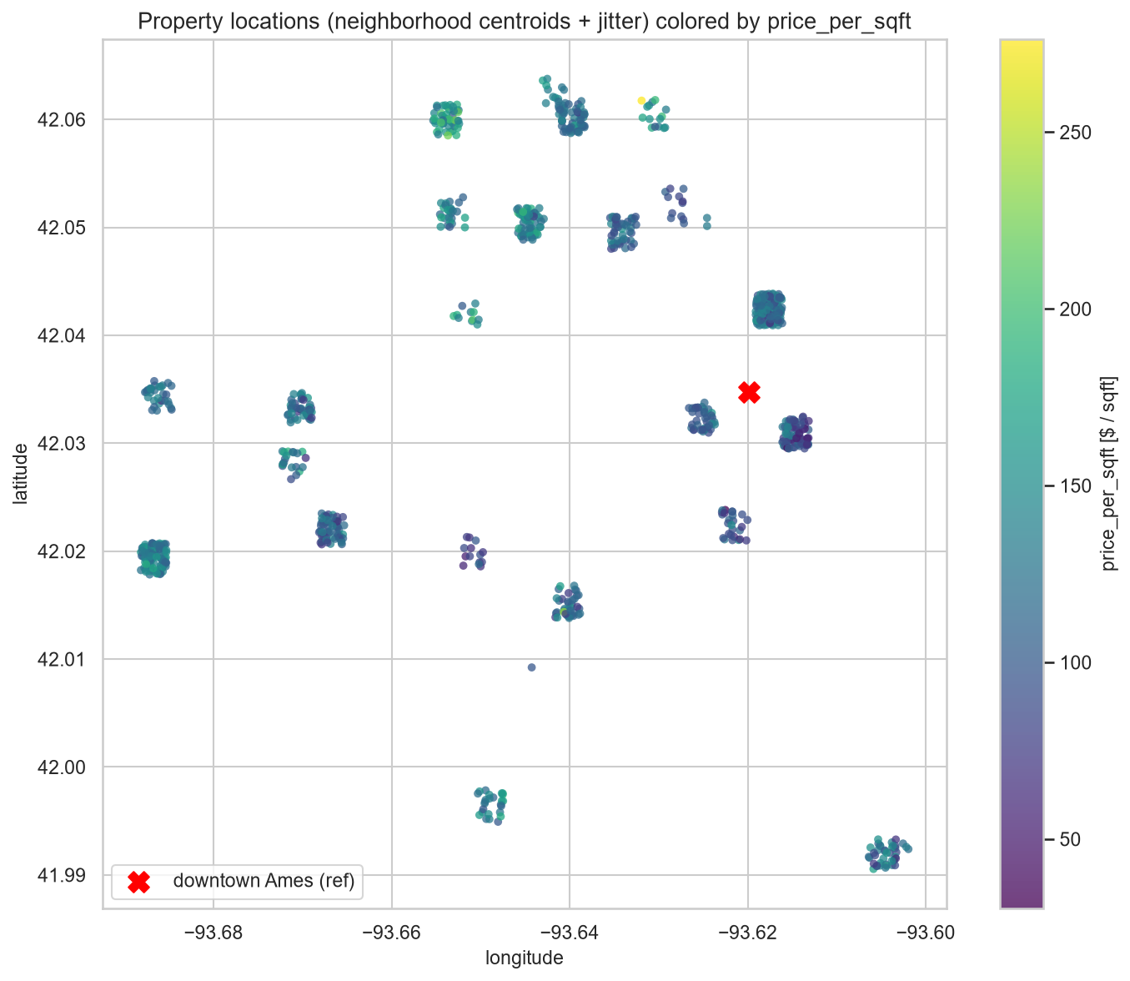
EDA — Location: Neighborhood Is the Signal
▪ Median prices span 3.18× — NridgHt $318k vs BrDale $100k
▪ Premium $/sqft sits north/northwest; distance to downtown only r = +0.28
▪ → neighborhood identity, not radial distance — justifies neighborhood stats + DBSCAN micro-markets
PropPulse · Project Review 1
7
Notes:
Mastan (~30 s): The 25 neighborhoods span a 3.18× median-price spread, and the map shows premium areas in the north/northwest while distance to downtown explains almost nothing. Location value IS neighborhood identity — that is what justifies our neighborhood statistics and the DBSCAN clustering. Hand over to Deepak.

Slide 8
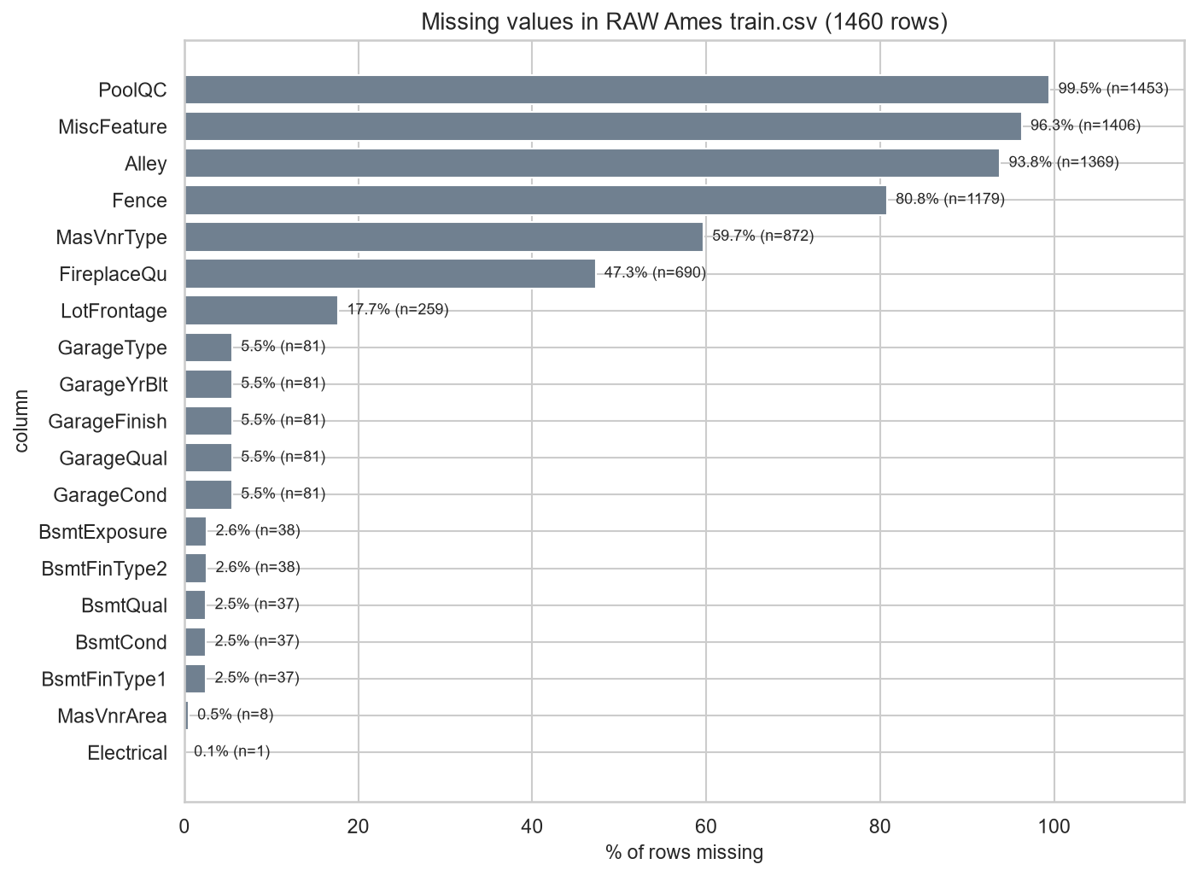
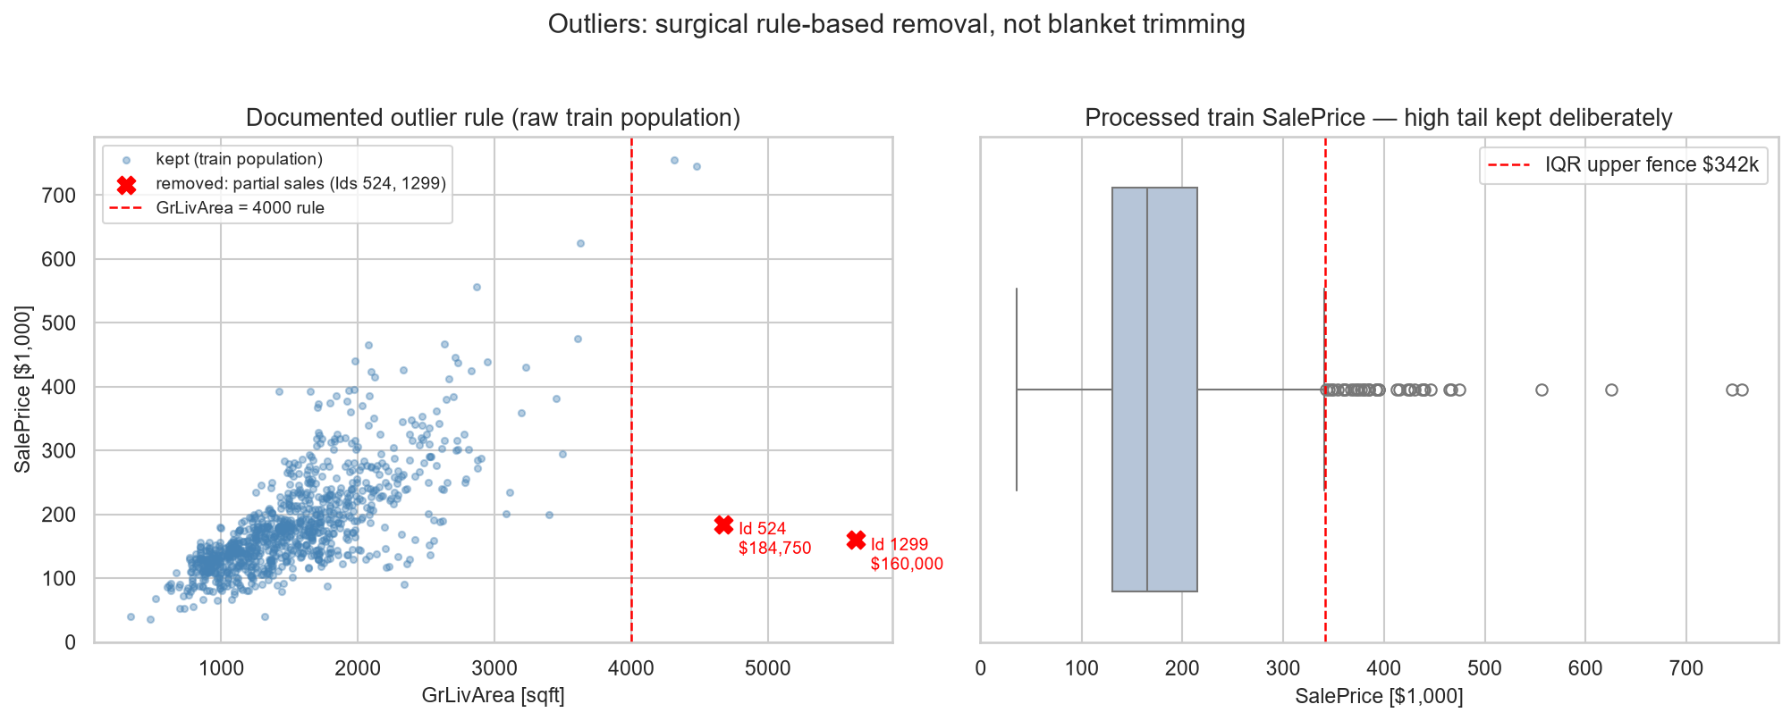
EDA — Data Quality: Missingness & Outliers
▪ 19 raw columns with NAs — nearly all structural (PoolQC 99.5%) → “None”, not imputed
▪ Only LotFrontage (17.7%) truly imputed — train-fit neighborhood medians
▪ Exactly 2 outliers removed (partial sales); the 39 luxury rows above the IQR fence are signal — kept
PropPulse · Project Review 1
8
Notes:
Deepak (~30 s): Missingness looks scary but is almost entirely structural — the feature is absent, so we fill ‘None’ per the official data description; only LotFrontage is genuinely imputed. Outliers: exactly two verified partial sales removed; the luxury tail stays because it is exactly the signal a valuation model needs.

Slide 9
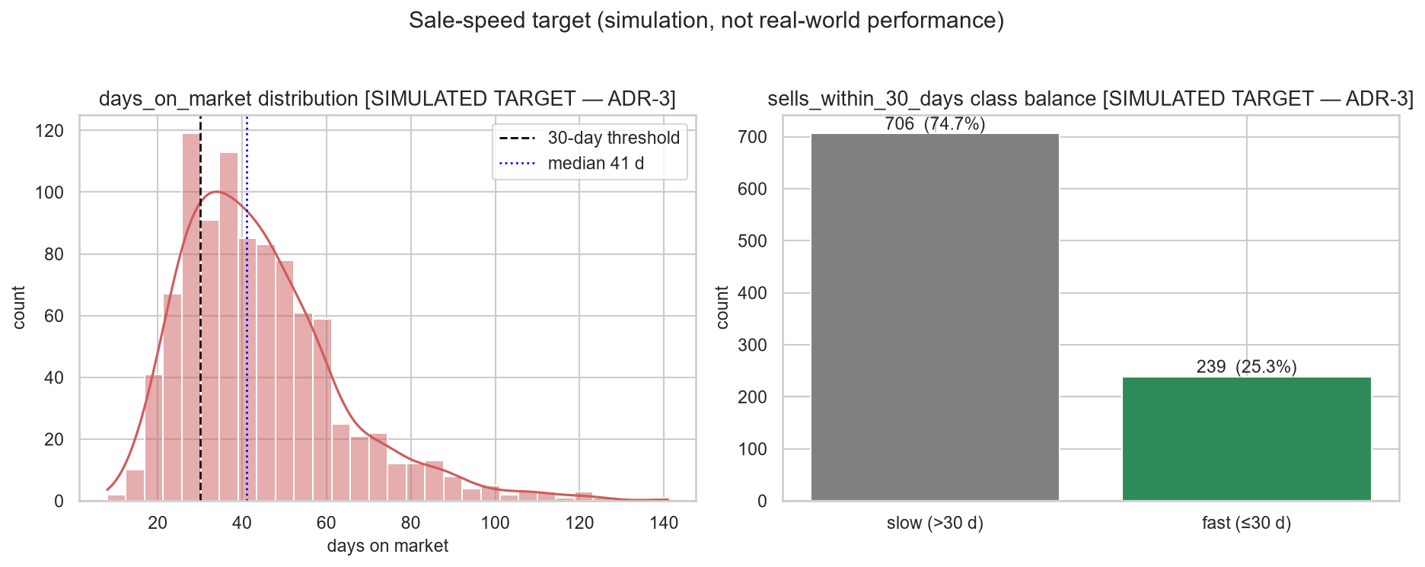
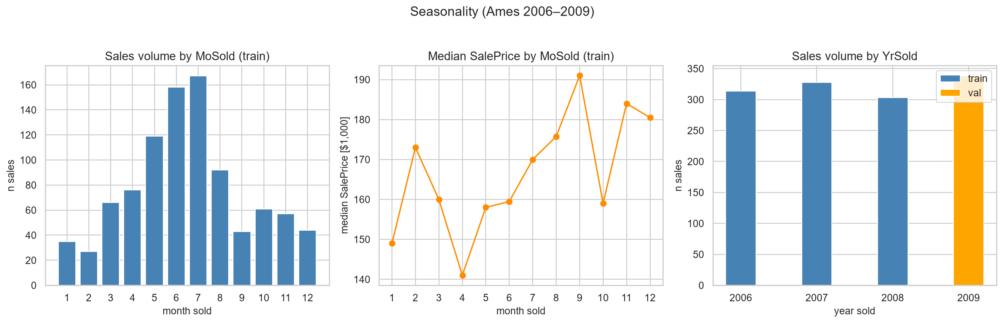
EDA — Seasonality & the Sale-Speed Target
▪ Volume is seasonal — July 167 sales vs Feb 27 — but price level barely moves
▪ Median price 2006→2008: +0.6% — no shock at the split boundary
▪ Simulated DOM: median 41 d, 25.3% fast → imbalance-aware modeling, PR-AUC primary
PropPulse · Project Review 1
9
Notes:
Deepak (~30 s): Seasonality is a volume effect, not a price effect, and prices are flat across 2006–2008 — our time-based split faces no distribution shock. Right: the simulated days-on-market target, median 41 days, one in four sales fast. Every classification metric will carry the simulated label.

Slide 10
What the EDA Tells Us to Build
1
Log target is mandatory — skew 1.967 → 0.175; RMSLE primary
2
Trees + a regularized linear baseline — non-linear size effects, non-monotone age; interpretable benchmark
3
Expected feature hierarchy — OverallQual > size block > neighborhood > age; importance read in groups
4
Hard leakage guards — price_per_sqft EDA-only; stats fit on train; SaleType/SaleCondition excluded; DOM never a feature
5
Imbalance-aware classification — 25.3% fast-sale → class weights, PR-AUC primary, calibration check
6
Neighborhood-grain clustering — median $/sqft + sale velocity + coordinates for DBSCAN micro-markets
PropPulse · Project Review 1
10
Notes:
Deepak (~30 s): Every finding maps to a design decision — walk the six quickly. This is the bridge from analysis to the build plan: log target, the two model families, the feature hierarchy, the four leakage rules, imbalance-aware classification, and the clustering grain.

Slide 11
Repository & Current Status
github.com/rushmanthnalluri/prop-pulse · branch main · everything shown today is committed
▪ ml/ data · features · training · evaluation · clustering · explainability · monitoring
▪ backend/ FastAPI service + API tests
▪ frontend/ React dashboard (Vite)
▪ notebooks/ 01_eda.ipynb — fully executed, 16/16 cells, reproduces all 14 figures
▪ reports/ + figures/ EDA report + audits + all figures
▪ docs/ spec, ADRs, architecture, API contract
454
automated tests passing
49/49
browser E2E tests
CI
on every push · Docker verified
100%
EDA reproducibility — figures regenerate identically
PropPulse · Project Review 1
11
Notes:
Deepak (~30 s): The repository is the evidence — give the URL. The EDA notebook re-runs end-to-end and reproduces every figure; engineering hygiene is real: 454 tests, browser E2E, CI, Docker, and every design decision recorded as an ADR. Hand back to Rushmanth to close.

Slide 12
Plan Toward Review 2
Done ✓
Next →
Then →
Problem definition · dataset, cleaning & time-based split · full EDA (this review) · repository with ADRs, CI, tests
Finalize 94-feature pipeline · train 5 regression + 4 classification candidates (5-fold CV, train only) · champion selection on validation + bootstrap test · one sealed-test evaluation
SHAP artifacts · FastAPI serving · React dashboard polish · drift monitoring · Docker packaging · stretch: real DOM & geocoding adapters
Thank you — questions welcome. github.com/rushmanthnalluri/prop-pulse
PropPulse · Project Review 1
12
Notes:
Rushmanth (~25 s): Close — EDA and repository are complete; next is model training and champion selection, then the serving layer. Thank the panel, invite questions. TOTAL ~5 minutes across the three of us.

