Slide 1
PROJECT REVIEW 1 | AUGUST 2026
PropPulse
An end-to-end machine learning platform for residential property valuation in Ames, Iowa
Rushmanth Nalluri 2500030215
Sk Mastan Saheb 2500030370
Rayala Deepak 2500030717
Under the guidance of Guide Name, Designation
Department of Computer Science & Engineering
github.com/rushmanthnalluri/prop-pulse
Notes:
OPENING (15 s, Rushmanth): We are team PropPulse: Rushmanth, Mastan and Deepak. Our project predicts a home's sale price, its probability of selling within 30 days, and its micro-market segment for residential real estate in Ames, Iowa, and explains every estimate. Speaker plan: Rushmanth takes slides 2 to 4 plus the closing, Mastan takes slides 5 to 7 (EDA part 1), Deepak takes slides 8 to 11 (EDA part 2 and the repository). Total about 5 minutes. Fill in the guide name before presenting.

Slide 2
Problem Statement
Residential property pricing is opaque. Buyers, sellers and agents get a number, but rarely an explanation of why it is that number.
How much is it worth?
How fast will it sell?
Which market is it in?
Sale price in dollars, with an 80% prediction interval (regression on log price).
Calibrated probability of selling within 30 days (classification).
Micro-market segment from 25 Ames neighborhoods (DBSCAN clustering).
The bar we set: every estimate explained with SHAP factors and served as a real product (FastAPI backend and React dashboard), not just a notebook.
PropPulse | Project Review 1
2
Notes:
Rushmanth (about 35 s): Property pricing is opaque. We answer three questions per home: how much, how fast, and which micro-market. The bar we set ourselves is that every number comes with an explanation and ships inside a working product.

Slide 3
Abstract
PropPulse is an end-to-end machine learning platform for residential property valuation in Ames, Iowa (Kaggle House Prices dataset, 1,460 sales from 2006 to 2010). It predicts a home's sale price in dollars, the probability that it sells within 30 days, and its micro-market segment. Every prediction is explained with SHAP factors.
The methodology is leakage-safe by construction: a time-based split (train up to 2008, validation 2009, sealed test 2010), all statistics fit on train only, and one feature pipeline shared by training and serving. Models are served by a FastAPI backend and a React dashboard, tracked with MLflow, monitored for drift with PSI, and packaged with Docker.
This review covers the problem statement, the completed exploratory data analysis (14 figures from a reproducible notebook), and the project repository.
PropPulse | Project Review 1
3
Notes:
Rushmanth (about 30 s): Summarize, don't read. Three predictions per property, an honest leakage-safe methodology with a sealed test set, and a full product stack. Then move to the dataset slide.

Slide 4
Objectives & Dataset
Six objectives
Dataset: Ames, Iowa housing (Kaggle, De Cock 2011)
▪ O1 Data pipeline: clean, validate, time-based split (done)
▪ O2 EDA: 14 figures, reproducible (this review) (done)
▪ O3 94-feature pipeline shared by training and serving
▪ O4 5 regression and 4 classification candidates
▪ O5 SHAP explainability, global and per-prediction
▪ O6 FastAPI, React, drift monitoring, Docker
▪ 1,460 rows, 81 columns of residential sales, 2006 to 2010
▪ Time-based split: train up to 2008 (945 rows), validation 2009 (338), test 2010 (175, sealed)
▪ Cleaning: structural gaps filled as “None”, only LotFrontage genuinely imputed, 2 partial-sale outliers removed
▪ Honest fallbacks: approximate neighborhood centroids for coordinates (ADR-2), simulated days on market, always labelled (ADR-3)
$165k
3.18×
25.3%
median price
(train, 945 rows)
price spread across
25 neighborhoods
fast-sale rate
(simulated target)
O1 and O2 are complete and in the repository today
PropPulse | Project Review 1
4
Notes:
Rushmanth (about 35 s): Six objectives. O1 and O2 are done and are today's subject. The dataset is the standard Ames benchmark. Emphasize the time-based split and the sealed 2010 test set, and be upfront about the two documented data fallbacks. Hand over to Mastan for the EDA.

Slide 5
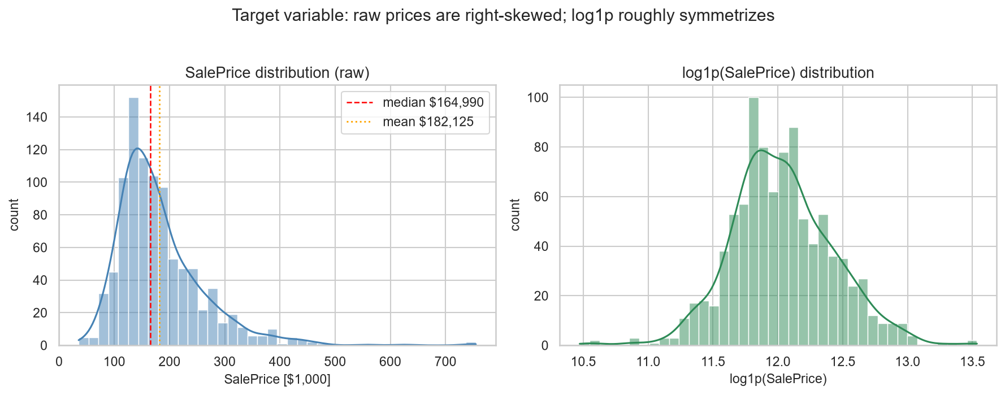
EDA: The Target Is Right-Skewed
▪ Skewness drops from 1.967 to 0.175 after a log transform, nearly symmetric
▪ Mean sits about 10% above the median, pulled up by a premium tail reaching $755k
▪ Errors scale with price, so a multiplicative model fits better
▪ Price per sq ft is tight (skew 0.43): most of the skew is a size effect, not a price-level effect
Decision (ADR-10): train on log price, use RMSLE as the primary metric, and report results back in dollars.
PropPulse | Project Review 1
5
Notes:
Mastan (about 35 s): The first finding is about the target itself. Raw prices are heavily right-skewed and nearly symmetric after a log transform, so we train on log price and use RMSLE. Price per square foot being tight tells us most of the skew is just house size.

Slide 6
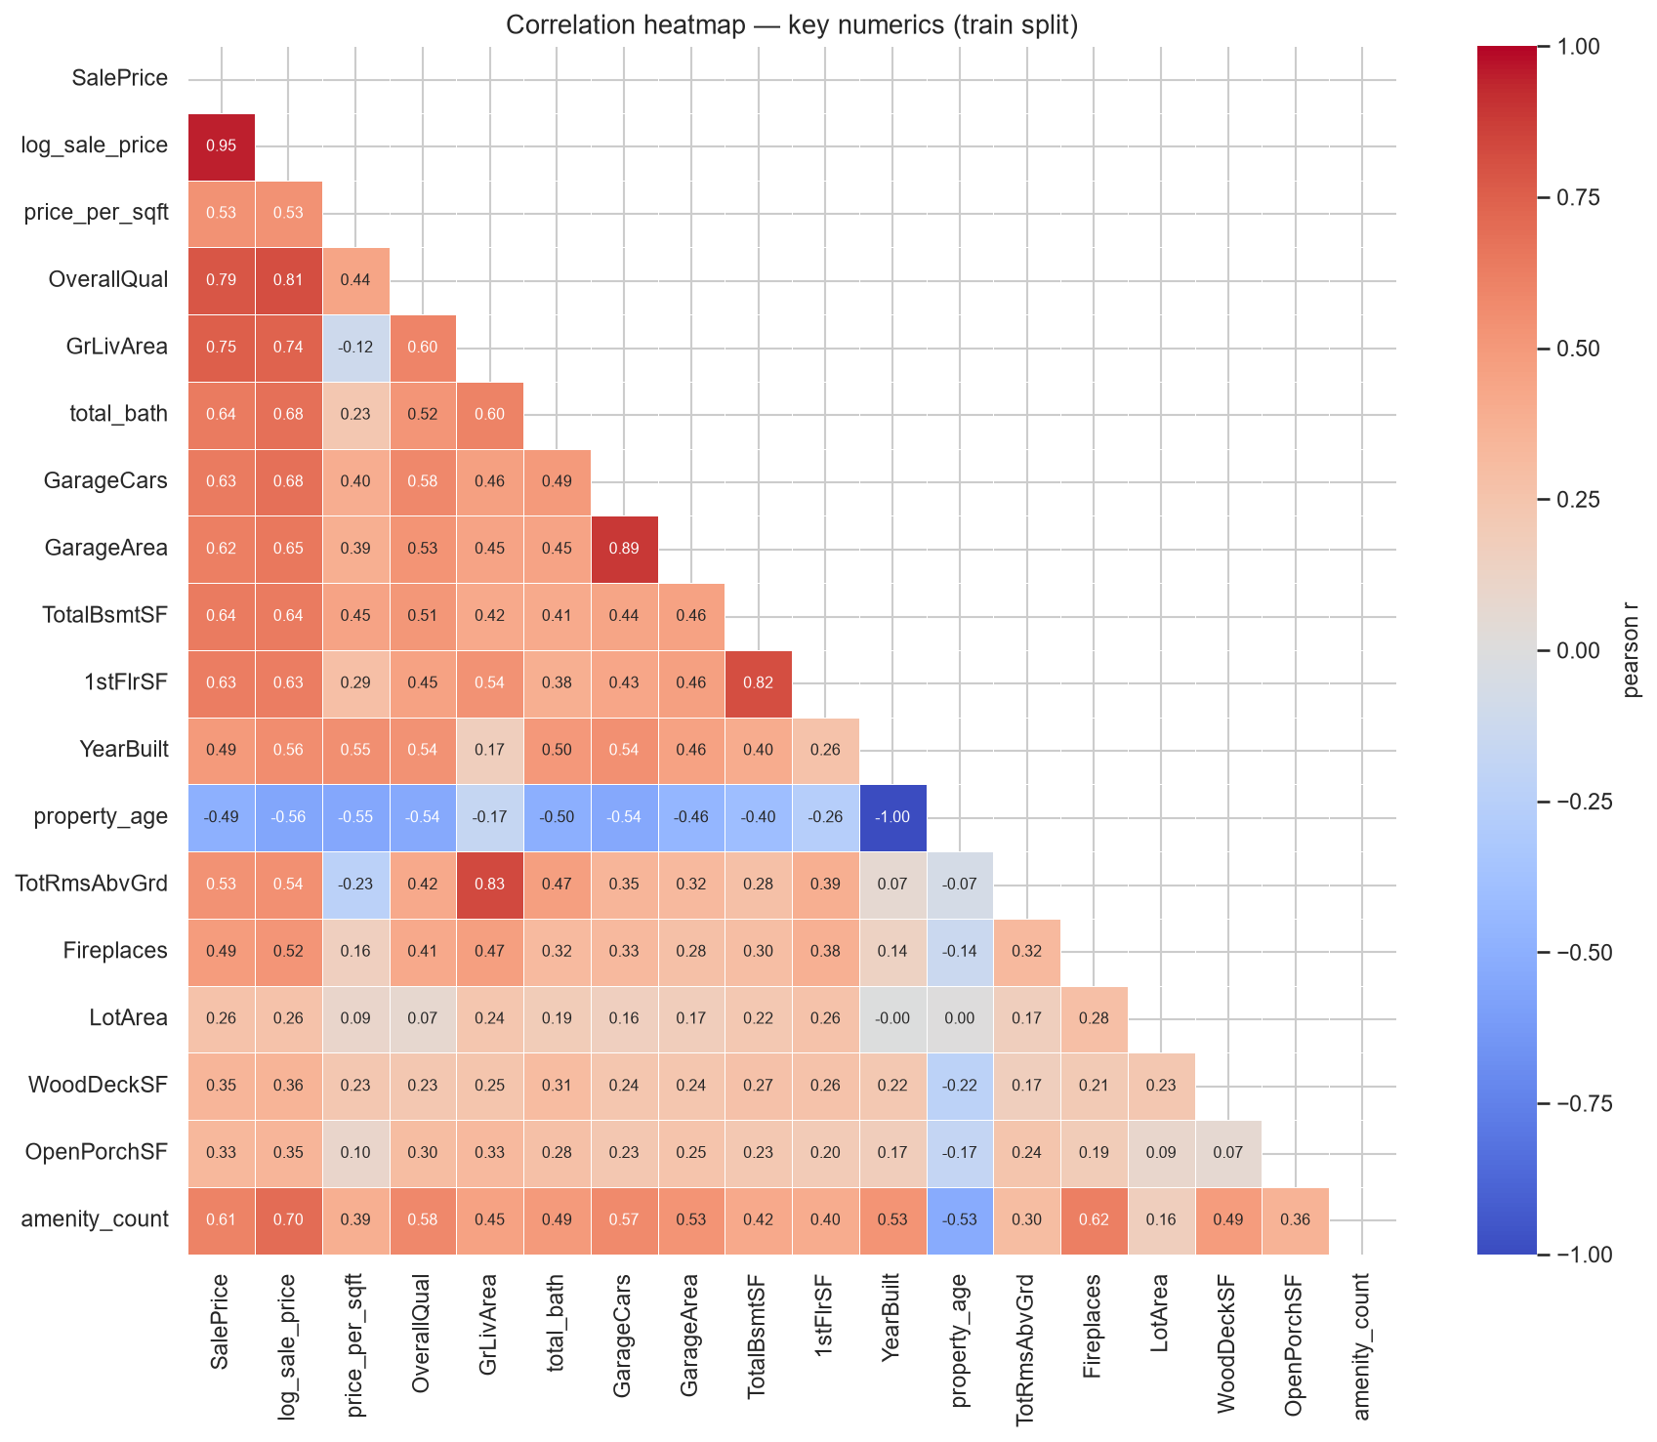
EDA: What Drives Price
0.79
0.75
0.61
OverallQual,
strongest correlate
GrLivArea,
strongest size feature
amenity count
(engineered)
▪ Quality ladder is exponential: median price climbs from $109k at grade 4 to $466k at grade 10
▪ Size block follows: TotalBsmtSF 0.64, total bathrooms 0.64, GarageCars 0.63
▪ Age correlates at -0.49 but is non-monotone; old character homes command premiums
▪ Heavy multicollinearity (GarageCars and GarageArea correlate at 0.89), so tree models or regularized linear, and read importance in groups
PropPulse | Project Review 1
6
Notes:
Mastan (about 35 s): OverallQual dominates with a correlation of 0.79, and the quality ladder is roughly exponential in dollars, which again supports the log target. Then the size block. Our engineered amenity count already reaches 0.61. Flag the multicollinearity: it is why we keep trees plus a regularized linear baseline.

Slide 7
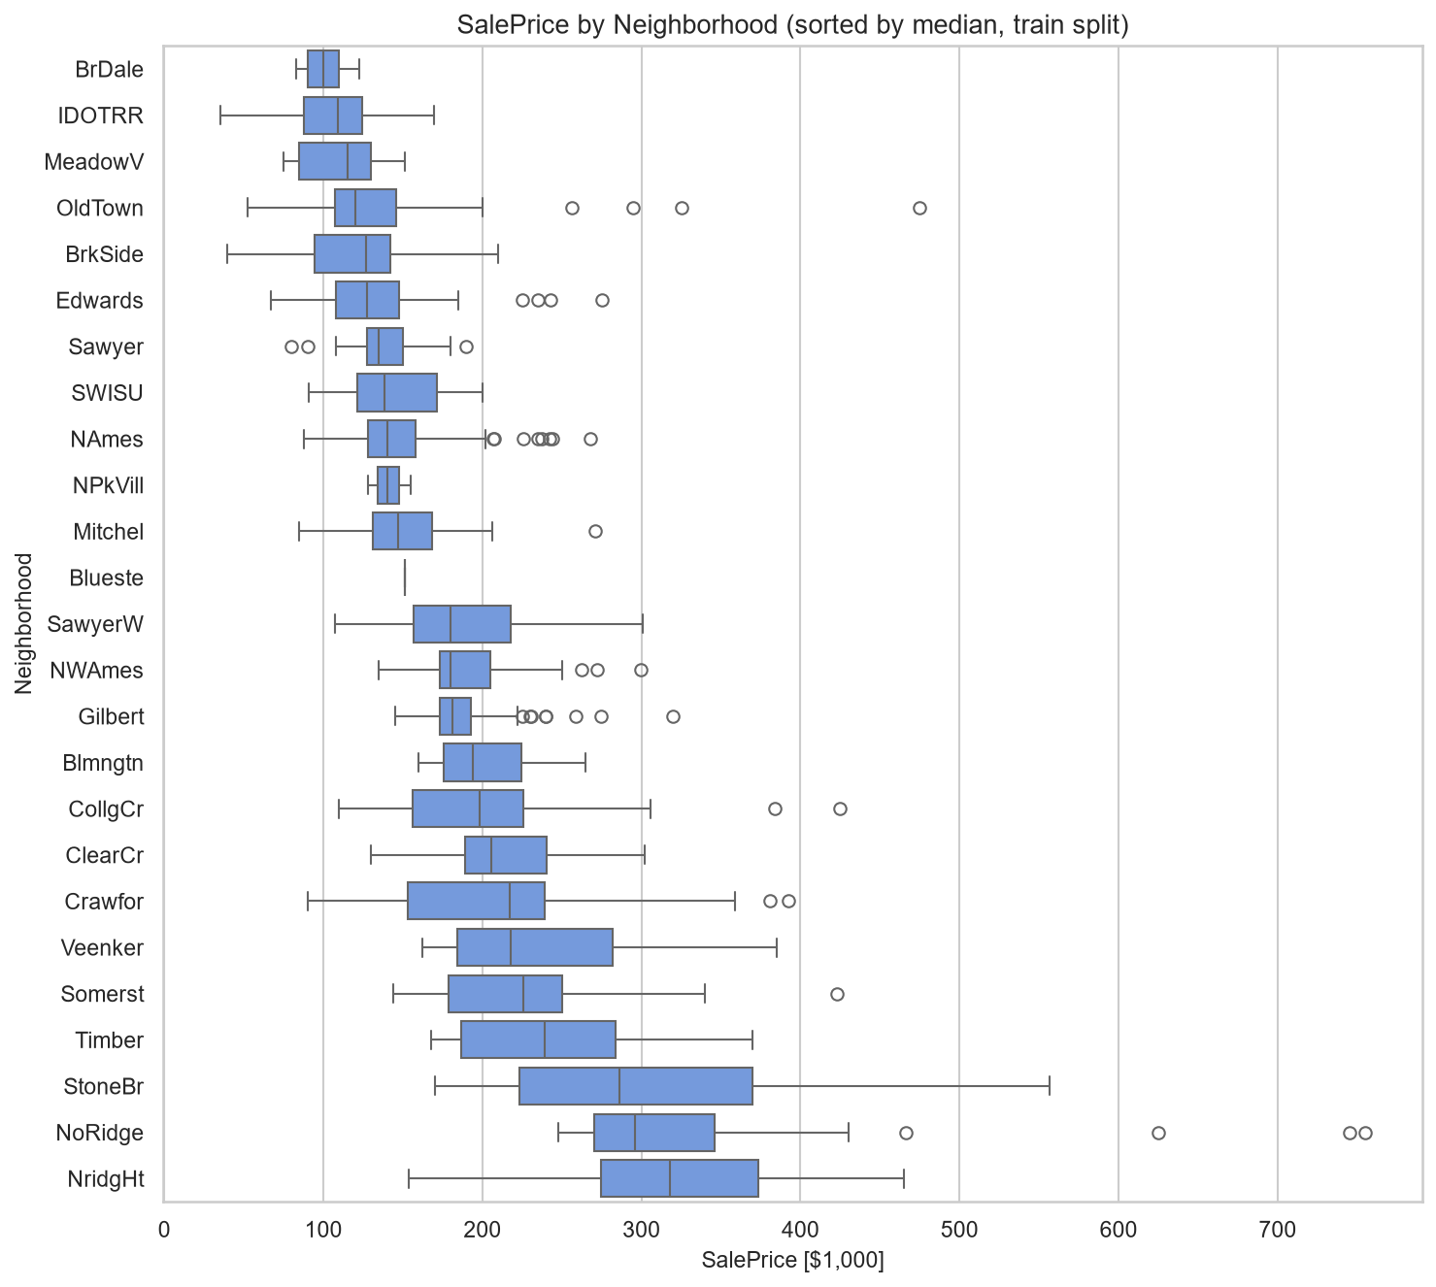
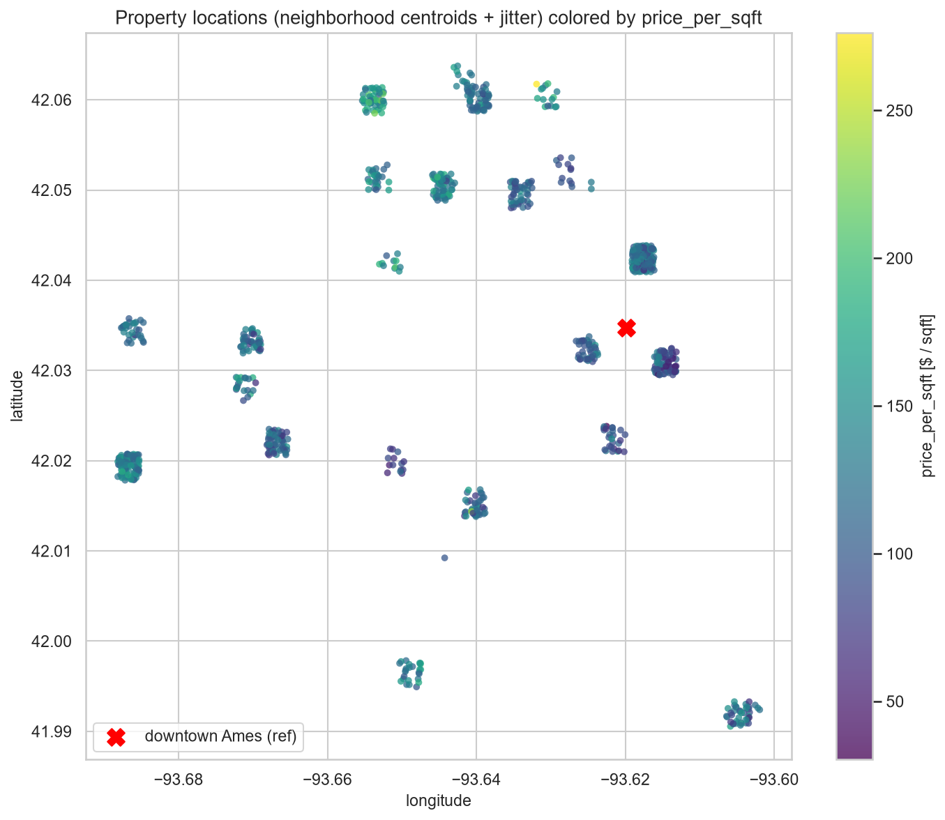
EDA: Location Value Lives in Neighborhoods
▪ Median prices span 3.18×, from BrDale at $100k to NridgHt at $318k
▪ Premium areas sit in the north and northwest; distance to downtown correlates at only +0.28
▪ So location value is neighborhood identity, not radial distance, which justifies neighborhood statistics and DBSCAN micro-markets
PropPulse | Project Review 1
7
Notes:
Mastan (about 30 s): The 25 neighborhoods span a 3.18 times median price spread. The map shows premium areas in the north and northwest while distance to downtown explains almost nothing. Location value is neighborhood identity, and that justifies both the neighborhood statistics and the DBSCAN clustering. Hand over to Deepak.

Slide 8
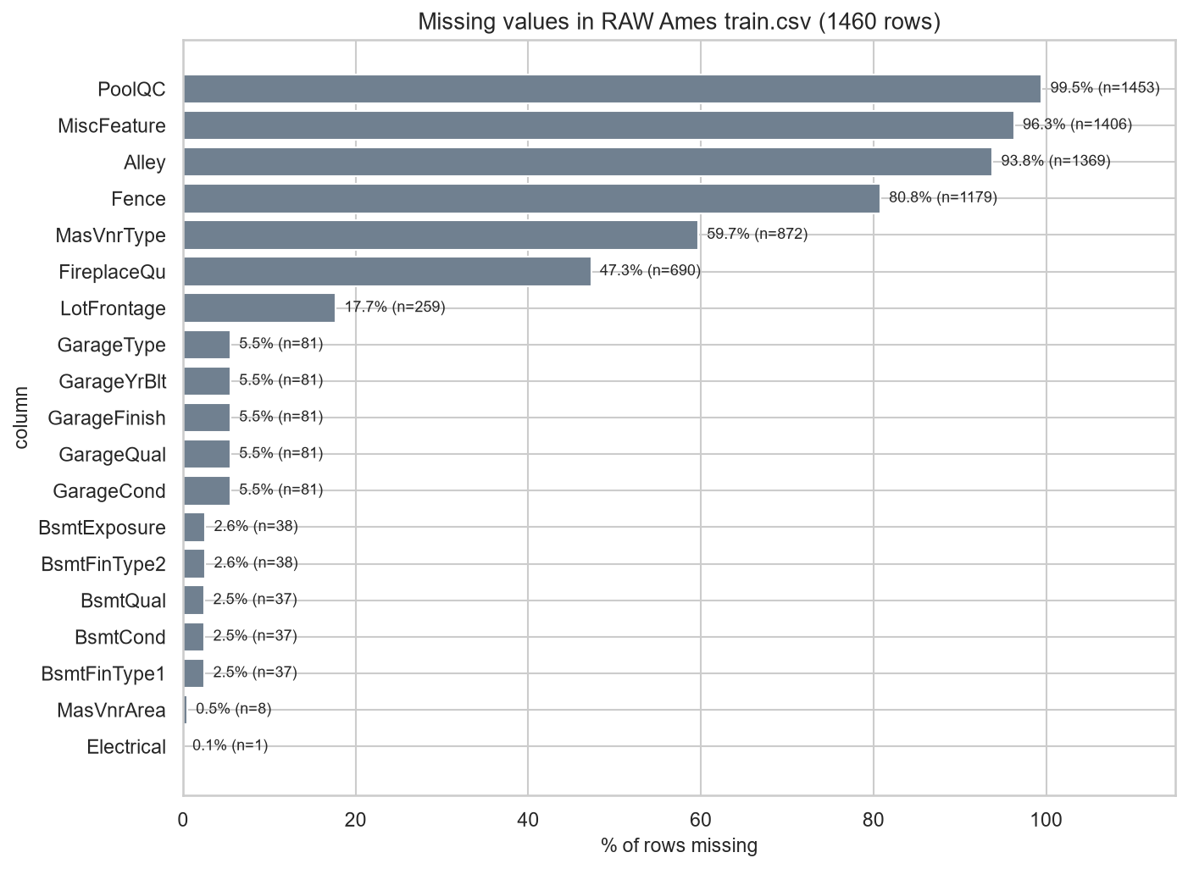
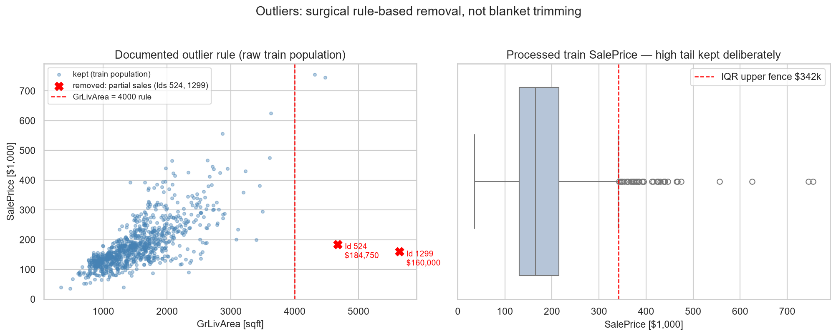
EDA: Data Quality, Missingness & Outliers
▪ 19 raw columns have gaps, nearly all structural (PoolQC 99.5%), filled as “None” rather than imputed
▪ Only LotFrontage (17.7%) is genuinely imputed, with train-fit neighborhood medians
▪ Exactly 2 outliers removed (verified partial sales); the 39 luxury rows above the outlier fence are real signal, so kept
PropPulse | Project Review 1
8
Notes:
Deepak (about 30 s): The missingness looks scary but is almost entirely structural: the feature is absent, so we fill it as None per the official data description. Only LotFrontage is genuinely imputed. For outliers, exactly two verified partial sales were removed, and the luxury tail stays because it is exactly the signal a valuation model needs.

Slide 9
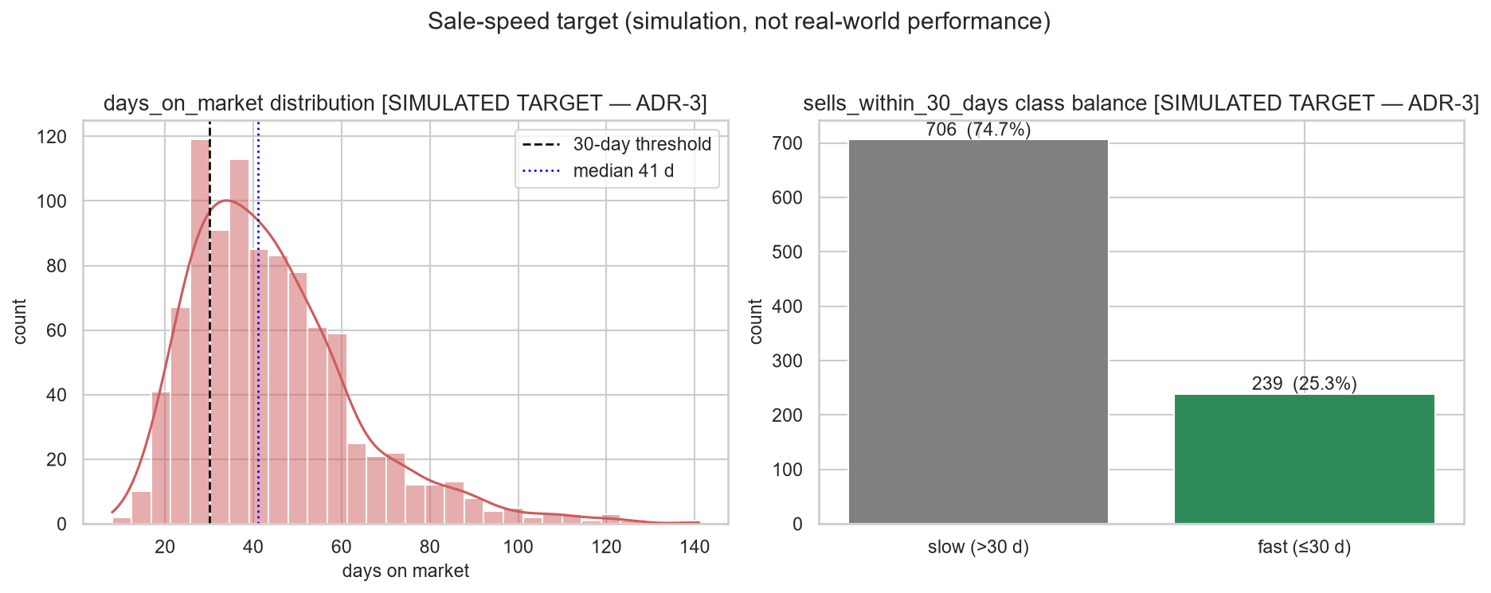
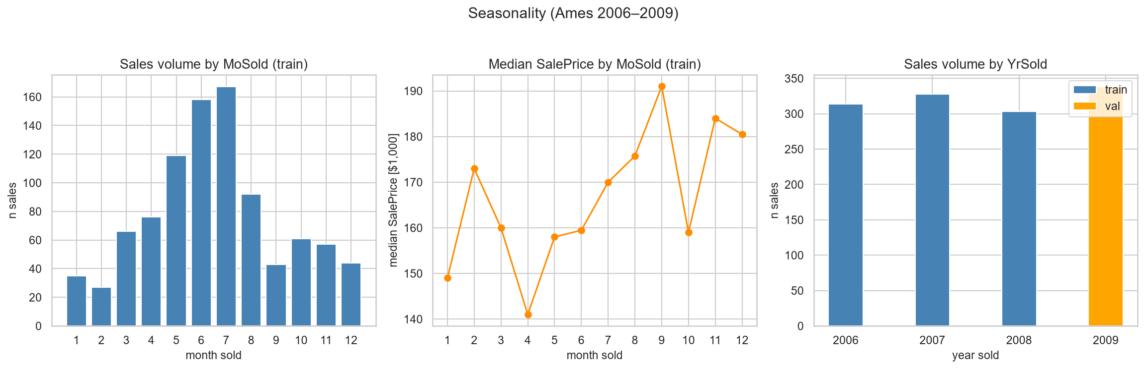
EDA: Seasonality & the Sale-Speed Target
▪ Volume is seasonal (July 167 sales vs February 27) but the price level barely moves
▪ Median price moved only +0.6% from 2006 to 2008; no shock at the split boundary
▪ Simulated days on market: median 41 days, 25.3% fast sales, so imbalance-aware modeling with PR-AUC as the primary metric
PropPulse | Project Review 1
9
Notes:
Deepak (about 30 s): Seasonality is a volume effect, not a price effect, and prices are flat across 2006 to 2008, so our time-based split faces no distribution shock. On the right is the simulated days-on-market target: median 41 days, one in four sales fast. Every classification metric will carry the simulated label.

Slide 10
What the EDA Tells Us to Build
1
Log target is mandatory: skewness 1.967 down to 0.175, RMSLE as the primary metric
2
Trees plus a regularized linear baseline: non-linear size effects and non-monotone age; the linear model stays as the interpretable benchmark
3
Expected feature hierarchy: OverallQual first, then the size block, neighborhood, and age; importance read in groups
4
Hard leakage guards: price per sq ft is EDA-only, statistics fit on train only, SaleType and SaleCondition excluded, days on market never a feature
5
Imbalance-aware classification: 25.3% fast-sale rate, so class weights, PR-AUC primary, and a calibration check
6
Neighborhood-grain clustering: median price per sq ft, sale velocity, and coordinates feed the DBSCAN micro-markets
PropPulse | Project Review 1
10
Notes:
Deepak (about 30 s): Every finding maps to a design decision. Walk the six quickly: log target, the two model families, the feature hierarchy, the four leakage rules, imbalance-aware classification, and the clustering grain. This is the bridge from analysis to the build plan.

Slide 11
Repository & Current Status
github.com/rushmanthnalluri/prop-pulse (branch: main). Everything shown today is committed.
▪ ml/ data, features, training, evaluation, clustering, explainability, monitoring
▪ backend/ FastAPI service and API tests
▪ frontend/ React dashboard (Vite)
▪ notebooks/ 01_eda.ipynb, fully executed, 16 of 16 cells, reproduces all 14 figures
▪ reports/ and figures/ EDA report, audits, and all figures
▪ docs/ specification, decision records, architecture, API contract
454
automated tests passing
49/49
browser E2E tests
CI
runs on every push, Docker verified
100%
EDA reproducibility: figures regenerate identically
PropPulse | Project Review 1
11
Notes:
Deepak (about 30 s): The repository is the evidence, so give the URL. The EDA notebook reruns end to end and reproduces every figure. The engineering hygiene is real: 454 tests, browser end-to-end tests, CI, Docker, and every design decision recorded. Hand back to Rushmanth to close.

Slide 12
Plan Toward Review 2
Done
Next
Then
Problem definition; dataset cleaning and time-based split; full EDA (this review); repository with decision records, CI and tests.
Finalize the 94-feature pipeline. Train 5 regression and 4 classification candidates with 5-fold cross validation on train only. Select the champion on validation with a bootstrap significance test, then evaluate the sealed test set once.
SHAP artifacts, FastAPI serving, React dashboard polish, drift monitoring, Docker packaging. Stretch goal: real days-on-market data and real geocoding through the ready adapters.
Thank you. Questions welcome. github.com/rushmanthnalluri/prop-pulse
PropPulse | Project Review 1
12
Notes:
Rushmanth (about 25 s): Close with the plan. EDA and the repository are complete; next is model training and champion selection, then the serving layer. Thank the panel and invite questions. Total about 5 minutes across the three of us.

