Slide 1
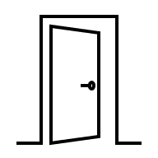



Waiting Area
(infinite capacity)
Service rate
(μ)
Arrival rate
(λ)
Server
…
Customer exits the system
Customers waiting in queue

