Slide 1
REVIEW 1 · PROJECT INITIATION
Academic Timetable
Scheduling System
A Database-Driven Constraint Enforcement System for Faculty, Room & Section Scheduling
Requirements Specification | ER Design | Implementation Roadmap
Database Management Systems Project

Slide 2
PROBLEM IDENTIFICATION
Background, Context & the Core Problem
🏫
Background & Context
!
Core Problem Statement
Academic institutions handle complex scheduling environments every semester. Managing faculty workloads, classroom allocations, and section timetables requires coordinating multiple moving parts across departments.
Manual and spreadsheet-based timetable generation processes are prone to human error, resource conflicts, and policy violations.
Modern academic departments lack a unified, automated database system to enforce scheduling rules in real time, monitor workload equity, and handle unexpected schedule modifications.
Academic Timetable Scheduling System
2

Slide 3
PAIN POINTS
Detailed Pain Points — Scheduling Conflicts (Clashes)
👤
🏫
📘
Faculty Overlap
Room Overlap
Section Overlap
A single faculty member accidentally assigned to teach two different sections during the same time slot.
Two distinct student sections scheduled in the same physical classroom at the same time.
A single student section assigned to two different courses/labs simultaneously.
These clashes arise from the absence of automated, real-time cross-checking across faculty, room, and section assignments.
Academic Timetable Scheduling System
3

Slide 4
PAIN POINTS
Resource Mismatches & Capacity Violations
Classrooms assigned without checking seating capacity against student batch sizes.
1
Large lecture halls (e.g., 100 capacity) allocated to small elective batches (e.g., 15 students), wasting high-capacity space.
2
Small classrooms allocated to large required courses, leading to overcrowding.
3
Academic Timetable Scheduling System
4

Slide 5
PAIN POINTS
Workload Discrepancies & Inequality
Difficulty tracking total weekly teaching hours per faculty member across different departments and course types (Lectures vs. Labs).
Tracking Difficulty
Risks of exceeding maximum workload limits defined by university or departmental norms.
Overload Risk
Unequal distribution of teaching hours among junior and senior faculty members.
Unequal Distribution
Academic Timetable Scheduling System
5

Slide 6
PAIN POINTS
Operational Friction & Data Integrity Issues
⇄
Inflexible Substitution & Operational Friction
☢
Data Redundancy & Lack of Integrity
When a faculty member is absent, finding an available substitute with matching subject expertise and free time slots requires manual cross-checking.
Lack of audit trails or historical records for past substitutions.
Storing schedule details across loose Excel files leads to duplicate data entries, outdated files, and missing foreign key checks.
Academic Timetable Scheduling System
6

Slide 7
LITERATURE SURVEY
Domain Analysis — Comparing Scheduling Approaches
Three existing approaches were analyzed to design an optimal system:
Approach | Overview | Key Limitation / Advantage
1. Manual & Spreadsheet (Excel / Google Sheets) | Academic coordinators use manual grid tables to place courses and faculty into time slots. | No relational integrity, no real-time clash detection, hard to scale.
2. Heuristic & AI-Based (Genetic Algorithms) | Uses meta-heuristic algorithms to automatically generate fully optimal timetables. | Highly complex, computationally heavy, over-engineered for small/medium depts.
3. Database-Driven Constraint Enforcement (Proposed) | A relational database (RDBMS) paired with an interactive application interface. | Strict ACID/3NF integrity, instant rule enforcement, <1s response time.
Academic Timetable Scheduling System
7

Slide 8
PROPOSED SYSTEM
Database-Driven Constraint Enforcement System
A relational database management system (RDBMS) paired with an interactive application interface.
✓
⚡
⏱
Strict Data Integrity
Instant Rule Enforcement
Fast Response Times
Guarantees strict transactional data integrity (3NF schema) and ACID compliance.
Enforces business rules instantly using unique composite constraints and application logic.
Provides fast response times (< 1 second) for clash checks, queries, and substitution logging.
Academic Timetable Scheduling System
8

Slide 9
PROJECT PLANNING
Implementation Phases & Timeline
1
PHASE 1
Problem Identification & Requirements
Requirements gathering, stakeholder analysis, and conceptual design foundation.
2
PHASE 2
3NF Normalization & Schema Design
Design of the relational schema, entity modeling, and constraint definition.
3
PHASE 3
Python / Java Application Development
Building the interactive application layer on top of the database engine.
Academic Timetable Scheduling System
9

Slide 10
REQUIREMENTS
Non-Functional Requirements (NFR)
▦
NFR-01
⚡
NFR-02
Data Integrity & Normalization
Performance & Speed
Database structure must adhere to 3NF standards to eliminate redundant entries and update anomalies.
Validation queries (clash check, workload check, room capacity check) must execute in under 1 second.
🔒
NFR-03
⚙
NFR-04
Security & Role-Based Access
Usability
Admin features (scheduling, modifying, deleting) must be password-protected from general student/faculty view access.
Clean interface featuring clear error messages whenever a scheduling attempt is rejected.
Academic Timetable Scheduling System
10

Slide 11
CONCEPTUAL MODEL
ER Diagram Specification — Entities & Key Attributes
# | Entity | Key Attributes
1 | DEPARTMENT | dept_id (PK), dept_name
2 | FACULTY | faculty_id (PK), name, email, max_hours_per_week, dept_id (FK)
3 | COURSE | course_id (PK), course_code, course_name, credits, weekly_hours, dept_id (FK)
4 | SECTION | section_id (PK), section_name, enrolled_students, course_id (FK)
5 | ROOM | room_id (PK), room_number, capacity, room_type
6 | TIMESLOT | slot_id (PK), day_of_week, start_time, end_time
7 | TIMETABLE_ENTRY | entry_id (PK), section_id (FK), faculty_id (FK), room_id (FK), slot_id (FK)
8 | SUBSTITUTION | substitution_id (PK), entry_id (FK), original_faculty_id (FK), substitute_faculty_id (FK), sub_date
Academic Timetable Scheduling System
11

Slide 12
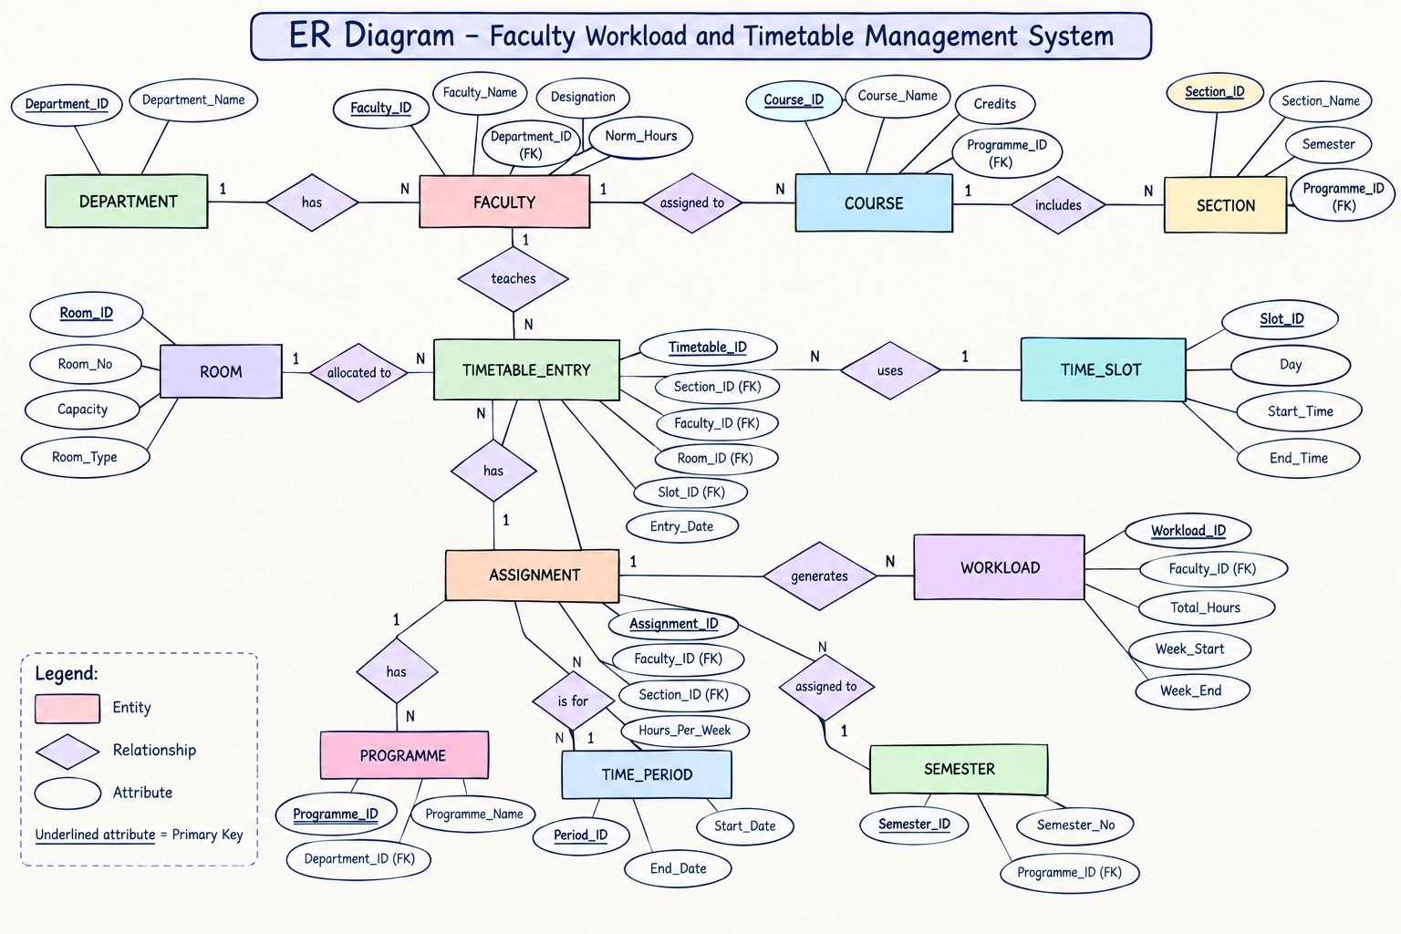

Slide 13
CONCEPTUAL MODEL
Relationship & Cardinality Mapping
DEPARTMENT
1 : N
FACULTY
A department employs multiple faculty members; a faculty member belongs to one department.
DEPARTMENT
1 : N
COURSE
A department offers multiple courses; a course belongs to one department.
COURSE
1 : N
SECTION
A course can have multiple sections; each section belongs to one course.
TIMETABLE_ENTRY
N : 1
FACULTY / ROOM / SLOT
Each timetable entry links one section to one faculty member, one room, and one timeslot.
Academic Timetable Scheduling System
13

Slide 14
PRESENTATION SUMMARY
“
Respected Faculty, in Review 1, we identify the operational bottlenecks in academic scheduling. Traditional Excel-based scheduling creates human errors such as double-booking rooms, assigning faculty past their weekly teaching hours, or placing 60 students in a 30-capacity room.
Our project resolves this by building a relational database system that automatically enforces zero-clash constraints, monitors workload caps, and validates room capacity before any schedule is saved.
Faculty Explanation Script — Review 1 Presentation
Academic Timetable Scheduling System
14

Slide 15
Thank You
Questions & Discussion
Academic Timetable Scheduling System | Review 1

