Slide 1
REVIEW 3 | WEEK 16 | FINAL EVALUATION
Faculty Workload and Timetable Management System
Integrated Dashboard Results, Clash Detection, Substitution Logic & System Testing
Rushmitha
B.Tech - Artificial Intelligence & Machine Learning (AIML)
Woxsen University - School of Technology | DBMS PBL Project

Slide 2
Project Journey: Review 1 to Review 3
REVIEW 1
REVIEW 2
REVIEW 3
Design
Build
Integrate & Validate
Problem statement
Literature survey
ER diagram & high-level schema
3NF schema (8 tables)
DDL with PK, FK, UNIQUE, CHECK
SQL queries & Streamlit prototype
Full dashboard with 4 analytic views
Clash detection & substitution logic
Testing, documentation, viva
COMPLETED
COMPLETED
CURRENT

Slide 3
Final System Architecture
Presentation Layer
Logic Layer
Data Layer
Streamlit dashboard
Python + SQL
SQLite / MySQL
4 navigation views, filters, charts, alerts
Workload calculation, clash detection, capacity validation
8 tables in 3NF with PK, FK, UNIQUE, CHECK constraints
TWO-LAYER CLASH PROTECTION
Application layer validates capacity and availability before any write; database layer enforces composite UNIQUE constraints on faculty+slot, room+slot and section+slot as a final guarantee.

Slide 4
Integrated Modules Delivered
Faculty Workload Report
Section Timetable View
Room Utilization Analysis
KPIs, load summary table and hours vs maximum norm chart.
Weekly schedule per section with section and day filters.
Usage metrics and weekly usage hours per room and lab.
Schedule Clash Monitor
Real-Time Validation
Substitution Logic
Detects and reports conflicts with entries, resource and time.
Capacity and double-booking checks before saving a schedule.
Finds free, eligible faculty and logs it in the Substitution table.

Slide 5
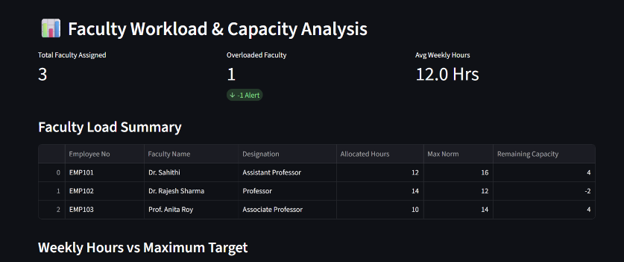
Result 1: Faculty Workload & Capacity
KEY FINDINGS
3 faculty assigned; average 12.0 hrs/week
1 overloaded: Dr. Rajesh Sharma, 14 h vs norm 12 h (-2)
Dr. Sahithi and Prof. Anita Roy have 4 spare hrs each
TAKEAWAY Overload is flagged instantly, and spare capacity points to who can take the load.

Slide 6
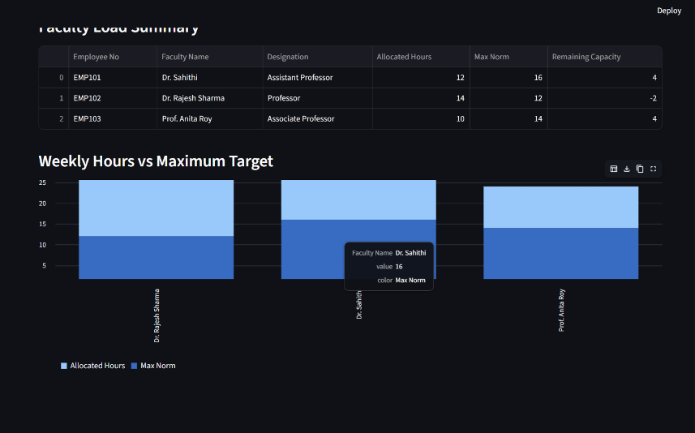
Result 2: Weekly Hours vs Maximum Target
INSIGHT
Interactive stacked chart: allocated hours vs each faculty's max norm
Hover shows faculty name, value and series
Overloads are visible at a glance
TAKEAWAY Visual comparison supports fair rebalancing and substitution decisions.

Slide 7
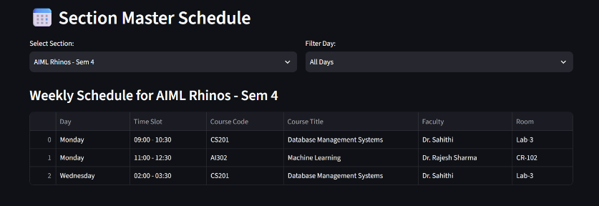
Result 3: Section Master Schedule
KEY FINDINGS
Filter by section and day (AIML Rhinos - Sem 4 shown)
Rows show day, slot, course, faculty and room
3 weekly sessions: CS201 (x2) and AI302
TAKEAWAY Students and coordinators get a clear, filterable weekly timetable per section.

Slide 8
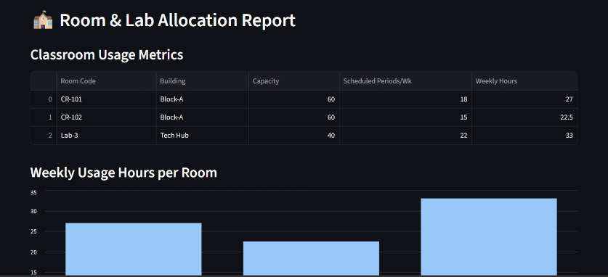
Result 4: Room & Lab Utilization
KEY FINDINGS
CR-101: 18 periods, 27 hrs/wk
CR-102: 15 periods, 22.5 hrs/wk
Lab-3: 22 periods, 33 hrs/wk (capacity 40)
TAKEAWAY Lab-3 is the busiest resource, so it is the first candidate for load balancing.

Slide 9
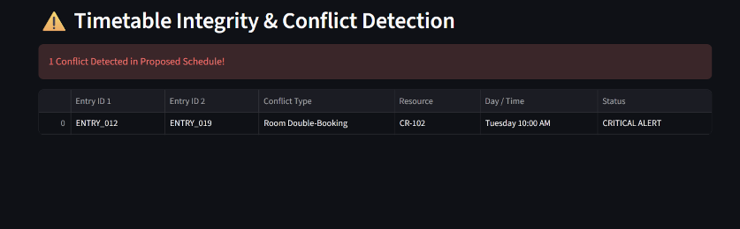
Result 5: Timetable Integrity & Conflict Detection
CONFLICT DETECTED
Alert: 1 conflict in the proposed schedule
ENTRY_012 vs ENTRY_019
Room double-booking: CR-102, Tuesday 10:00 AM
Status: CRITICAL ALERT
TAKEAWAY Clashes are caught and reported before they reach the final timetable.

Slide 10
Clash Detection & Substitution Logic
Detect double-booked rooms
SUBSTITUTION WORKFLOW
SELECT room_id, slot_id, COUNT(*) AS clashes
FROM TimetableEntry
GROUP BY room_id, slot_id
HAVING COUNT(*) > 1;
1
Faculty reported absent for a slot
2
Query free faculty under their weekly max
Find eligible substitutes for a slot
3
Check same-department preference
SELECT f.faculty_id, f.name FROM Faculty f
WHERE f.faculty_id <> :absent_id
AND f.faculty_id NOT IN (SELECT faculty_id
FROM TimetableEntry WHERE slot_id = :slot)
AND (SELECT COUNT(*) FROM TimetableEntry t
WHERE t.faculty_id = f.faculty_id)
< f.max_hours_per_week;
4
Insert record into Substitution table
5
Workload report refreshes automatically

Slide 11
System Testing & Validation
ID | Feature | Test / Expected result | Status
TC-01 | Workload report | Dr. Rajesh Sharma shown at 14 h vs 12 h norm (-2) | Pass (observed)
TC-02 | Overload KPI | 1 of 3 faculty flagged; average 12.0 hrs | Pass (observed)
TC-03 | Section timetable | Section and day filters return 3 sessions | Pass (observed)
TC-04 | Room utilization | CR-101 27 h, CR-102 22.5 h, Lab-3 33 h | Pass (observed)
TC-05 | Clash detection | ENTRY_012 vs ENTRY_019 on CR-102 flagged critical | Pass (observed)
TC-06 | Capacity validation | Section strength above room capacity is rejected | To verify
TC-07 | Substitution | Free eligible faculty assigned; record saved | To verify
TC-08 | Edge-case load | Bulk entries run without errors or false clashes | To verify

Slide 12
Conclusion & Future Scope
ACHIEVEMENTS
LIMITATIONS
FUTURE SCOPE
3NF database with 8 constrained tables
Working 4-view analytics dashboard
Conflicts and overloads detected automatically
Prototype data (3 faculty, 3 rooms)
Substitution logic yet to get a dashboard view
Manual schedule entry
Auto-generated timetables
Role-based login for faculty and admin
Export to PDF/Excel and email alerts
Thank you | Questions?

