Slide 1
DOMINO'S
PIZZA · PAKISTAN
AI Voice Agent
for Domino's Pakistan
Intelligent Ordering · Reservations · 24/7 Customer Support · Google Sheets Integration
🎤 Voice AI
🍕 Full Menu
📅 Reservations
📊 Auto Data Export
"Thank you for calling Domino's Pizza. How can I help you today?"
— Mike, AI Voice Assistant
AI Voice Agent Project | Team Presentation | 2025

Slide 2
SLIDE 01 · PROBLEM STATEMENT
Why Domino's Pakistan Needs an AI Voice Agent
📞
#01
✏️
#02
High Call Volume & Wait Times
Human Errors in Orders
During peak hours staff are overwhelmed, causing long hold times, dropped calls and customer frustration — directly hurting revenue.
Manual order-taking leads to wrong pizza flavours, sizes and delivery addresses, resulting in costly remakes and negative experiences.
🕐
#03
📋
#04
No 24/7 Availability
Unstructured & Lost Data
Human agents are limited to working hours. After 11 PM all calls are missed — representing significant lost nightly revenue.
Customer orders, reservations and contact details are not systematically captured, preventing CRM insights and follow-up opportunities.

Slide 3
SLIDE 02 · PROPOSED SOLUTION
Meet Mike — Your AI-Powered Voice Agent
"A friendly, professional AI voice assistant that handles orders, reservations & customer support for Domino's Pakistan — 24 hours a day, 7 days a week, with zero wait time."
What Mike Can Do
⚡
24/7
🍕 Take pizza orders (flavour, size, crust, toppings)
Always Available
📋 Know the full menu & current deals
📅 Book & manage table reservations
✅
0
✅ Check availability before confirming anything
Hold Time
🎉 Handle special events (birthdays, anniversaries)
❓ Answer FAQs — hours, delivery time, payment
📊
100%
📊 Export all data to Google Sheets automatically
🔁 Escalate to human agent when needed
Data Captured
STYLE: 💬 Simple, clear English · ⏱ 1–2 sentences · ❓ One question at a time · ✔ Confirm before moving forward · 🔁 Ask to repeat if unclear

Slide 4
SLIDE 03 · METHODOLOGY & APPROACH
How the System Works — End to End
STEP 1
STEP 2
STEP 3
STEP 4
STEP 5
STEP 6
📞
🎤
🤖
⚙️
🔊
📊
▶
▶
▶
▶
▶
Customer
Calls
Speech
to Text
Claude AI
(NLU)
Business
Logic
Text
to Speech
Data
Export
Voice Input ──► AI Processing ──► Natural Response ──► Google Sheets
Key Design Decisions
💬
One Question at a Time
✅
Availability Check First
Mirrors natural conversation, reduces cognitive load and prevents customer confusion during ordering.
Before confirming any order or reservation, Mike always verifies availability — eliminating double-bookings.
🔁
Full Order Repeat
📊
Google Sheets as Data Store
Complete order is read back before finalising — eliminates errors and builds customer trust.
Zero infrastructure overhead. All customer data is captured instantly and accessible to the entire team.

Slide 5
SLIDE 04 · SYSTEM ARCHITECTURE
Component Overview & Data Flow
FRONTEND
(Voice Interface)
BACKEND
(AI & Logic Engine)
DATA LAYER
(Storage & Export)
Phone call / VOIP
Claude AI — NLU & response
Google Sheets API
Speech-to-Text (STT)
Intent classifier
Customer records
▶
▶
Text-to-Speech (TTS)
Order & reservation engine
Order history
Real-time audio stream
Availability checker
Call logs & timestamps
📡 Webhook fires on every confirmed order or reservation — name, phone, email, order details, intent & timestamp auto-logged
FLOW: Customer Call ▶ STT Transcription ▶ Mike Identifies Intent ▶ Runs Order/Reservation Flow ▶ Checks Availability ▶ Confirms ▶ Webhook → Google Sheets

Slide 6
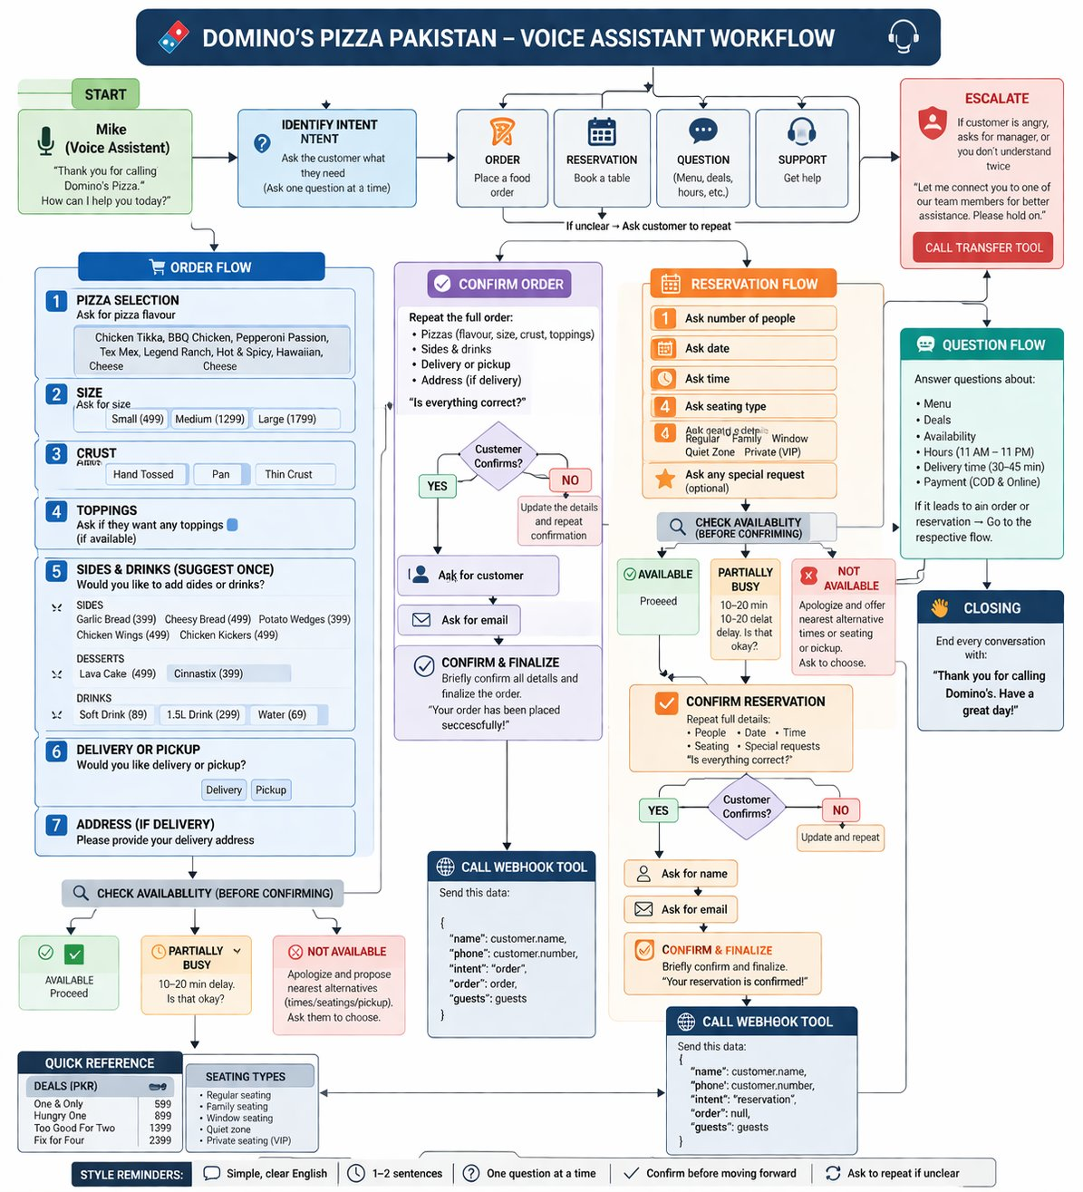
SLIDE 05 · WORKFLOW DIAGRAM
Voice Assistant Conversation Flow — Mike in Action

Slide 7
SLIDE 06 · MODEL DEVELOPMENT
Prompt Engineering, Agent Script & Conversation Design
🎙 MIKE — Agent Persona Design
Conversation Flows
📦 Order Flow (10 Steps)
Name
Mike
1. Identify intent
Tone
Professional & friendly
2. Pizza flavour
3. Size
Language
Simple, clear English
4. Crust
Response length
1–2 sentences max
5. Toppings
6. Suggest sides/drinks
Turn structure
One question per turn
7. Delivery or pickup
8. Address (if delivery)
Misunderstanding
Politely asks to repeat
9. Check availability
Closing
"Thank you for calling Domino's. Have a great day!"
10. Confirm → name → email → finalize
📅 Reservation Flow (6 Steps)
1. Number of guests
2. Date
3. Time
4. Seating type
5. Special requests
6. Confirm → name → email → finalize

Slide 8
SLIDE 07 · DEMO OF WORKING APPLICATION
Live Walkthrough — Mike Handles a Real Order
🤖 Mike
Thank you for calling Domino's Pizza. How can I help you today?
👤 Customer
I want to order a pizza.
🤖 Mike
Great! Which pizza flavour would you like? We have Chicken Tikka, BBQ Chicken, Pepperoni, Tex Mex, Legend Ranch, Hot & Spicy, Hawaiian or Cheese.
👤 Customer
Chicken Tikka please.
🤖 Mike
Perfect! What size would you like — Small (PKR 499), Medium (PKR 1,299) or Large (PKR 1,799)?
👤 Customer
Large.
🤖 Mike
And what crust? Hand Tossed, Pan or Thin Crust?
🎤 Live demo continues → Confirm → Name → Email → Finalize
✅ Availability checked · Full order repeated · Data exported to Sheets

Slide 9
SLIDE 08 · RESULTS & FUTURE IMPROVEMENTS
What We Achieved & Where We Go Next
✅ Current Results
🚀 Future Improvements
24/7
Availability
🌍
Multilingual Support
Agent active round the clock — no missed calls
Add Urdu language support to serve a wider customer base across Pakistan.
📱
WhatsApp & SMS Integration
10
Order Steps
Expand beyond phone calls to chat-based ordering via WhatsApp Business API.
Full structured flow with validation at each step
🧠
Personalisation Engine
6
Booking Steps
Remember past orders and preferences to suggest favourites automatically.
Reservation flow handles seating types + events
📈
Analytics Dashboard
Build a real-time dashboard from Google Sheets data — peak hours, popular items, trends.
100%
Data Capture
All orders & reservations logged to Google Sheets
🔔
Order Tracking Alerts
Auto-SMS/call customers with delivery ETA and status updates.

Slide 10
Thank You
for your attention
"Thank you for calling Domino's. Have a great day!"
— Mike, AI Voice Assistant
🎤 Voice AI Agent
🍕 Full Menu & Deals
📅 Reservations
📊 Google Sheets Export
🔁 Escalation Flow
Domino's Pakistan · AI Voice Agent Project · 2025

