Slide 1
Project Presentation of CO-OP Project at Industry (Module-2) (22CS421)
On
Improving Backend Operations Using ERP-Based Administrative Systems
Rushneet Kaur
2210992196
Supervised By
Rajat Takkar
Associate Professor, Department of Computer Science and Engineering
Department of Computer Science and Engineering,
Chitkara University, Punjab

Slide 2
Introduction
In the modern organizational environment, backend operations play a crucial role in ensuring the smooth and efficient functioning of administrative activities. Departments such as finance, human resources, procurement, and inventory management are responsible for maintaining internal stability, yet many organizations still rely on separate systems and manual methods to manage these functions. This lack of integration often leads to delays, data duplication, communication gaps, and operational errors that affect overall efficiency. The adoption of Enterprise Resource Planning (ERP) systems has emerged as an effective solution to overcome these challenges by connecting all departments through a unified platform. While ERP offers numerous advantages in improving backend efficiency, its implementation also involves challenges such as high initial costs, system complexity, and resistance from employees. Therefore, it becomes essential to analyze how ERP-based administrative systems enhance backend operations and contribute to long-term organizational effectiveness.
2

Slide 3
Problem Statement
In many organizations, backend departments such as finance, human resources, procurement, and inventory management continue to operate using disconnected systems and manual processes. While organizations are increasingly adopting Enterprise Resource Planning (ERP) solutions, there is still limited structured analysis of how ERP-based administrative systems practically improve backend efficiency and coordination.
Key Issues:
Disconnected departmental systems
Manual and repetitive administrative work
Data duplication and reporting delays
Core Problem: To analyze how ERP-based administrative systems improve backend operations by enhancing efficiency, data accuracy, coordination, and decision-making through an integrated, centralized approach.

Slide 4
Objectives
The main objectives of this study are:
To analyze how Enterprise Resource Planning (ERP) systems improve the efficiency of backend operations
To examine the role of ERP in reducing manual workload and administrative errors
To study how ERP enhances data accuracy and inter-departmental coordination
To evaluate how real-time reporting and automation through ERP support better decision-making

Slide 5
Literature Review
Several studies have examined how administrative inefficiencies arise when backend departments operate through isolated systems and manual procedures. Research highlights that the absence of integration among finance, human resources, procurement, and inventory departments often leads to delays, data redundancy, miscommunication, and frequent reporting errors. These issues negatively affect organizational productivity and decision-making processes.
The implementation of Enterprise Resource Planning (ERP) systems is widely recognized as a solution to these challenges. This integration reduces manual workload, improves data accuracy, and strengthens coordination among different functional units.
However, most existing studies focus on general benefits and case-based observations of ERP adoption. There is limited comparative analysis between traditional backend systems and ERP-based administrative systems to clearly measure improvements in efficiency, accuracy, coordination, and overall operational performance.

Slide 6
Methodology
This study follows a structured comparative approach to analyze how Enterprise Resource Planning (ERP) systems improve backend administrative operations.
Dataset of organizational practices and case studies collected with key variables: Operational Efficiency Workload Reduction Data Accuracy Inter-departmental Coordination Decision-Making Speed
Data review and analysis performed using: Research papers, journals, and industry case studies
Comparative analysis used to identify patterns and improvements between traditional systems and ERP-based systems
Analytical evaluation applied: Systematic comparison to measure backend performance improvements through ERP implementation

Slide 7
Machine Learning Model
Model Used: Comparative System Evaluation Objective: Assess improvement in backend efficiency after ERP implementation
System Comparison: Traditional Administrative Practices ERP-Based Administrative Practices
Evaluation Metrics: Operational Efficiency Data Accuracy Inter-departmental Coordination Decision-Making Speed
The analysis shows a positive relationship, indicating that ERP implementation leads to improved efficiency, reduced errors, and better organizational coordination.

Slide 8
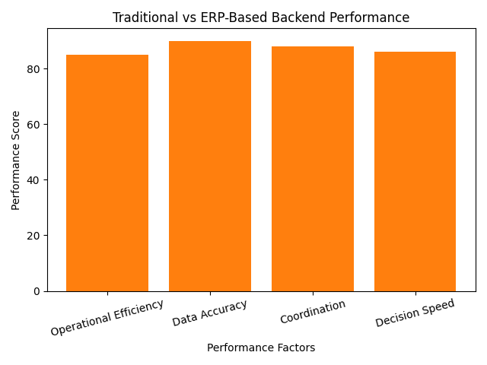
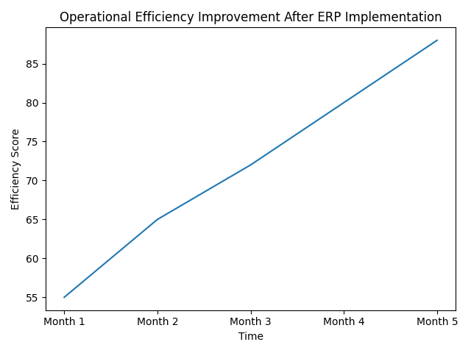
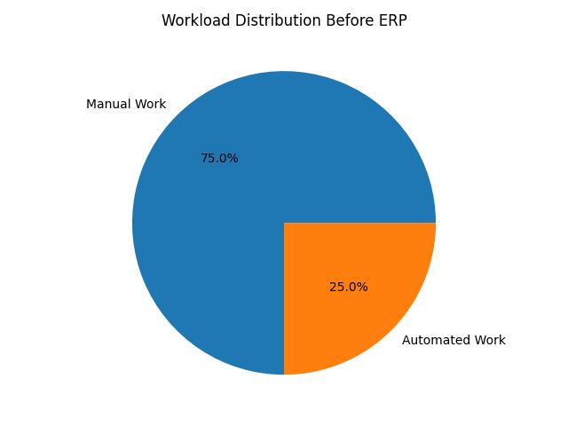
Exploratory Data Analysis (EDA)
Exploratory analysis was performed to identify patterns and relationships between backend operational factors.
Chart Representation: Shows comparison between traditional systems and ERP-based systems Bar Chart: Displays improvement in operational efficiency after ERP adoption Process Flow Diagram: Represents integration of departments through ERP
Key Insight: Backend efficiency improves significantly after ERP implementation, showing a clear positive impact on coordination, accuracy, and workflow.

Slide 9
Correlation Analysis
Correlation analysis was performed to understand the relationship between ERP adoption and backend operational factors.
Positive correlation between: ERP Implementation and Operational Efficiency ERP Implementation and Data Accuracy ERP Implementation and Inter-departmental Coordination
Negative correlation between: ERP Implementation and Manual Workload ERP Implementation and Administrative Errors
Key Insight: Higher adoption of Enterprise Resource Planning (ERP) leads to improved efficiency, better coordination, and reduced errors in backend operations.

Slide 10
Results & Discussion
The analysis highlights the significant impact of ERP adoption on improving backend administrative performance.
Moderate system integration improves coordination and workflow efficiency Effective ERP usage leads to: Increased operational efficiency Reduced administrative errors Faster decision-making and reporting
Key factors improving performance: Process automation Centralized data management Real-time information access
The comparative evaluation confirms a positive relationship between Enterprise Resource Planning (ERP) implementation and backend efficiency.

Slide 11
Conclusion
This study highlights that backend administrative systems play a significant role in influencing organizational efficiency and coordination.
Inefficient and disconnected systems lead to: Reduced operational efficiency Increased administrative errors Delays in reporting and decision-making
Structured and integrated use of Enterprise Resource Planning (ERP) systems can improve overall performance and workflow management.
A systematic comparative approach helps in better understanding and evaluating how ERP enhances backend operations and organizational effectiveness.

Slide 12
Recommendations
To improve backend efficiency and administrative performance, the following measures are suggested:
Implement Enterprise Resource Planning (ERP) in a phased and planned manner
Provide proper training to employees for effective system usage
Automate routine administrative tasks to reduce manual workload
Ensure data integration across all departments
Continuously monitor system performance and workflow
Adopting these measures can help organizations achieve better coordination, reduced errors, and improved operational efficiency.

Slide 13
Future Work
The study can be extended in the following ways:
Integrate advanced analytics and AI capabilities with Enterprise Resource Planning (ERP) for smarter decision-making
Include more organizational case studies for broader comparative analysis
Collect real-time operational data from ERP dashboards for deeper insights
Analyze additional factors such as cost optimization and resource utilization
These improvements can provide deeper insights into how ERP systems enhance backend performance and long-term organizational effectiveness.

Slide 14
Thank You
14

