Slide 1
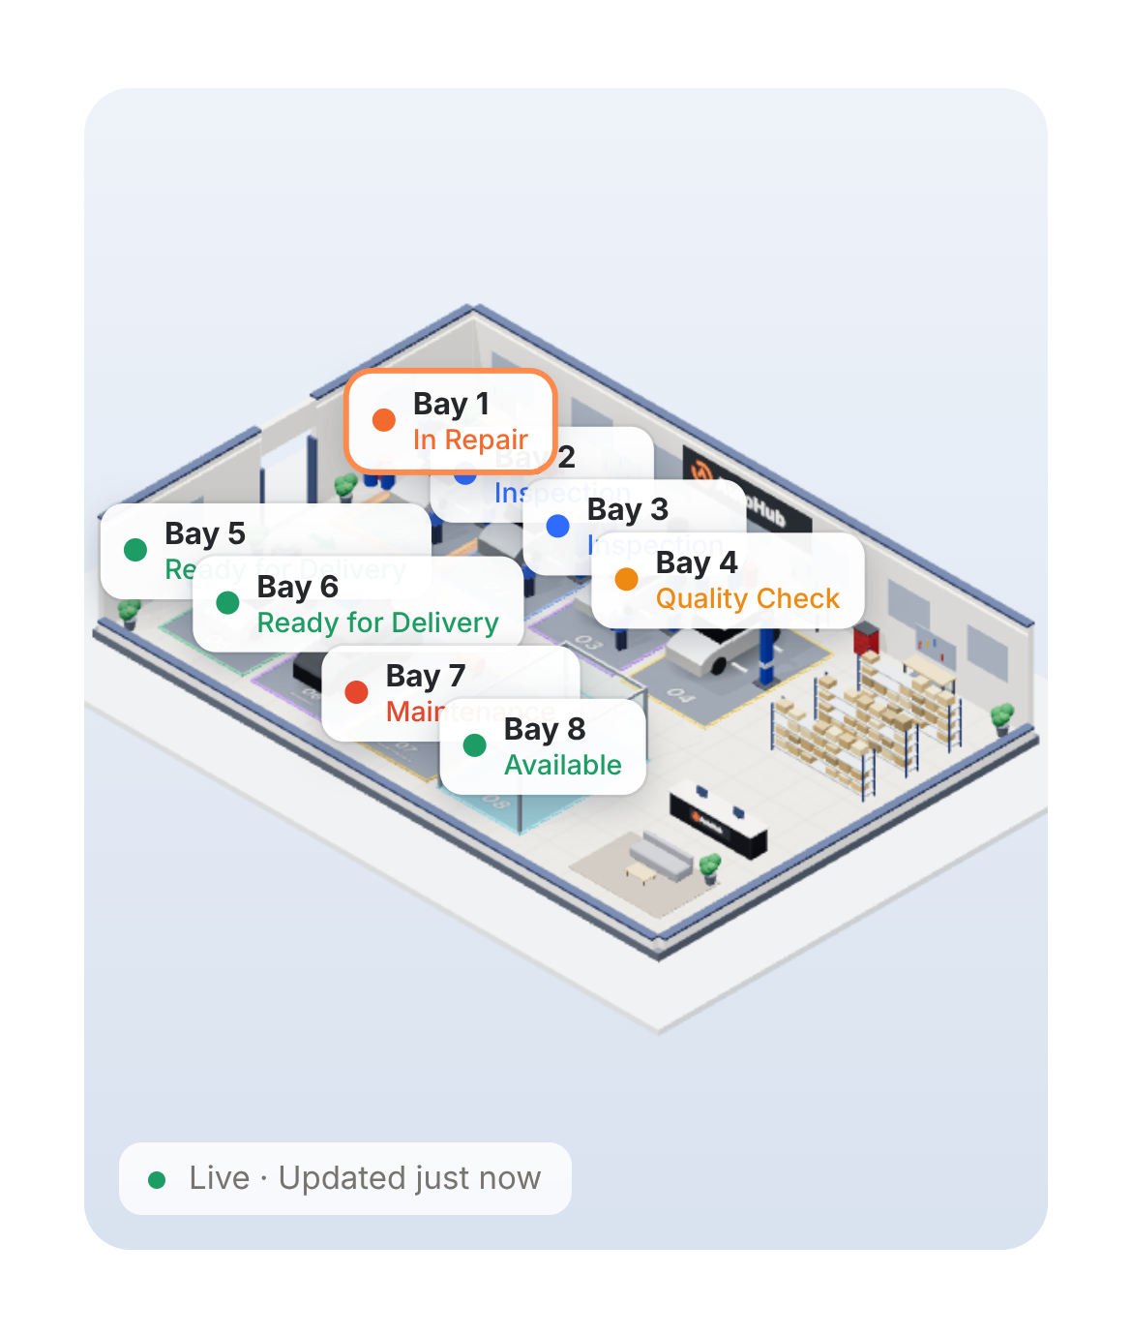
Run your whole workshop from one screen
AutoHub
Jobs, customers and insurance claims in one simple system for garages.
Client presentation
Notes:
Welcome. In the next few minutes I will show how AutoHub helps a garage run jobs, customers and insurance claims in one place.

Slide 2




Running a garage is harder than it should be
Endless status calls
Details get lost
Customers keep phoning to ask, "Is my car ready?"
Job information sits on paper, WhatsApp and in memory.
Insurance paperwork
No clear picture
Missing documents, surveyor delays and late payments.
The owner cannot see which car is in which bay.
Notes:
These are the everyday problems: calls asking for status, details lost on paper and WhatsApp, insurance paperwork, and no clear picture of the floor.

Slide 3



One platform, three portals
Owner
Technician
Customer
Sees the whole workshop live. Creates jobs, sends estimates, tracks insurance claims.
Opens their own jobs on a phone. Inspects cars, updates status, asks for parts.
Follows the car from a private link. Approves work and pays, with no app.
Everyone works from the same live information, so nothing is lost between people.
Notes:
AutoHub has three parts that share the same live information: one for the owner, one for technicians, one for customers.

Slide 4
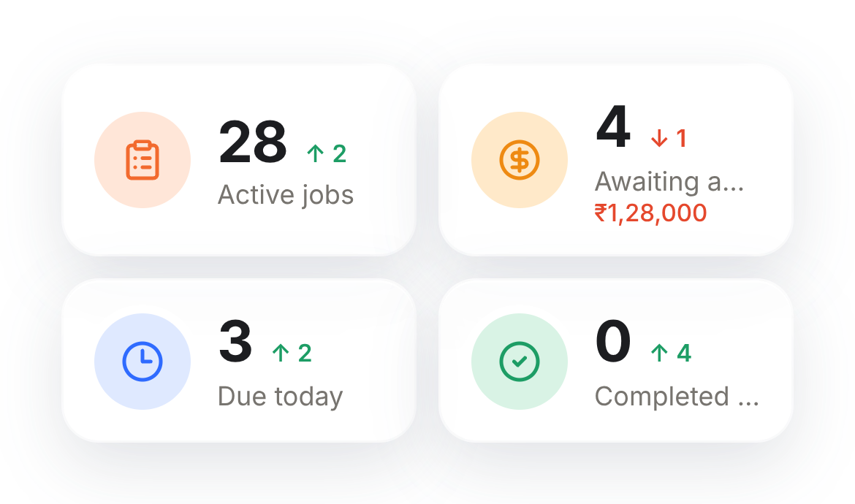
See your whole workshop, live
Every bay, every car and every technician on one map
Switch between a simple 2D plan and a 3D view
Tap any bay to open the job and update its status
Today's jobs, due-today and waiting-for-approval at a glance
Demo data shown.
Notes:
The owner sees every bay and car on one live map, in 2D or 3D. Tapping a bay opens the job.

Slide 5
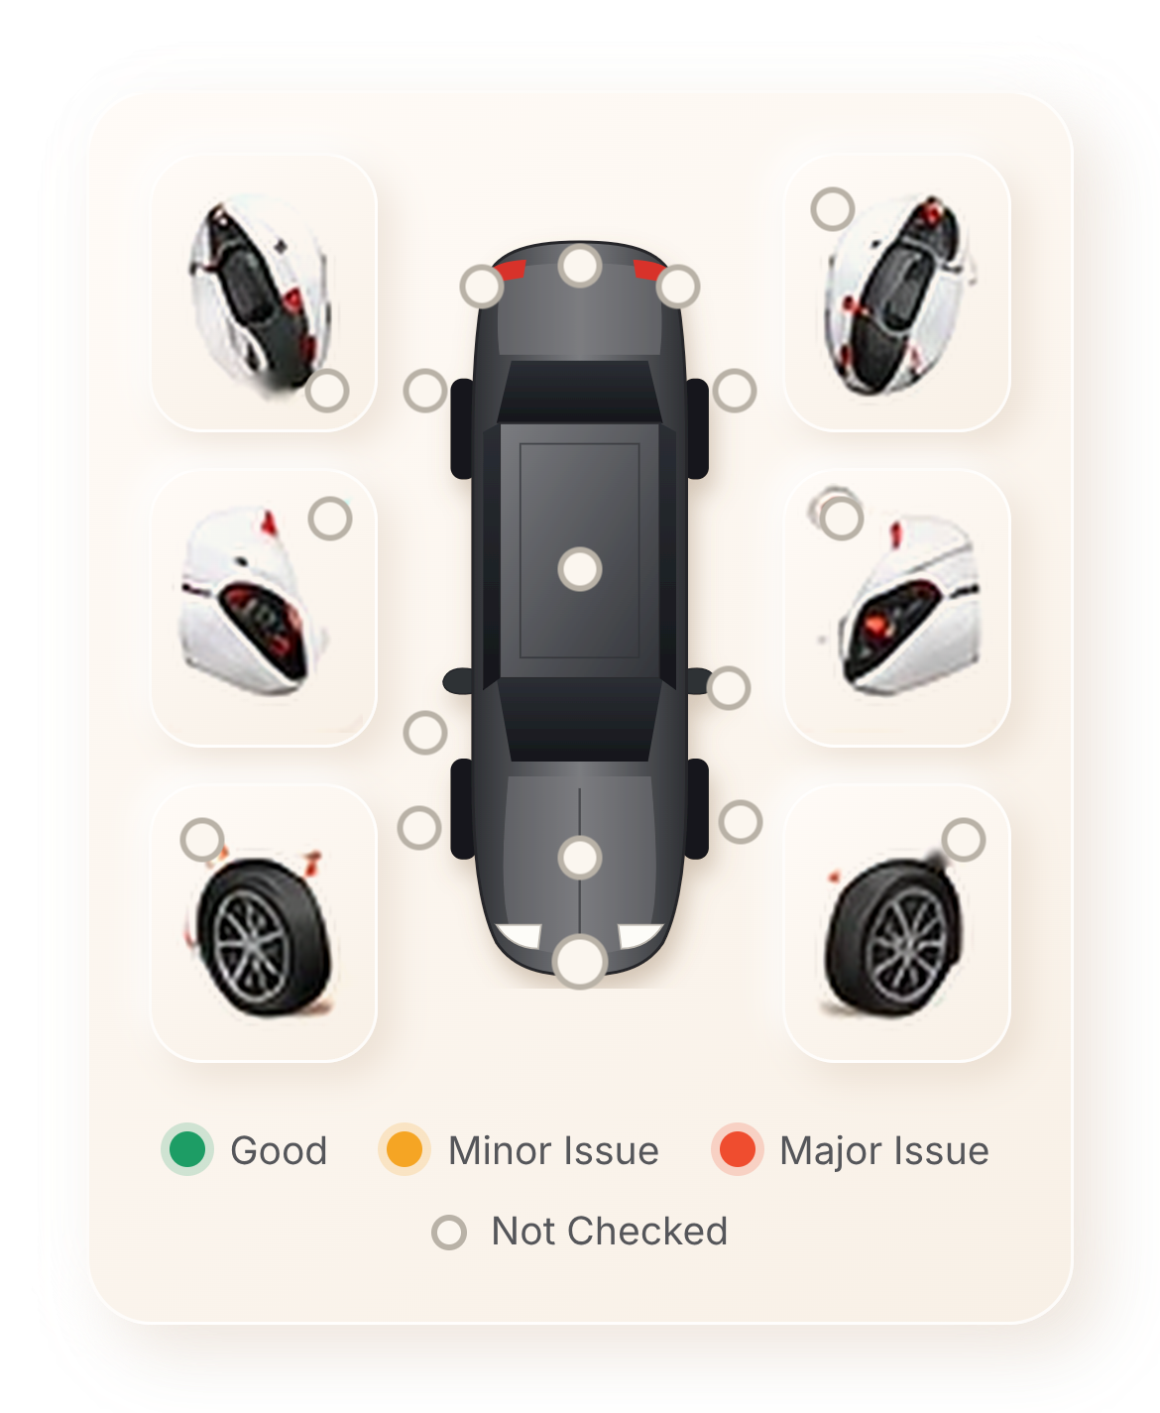
Creating a job takes about a minute
1
Vehicle: find the car or add a new one
2
Service: choose the work and the technician
3
Inspection: mark damage on the car
4
Estimate: build the quote
5
Review: create the job
The condition of the car is recorded at drop-off. That protects you and the customer.
Notes:
A job is created in five short steps. The car condition is marked on a diagram at check-in.

Slide 6
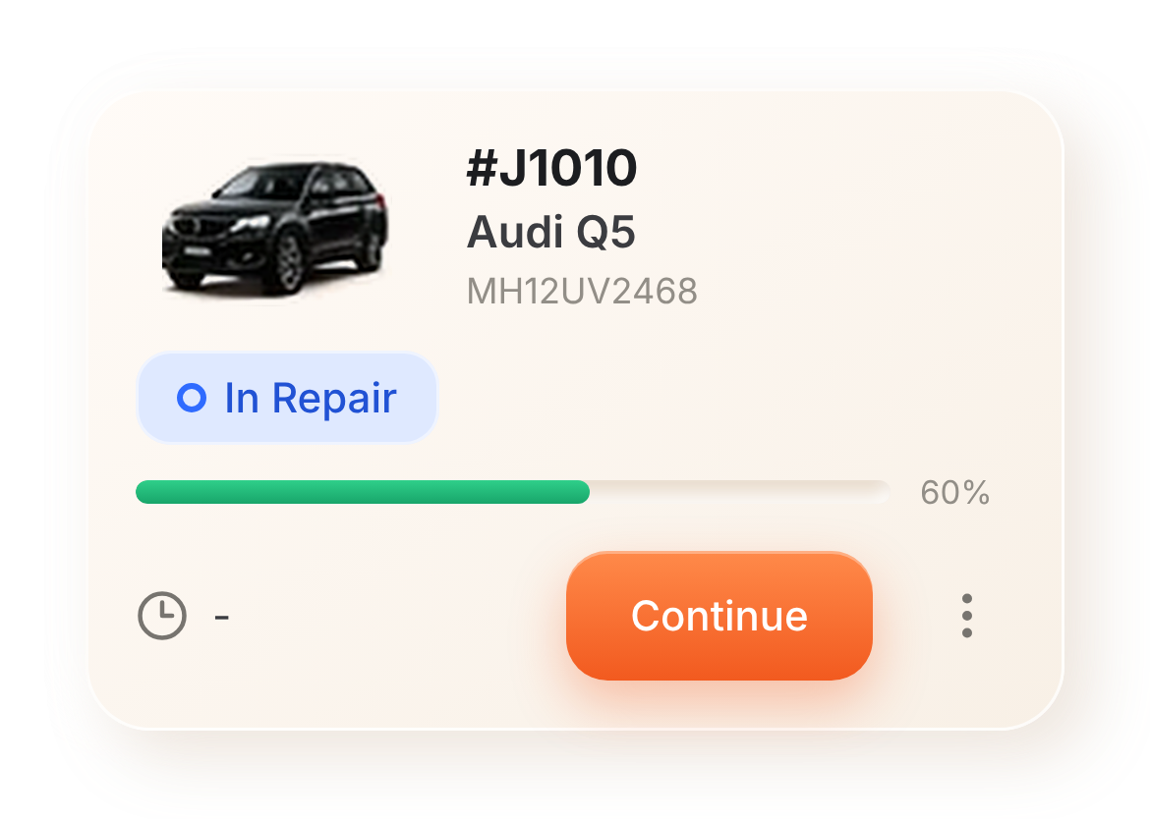
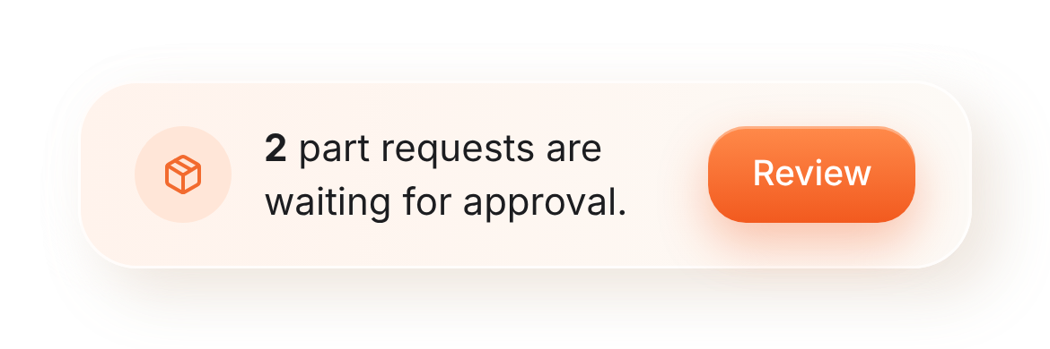
Technicians work from their phone
Each technician sees only their own jobs
Update the status in one tap
Request a part without walking to the counter
The store sees the request straight away
Demo data shown.
Notes:
Technicians see only their jobs. They update status and request parts from the phone.

Slide 7
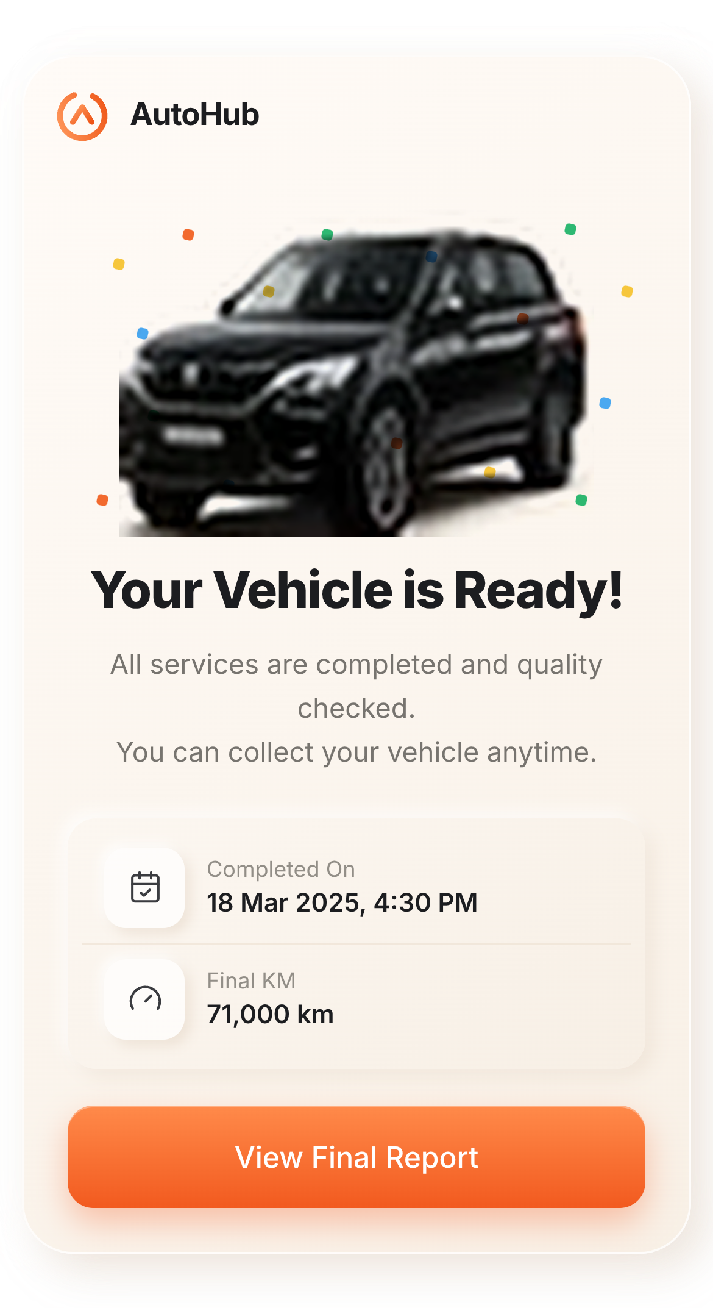
Customers always know where their car is
A private link for every car. No app, no login
Live status from inspection to ready for pickup
Photos and findings from the workshop
Fewer "is it ready?" calls to your team
Notes:
Customers get a private link. They see live status without calling.

Slide 8
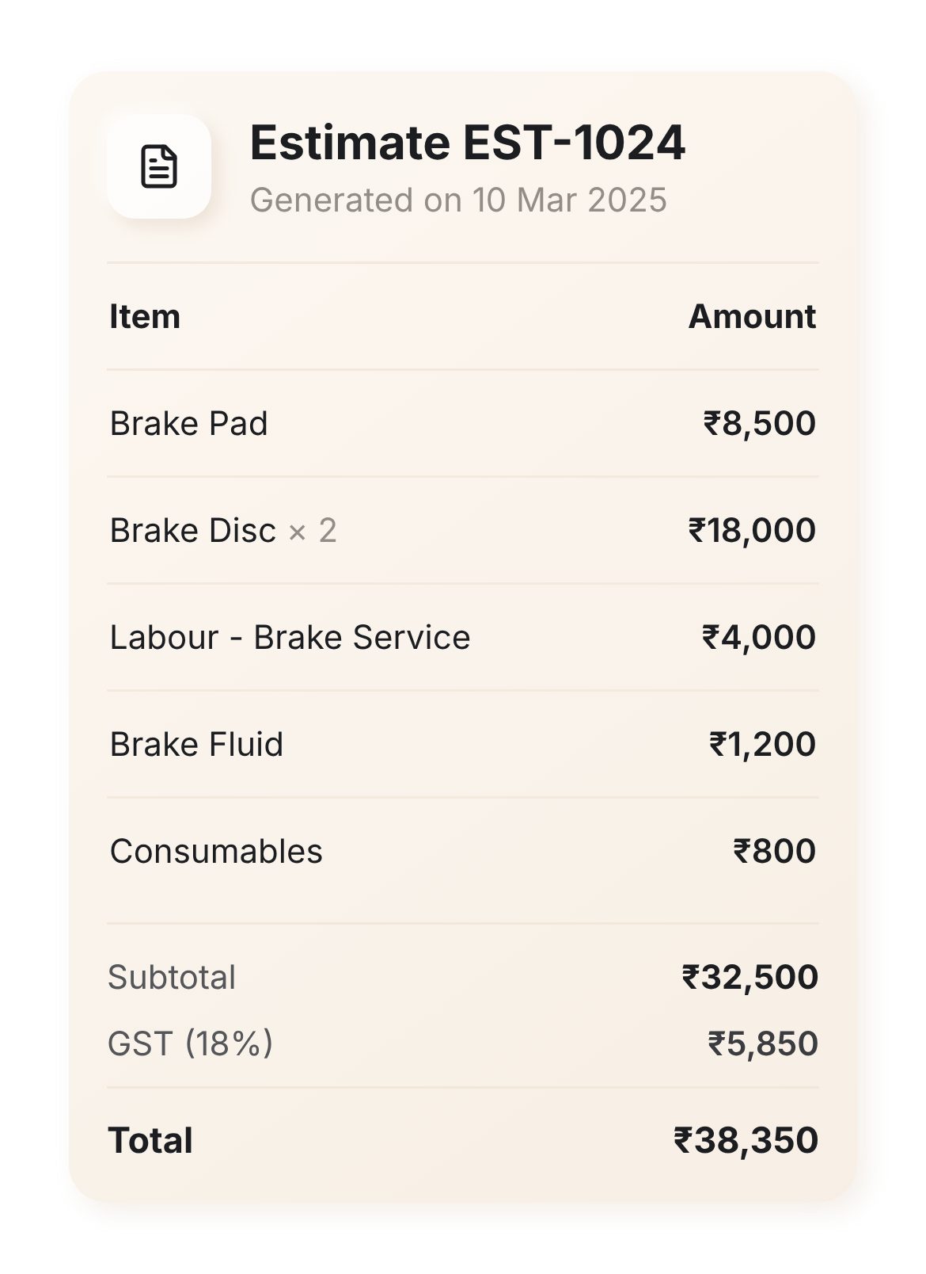
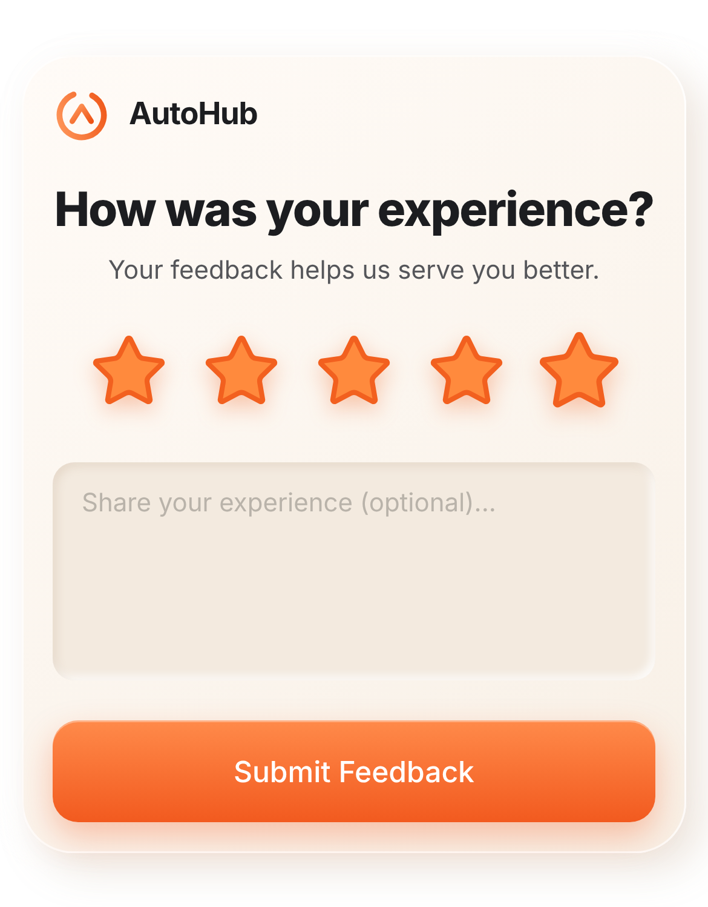
Approve extra work and pay with a tap
Extra work is sent with photos and a clear price
The customer approves from the link
Pay online on delivery day
Then leave a star review
Estimate shown. Review step shown. Demo data.
Notes:
Extra work is sent with photos and price. The customer approves with one tap, pays online and can leave a review.

Slide 9
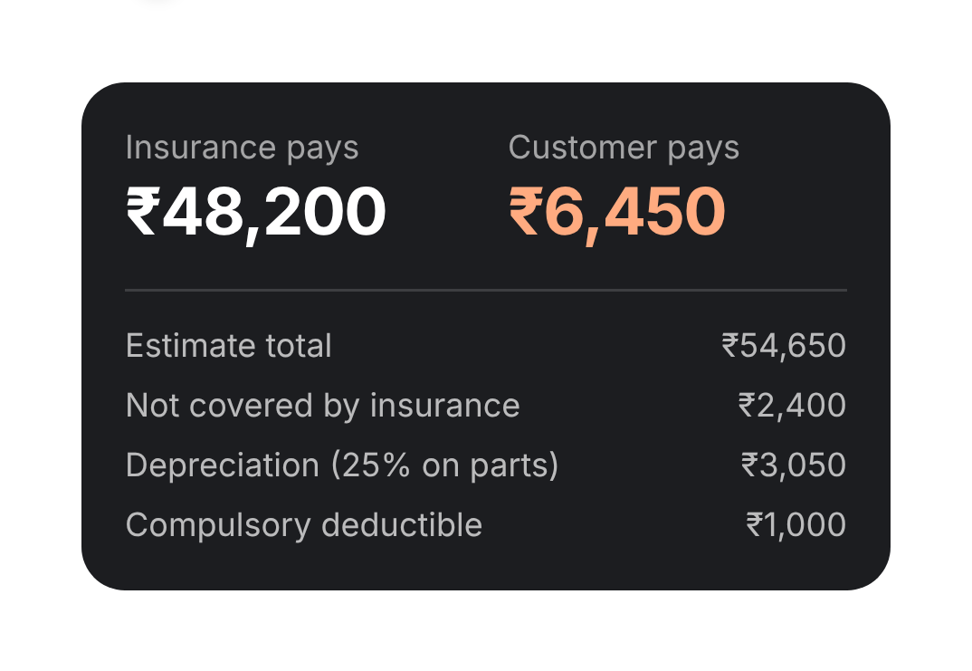
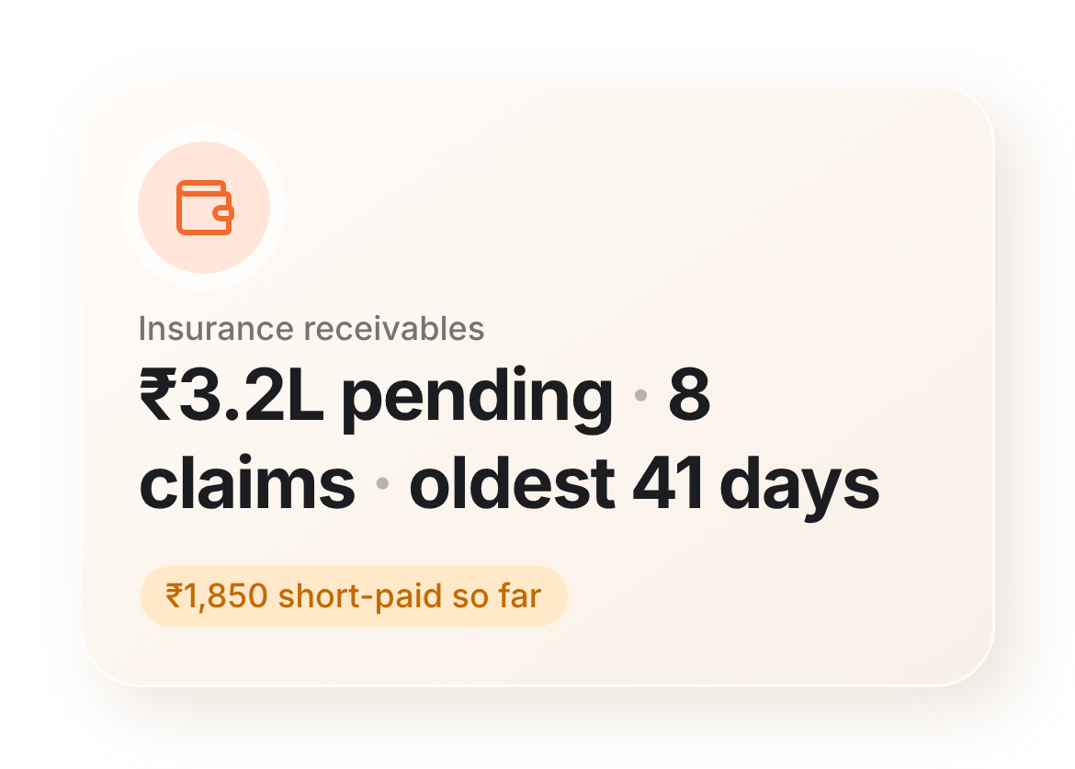
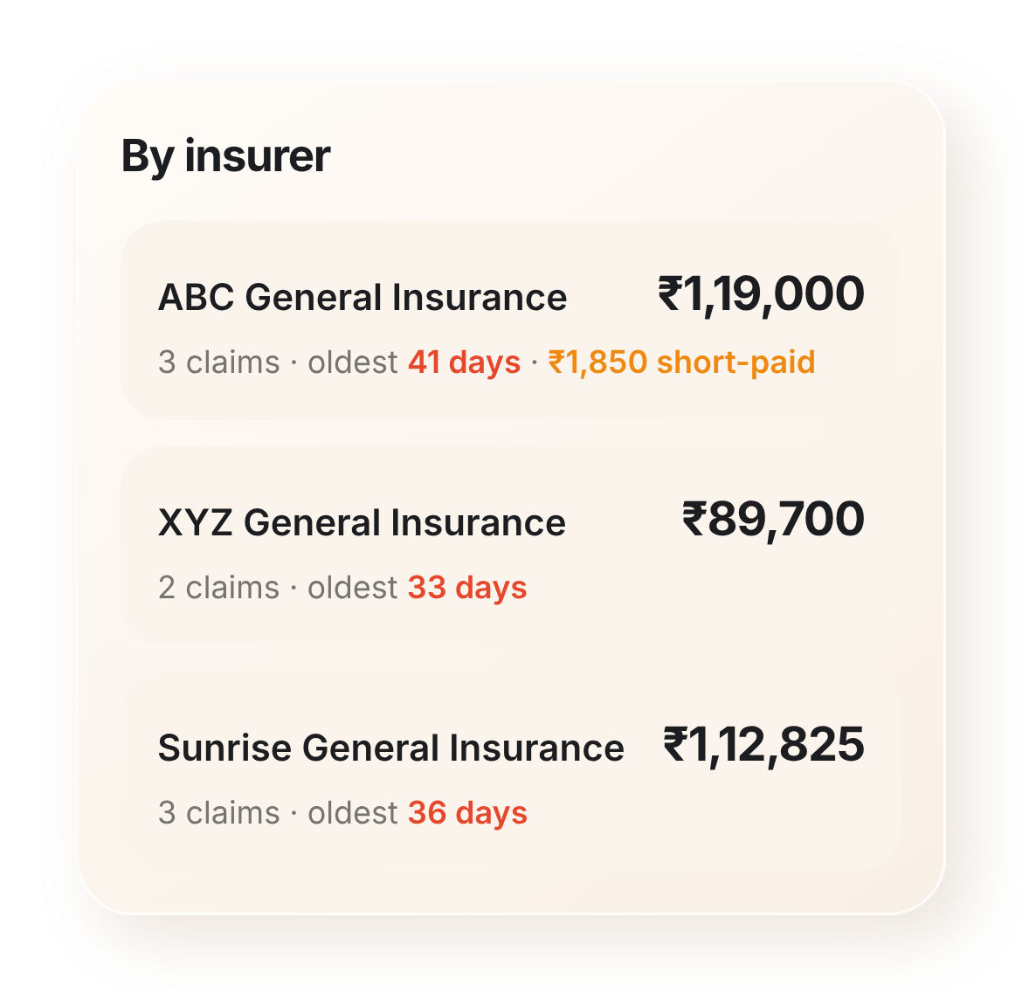
Insurance claims, under control
Checklist for documents and photos
One claim pack to send to the surveyor
A clear split: what the insurer pays and what the customer pays
See what each insurer owes you, and for how long
Demo data shown.
Notes:
For insurance jobs we track documents and photos, prepare the claim pack for the surveyor, split the bill between insurer and customer, and show what each insurer owes.

Slide 10




What you gain
Fewer phone calls
Faster approvals
Customers check status themselves.
One tap on a link instead of a call.
Fewer disputes
Clear insurance money
The car's condition is recorded at check-in.
Know what each insurer owes you.
Also included: calendar, inventory and parts approval, reports, team, customer bookings, and a designer for your workshop layout.
Notes:
The result: fewer calls, faster approvals, fewer disputes and clear insurance money.

Slide 11




How we get you started
1. Walkthrough
2. Set up
3. Train
4. Go live
We show it using your own cars and bays.
Your bays, services and team are added.
A short session for staff and mechanics.
You start running real jobs.
Notes:
Getting started is simple: a walkthrough, setup, training and go-live.

Slide 12
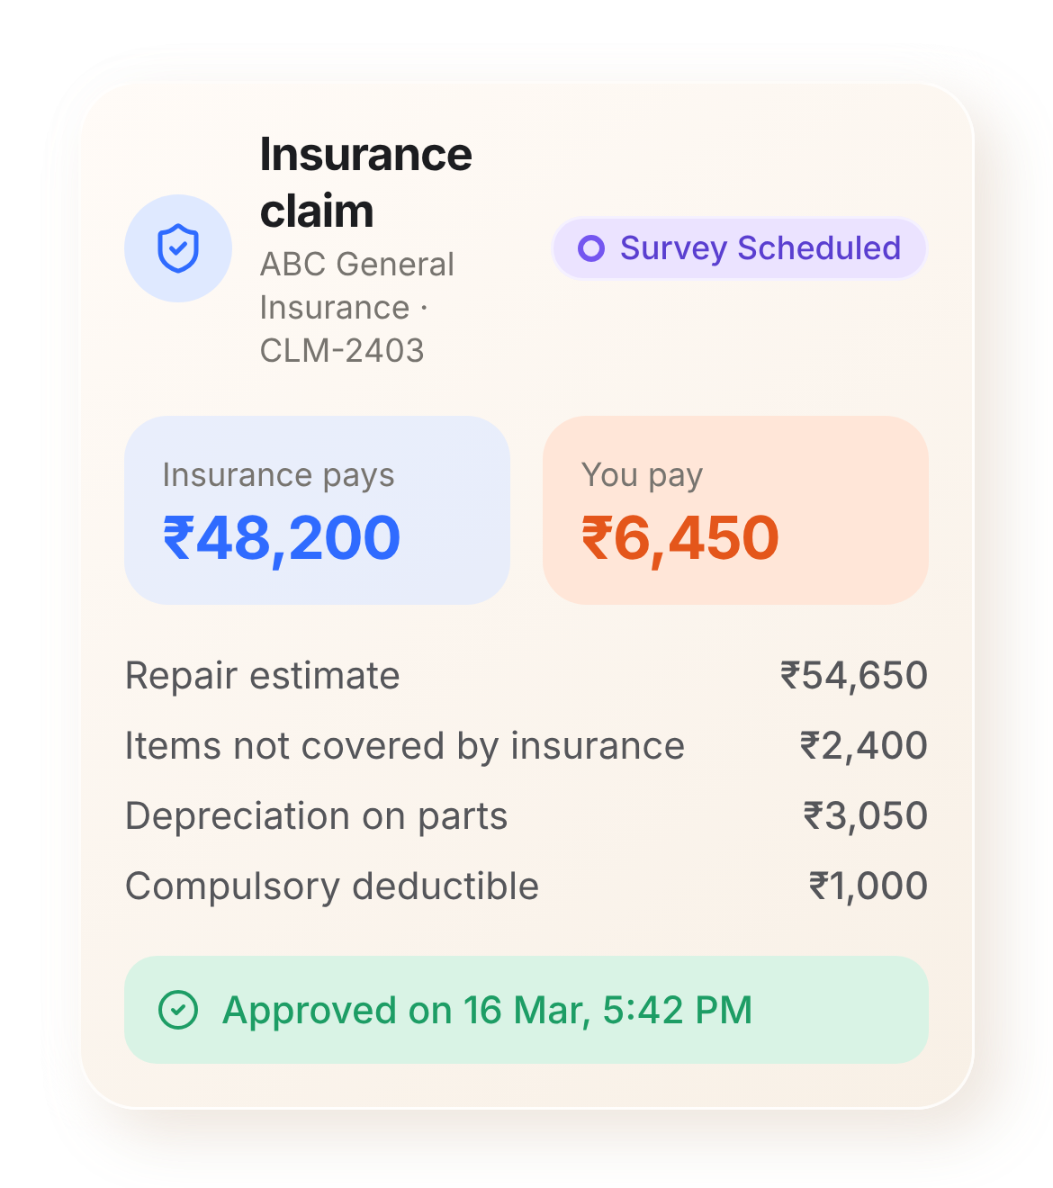
Let's see it on your workshop
Book a short walkthrough. We will use your own cars, bays and team.
Screens in this presentation use demo data.
Notes:
Next step: a short walkthrough using your own workshop.

