Slide 1
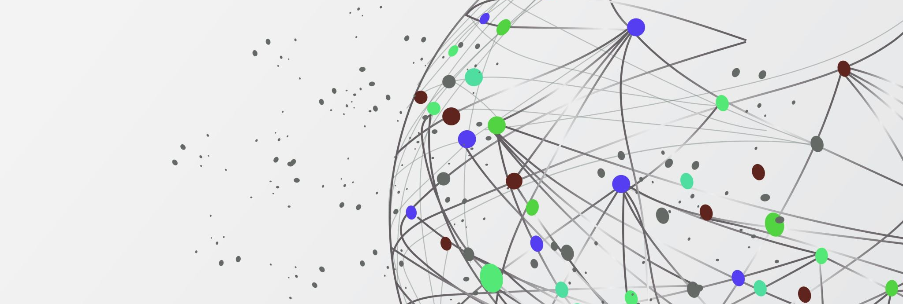
The Power of Pub-Sub: Real-World Use Cases
Exploring messaging patterns in modern applications
Notes:
AI-generated content may be incorrect. ---

Slide 2
Introduction to Pub-Sub Systems
Notes:
Title Slide, What is a Pub-Sub System?

Slide 3

Title Slide
Introduction to Pub-Sub
Pub-Sub is an asynchronous messaging pattern enabling decoupled communication between components in distributed systems.
Significance in Software Architecture
Pub-Sub systems enhance scalability and real-time communication in modern software architectures.
Real-World Applications
Pub-Sub enables versatile use cases such as notifications, event streaming, and data synchronization.
Notes:
The presentation titled 'The Power of Pub-Sub: Real-World Use Cases' introduces the concept of asynchronous messaging patterns. It sets the stage for understanding how publish-subscribe (Pub-Sub) systems operate and their significance in modern software architecture. The title slide serves as a gateway into exploring various real-world applications of Pub-Sub systems, emphasizing their power and versatility in enabling decoupled, scalable, and real-time communication across distributed systems.

Slide 4
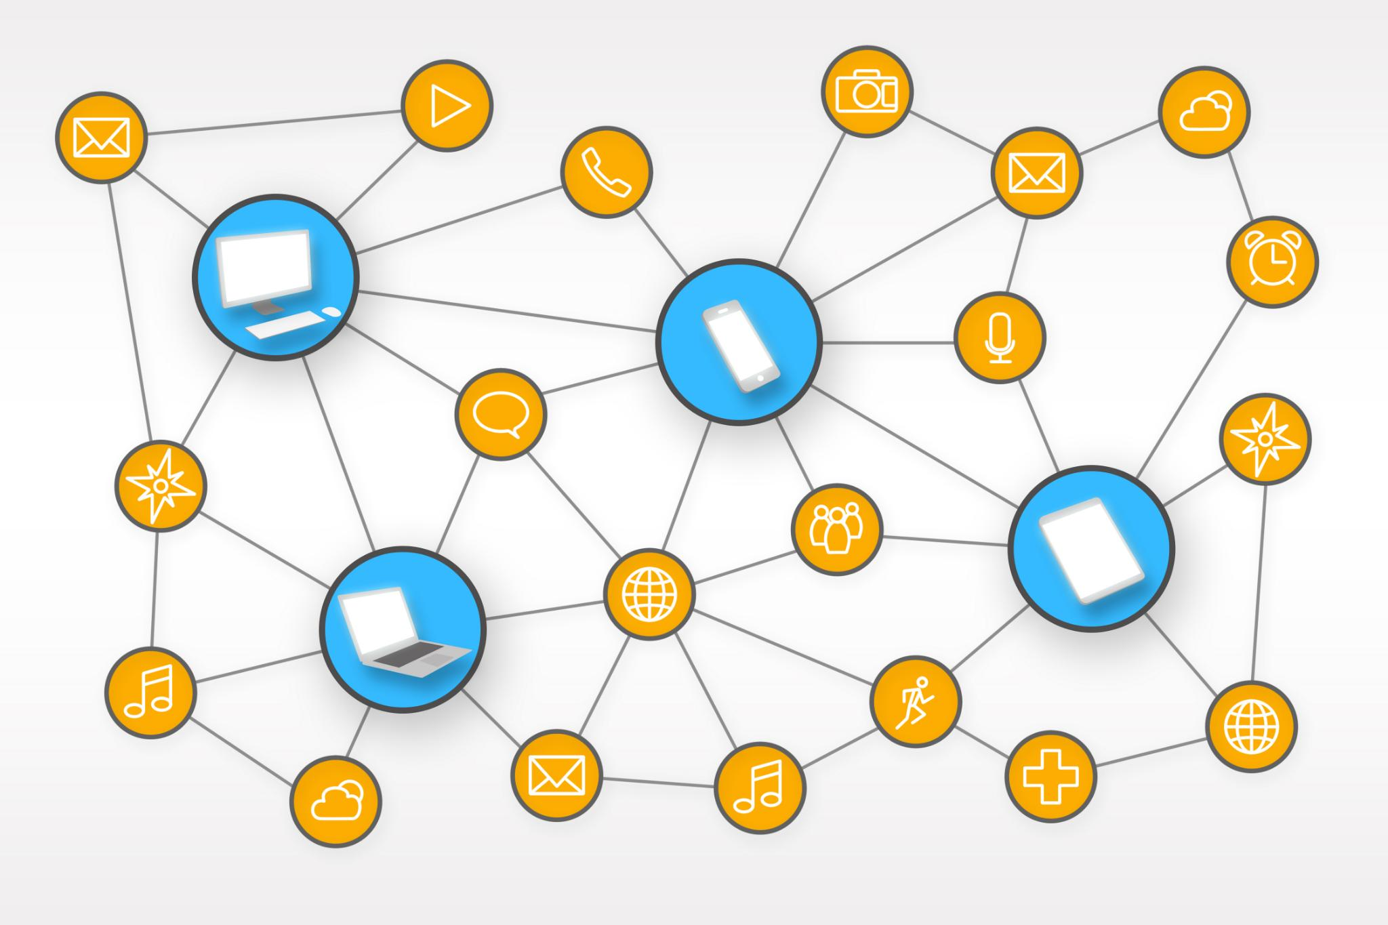
What is a Pub-Sub System?
Decoupled Communication
Publishers and subscribers communicate asynchronously through topics, operating independently without direct connections.
Topic-based Messaging
Messages are published to topics; subscribers receive messages only from topics they subscribe to, enabling selective communication.
Scalability and Flexibility
The system supports adding new subscribers without changing publishers, enhancing scalability, flexibility, and resilience.
Event-driven Foundations
Pub-Sub systems enable event-driven architectures critical for real-time data dissemination and processing applications.
Notes:
A Pub-Sub (Publish-Subscribe) system is a messaging pattern that enables asynchronous communication between different components of a software system. In this architecture, message senders, known as publishers, do not send messages directly to specific receivers. Instead, they publish messages to abstract channels called topics. Subscribers express interest in one or more topics and receive messages that are published to those topics. This model creates a decoupled architecture where publishers and subscribers operate independently, unaware of each other's existence. Such decoupling enhances scalability, as new subscribers can be added without modifying the publisher's code. It also improves flexibility and resilience, allowing different parts of the system to evolve independently. Pub-Sub systems are foundational in building event-driven architectures and are widely used in scenarios requiring real-time data dissemination and processing.

Slide 5
Real-World Use Cases of Pub-Sub
Notes:
Use Case 1: E-commerce & Retail 🛒, Use Case 2: Real-time Data Analytics 📊, Use Case 3: Internet of Things (IoT) 🌐, Use Case 4: Microservices Communication 🔗, Use Case 5: Notifications & Alerts 🔔, Use Case 6: Financial Services 💹

Slide 6
Use Case 1: E-commerce & Retail 🛒
Order Event Publishing
Order Service publishes 'order_placed' events to notify multiple services simultaneously.
Independent Service Operations
Inventory, Notifications, and Shipping services subscribe and act independently on events.
System Extensibility
New services like Fraud Detection can subscribe without changing existing system architecture.
Notes:
In the e-commerce and retail sector, Pub-Sub systems are instrumental in orchestrating complex workflows. Consider a scenario where a customer places an order. The Order Service publishes an 'order_placed' event to a topic. Multiple services subscribe to this event to perform their respective tasks. The Inventory Service updates stock levels, the Notifications Service sends a confirmation email, and the Shipping Service prepares the package for dispatch. This architecture allows each service to operate independently, enhancing modularity and maintainability. A significant advantage is the ease of extending the system; for instance, a new Fraud Detection Service can subscribe to the same event without requiring changes to the existing services. This flexibility makes Pub-Sub systems ideal for dynamic and scalable e-commerce environments.

Slide 7

Use Case 2: Real-time Data Analytics 📊
Event Publishing in Pub-Sub
User actions like play, pause, and search are published as events to specific data topics in real-time.
Parallel Data Consumption
Multiple subscribers consume the same data stream for various purposes such as recommendations and analytics.
Decoupled System Architecture
Pub-Sub enables independent evolution of analytics components without disrupting workflows.
Notes:
Real-time data analytics is another domain where Pub-Sub systems shine. Take the example of Netflix analyzing viewer activity. User actions such as play, pause, and search are published as events to specific topics. These events are then consumed by multiple subscribers. A Recommendation Engine uses the data to personalize content in real-time, while an Analytics Service calculates popularity metrics. This setup allows for parallel processing of the same data stream for different purposes, enhancing efficiency and responsiveness. The decoupled nature of Pub-Sub ensures that each analytical component can evolve independently, and new analytics modules can be added without disrupting existing workflows. This capability is crucial for platforms that rely on timely insights to drive user engagement and operational decisions.

Slide 8

Use Case 3: Internet of Things (IoT) 🌐
Pub-Sub Architecture
Pub-Sub systems enable efficient data distribution from smart sensors to multiple subscribers in IoT networks.
Real-Time Monitoring
Temperature sensors publish live data used by dashboards and alert systems for instant operational insights.
Scalable Connectivity
The IoT setup supports thousands of devices interacting simultaneously through reliable fan-out communication.
Data Archiving and Analysis
Collected sensor data is archived for future analysis to improve operational efficiency and safety.
Notes:
In the Internet of Things (IoT) landscape, Pub-Sub systems are essential for managing vast networks of connected devices. Imagine a factory equipped with smart sensors that monitor temperature. Each sensor publishes its readings to a topic, such as 'sensors/foundry-1/temperature'. Various subscribers then consume this data. A monitoring dashboard displays live temperatures, an alerting system triggers alarms if thresholds are exceeded, and a data-logging service archives the readings for future analysis. This architecture supports immense scalability, allowing thousands of sensors and applications to interact seamlessly. The fan-out capability of Pub-Sub ensures that a single data source can serve multiple consumers reliably. This model is particularly effective in industrial settings where real-time monitoring and responsiveness are critical for operational efficiency and safety.

Slide 9
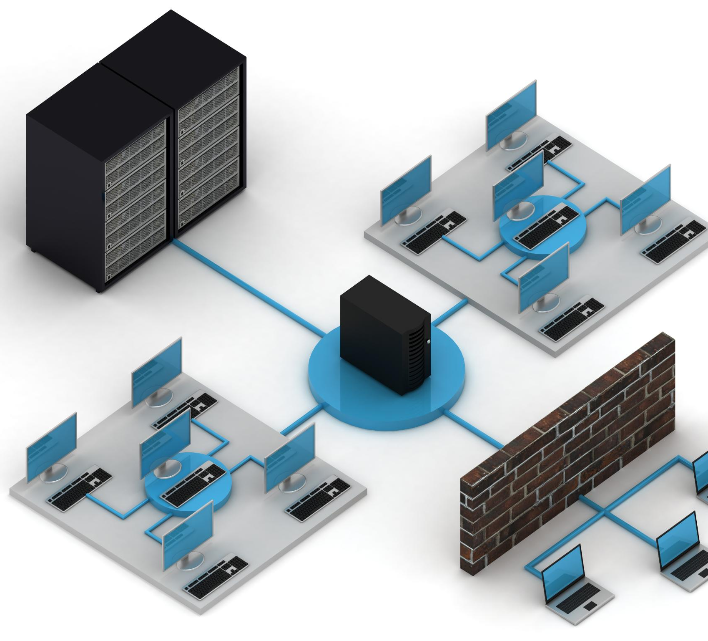
Use Case 4: Microservices Communication 🔗
Pub-Sub in Microservices
Pub-Sub systems enable efficient inter-service communication by decoupling services in microservices architectures.
User Created Event Flow
When a new user signs up, User Service publishes a 'user_created' event consumed by Email and Profile Services.
Resilience and Decoupling
Services remain independent and resilient, allowing operations despite temporary service unavailability.
Notes:
Microservices architectures benefit greatly from Pub-Sub systems, which serve as the backbone for inter-service communication. Consider a scenario where a new user signs up for an application. The User Service publishes a 'user_created' event. This event is consumed by the Email Service to send a welcome email and by the Profile Service to create a blank user profile. The decoupled nature of this setup ensures that services remain independent and can function even if others are temporarily unavailable. For example, if the Email Service is down, the user can still sign up, and the message will be processed once the service is back online. This resilience and flexibility are key advantages of using Pub-Sub in microservices, enabling robust and scalable system design.

Slide 10
Use Case 5: Notifications & Alerts 🔔
Real-Time Notification Delivery
Pub-Sub systems enable instant notifications across devices by publishing messages to user-specific topics.
Multi-Endpoint Support
Notifications are delivered simultaneously to phones, web browsers, and tablets, ensuring consistent user experience.
Scalability for High Traffic
The system can handle millions of concurrent notifications, suitable for busy social platforms and communication services.
Notes:
Pub-Sub systems are highly effective for delivering notifications and alerts in real-time. For instance, when a user receives a new 'like' on a social media post, the backend publishes a message to a topic specific to that user, such as 'notifications/user-123'. The user's mobile app and web browser, which are subscribed to this topic, immediately display the notification. This mechanism ensures instant delivery of information across multiple endpoints, including phones, web browsers, and tablets. The ability to push updates in real-time enhances user engagement and satisfaction. Moreover, the system's scalability allows it to handle millions of such notifications concurrently, making it ideal for high-traffic social platforms and communication services.

Slide 11

Use Case 6: Financial Services 💹
Real-Time Market Data Distribution
Pub-Sub systems enable instant delivery of stock price updates to multiple subscribers simultaneously.
Low Latency & High Throughput
These systems ensure minimal delays and high data volumes for critical financial decisions.
Wide Subscriber Base
Thousands of trading terminals, analytics tools, and bots subscribe to real-time financial topics.
Critical Decision Support
Reliable data distribution supports traders in making timely and informed decisions.
Notes:
In financial services, Pub-Sub systems are crucial for distributing high-speed market data. A typical scenario involves a data feed provider publishing stock price updates to topics like 'stocks/NASDAQ/GOOG'. Thousands of trading terminals, analytical systems, and automated bots subscribe to these topics to receive updates the moment they are available. This setup ensures low-latency, high-throughput performance, which is essential for time-sensitive financial applications. Traders rely on real-time data to make informed decisions, and any delay can result in significant financial loss. Pub-Sub systems provide the necessary infrastructure to support such demanding requirements, enabling reliable and efficient dissemination of critical market information.

Slide 12
Conclusion and Discussion
Notes:
Summary, Q&A

Slide 13
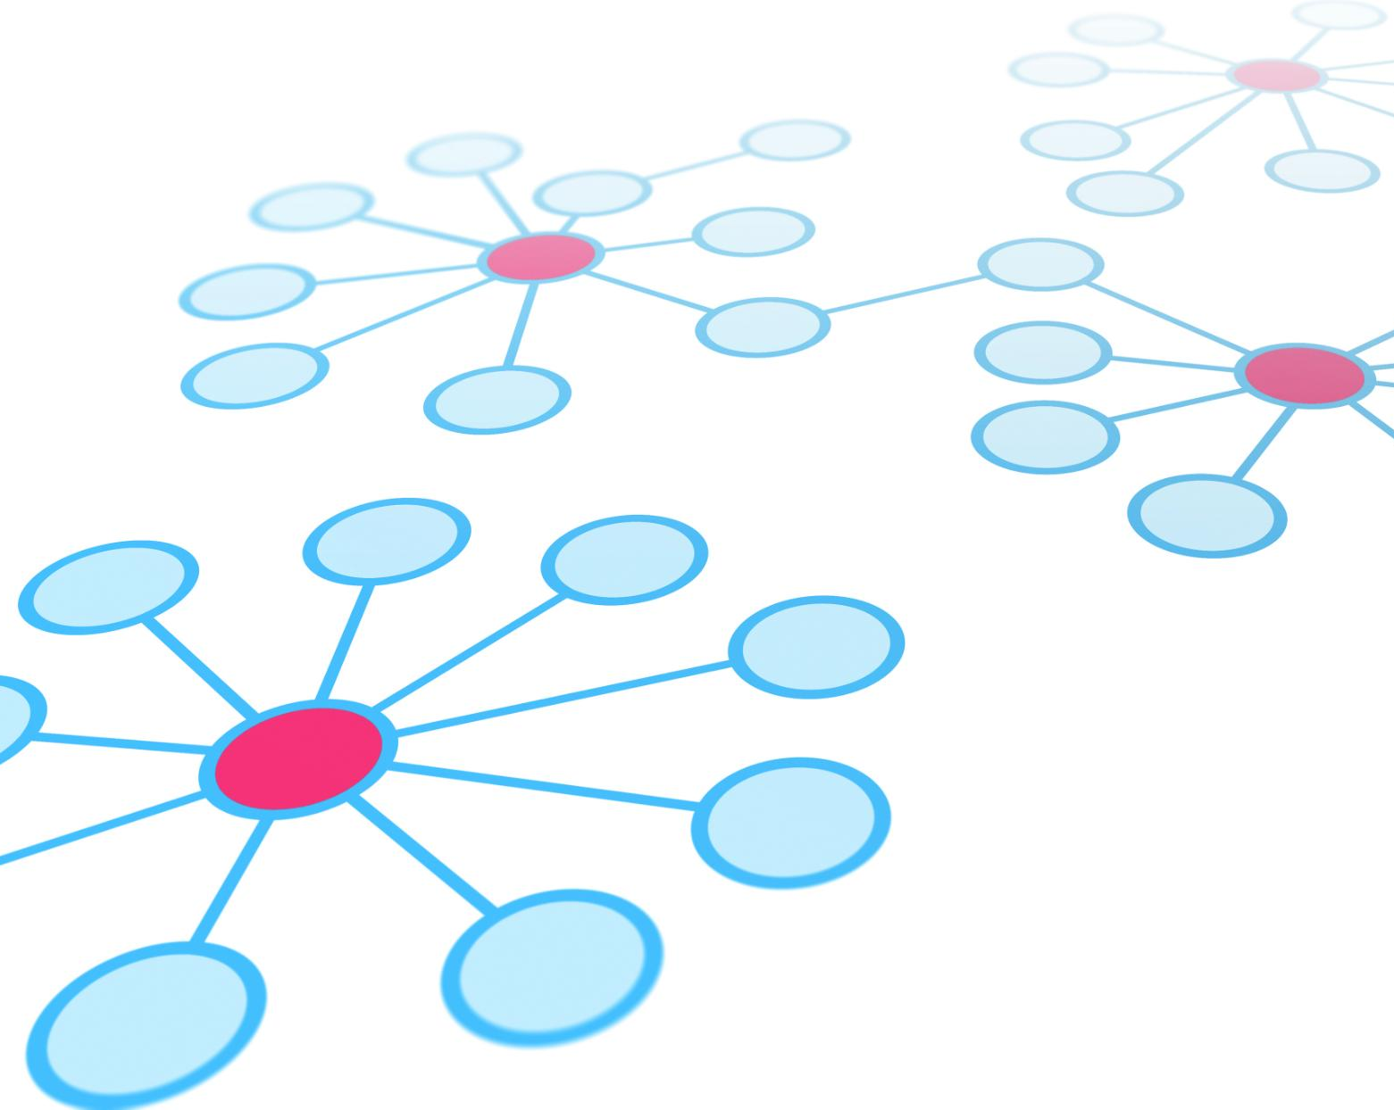
Summary
Decoupling of Components
Pub-Sub systems fully decouple publishers and subscribers for independent operations without mutual awareness.
Scalability and Flexibility
The architecture easily scales by adding publishers or subscribers and supports flexible component evolution.
Resilience and Fault Isolation
Failures in one component do not cascade, ensuring resilience and continuous system operation.
Real-time Asynchronous Communication
Supports event-driven workflows enabling highly responsive, real-time communication between components.
Notes:
Pub-Sub systems offer numerous advantages that make them indispensable in modern software architectures. They enable complete decoupling between publishers and subscribers, allowing each to operate independently without knowledge of the other. This decoupling facilitates scalability, as new publishers or subscribers can be added seamlessly to handle increased load. The architecture also supports flexibility and resilience; different components can evolve independently, and failures in one part do not cascade through the system. Additionally, Pub-Sub systems enable real-time communication, supporting asynchronous, event-driven workflows that are highly responsive. These benefits make Pub-Sub a powerful pattern for building robust, scalable, and maintainable systems across various domains.

Slide 14

Q&A
Encouraging Audience Interaction
The Q&A session invites the audience to ask questions and participate actively in the discussion.
Clarifying Concepts
This session helps clarify doubts and deepen understanding of the presented Pub-Sub concepts and use cases.
Reinforcing Key Takeaways
Dialogue during Q&A reinforces the main points and provides real-world insights from discussion.
Notes:
This slide invites the audience to ask questions and engage in a discussion about the concepts and use cases presented. It provides an opportunity to clarify doubts, explore additional scenarios, and deepen understanding of Pub-Sub systems. The Q&A session is a crucial part of the presentation, fostering interaction and reinforcing the key takeaways through dialogue and real-world insights.

