Slide 1
E-Commerce
SHOPPIUSPIUS
ELISON ELECTRONICS
J. Rushwanth yadav

Slide 2
Brief History
Early 1970s saw introduction of Electronic Fund Transfers (EFT)
  Limited to large organisations, financial institutions, few daring small business
Late 1970s and early 1980s – Electronic data interchange(EDI)for e-commerce within companies
  Used by businesses to transmit data from one business to another
  to include other transaction processes besides financial; included manufacturers, retailers, services, etc
1990s- the World Wide Web on the Internet provides easy to use technology for information publishing and dissemination
  Cheaper to do business (economics of scale)
  Enable diverse business activities (economics of scope)
Between 1997 and 2000, more than 12000 Internet-related business were
started

Slide 3
Topics to be covered
Abstract
What is e-commerce
Types of e-commerce
Advantages
Disadvantages
Infrastructure
Modules and Algorithms
Issues
Impact of e-commerce
Conclusion
Reference

Slide 4
ABSTRACT
ShopPlusPlus is a comprehensive e-commerce platform designed to provide an efficient, user-friendly online shopping experience. Developed using Java, the platform offers essential features such as user account management, product browsing, wishlist creation, shopping cart functionality, and order history tracking. The system utilizes basic algorithms like CRUD operations, sorting, filtering, and session management to ensure seamless functionality and user interaction. Designed with scalability and flexibility in mind, ShopPlusPlus addresses the common challenges of existing platforms by offering enhanced performance, data security, and easy navigation. Future improvements, such as AI-driven recommendations, could further elevate the platform's capabilities. This documentation outlines the system's architecture, implementation, and testing process, showcasing its potential as a scalable solution for modern e-commerce needs.

Slide 5
What is e-commerce?
"The conducting of commercial transactions (the exchange of merchandise, services, information, and/or money between suppliers and receivers for the commercial transfer of goods between economic actors) through electronic mediation using Internet technology."
  -Ministry of International Trade and Industry of Japan

Slide 6
What is e-commerce?
"Electronic commerce (e-commerce) is business transactions conducted over the public and private computer networks. It is based on the electronic processing and transmission of data, text, sound and video. E-commerce includes transactions within a global information economy such as electronic trading of goods and services, on-line delivery of digital content, electronic fund transfers, electronic share trading, electronic bills of lading, commercial auctions, collaborative design and engineering, on-line sourcing, public procurement, direct consumer marketing and after-sales services. It involves the application of multimedia technologies in the automation and re-design of transactions and workflows, aimed at increasing business competitiveness."
- Inter-Agency Task Force on Electronic Commerce (IATFEC), Malaysia

Slide 7
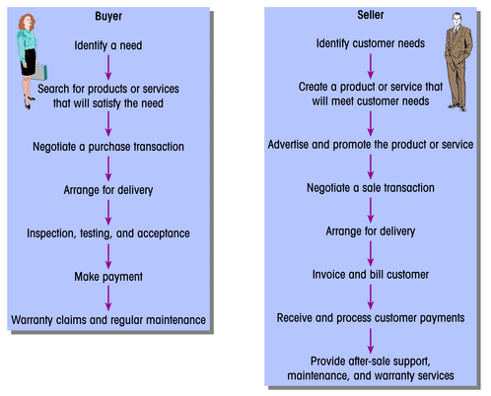
Buyer and Seller Roles In Commerce

Slide 8
Communication on the Web
Mass media:
  One-to-many model
  Flows from one advertiser to many customers
  Seller is active, buyer is passive
Personal contact:
  One-to-one model
  Interchange within a framework of trust
  Seller and buyer are active

Slide 9
Communication on the Web (cont.)
Web:
  Many-to-one/many-to-many model
  Buyers can communicate with many sellers
  Buyer actively searches, and controls the length, depth and scope of the search

Slide 10
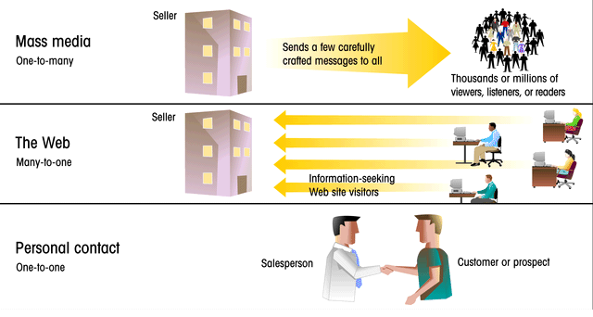
Communication Channels

Slide 11
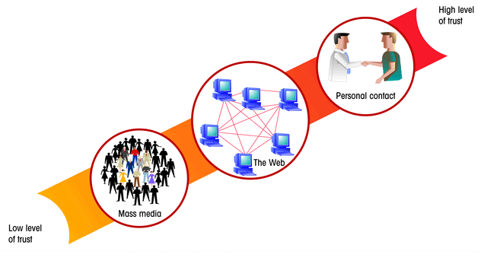
Levels of Trust

Slide 12
Types of e-commerce
2 types of e-commerce:
  B2C
  B2B
  B2G (business to government)

Slide 13
B2C
B2C means e-commerce transactions between business and consumer
Commerce between companies and consumers
Involve customer gathering information; purchasing physical goods (tangible such as books or consumer products) or information goods (goods of electronic material or digitised contents such as software or e-books
2nd largest and earliest form of e-commerce
Example of B2C business:
  Retailing business: Amazon.com, pizzahut.com,
  Information goods: cuticuti.com,
With the use of online banking tools (example: Maybank2u)

Slide 14
B2B means e-commerce transactions between business and business:
  E-commerce between companies
    Example: IBM, HP, Dell
B2G means e-commerce between companies and public sector:
  involves borderless transactions.
  Internet for public procurement,
  Example: myeg.com.my, e-tender by JKR, licensing procedures and other government related operation

Slide 15
Advantage/benefit to business
Wide base for customers – internationally; geographically scattered; areas
not previously reached
Identify new suppliers and business partners
Ability to create highly specialised businesses
Lower communication costs
Buyers have wide range of choices of vendors and products
Availability 24/7
Competitive market causes decrease in prices, discounts or “freebies” thrown in
Customers receive relevant and detailed information in seconds, as opposed to days or weeks
Allows individuals to work from home, do less travel

Slide 16
Disadvantage to business
Some businesses processes may not work using e-commerce
Perishable goods
Difficult to calculate return-on-investment (ROI)
Potential cultural and legal obstacles
Legal environment still unclear and have conflicting laws
No “touch-and-feel” aspect
Loss of ability to inspect products from remote locations

Slide 17
E-commerce infrastructure
Information superhighway infrastructure:
  Internet, LAN, WAN, routers, etc
  Telecom, cable TV, wireless, etc
Messaging and information distribution infrastructure:
  HTML, XML, email, HTP, etc
Common business infrastructure:
  Security, authentication, electronic payment, directories catalogs, etc
Web architecture:
  Client/server model
  N-tier architecture; e.g. web servers, application servers, database servers, scalabilty

Slide 18
Modules
Cart module
Product management module
Wishlist module
Admin management module
Algorithms
Hashmap
CAUD operations
Encryption algorithms

Slide 19
The process of e-commerce
Attract customers:
  Advertising, marketing
Internet with customers:
  Catalog, negotiation
Handle and manage orders:
  Order capture
  Payment
  Transaction
  Fulfillment (physical good, service good, digital good)
React to customer inquiries:
  Customers service
  Order tracking

Slide 20
Trust Issues
How do I know who you say you are?
How can I guarantee that you will supply me with the products you offer within the timeframe you gave?
Established companies, especially those with offline presence, have easy time creating trust on the Web
New companies face difficulties due to anonymity that exists
Visitors won’t just buy from anyone, especially if they have never heard of the company before

Slide 21
Culture Issues
Common language and common customs provide an easier time for consumers to determine how companies will react in situations of misrepresentation of quality, etc
Laws and business practices vary between countries
Wine.com (not suitable for Muslim culture)
Use of icons and terms to depict common actions
Shopping carts used in US; shopping baskets used in Europe; shopping trolleys used in Australia
The OK symbol seen as an obscene gesture in some countries

Slide 22
Culture and Government
Government controls that limit forms of open online discussions
Some officials in North African and Middle East take public issue with the availability of sexually explicit, anti-Islamic content on the Web

Slide 23
Infrastructure Issues
Local connection costs in developing countries high; some countries required payment for time spent online
  This could lead to people spending less time online
  Introduction of flat-rate access required
  Check Tmnet promotion, W1max, Celcom and Maxis broadband
More than half of businesses on web turn away international orders as do not have capacity or processes in place to fill them

Slide 24
Obstacle, problems and issue faced by companies in engaging e-commerce
Lack of awareness and understanding of the value of e-commerce
  Many thinks that e-commerce suited only for big companies
  Additional cost that will not bring any major returns to investment
Financial cost
  Initial investment to adopt new technology is proportionately heavier for small than for large firm
  Firms will need to undertake investment in an appropriate computer system to implement e-commerce.
  High cost of computer and internet access
Infrastructure
  Many developing countries has poor telecommunication infrastructuren
Security
  Ensuring security on payment and privacy of online transaction
  Lack of trust to use internet to make online payment

Slide 25
Impact of e-commerce
e-commerce will eliminate mediation process as producers can sell direct to consumers.
firms will have fast knowledge of what customers want.
Firms can use this knowledge to guide the development of their product lines and to identify new growth areas at their earlier stages.
e-commerce will also help small- and medium-sized enterprises (SMIs) to gain greater market reach for their products and services.
With a wider choice of products and services offered to them, they can cast their preferences by describing what they want.
In this environment, e-commerce will hasten the shift of market power of consumers, from a "product taker" to a "product maker".

Slide 26
Impact of e-commerce
In fact, e-commerce can be an efficient and economical way for many SMIs to enter an export market.
E-commerce offers consumers a wide range of new opportunities to do direct shopping and banking using the convenience of a home computer or other communication devices.
Consumers will also benefit in terms of lower final prices due to lower transaction costs as described above.
e-commerce consumers will have a wider and direct access to producers of goods and services without intermediaries.
As a result, this process will lead to greater competition among firms to protect their market share.
e-commerce will result in higher investment by the Government, firms and consumers.

Slide 27
conclusion
ShopPlusPlus is a comprehensive e-commerce platform designed for scalability, security, and ease of use. Built with Java, it efficiently integrates essential features like user management, product browsing, wishlists, shopping carts, and order tracking. The system addresses limitations in existing platforms by offering a seamless user experience and robust performance. Its modular architecture allows for future expansions, such as AI-driven product recommendations and multilingual support, ensuring adaptability to the growing demands of online commerce. ShopPlusPlus is a flexible solution poised for continued improvement and success in the competitive e-commerce landscape.

Slide 28
Reference
Designing Data-Intensive Applications by Martin Kleppmann (2017). O'Reilly Media.
A comprehensive guide on designing scalable, fault-tolerant systems, which is crucial for understanding how to build platforms like ShopPlusPlus.
Effective Java by Joshua Bloch (2018). Addison-Wesley.
one of the best resources for mastering Java, covering best practices and patterns that can be applied in ShopPlusPlus development.

Slide 29
Thank you

