Slide 1
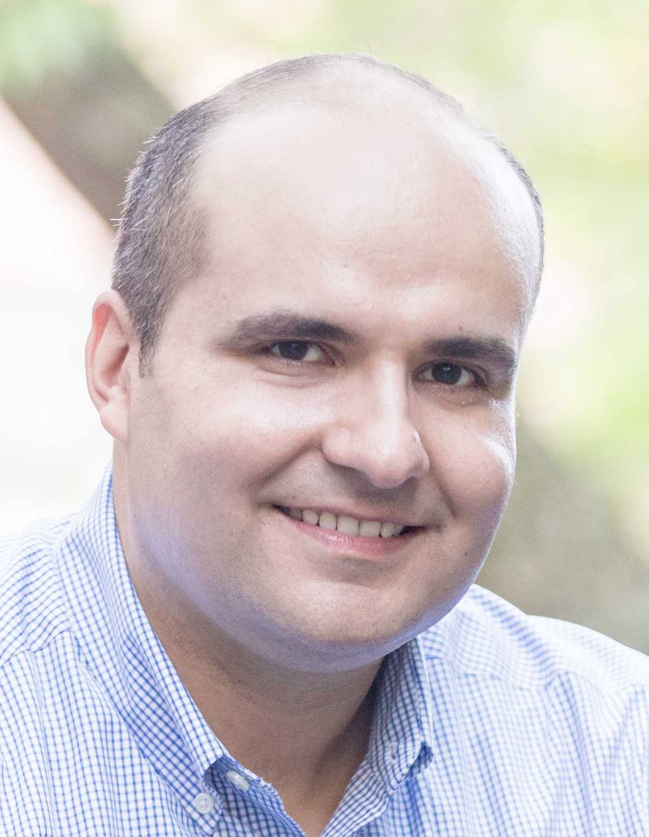
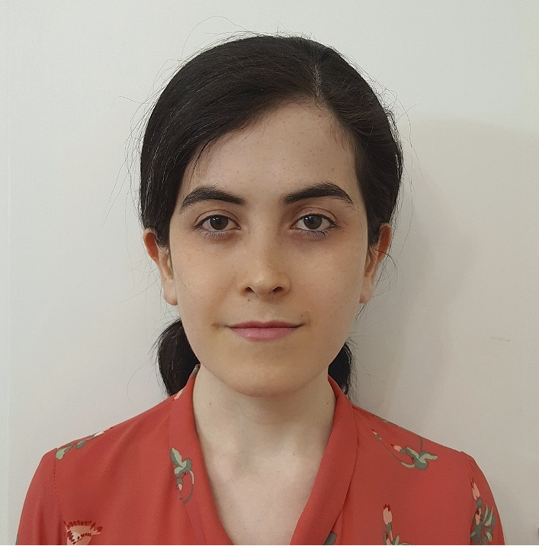
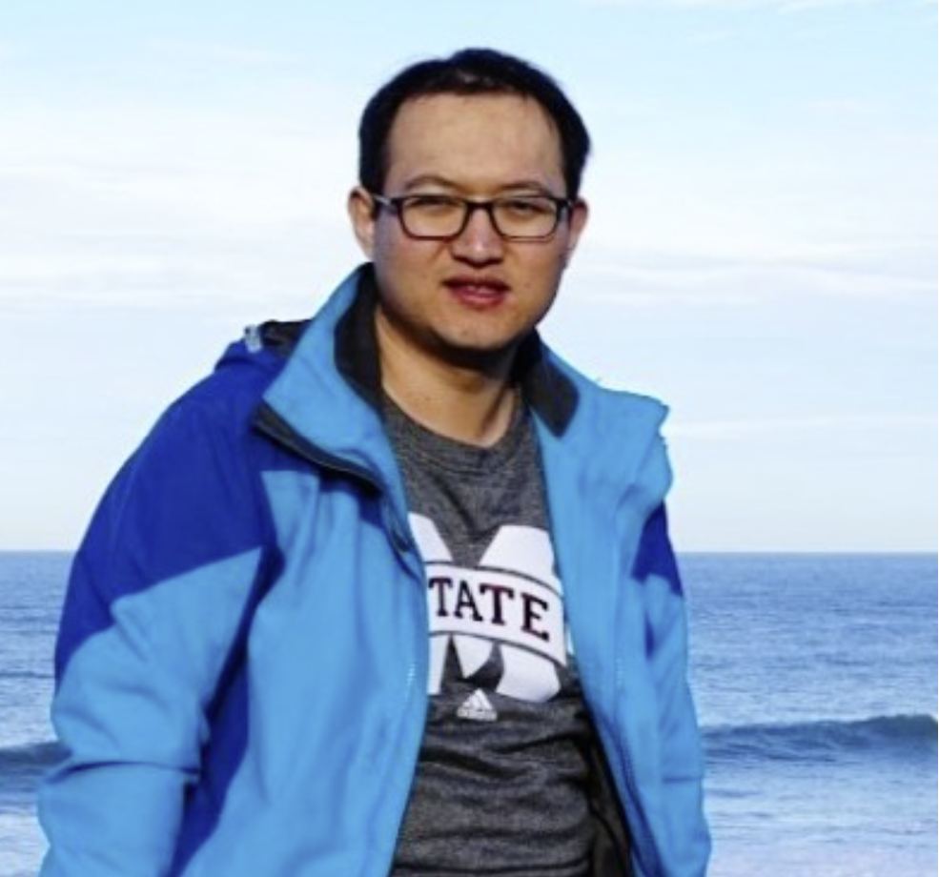

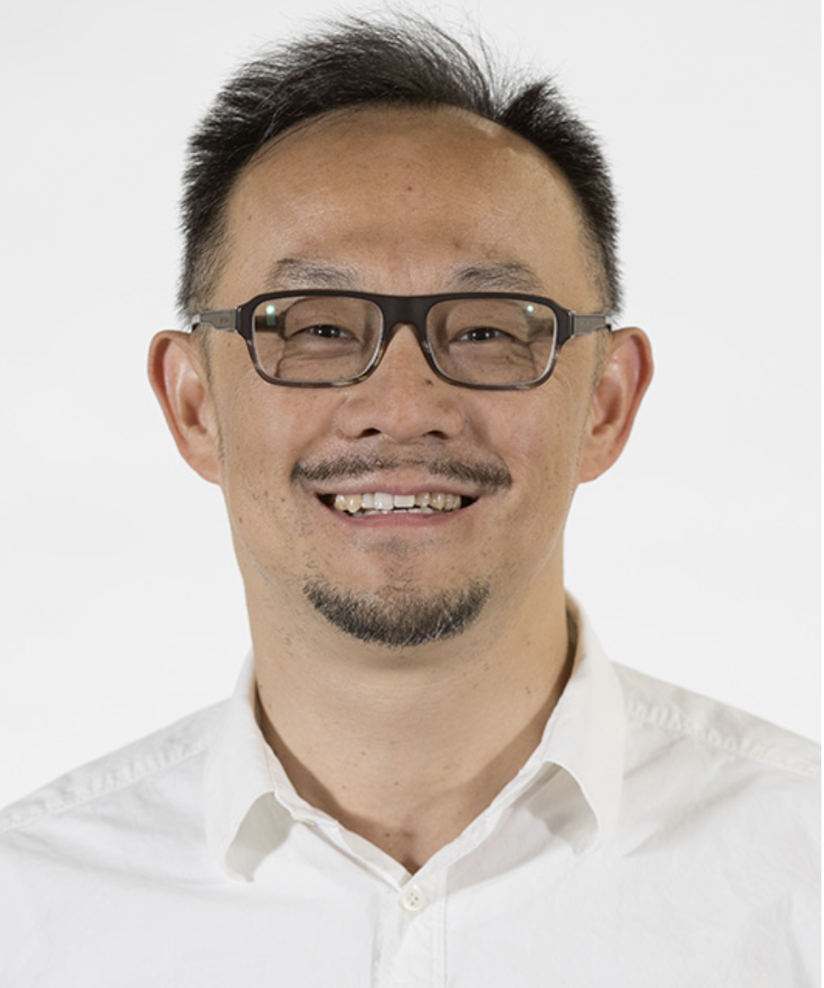
Benchmark and Neural Architecture for Conversational Entity Retrieval from a Knowledge Graph
Alexander Kotov
Associate Professor
Director of Textual Data Analytics (TEANA) lab
Department of Computer Science
Wayne State University, USA
joint work with Mona Zamiri, Yao Qiang,
Fedor Nikolaev and Dongxiao Zhu
Notes:
Hello, I am Alexander Kotov. I am the director of the Textual Data Analytics laboratory and I would like to introduce to you our WWW 2024 paper which is a joint work with students and other faculty from the Department of Computer Science at Wayne State University.

Slide 2
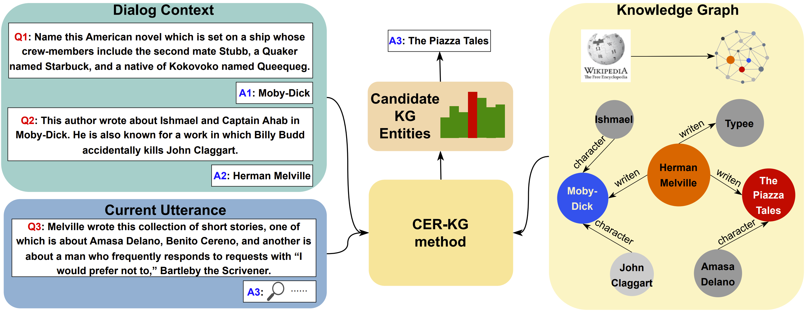
New Problem
Conversational Entity Retrieval from a Knowledge Graph (CER-KG) is an IR task that focuses on retrieving an entity from a KG in response to a free-form query that relies on the dialog context, such as preceding answers
Notes:
In this paper, we introduce a new problem of CER-KG, which focuses on retrieving an entity from a KG in response to a free-form query that relies on the dialog context, such as preceding answers. Here we can see an example of an information-seeking dialog, in which the answers are entities retrieved from a KG.

Slide 3
Differences between CER-KG and CQA-KG
Conversational ER from a KG
Conversational QA from a KG
Utterances: long, manually written, trivia-style queries with multiple entity mentions
Utterances: short, automatically constructed questions with one or two entity mentions
Answers: KG entity (always present in a KG)
Answers: entity(ies), numbers, no answer (may not be present in a KG)
Task: sequence of interrelated rounds of candidate KG entity retrieval and ranking
Task: sequence of interrelated inference and reasoning procedures over a KG subset
Key challenges: identification of a comprehensive set of candidate answer entities and their precise ranking
Key challenges: multi-hop traversal of a KG or performing reasoning, comparison, counting or set operations
Notes:
We envision that the methods for CER-KG (full) will complement the methods for CQA-KG (full) in addressing different types of information needs in real-life information-seeking conversations. In fact, there are several important differences between the two tasks. The utterances in our proposed benchmark for CER-KG are long, manually written, trivia-style queries with multiple entity mentions. In contrast, the utterances in most benchmarks for CQA-KG are short, automatically constructed questions with one or two entity mentions. Consequently, the two tasks present orthogonal challenges for researchers.

Slide 4
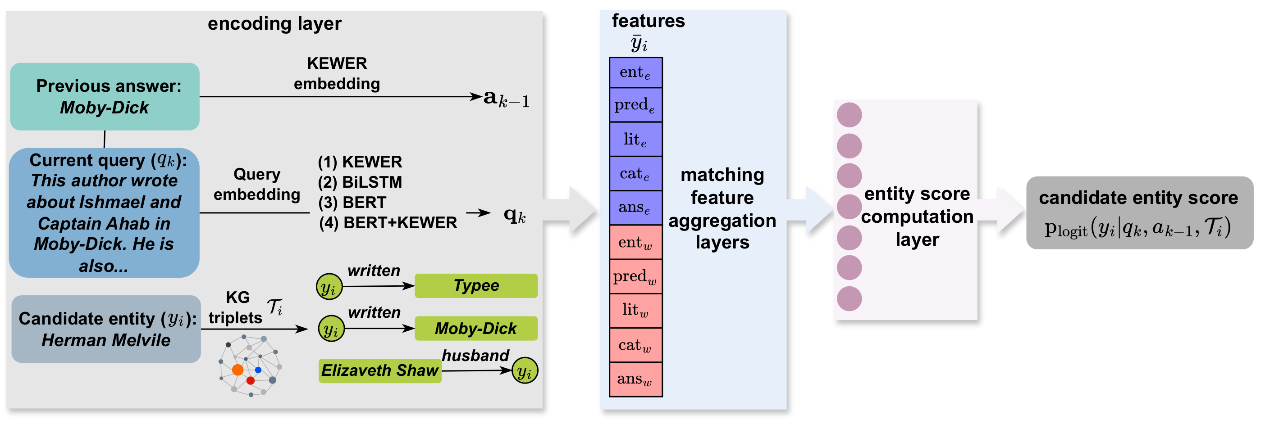
Solution
Neural Architecture for Conversational Entity Retrieval (NACER) - feature-based neural architecture using diverse relevance signals to rank the candidate KG entities for each dialog turn
Notes:
As an initial solution to CER-KG, we propose NACER, a neural architecture for point-wise learning-to-rank of candidate answer entities. It consists of three layers:
an encoding layer
matching feature aggregation layers, which aggregate the relevance signals captured by various semantic and lexical matching features
and candidate entity score computation layer

Slide 5
Key findings
NACER outperformed BM25F (with original and fine-tuned weights) adapted to the conversational IR scenario and key-value memory networks
CER-KG proved to be a challenging task for a Transformer-based auto-regressive answer entity generation model (GENRE) and in-context learning with a foundation LLM (LLaMa-2)
Effective methods for CER-KG should identify, capture, and combine diverse lexical and semantic matching signals in the answer entity’s KG neighborhood
Notes:
Our experimental results led to several key findings. First, NACER outperformed established IR baselines based entirely on lexical matching, such as BM25F, and key-value memory networks. We also found out that CER-KG proved to be a challenging task auto-regressive answer entity generation models and in-context learning with foundational LLMs. Lastly, our results indicate that effective methods for CER-KG should identify, capture, and combine diverse lexical and semantic matching signals in the answer entity’s KG neighborhood. In summary, CER-KG is an interesting new task, which you can study in your future work.

