Slide 1

Predicting the Outcome of Patient-Provider Communication Sequences using Recurrent Neural Networks and Probabilistic Models
S38: Predictive Modeling for Clinical Outcomes and Beyond
Mehedi Hasan, Alexander Kotov, April Idalski Carcone, Ming Dong, Sylvie Naar
Wayne State University, Detroit, MI

Slide 2
Disclosure
I and my co-authors as well as my and their spouses/partners have no relevant relationships with commercial interests to disclose.

Slide 3
Learning Objectives
After participating in this session the learner should be better able to:
Formulate the problem of predicting the likelihood of eliciting a certain type of behavioral response during motivational interview as a sequence classification problem
Understand how probabilistic and deep learning based methods can be applied to address this problem
Learn how these methods can be applied to monitor the progression of motivational interviews and predicting the likelihood of eliciting “change talk”

Slide 4
Motivation
The problem of analyzing temporally ordered sequences of observations generated by molecular, physiological and psychological processes to make predictions regarding the outcome of these processes arises in many domains of clinical informatics
We focus on predicting the outcome of patient-provider communication exchanges in the context of a clinical dialog
Automated methods to estimate the likelihood of eliciting a particular behavioral response from a patient based on a sequence of coded patient-provider communication exchanges
Such methods can be used to help providers monitor progression of a clinical dialog in real-time

Slide 5
Study Context
We focus on transcripts of Motivational Interviews (MI) with obese adolescents conducted by the counselors at the Department of Family Medicine and Public Health Sciences at Wayne State University
In our previous work, we proposed and evaluated machine learning methods for automated annotation of MI transcripts with behavior codes:
Alexander Kotov, Mehedi Hasan, April Carcone et al. "Interpretable Probabilistic Latent Variable Models for Automatic Annotation of Clinical Text", In Proceedings of the 2015 Annual Symposium of the American Medical Informatics Association (AMIA'15), pages 785-794
Mehedi Hasan, Alexander Kotov, April Idalski Carcone et al., "A Study of the Effectiveness of Machine Learning Methods for Classification of Clinical Interview Fragments into a Large Number of Categories", In the Journal of Biomedical Informatics (JBI), Volume 62, August 2016, pages 21-31
In this work, we focus on machine learning methods to predict the outcome of MI interviews (eliciting patient’s motivational statements, a.k.a. “change talk”)

Slide 6
Study Data: A Fragment of Motivational Interview Transcript
Code | Behavior | Speaker | Utterance
SS | Structure Session | Counselor | Okay. Can I meet with Xxxx alone for a few minutes?
OQO | Open-ended question, other | Counselor | So, Xxxx, how you doing?
HUPO | High uptake, other | Adolescent | Fine
OQTBN | Open-ended question, target behavior neutral | Counselor | That’s good. So, tell me how do you feel about your weight?
CHT+ | Change talk positive | Adolescent | It’s not the best.
CQECHT+ | Closed question, elicit change talk positive | Counselor | It’s not the best?
CHT+ | Change talk positive | Adolescent | Yeah
CQTBN | Closed question, target behavior normal | Counselor | Okay, so have you tried to lose weight before?
HUPW | High uptake, weight | Adolescent | Yes

Slide 7
Study Data: Motivational Interviews
129 motivational interview transcripts that include 50,239 segmented and annotated utterances
5,143 observed sequences
4,225 or 82.15% were positive
Only 918 or 17.85% were negative
Dealing with imbalanced data:
Oversampling: new synthetic examples are generated for minority classes at the borderline between the majority and minority classes
Undersampling: the number of samples in majority class was reduced by replacing the clusters of samples identified by the k-means clustering algorithm with the cluster centroids

Slide 8
Methods: Probabilistic Models
Markov Chain (MC)
Hidden Markov Model (HMM)
0.4
0.4
SS
SO
GINFO+
OQO
CQO
SS
OQO
0.7
0.7
0.6
0.6
0.3
0.1
0.3
0.1
HUPO
LUP+
HUPW
CHT+
CML+
HUPO
CHT+
0.9
0.9

Slide 9
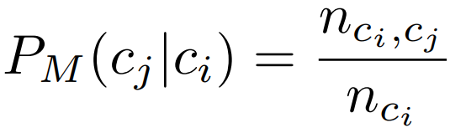
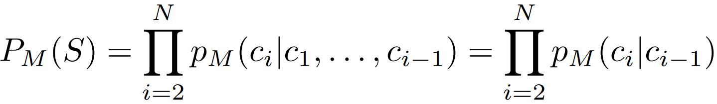
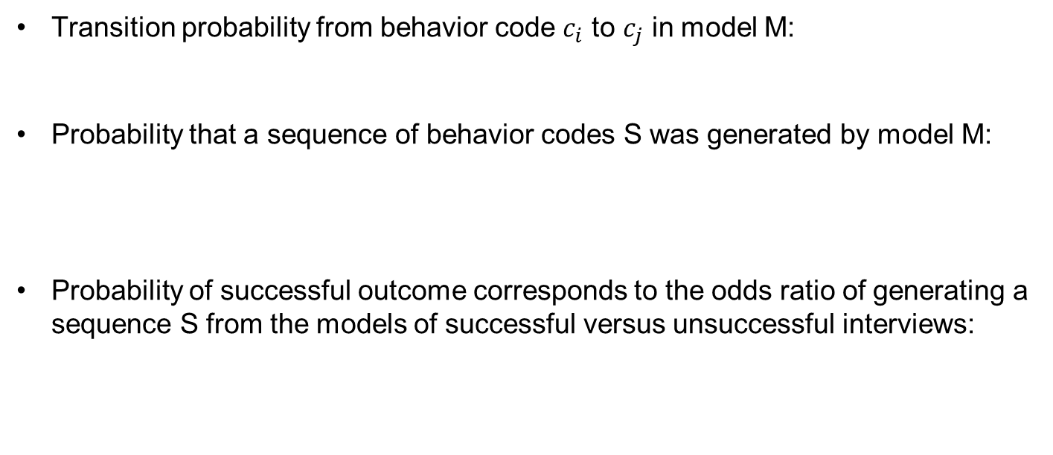
Methods: Probabilistic Models
Transition probability from behavior code $c_{i}$ to $c_{j}$ in model M:
Probability that a sequence of behavior codes S was generated by model M:
Probability of successful outcome corresponds to the odds ratio of generating a sequence S from the models of successful versus unsuccessful interviews:

Slide 10
Methods: Recurrent Neural Networks
Able to capture long-term dependencies between observations in a sequence
Allow information to be passed between temporally separated observations in a sequence
Have a memory, which can be reset
RNNs have demonstrated remarkable results for NLP tasks, such as machine translation
Employed RNN methods:
Long Short Term Memory (LSTM)
Gated Recurrent Unit (GRU)

Slide 11
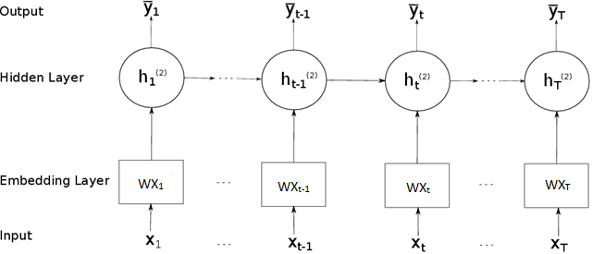
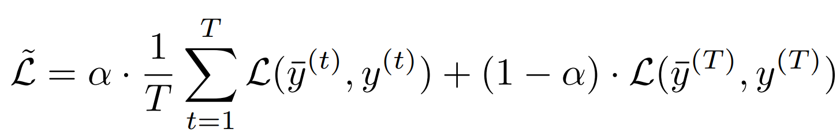
Methods: Recurrent Neural Networks
Loss

Slide 12
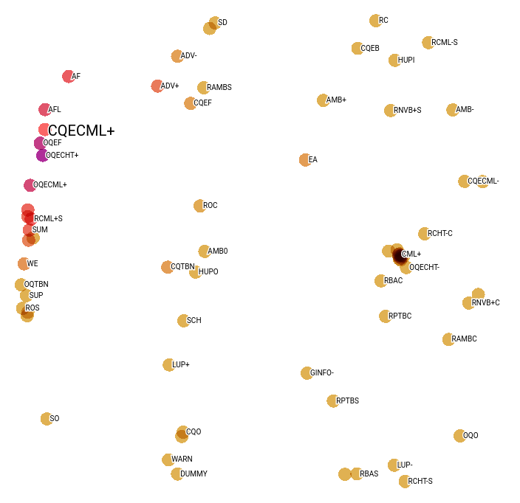
Methods: Behavior Code Embeddings
Embeddings (i.e. real-valued low-dimensional vector representations) of behavior codes are produced as a byproduct of training RNNs
Embeddings of similar codes are close to each other in low-dimensional space.
The behaviors that tend to elicit CHT+/CML+ group together, whereas the behaviors that tend to elicit CHT-/CML- also group together and are located in the opposite regions of semantic space.
2D embedding diagram produced by t-SNE

Slide 13
Results: Model Performance
Method | Under-sampling |  |  | Over-sampling
 | Precision | Recall | F1-Score | Precision | Recall | F1-Score
Markov Chain 1st Order | 0.7060 | 0.7044 | 0.7038 | 0.7932 | 0.7799 | 0.7775
Markov Chain 2nd Order | 0.6395 | 0.6385 | 0.6379 | 0.7111 | 0.7029 | 0.7000
Hidden Markov Model | 0.6244 | 0.6143 | 0.6067 | 0.7775 | 0.7567 | 0.7520
LSTM | 0.8672 | 0.8626 | 0.8622 | 0.8411 | 0.8372 | 0.8368
LSTM-TR | 0.8733 | 0.8681 | 0.8677 | 0.8424 | 0.8385 | 0.8381
GRU | 0.8674 | 0.8648 | 0.8646 | 0.8379 | 0.8342 | 0.8337
GRU-TR | 0.8705 | 0.8676 | 0.8673 | 0.8412 | 0.8377 | 0.8373

Slide 14
Conclusion
The task of predicting the outcome of patient-provider communication exchanges can be framed as a sequence classification problem
RNNs significantly outperform probabilistic models for this problem
LSTM with target replication as a training strategy is the most accurate predictor of the outcome of communication exchanges in clinical interviews
Deep learning methods can be successfully applied for real-time monitoring of the progression of motivational interviews and establishing causal relationships between different provider communication strategies and patient behaviors

Slide 15
Future Research Directions
Apply the proposed methods to other types of behavioral interventions or clinical interviews
Automated methods to identify the most effective provider communication strategies to elicit a specific type of behavioral response from a given demographic group of patients (e.g. African-American adolescents)

Slide 16

Acknowledgments
Advisor:
Dr. Alexander Kotov
Textual Data Analytics Lab
Wayne State University
Other collaborators:
Dr. April Carcone
Dr. Ming Dong
Dr. Sylvie Naar
Funding:
National Institute of Health (NIDDK)
R21DK108071
Department of Family Medicine and Public Health members:
Student assistants
Research staff

Slide 17
Thank you! Questions?

